Slide 1

GEOMETRIYA
8- sinf
MAVZU: O‘TKIR BURCHAKNING
SINUSI, KOSINUSI,
TANGENSI VA
KOTANGENSI

Slide 2

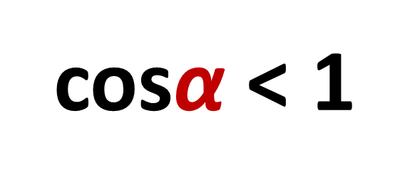
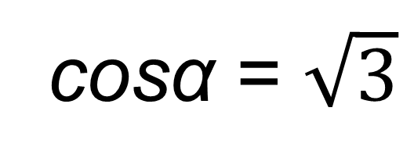
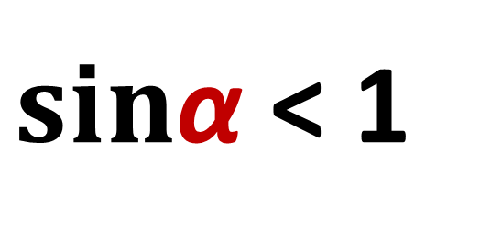
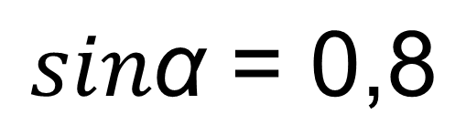

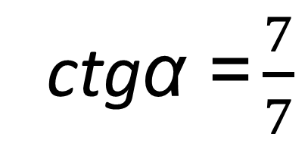

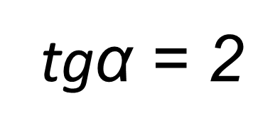
Mustahkamlash
$sin\text{α}$< 1
$$\text{tg}\text{α}{>1}$$
$$sin\text{α} \text{= 0,8}$$
tg$\text{α}\text{ = }\text{2}$
cos$\text{α}$< 1
$$\text{ctg}\text{α}{=\text{1} }$$
cos$\text{α} \text{= }\sqrt{3}$
?
ctg$\text{α}\text{ =}\frac{7}{7}$

Slide 3
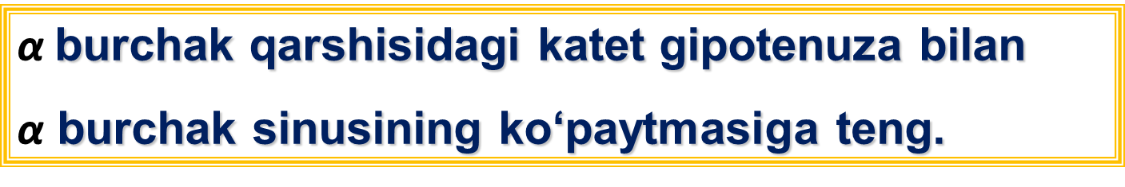



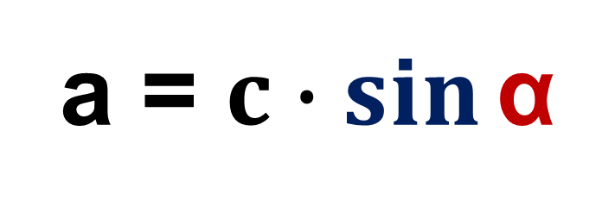
1- qoida
$\text{α}$burchak qarshisidagi katet gipotenuza bilan
$\text{α}$ burchak sinusining ko‘paytmasiga teng.
c
a = $c∙\sin{\text{α} }$
$$a$$
$$= \frac{a}{c}$$
$$\sin{\text{α} }$$
α
b

Slide 4



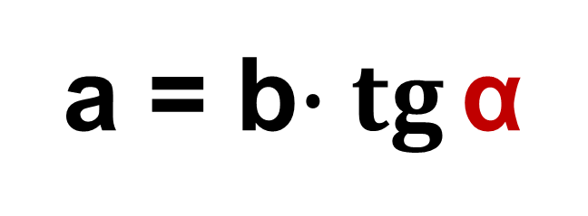
2- qoida
$\text{α}$burchak qarshisidagi katet ikkinchi katet bilan $\text{α}$ burchak tangensining ko‘paytmasiga teng.
a = b$∙\operatorname{tg}{\text{α} }$
c
$$a$$
$$= \frac{a}{b}$$
$$\text{tg} \text{α}{ }$$
α
b

Slide 5



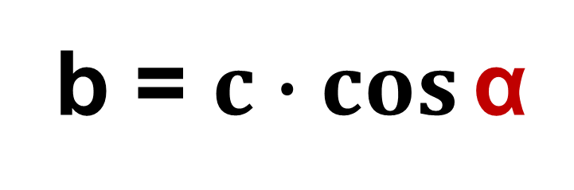
3- qoida
$\text{α}$burchakka yopishgan katet gipotenuza bilan $\text{α}$ burchak kosinusining ko‘paytmasiga teng.
c
b = $c∙\cos{\text{α} }$
$$a$$
$$\text{cos} \text{α}{ }$$
$$= \frac{b}{c}$$
α
b

Slide 6




4- qoida
$\text{α}$burchakka yopishgan katet qarshisidagi katetning $\text{α}$ burchak tangensiga nisbatiga teng.
$$\text{b}{= \frac{a}{\operatorname{tg}{\text{α} }} }$$
c
$$a$$
$$=\frac{a}{b}$$
$$\text{tg}\text{α}{ }$$
α
b

Slide 7


5- qoida
Gipotenuza $\text{α}$o‘tkir burchak qarshisidagi katetning $\text{α}$ burchak sinusiga nisbatiga teng.
c
$$\text{c}{= \frac{a}{\sin{\text{α} }} }$$
$$a$$
α
b

Slide 8


6- qoida
Gipotenuza $\text{α}$o‘tkir burchak yopishgan katetning $\text{α}$ burchak kosinusiga nisbatiga teng.
c
$$a$$
$$\text{c}{= \frac{b}{\cos{\text{α} }} }$$
α
b

Slide 9


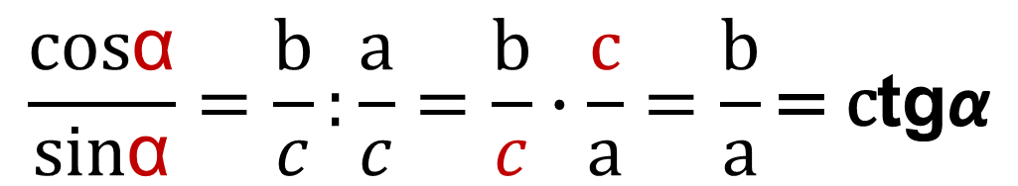

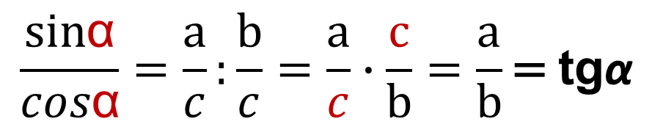
Tangens va kotangenslarni sinus va
kosinuslar orqali ifodalash.
$$\text{tg}\text{α}{= \frac{\text{sin}\text{α}}{cos\text{α}} }$$
$$\text{c}\text{tg}\text{α}{= \frac{\text{cos}\text{α}}{\text{sin}\text{α}} }$$
c
$$\frac{\text{sin}\text{α}}{cos\text{α}}=\frac{\text{a}}{c}:\frac{\text{b}}{c}=\frac{\text{a}}{c}∙\frac{\text{c}}{b}=\frac{\text{a}}{b}\text{=} \text{tg}\text{α}$$
$$a$$
$$\frac{\text{cos}\text{α}}{\text{sin}\text{α}}=\frac{\text{b}}{c}:\frac{\text{a}}{c}=\frac{\text{b}}{c}∙\frac{\text{c}}{a}=\frac{\text{b}}{a}\text{=} \text{c}\text{tg}\text{α}$$
α
b

Slide 10


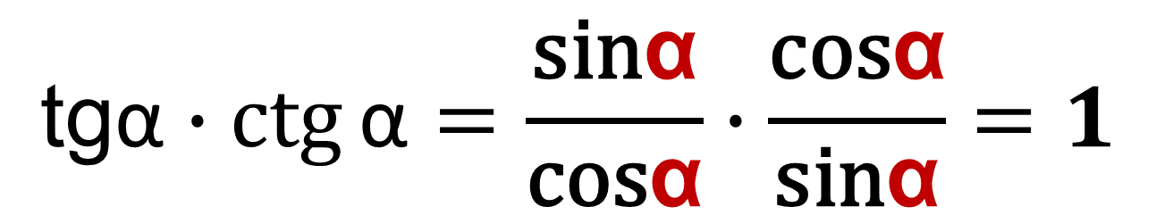
$\text{α}$ o‘tkir burchak tangens va kotangensining ko‘paytmasi 1 ga teng.
$$\text{tg}\text{α}∙ctg{\text{α}\text{ =} \text{1} }$$
$$\text{tg}\text{α}∙ctg{\text{α}}=\frac{\text{sin}\text{α}}{\text{cos}\text{α}}∙\frac{\text{cos}\text{α}}{\text{sin}\text{α}}=1$$

Slide 11
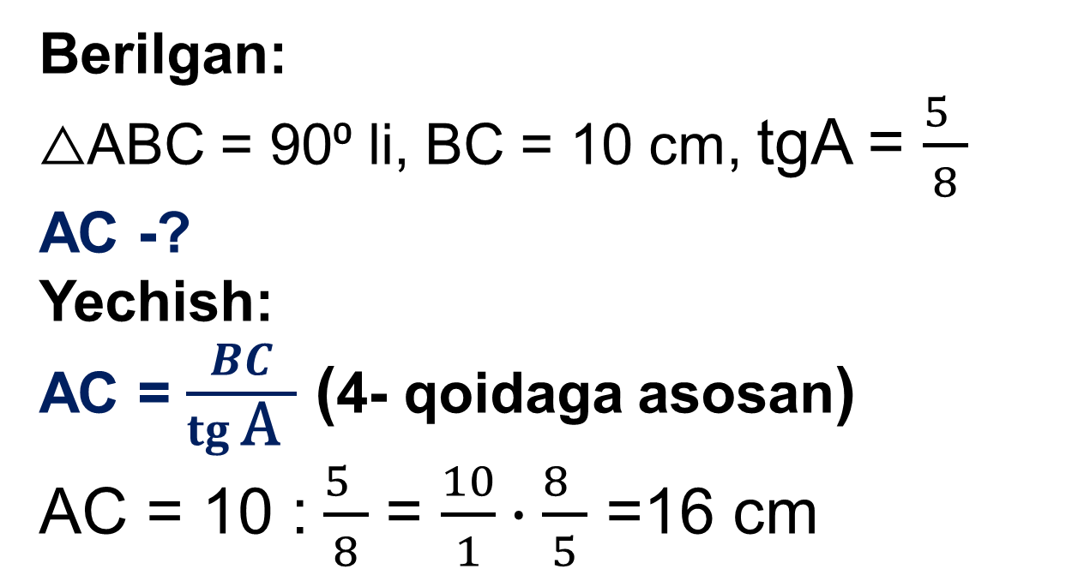
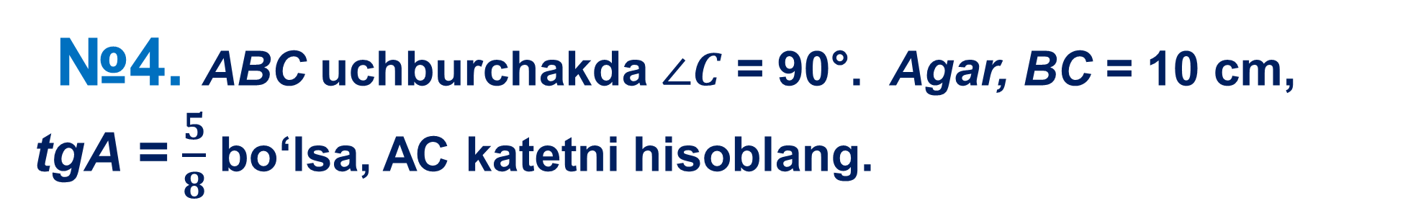
№4. ABC uchburchakda $∠C$ = 90°. Agar, BC = 10 cm,
tgA = $\frac{5}{8}$ bo‘lsa, AC katetni hisoblang.
Berilgan:
△ABC = 90⁰ li, BC = 10 cm, tgA = $\frac{5 }{8}$
AC -?
Yechish:
AC = $\frac{BC}{\operatorname{tg}{\text{A} }}$ (4- qoidaga asosan)
AC = 10 :$\frac{5 }{8}$ = $\frac{10}{1}∙\frac{8 }{5}$ =16 cm
B
С
A
Javob: 16 cm.

Slide 12
MUSTAQIL BAJARISH UCHUN TOPSHIRIQLAR:
Darslikda berilgan
3-, 5-, 6 - masalalarni yechish (40-sahifa).

