Slide 1
GEOMETRIYA
GEOMETRIYA
8- sinf
8- SINF
Mavzu: Masalalar yechish

Slide 2
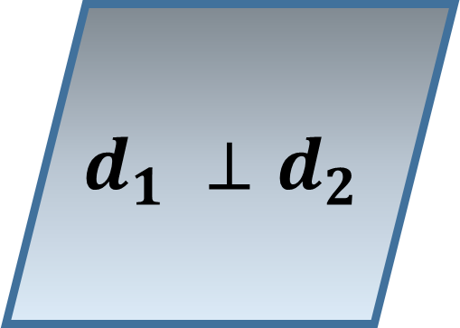
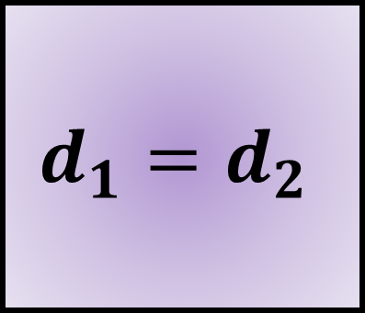
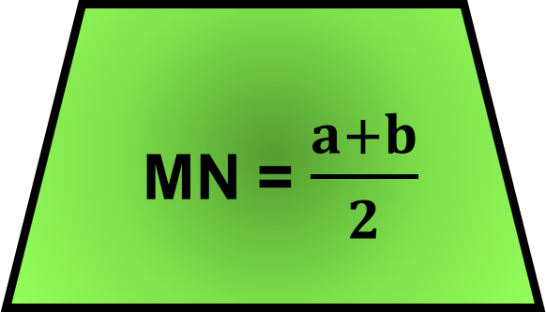
P = 2(a+b)
$$d_{1} ⊥d_{2}$$
S = ab
m = 0,5 a
MN = $\frac{a+b}{2}$
$$d_{1}=d_{2}$$

Slide 3
To‘g‘ri to‘rt burchakning dioganallari kesishish nuqtasidan 8 cm ga teng katta tomonigacha bo‘lgan masofa 2,5 cm ga teng bo‘lsa, to‘g‘ri to‘rt burchak yuzni toping.
8 cm
С
В
CD = 2∙ 2,5 = 5 cm
O
S = 5∙8 = 40 ${cm}^{2}$
2,5 cm
2,5
A
D
Е

Slide 4
ABC uchburchakning BC tomoni to‘rtta teng kesmaga
bo‘linib, bo‘linish nuqtalari orqali uzunligi 22 cm ga teng bo‘lgan AB tomonga parallel ravishda to‘g‘ri chiziqlar o‘tkazilgan. Shu to‘g‘ri chiziqlarning uchburchak ichida
qolgan kesmalarning uzunliklarini toping.
B
$$B_{1}$$
${C_{3}B}_{1}$, ${C_{2}B}_{2}$, ${C_{1}B}_{3}$ - ?
22
$$B_{2}$$
$$B_{3}$$
A
C
$$C_{3}$$
$$C_{2}$$
$$C_{1}$$

Slide 5
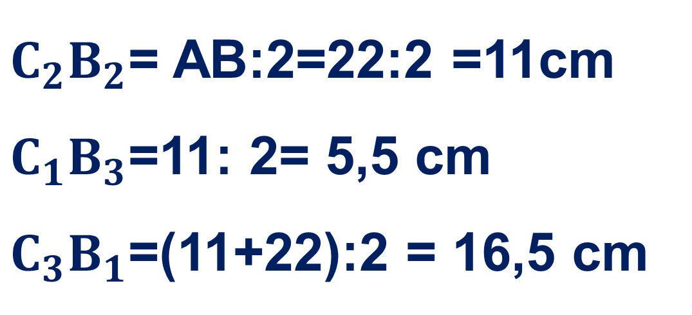
B
Yechim:
$$B_{1}$$
22 cm
${C_{2}B}_{2}$= AB:2=22:2 =11cm
${C_{1}B}_{3}$=11: 2= 5,5 cm
${C_{3}B}_{1}$=(11+22):2 = 16,5 cm
$$B_{2}$$
x
y
$$B_{3}$$
z
A
C
$$C_{3}$$
$$C_{2}$$
$$C_{1}$$
Javob: 11 cm, 5,5 cm, 16,5 cm

Slide 6
To‘g‘ri to‘rtburchak tomonlariga chizilgan (qurilgan) kvadratlarning yuzalari mos ravishda 169 ${cm}^{2}$ va 49${cm}^{2}$ga teng bo‘lsa, to‘g‘ri to‘rtburchakning perimetrini toping.
S = 49 сm²
^{a = 7 cm}
49 сm²
(7+13)∙2$=40 cm$
S = 169 сm²
^{b = 13 cm}
P - ?
169 сm²

Slide 7
Rombning diagonallari bilan tomonlari orasida hosil bo‘lgan burchaklarning nisbati 7:11 kabi. Rombning burchaklarini toping.
В
7x + 11x = 90⁰
18x = 90⁰
x = 5⁰
7x
11x
А
$$∠A=∠C=22x=110^{0}$$
$$∠B=∠D=14x=70⁰$$
С
D

Slide 8
ABCD trapetsiyada AD – katta asosi. B uchi orqali CD tomonga parallel va AD tomonni E nuqtada kesuvchi to‘g‘ri chiziq o‘tkazilgan, BC= 7 cm, AE= 4 cm.
1) trapetsiya o‘rta chizig‘ini;
2) ABE uchburchakning perimetri 17 cm bo‘lsa, shu trapetsiya perimetrini toping.
7 cm
B
C
m -?
4 cm
A
E
D

Slide 9
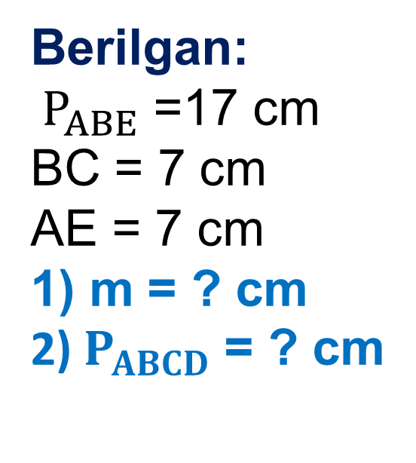
7 cm
B
C
Berilgan:
$P_{ABE}$ =17 cm
BC = 7 cm
AE = 7 cm
1) m = ? cm
2) $P_{ABCD}$ = ? cm
x
y
m -?
y
4 cm
A
E
D
Yechish:
1) m = $\frac{4+7+7}{2}$ = 9 cm
2) $P_{ABE}$ = x+y+4
17 = x+y+4
x+y = 13
$P_{ABCD}$= x+7+y+4+7=13+18 = 31
Javob: 9 cm va 31 cm

Slide 10
Parallelogrammning qo‘shni tomonlarining yig‘indisi
50 mm ga, ayirmasi esa 28 mm ga teng. Parallelogramm tomonlarini toping.
x
+
B
C
x+y = 50
x-y = 28
2x =78
x = 78:2
x = 39
39+y=50
y = 50-39
y = 11
y
A
D
Javob: 39 mm va 11 mm

Slide 11
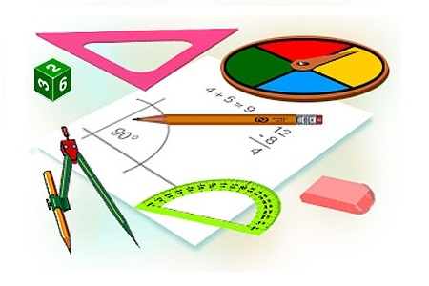
Mustaqil bajarish uchun topshiriqlar:
Darslikda berilgan
1-,2-,3- masalalarni
yechish (33-bet).

