Slide 1
GEOMETRIYA
GEOMETRIYA
8- sinf
8- SINF
Mavzu: Uchburchakning
o‘rta chizig‘i

Slide 2
Diametr aylanani teng ikkiga bo‘lishini isbotlagan, quyosh tutilishini oldindan aytib bergan olim haqida malumot bering.
Mustahkamlash

Slide 3
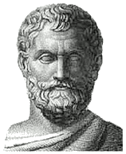
MILETLIK FALES — yunon faylasufi, antik falsafa va fanning ilk namoyandasi. Milet maktabiga asos solgan.O‘z zamonasidagi yetti donishmandning biri bo‘lgan. Falakiyotshunoslik bilan ham shugullanib, bir qancha teoremalarni isbotlagan olim.
Mustahkamlash
Miletlik Fales (miloddan avvalgi
625-547 yillar)

Slide 4
Mustahkamlash
Fales teoremasini keltiring.
B₃
b
B₂
B₁
a
O
A₁
A₂
A₃

Slide 5
Uchburchak o‘rta chizig‘i
Ta’rif: Uchburchakning o‘rta chizig‘i deb, uning ikki tomoni o‘rtalarini tutashtiruvchi kesmaga aytiladi.
B
DE - o‘rta chiziq
AC – asos
AD = DB, CE = EB
D
E
A
C

Slide 6
Uchburchak o‘rta chizig‘i
Har qanday uchburchakning uchta o‘rta chizig‘i bo‘ladi.
B
DE, EF, FD- o‘rta chiziqlar
D
E
△ADF =△CFE=△BDE=△DEF
A
F
C

Slide 7
Teorema
B
! Uchburchakning o‘rta chizig‘i uning uchinchi tomoniga parallel bo‘lib, uzunligi bu tomon uzunligining yarmiga teng.
L
K
A
C

Slide 8
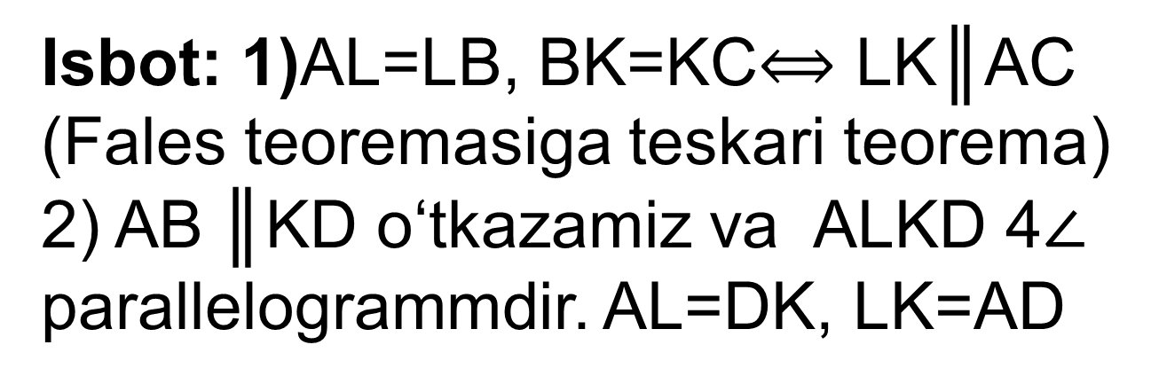
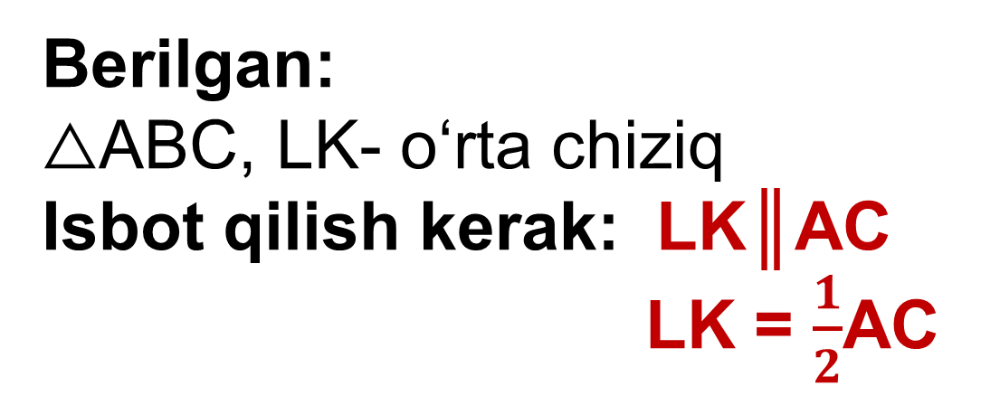
B
Berilgan:
△ABC, LK- o‘rta chiziq
Isbot qilish kerak: LK║AC
LK = $\frac{1}{2}$AC
L
K
Isbot: 1)AL=LB, BK=KC$⟺\text{LK}\text{║}\text{AC}$
(Fales teoremasiga teskari teorema)
2) AB $\text{║}$KD o‘tkazamiz va ALKD 4$∠$
parallelogrammdir. AL=DK, LK=AD
A
C
D
3) AB $\text{║}$KD va Fales teoremasiga asosan, AD=DC$⟹$ AC= 2AD, LK= AD$⟹$AC=2LK
LK= $\frac{1}{2}$ AC teorema isbotlandi.

Slide 9
3 – masala(28-bet)
Uchburchakning o‘rta chizig‘lari 6 cm, 7 cm
va 9 cm ga teng bo‘lgan uchburchakning tomon-larini toping.
E
D
7
9
6
C

Slide 10
B
Berilgan:
△ABCda,EF=6 cm,
DE=7 cm, DC= 9cm
AB, BC, AC - ?
D
7
E
9
6
C
A
F
Yechish:
AB= 0,5EF= 0,5∙6 = 3
BC=0,5DF= 0,5∙7 = 3,5
AC= 0,5DE= 0,5∙9 = 4,5
AC =3cm; BC =3,5cm
va AC = 4,5cm

Slide 11
Masala
To‘g‘ri to‘rt burchakning dioganallari kesishish nuqtasidan katta tomonigacha bo‘lgan masofa 2,5 cm ga teng bo‘lsa to‘g‘ri to‘rt burchakning kichik tomonini toping.

Slide 12
Darslikda keltirilgan 2- 4- topshiriqlarni bajarish (28- betlar).
Mustaqil bajarish uchun topshiriqlar:

Slide 13
Masala
ABC uchburchakning BC tomoni to‘rtta teng
kesmaga bo‘linib, bo‘linish nuqtalari orqali
uzunligi 22 cm ga teng bo‘lgan AB tomonga
parallel ravishda to‘g‘ri chiziqlar o‘tkazilgan.
Shu to‘g‘ri chiziqlarning uchburchak ichida
qolgan kesmalarning uzunliklarini toping.

Slide 14
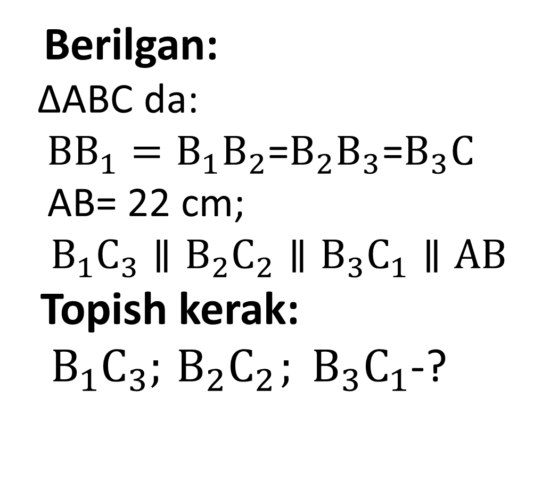
Yechim
Berilgan:
∆ABC da:
${BB}_{1}=B_{1}B_{2}$=${B_{2}B}_{3}$=$B_{3}C$
AB= 22 cm;
$$B_{1}C_{3}∥{B_{2}C}_{2}∥B_{3}C_{1}∥AB$$
Topish kerak:
${ B}_{1}C_{3};{ B_{2}C}_{2}; B_{3}C_{1}$-?
B
$$A_{3}$$
$$B_{1}$$
$$A_{2}$$
$$B_{2}$$
$$A_{1}$$
$$B_{3}$$
A
C
$$C_{3}$$
$$C_{2}$$
$$C_{1}$$

Slide 15
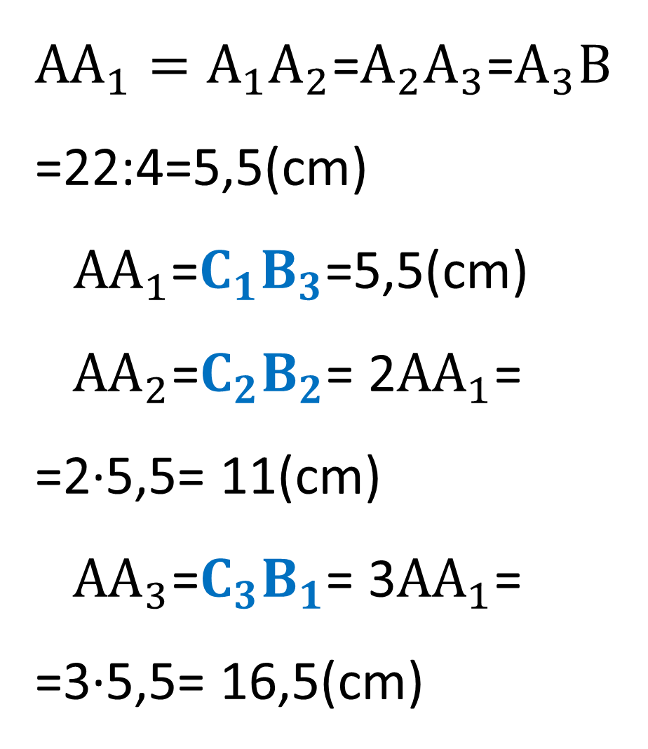
${{AA}_{1}=A}_{1}A_{2}$=${A_{2}A}_{3}$=$A_{3}B$=22:4=5,5(cm)
${AA}_{1}$=${C_{1}B}_{3}$=5,5(cm)
${ AA}_{2}$=${C_{2}B}_{2}$= 2${AA}_{1}$= =2∙5,5= 11(cm)
${ AA}_{3}$=${C_{3}B}_{1}$= 3${AA}_{1}$= =3∙5,5= 16,5(cm)
Yechish:
B
$$A_{3}$$
$$B_{1}$$
$$A_{2}$$
$$B_{2}$$
$$A_{1}$$
$$B_{3}$$
A
C
$$C_{3}$$
$$C_{2}$$
$$C_{1}$$
${C_{1}B}_{3}$=5,5cm; ${C_{2}B}_{2}$=11cm
va ${C_{3}B}_{1}$=16,5cm

