Slide 1
GEOMETRIYA
8- sinf
MASALALAR
YECHISH
MAVZU:
O‘qituvchi: Yusupjonova Shahnoza Mirzatillayevna

Slide 2
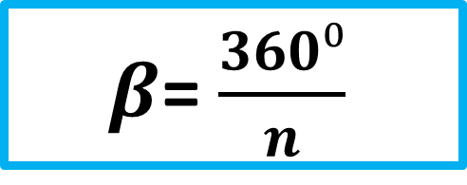
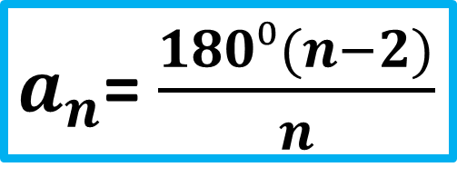
Mustahkamlash
Ko‘pburchak ichki burchaklari yig‘indisini topish formulasini aniqlang.
180°(n - 2)
360°
$a_{n}$= $\frac{180⁰(n−2)}{n}$
$β$= $\frac{360⁰}{n}$

Slide 3
Mustahkamlash
Qarama-qarshi tomonlari o‘zaro parallel bo‘lgan to‘rtburchak qanday nomlanadi?
parallelogramm

Slide 4
Mustahkamlash
Tomonlari teng bo‘lgan parallelogramm
nomini aniqlang?
Uchburchak
Ko‘pburchak
Romb
To‘g‘ri to‘rtburchak

Slide 5
Mustahkamlash
Tomonlari teng va burchaklari to‘g‘ri bo‘lgan geometrik shakl nomini aniqlang?
Kvadrat
Romb
To‘g‘ri to‘rtburchak

Slide 6
1- masala
Tashqi burchagining har biri:
a) 18° ga; b) 24° ga; c) 60° ga teng bo‘lgan qavariq ko‘pburchakning nechta tomoni bor?
Yechish: Tashqi burchaklar yig‘indisi 360⁰.
$a) β_{n}$ =18° da, n = 360⁰ : 18⁰ = 20
$b) β_{n}$ =24° da, n = 360⁰ : 24⁰ = 15
$c) β_{n}$ =60° da, n = 360⁰ : 60⁰ = 6
Javob: 20 ta, 15 ta va 6 ta

Slide 7
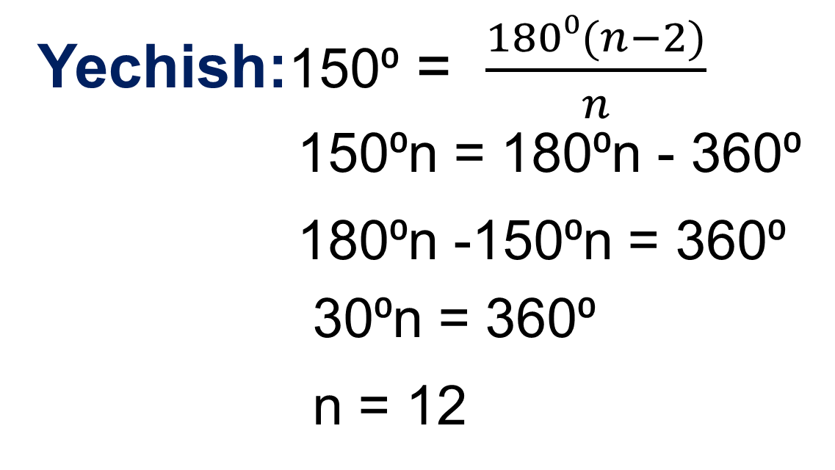
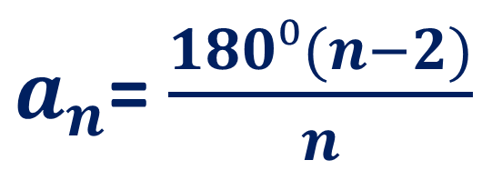
2- masala
Har bir ichki burchagi 150⁰ ga teng bo‘lgan qavariq ko‘pburchakning nechta tomoni bor?
Yechish:150⁰ = $\frac{180⁰(n−2)}{n}$
150⁰n = 180⁰n - 360⁰
180⁰n -150⁰n = 360⁰
30⁰n = 360⁰
n = 12
$a_{n}$= $\frac{180⁰(n−2)}{n}$
Javob: 12 ta

Slide 8
3- masala
Parallelogramm burchaklaridan birining bissektrisasi o‘zi kesib o‘tadigan tomonni 4 cm va 5 cm li kesmalarga bo‘ladi. Parallelogrammning perimetrini toping.

Slide 9
P
B
C
Berilgan:
ABCD – parallelogram
AP – bissektrisa
BP = 5 cm, PC = 4 cm.
Topish kerak: P -?
4
3
1
2
D
A
Yechish: $∠\text{1} \text{=} ∠\text{2} \text{(}\text{bissektrisa}\text{ )}$ , $∠\text{1} \text{=} ∠\text{4}$
△ ABC – teng yonli $⟹$ AB = BP = 5 cm.
P = 2AB + 2BC = 2∙5 + 2∙(4+5) = 10+18 = 28 (cm).
Javob: 28 cm

Slide 10
4- masala
ABCD parallelogrammning qo‘shni tomonlarining yig‘indisi 20 cm ga, ayirmasi esa 12 cm ga teng. Shu parallelogramm
tomonlarini toping.
D
C
AB = a
AD = b
b
a
A
B

Slide 11
D
Berilgan:
ABCD – parallelogramm
a + b = 20 cm,
a – b = 12 cm,
a -? cm, b - ? cm.
C
b
a
A
B
Yechish:1) a + b = 20
a – b = 12
2a = 32
a = 32 : 2
a = 16 (cm)
2) a + b = 20
16 + b =20
b = 20 -16
b = 4 (cm)
+
Javob: 16 cm va 4 cm.

Slide 12
5- masala
Rombning diagonallari bilan tomonlari orasida hosil bo‘lgan burchaklarning nisbati 4 : 5 kabi. Rombning burchaklarini toping.

Slide 13
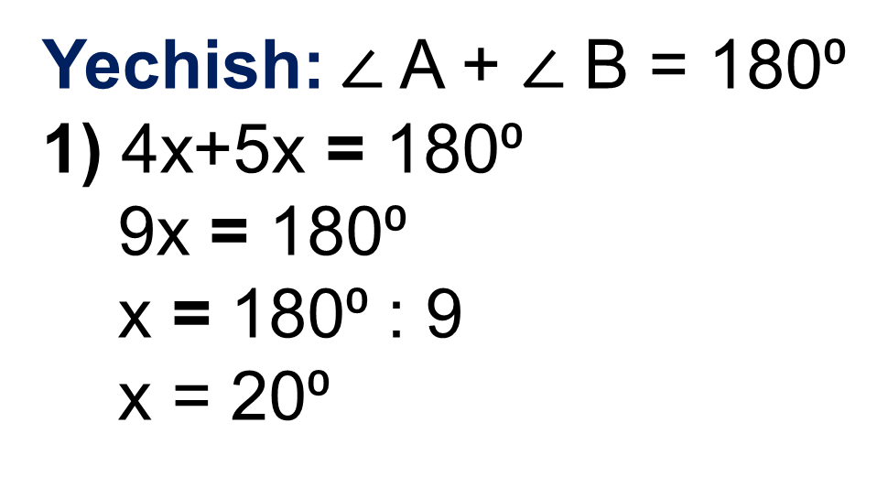
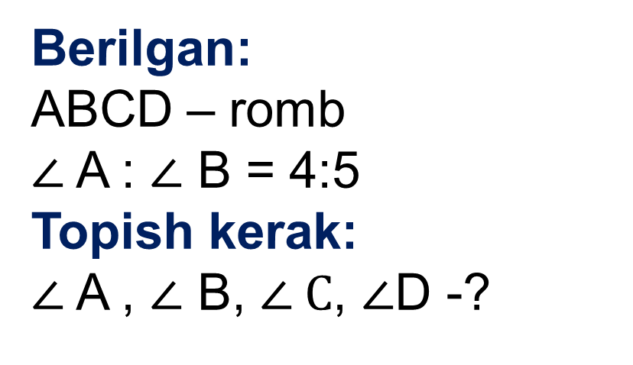
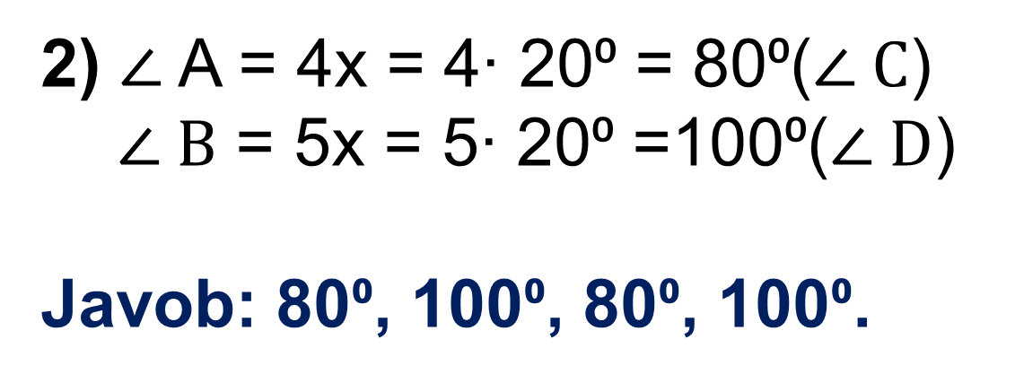
4- masala
B
Berilgan:
ABCD – romb
$∠$A : $∠$ B = 4:5
Topish kerak:
$∠$A , $∠$ B, $∠ C$, $∠$D -?
5x
A
C
4x
D
Yechish: $∠$A + $∠$ B = 180⁰
1) 4x+5x = 180⁰
9x = 180⁰
x = 180⁰ : 9
x = 20⁰
2) $∠$A = 4x = 4∙ 20⁰ = 80⁰($∠ C$)
$∠ B$ = 5x = 5∙ 20⁰ =100⁰($∠ D$)
Javob: 80⁰, 100⁰, 80⁰, 100⁰.

Slide 14
4 - masala
ABCD trapetsiyada AD- katta asosi.
B uchi orqali CD tomonga parallel va
AD tomonni E nuqtada kesuvchi to‘g‘ri
chiziq o‘tkazilgan, BC =7cm, AE =4 cm. Agar, ABE uchburchakning perimetri
17 cm ga teng bo‘lsa, trapetsiya o‘rta chizig‘ini va shu trapetsiyaning perimetrini toping.

Slide 15
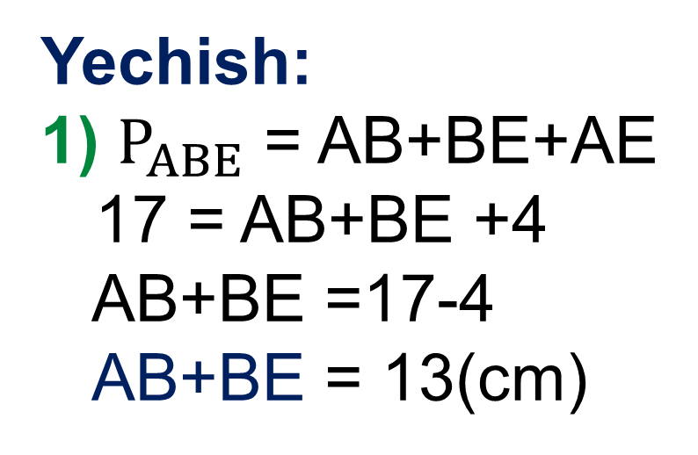
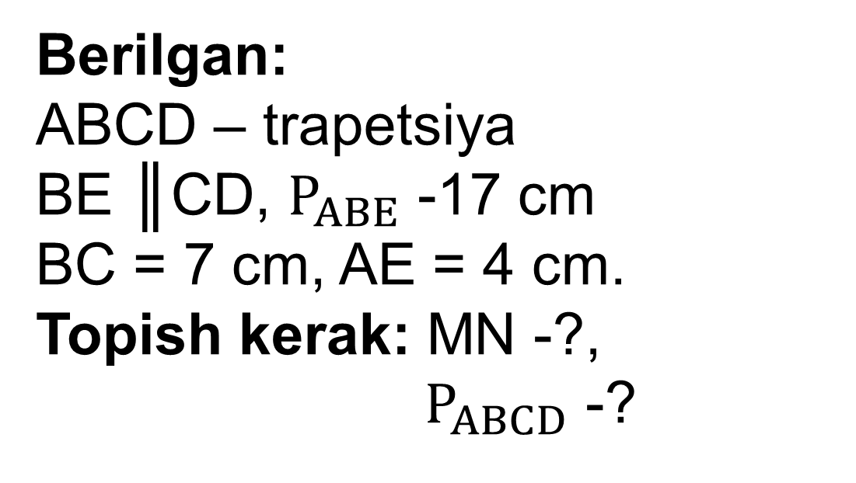
B
C
Berilgan:
ABCD – trapetsiya
BE ║CD, $P_{ABE}$ -17 cm
BC = 7 cm, AE = 4 cm.
Topish kerak: MN -?,
$P_{ABCD}$ -?
7 cm
M
K
N
A
4cm
D
E
Yechish:
1) $P_{ABE}$ = AB+BE+AE
17 = AB+BE +4
AB+BE =17-4
AB+BE = 13(cm)
2) MN =MK+KN= 2+7 =9(cm)
3) $P_{ABCD}$ = AB+CD+BC+AD
BE = CD (BECD- parallelog.)
$P_{ABCD}$ = 13+7+(4+7)=31 cm
Javob: 9 cm va 31 cm

Slide 16
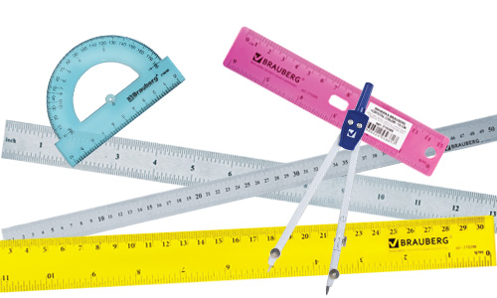
Mustaqil bajarish uchun topshiriqlar:
Darslikning 33 - sahifasidagi
1- 4- masalalarni yechish.

Slide 19
3-masala
To‘g‘ri to‘rtburchakning perimetri 42 cm, tomonlaridan biri esa ikkinchisidan ikki marta katta. To‘g‘ri to‘rtburchakning tomonlarini toping.

