Slide 1
GEOMETRIYA
8-sinf
MAVZU: PARALLELOGRAMM
VA UNING
XOSSALARI
O‘qituvchi: Yusupjonova Shahnoza Mirzatillayevna

Slide 2
Mustahkamlash
1
C
2
D
B
Noqavariq
ko‘pburchak
C
D
B
E
Qavariq
ko‘pburchak
A
A
E
Qavariq ko‘pburchakni aniqlang .

Slide 3
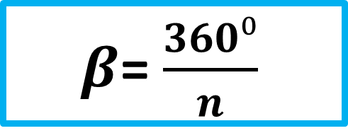
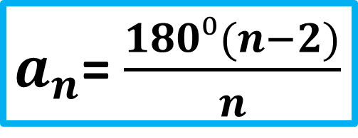
C
180°(n - 2)
360°
B
D
Ichki burchaklari
yig‘indisi
Tashqi burchaklari yig‘indisi
A
E
$a_{n}$= $\frac{180⁰(n−2)}{n}$
$β$= $\frac{360⁰}{n}$
Muntazam ko‘pburchak
ichki burchagi.
Muntazam ko‘pburchak
tashqi burchagi.

Slide 4
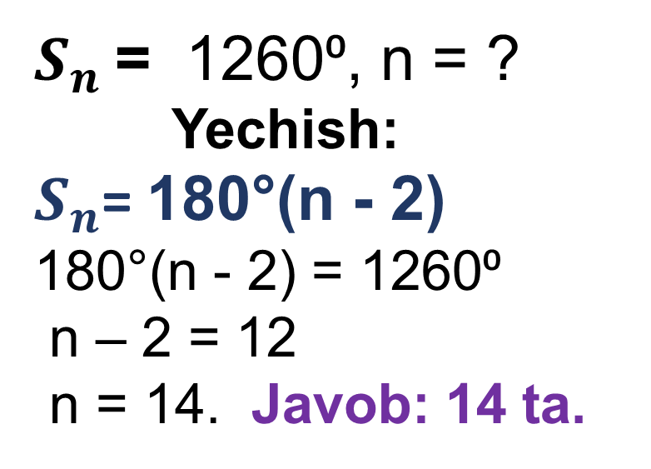
1. Ichki burchaklari yig‘indisi 1260⁰ga teng bo‘lgan ko‘pburchakning nechta tomoni mavjud?
2. Tashqi burchagining
har biri 72⁰ga teng bo‘lgan ko‘pburchakning nechta tomoni mavjud?
$S_{n}$= 1260⁰, n = ?
Yechish:
$S_{n}$= 180°(n - 2)
180°(n - 2) = 1260⁰
n – 2 = 12
n = 14. Javob: 14 ta.
$β$= 72⁰ bo‘lsa, n = ?
Yechish:
$β$= $\frac{360⁰}{n}$
n =360⁰ : 72⁰
n = 5. Javob: 5 ta.

Slide 5
PARALLELOGRAMM
Tekislikda ikkita parallel to‘g‘ri chiziqning boshqa ikkita parallel to‘g‘ri chiziq bilan kesishishidan hosil bo‘lgan to‘rtburchak parallelogramm deyiladi.
B
C
A
D

Slide 6
Parallelogramm
Ta’rif: Qarama-qarshi tomonlari o‘zaro parallel bo‘lgan to‘rtburchak parallelogramm deb ataladi.
B
C
B
C
$$h_{2}$$
AB II DC
$$h_{1}$$
$$h_{1}$$
F
AD II BC
$$h_{1}≠h_{2}$$
A
D
A
D
P

Slide 7
Parallel to‘gri chiziqlar: a II b
c
1
b
c
2
b
1
1
a
2
2
a
$$∠ \text{1}\text{= }∠ \text{2}$$
$$∠ \text{1}\text{= }∠ \text{2}$$
c
b
3
1
a
2
$$∠ \text{1 +}∠ \text{2 = 180}⁰$$

Slide 8
1 - teorema:
Parallelogrammning bir tomoniga yopishgan burchaklari yig‘indisi 180° ga teng.
Isbot qilish kerak:
$$∠\text{1 }\text{+ }∠\text{2}\text{ =180}⁰$$
Isbot: AB II CD(parall.m)
BC- kesuvchi to‘g‘ri chizig.
II va kesuvchi to‘g‘ri chizig-
larning 3–xossasiga, asosan,
$∠\text{1 }\text{+ }∠\text{2}\text{ =180}⁰$ bo‘ladi.
B
C
2
3
1
4
A
D

Slide 9
2 - teorema:
Parallelogrammning qarama-
qarshi tomonlari va qarama-qarshi burchaklari o‘zaro teng.
B
C
AB = CD, AD = BC
$$∠\text{A}\text{ = }∠\text{C} \text{,} ∠\text{B} \text{=} ∠\text{D}$$
A
D

Slide 10
B
C
Berilgan:
ABCD- to‘rt burchak
AC - dioganal
△ABC = △ACD
2
3
1
4
A
D
Isbot qilish kerak: :AB = CD, AD = BC
$∠\text{A}\text{ = }∠\text{C}\text{ ,} ∠\text{B}\text{ = }∠\text{D}$
Isbot: AC – dioganal o‘tkaziladi. △lar tengligining
BTBga ko‘ra, △ABC = △ACD (AC-umumiy tomon),
$∠\text{1= }∠ \text{3 }\text{va} ∠ \text{2= }∠ \text{4}$ (II t/ ch, kesuvchilar hosil qilgan $∠$)
$⇔$ AB = CD, AD = BC va $∠\text{1}\text{ +} ∠ \text{3 }\text{=} ∠ \text{2}+∠ \text{4}$ $⇔$
$∠\text{A}\text{ = }∠\text{C}\text{ ,} ∠\text{B}\text{ = }∠\text{D}$.

Slide 11
3 - teorema:
Parallelogrammning diagonallari kesishadi va kesishish nuqtasida teng ikkiga bo‘linadi.
B
C
O
AO = OC
BO = OD
A
D

Slide 12
3- masala
Parallelogramm burchaklaridan ikkitasining yig‘indisi 1) 70⁰ga, 2) 110⁰
ga, 3) 170⁰ ga teng bo‘lsa , uning hamma burchaklarini toping.
C
B
A
D

Slide 13
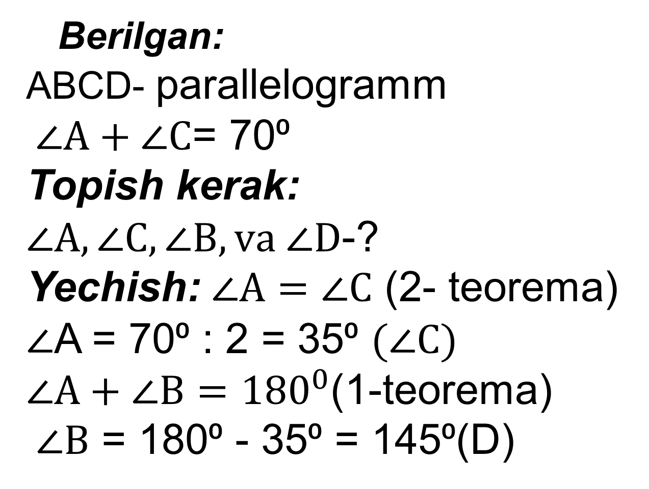
1-yechim:
Berilgan:
ABCD- parallelogramm
$∠A+∠C$= 70⁰
Topish kerak:
$∠A,∠C,∠B,va ∠D$-?
Yechish: $∠A=∠C$ (2- teorema)
$∠$A = 70⁰ : 2 = 35⁰ $(∠C)$
$∠A+∠B={180}^{0}$(1-teorema)
$∠B$ = 180⁰ - 35⁰ = 145⁰(D)
B
C
A
D
Javob: 35⁰; 145⁰;
35⁰ ;145⁰.

Slide 14
5- masala
Parallelogramm qo‘shni tomonlarining yig‘indisi
20 cm ga, ayirmasi esa
12 cm ga teng. Shu parallelogramm tomon-larini toping.
B
C
A
D
Javob: 16 cm va 4 cm

Slide 15
Mustaqil bajarish uchun topshiriqlar:
Darslikning 10 - sahifasida
keltirilgan
3-, 5-, 6 – masalalarni yechish.

Slide 17
Parallelogramm
Masala. $△$ABC =$△$CDA. ABCD to‘rtburchak parallelogramm ekanini isbotlang.
B
C
A
D

