Slide 1
Geometriya
8-sinf
Mavzu:
Uchburchaklar xossalariga doir masalalar yechish.
O‘qituvchi
Yusupjonova Shaxnoza Mirzatillayevna

Slide 2
Turli tomonli
Teng yonli
Teng tomonli
Uchburchaklar
O‘tkir burchakli
O‘tmas burchakli
To‘g‘ri burchakli

Slide 3
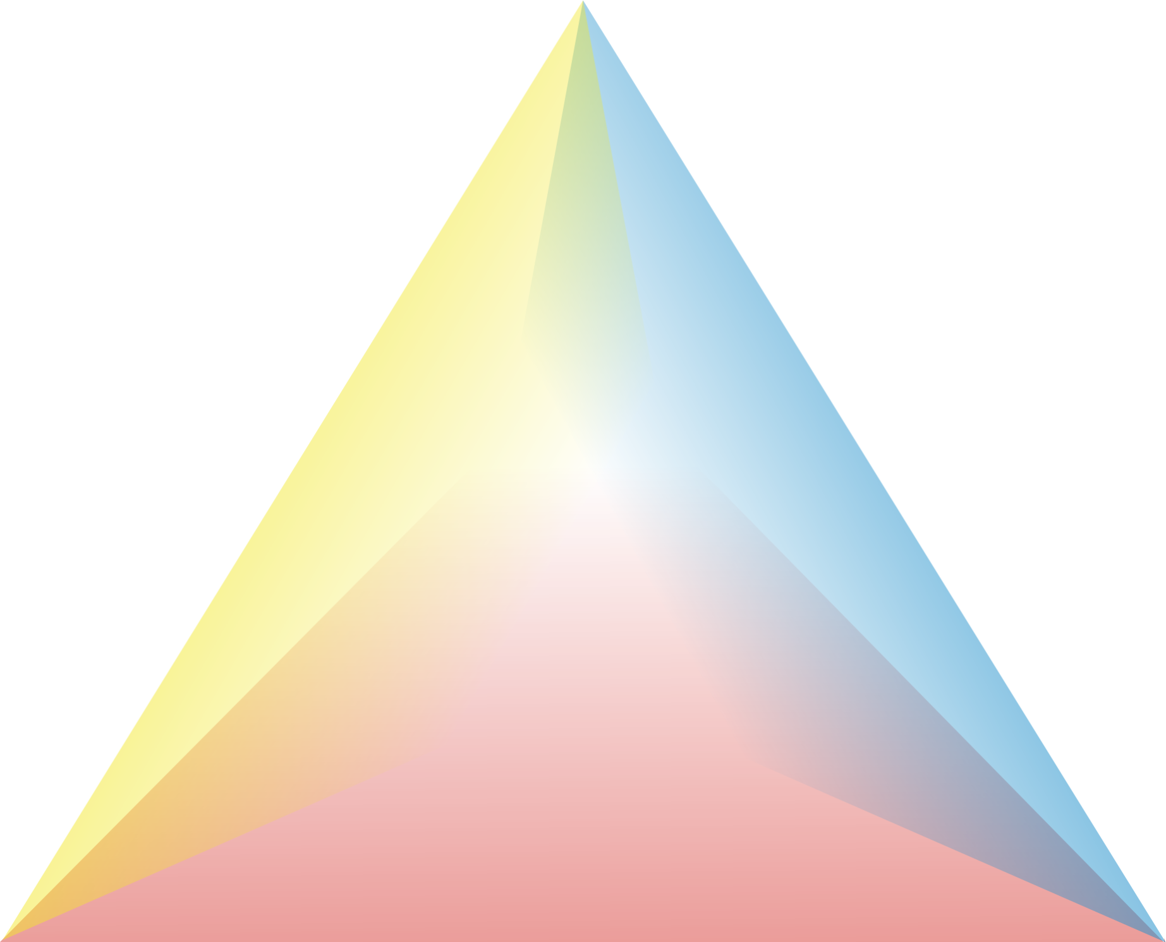
${ ∠A}^{1}$= $∠C$ +$∠B$
Ichki burchak
xossasi
Tashqi burchak
xossasi
Teng tomonli∆
xossasi

Slide 4
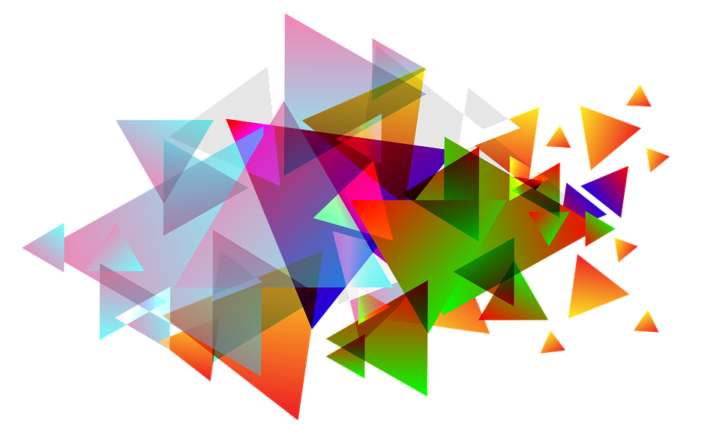
c = 2a (30°)
90° li∆
O‘tmas burchakli∆
O‘tkir burchakli∆

Slide 5
a = b , $∠α$=$∠β$
90° li∆
Teng yonli∆
Teng tomonli∆

Slide 6
Masala
To‘g‘ri burchakli ABC uchburchakda $∠C−$ to‘g‘ri burchak, A uchidagi tashqi burchak 120$°$ ga teng.
Agar, AC + AB = 18 sm bo‘lsa, uchburchakning gipotenuzasini toping.
6

Slide 7
c = 2b (30°)
Berilgan:
∆ABC - 90°li,
$A^{1}$= 120°; AC+AB=18sm
Topish kerak: AB=c=?
B
30°
c
$∠A$= 180°-120°=60°
$∠B$=90$°$-$∠A$= 30$⟹$ c=2b
b+ c = 18;
b+2b=18;↔ 3b =18
b = 6 cm; c=2·6=12(sm)
120°
60°
A
C
b
Javob: 12 sm

Slide 8
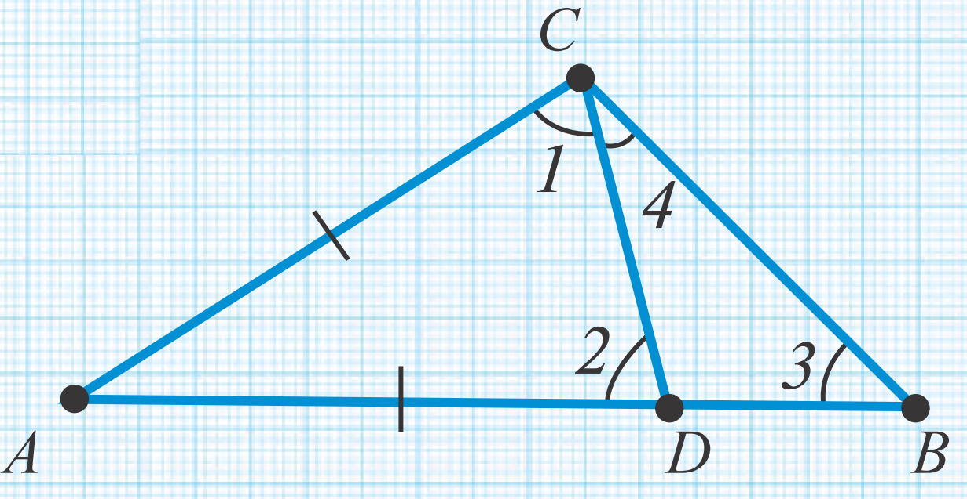
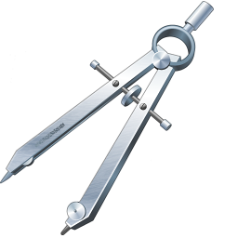
Masala
Rasmda berilgan ma’lumotlardan foydalanib, $∠$1 > $∠$3 ekanligini isbotlang.
8

Slide 9
Berilgan:
$△$ACD- teng yonli
Isbot qilish kerak:
$∠1$ > $∠$3 ekanligini
Isbot:
$∠$2 - △ BDCning tashqi $∠$gi
$∠$2 =$∠$3+$∠$4
(tashqi burchak xossasiga ) va $∠$4 > 0
△ ACD - teng yonli bo‘lgani uchun $∠$1=$∠$2.
Demak, $∠$1 >$∠$3 bo‘ladi.
9

Slide 10
10-masala (4- bet)
Uchburchakning 117⁰ li tashqi burchagiga qo‘shni bo‘lmagan ichki burchaklarning nisbati 5:4 kabi. Uchburchakning ichki burchaklarini toping.
10

Slide 11
${ ∠A}^{1}$= $∠C$ +$∠B$
Berilgan:
∆ABC - ixtiyoriy
${∠A}^{1}$= 117°; $∠B:∠C$= 5:4
Topish kerak:$∠A,$ $∠B,$ $∠C$
B
5x
4x
C
Y:1) 5x+4x =117⁰
9x = 117⁰
x=117⁰:9
x=13⁰
A
117°
2) 5∙13⁰=65⁰ ($∠B$)
4∙13⁰=52⁰ ($∠C$)
180⁰-117⁰=63⁰ ($∠$A)

Slide 12
19-masala (4- bet)
To‘g‘ri burchakli ABC uchburchaknig C burchagi to‘g‘ri, A uchidagi tashqi burchagi esa 136⁰ ga teng. B burchakni toping.
C
B
A

Slide 13
${ ∠A}^{1}$= $∠C$ +$∠B$
Berilgan:
△ABC - 90⁰ li
$∠A^{1}$= 136⁰
Topish kerak: $∠$B =?
B
?
Yechish:
${∠A}^{1}$= $∠C$ +$∠B$ (tashqi $∠$)
$$∠B{ =∠A}^{1}−∠C$$
$∠$B = 136⁰ - 90⁰ = 46⁰
136⁰
A
C
Javob: 46⁰

Slide 14
Masala
To‘g‘ri burchakli teng yonli uchbur-chakning peremetri 24cm, gipotenuza-ning uzunligi 6 cm ortiq bo‘lsa,gipote-nuza uzunligini toping?

Slide 15
Yechim:
P=2a+c
Berilgan:
△ABC - 90⁰ li,
teng yonli.
P = 24 cm
a=b -? cm
c = a+6 -? cm
Yechish:
24= 2a+a+6
3a = 24-6
3a = 18
a=18:3
a=6 (cm) c=6+6=12 (cm)
a+6
a
a
Javob: 6 cm va 12 cm

Slide 16
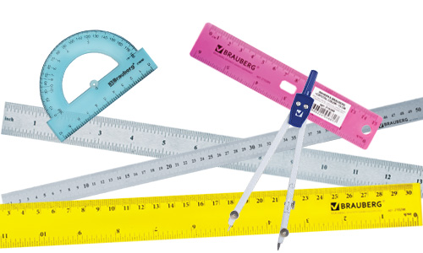
Mustaqil bajarish uchun topshiriqlar
Darslikning 4- sahifasidagi
13,- 16,- 18- masalalarni yechish.

