Slide 1
Geometriya
8-
sinf
Mavzu:
7-sinf ’’Geometriya’’
kursini takrorlash
O‘qituvchi Yusupjonova Shahnoza Mirzatillayevna.

Slide 2
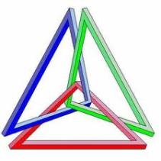
Darsda :
Uchburchakning perimetri, bissektrisasi balandligi va ular orasidagi bog‘lanishlarga doir masalalar yechish.
A
$$h_{a}$$
$$m_{a}$$
$$l_{a}$$
B
D
C

Slide 3
Uchburchak perimerti
a
Teng yonli uchburchak
P =…
b
$P_{△}$=2a+b
c
Muntazam uchburchak
Turli tomonli uchburchak
$P_{△}$= 3a
$P_{△}$= a+b+c

Slide 4
Asosiy elementlar
Uchburchakning asosiy elementlari qanday nomlanadi?
Bissektrisa
Mediana
Balandlik

Slide 5
Bissektrisa…
A
Uchburchakning biror uchidan chiqib, shu burchakni teng ikkiga bo‘luvchi nurga bissektrisa deyiladi.
A
A
$$l_{a}$$
$$l_{a}$$
B
D
C
B
D
C
$∠BAD=$ $∠CAD$

Slide 6
Mediana…
Mediana bu - uchburchak uchidan shu uch qarshisidagi tomonni teng ikkiga ajratuvchi kesmaga aytiladi.
A
A
$$m_{a}$$
BD = DC
B
D
C

Slide 7
Balandlik…
Balandlik - uchburchak uchidan shu uch qarshisi-dagi tomonga tushirilgan perpendikulyardir.
A
A
h
$∠ADB=90$⁰
B
D
C

Slide 8
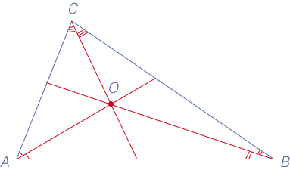
SAVOL…
Chizmadagi bir
nuqtada kesish-gan to‘g‘ri chiziq-lar nomini toping?
Bissektrisa

Slide 9
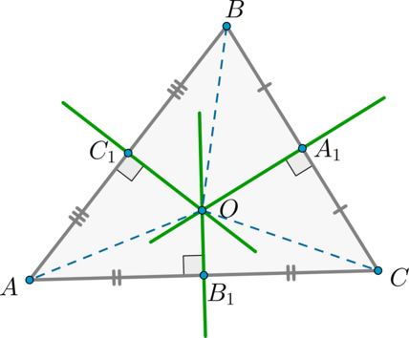
SAVOL…
Chizmadagi bir nuqtada kesishgan to‘g‘ri chiziqlar nomi qanday nomlanadi?
O‘rta perpendikulyar

Slide 10
3-bet, 2-masala
Perimetri 18 sm ga teng bo‘lgan uchburchakning bissektrisasi uni perimetri 12 va 15 sm ga teng bo‘lgan uchburchaklarga ajratadi. Uchburchak bissektrisasini toping.

Slide 11
A
Berilgan:
∆ABC-ixtiyoriy
$P_{ABC}$= 18 cm
$P_{AEC}$= 12 cm
$P_{AEB}$= 15 cm
AE -?
$$l_{A}$$
C
B
E
Yechish:
$P_{ABC}$= $P_{AEC}$+$P_{AEB}$-2AE
18= 12+15 -2AE
2AE=27- 18
AE=9:2=4,5(cm) Javob: 4,5 cm

Slide 12
3-bet, 3-masala
Uchburchakning asosiga tushirilgan medianasi uni perimetri 18 sm va 24sm ga teng ikkita uchburchakka ajratadi.Berilgan uchburchakning kichik yon tomoni 6 sm ga teng.Uning katta yon tomonini toping.
12

Slide 13
A
3-masala
Berilgan:
∆ABC-ixtiyoriy
$P_{AEC}$= 18sm
$P_{AEB}$= 24sm
AC = 6 sm
AB-?
6
$$m_{A}$$
x
x
C
B
E
Yechish:
${1) P}_{AEC}$=6+x+m
18=6+x+m
m=18-6-x
m=12-x
${2) P}_{AEB}$= m+x+AB
24 = 12-x+x+AB
AB= 24-12
AB =12
Javob: 12 sm

Slide 14
8- masala(4- bet)
Teng yonli uchburchakning perimetri 22,5 sm, yon tomoni esa 0,6 dm. Shu uchburchakning asosini toping.
A
?
C
B

Slide 15
Yechim
A
Berilgan:
∆ABC- teng yonli
$P_{ABC}$= 22,5 sm
AC = 0,6 dm = 6sm
BC = ? sm
0,6 dm
B
C
Yechish:${ 1) P}_{ABC}$= 2AC+BC
22,5 = 2∙6+BC
BC = 22,5 - 12
BC = 10,5
Javob: 10,5 sm

Slide 16
Mustaqil bajarish uchun
vazifalar
Darslikning 3-betidagi 5, 7 va 9- masalalarni yechish.

