Slide 1
GEOMETRIYA
7- sinf
MAVZU: HISOBLASHGA DOIR
MASALALAR

Slide 2
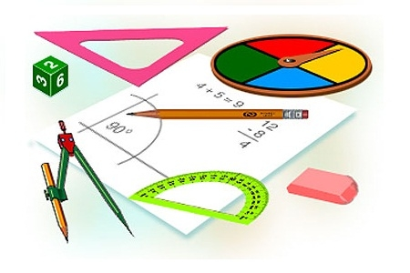
Masalani yechish bosqichlarini
sanang
Masalani tushunish
Rejalashtirish
Yechish
Tekshirish

Slide 3
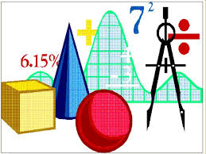
Geometrik masalalarning qanday turlarini bilasiz?
Hisoblashga doir masalalar
Isbotlashga doir masalalar
Yasashga doir masalalar

Slide 4
teoremalar
xossalar
Masala
yechish
uchun…
chizma
formulalar
usullar

Slide 5
Chizmadagi noma‘lum X ni toping.
B
C
O
x
K
Javob: BD= 14
7
A
D

Slide 6
Chizmadagi no‘ma‘lum X ni toping.
B
x= 2·12= 24
X = ?
Javob: 24 cm
12
30°
A
C

Slide 7
§ 62 №1 (147- bet)
AB kesma uzunliklari 1:2:3:4 kabi nisbatdagi kesmalarga ajratilgan. Agar chetki kesmalarning o‘rtalaridagi masofa 15 cm ga teng bo‘lsa, AB kesmaning uzunligini toping.
K
L
A
C
D
E
B

Slide 8
15 cm
Berilgan:
AB kesma 1:2:3:4
AC = x, CD = 2x
DE = 3x ,BE = 4x
KL = 15cm
K
L
A
C
D
E
B
Yechish:
KL= KC+CD+DE+LE
1) 0,5x+2x+3x+2x =15
7,5x = 15
x = 15:7,5
x = 2(AC)
AB = ?
2)CD=2·2=4; DE=2·3=6; BE=4·2=8
3)AB = AC+CD+DE+BC
AB = 2+4+6+8= 20
Javob: AB = 20 cm

Slide 9
§62, №2 (147- bet)
$∠$ABC = 160° bo‘lgan burchakning uchidan shu burchak tomonlari orasida yotuvchi BO va BE nurlar chiqarilgan. Agar BO nur berilgan burchakni teng ikkiga, BE nur 3:5 kabi nisbatda bo‘lsa, OBE burchakni toping.
A
E
O
B
C

Slide 10
Berilgan:
$∠$ABC=160°
BO, BE- nur
$∠$ABO= 0,5· $∠$ABC
$∠$ABE :$∠$CBE = 3:5
E
O
A
Topish kerak: $∠$OBE-?
B
C
Yechish:
1) $∠$ABE + $∠$CBE =160°
3x+5x=160°
8x=160°
x=160°:8
x=20°
2) $∠$ABE=3·20°=60°
$∠$ CBE= 5·20°=100°
$∠$OBE=100°-80°=20°
Javob: $∠$OBE = 20°

Slide 11
§62 №10 (147- bet)
B
Agar, chizmadagi
AB = BC, $∠$ABC = 50°, AE va CF – bissektrisalar bo‘lsa, u holda AOB, EOC burchaklarni toping.
F
E
O
A
D
C

Slide 12
Berilgan:
∆ABC- teng yonli, AB = BC
$∠$ABC=50°, $∠$BDC = 90°
AE, CF - bissektrisa
Topish kerak: $∠$AOB,$∠$EOC-?
B
F
E
O
A
D
C
Yechish:
1) $∠$A= $∠$C(teng yonli)
$∠$A= $∠$C=(180-50):2=65°
$∠$ABO = 50°:2 = 25°
$∠$BAO=65°:2=32,5
$∠$AOB=180°-(25+32,5) =122,5°
2) $∠$EOC= $∠$BOC - $∠$COB
$∠$BOC= $∠$AOB=122,5°
$∠$COD = 90-22,5 = 67,5°
$∠$EOC=122,5-67,5=55°
Javob: 122,5° va 55°

Slide 13
Mustaqil bajarish uchun topshiriqlar:
147-bet
3-, 5- ,7- va 9 - masalalar

