Slide 1

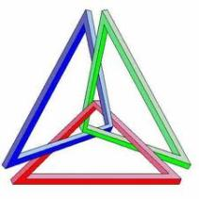
GEOMETRIYA
7- sinf
MAVZU: UCHBURCHAKLAR
TENGLIGINING BIRINCHI ALOMATI(TBT)

Slide 2
Uchburchaklar turini aniqlang:
To‘g‘ri burchakli
uchburchak
O‘tmas burchakli
uchburchak
Muntazam
uchburchak
120⁰
70⁰
O‘tkir burchakli
uchburchak
60⁰
50⁰
Teng yonli
uchburchak

Slide 3
Mustahkamlash
Teng tomonli uchburchakning peremetri 27 m bo‘lsa asosining uzunligi necha detsimetrga teng?
a
P=3a
a
a
a = 27:3 = 9m = 90dm

Slide 4
Teng yonli uchburchakning asosi yon tomonidan
2 cm uzun, peremetri 32 cm ga teng bo‘lsa, asosining uzunligini toping?
P=2a+b
x
x + x + x + 2 = 32
3x = 32-2
x = 30:3
x = 10 (a)
10 + 2 = 12(b)
x
P= 32cm
x+2
Javob: 12 cm

Slide 5
Mustahkamlash
Uchburchak uchidan shu uch qarshisidagi tomonni teng ikkiga ajratuvchi kesma nomini toping
A
Mediana

Slide 6
Mustahkamlash
Uchburchakning biror uchidan chiqib, shu burchakni teng ikkiga bo‘luvchi nur nomini toping
A
Bissektrisa

Slide 7
Mustahkamlash
Uchburchak uchidan shu uch qarshisidagi tomonga tushirilgan perpendikulyar nomini toping
A
Balandlik

Slide 8
Teng shakllar
Birini ikkinchisining ustiga aynan ustma-ust tushadigan qilib qo‘yish mumkin bo‘lgan shakllarga teng shakllar deyiladi.
2
∆1 = ∆2
1

Slide 9
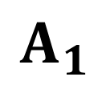

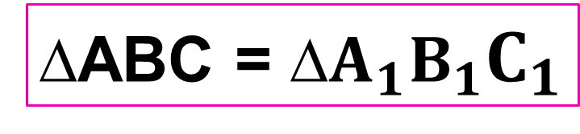
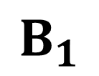
Uchburchaklar tengligining birinchi alomati (TBT):
Agar bir uchburchakning ikki tomoni va ular orasidagi burchagi mos ravishda ikkinchi uchburchakning ikki tomoni va ular orasidagi burchagiga teng bo‘lsa, bunday uchburchaklar o‘zaro teng bo‘ladi
∆ABC = ∆$A_{1}B_{1}C_{1}$
A
$$C_{1}$$
$$B_{1}$$
B
C
$$A_{1}$$

Slide 10
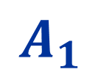


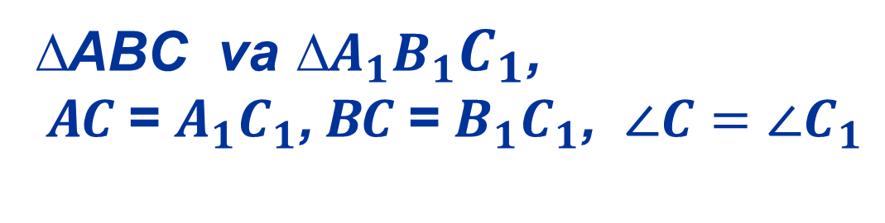
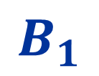
A
$$C_{1}$$
$$B_{1}$$
B
C
$$A_{1}$$
∆ABC va ∆$A_{1}B_{1}C_{1}$,
AC = $A_{1}C_{1}$, BC = $B_{1}C_{1}$, $∠C=∠C_{1}$
Berilgan:
Isbot qilish kerak:
∆ABC = ∆$A_{1}B_{1}C_{1}$

Slide 11
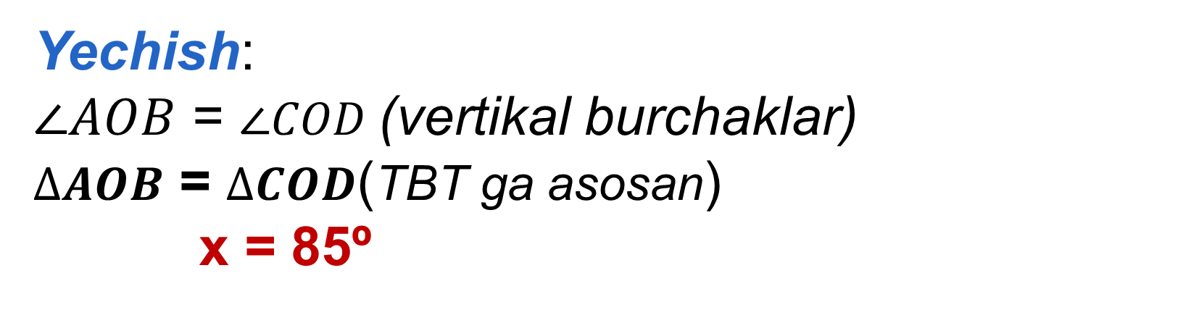
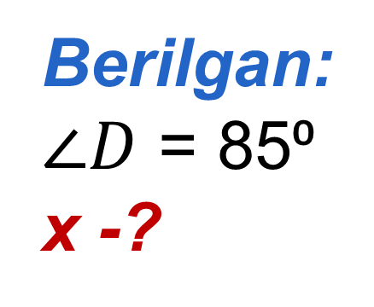
11- masala
B
C
Berilgan:
$∠D$ = 85⁰
x -?
x
O
85⁰
D
A
Noma‘lum x burchakni toping.
Yechish:
$∠AOB$ = $∠COD$(vertikal burchaklar)
$∆AOB$ = $∆COD$(TBT ga asosan)
x = 85º

Slide 12
Mustaqil bajarish uchun topshiriqlar:
Darslikning 59-betida berilgan
5 - 9 masalalarni yechish.

