Slide 1

GEOMETRIYA
7- sinf
MAVZU: UCHBURCHAKNING
MUHIM ELEMENTLARI:
MEDIANA, BALANDLIK VA BISSEKTRISSA

Slide 2
Uchburchaklar turini aniqlang:
To‘g‘ri burchakli
uchburchak
O‘tmas burchakli
uchburchak
Muntazam
uchburchak
120⁰
70⁰
O‘tkir burchakli
uchburchak
60⁰
50⁰
Teng yonli
uchburchak

Slide 3
Mustahkamlash
Teng tomonli uchburchakning peremetri 27 m bo‘lsa asosining uzunligi necha detsimetrga teng?
a
P=3a
a
a
a = 27:3 = 9m = 90dm

Slide 4
Teng yonli uchburchakning asosi yon tomonidan
2 cm uzun, peremetri 32 cm ga teng bo‘lsa, asosining uzunligini toping?
P=2a+b
x
x + x + x + 2 = 32
3x = 32-2
x = 30:3
x = 10 (a)
10 + 2 = 12(b)
x
P= 32cm
x+2
Javob: 12 cm

Slide 5
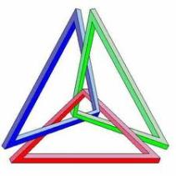
Uchburchakning muhim elementlari
Balandlik
Bissektrisa
A
Mediana

Slide 6

Mediana…
Mediana bu - uchburchak uchidan shu uch qarshisidagi tomonni teng ikkiga ajratuvchi kesma.
A
A
BD = DC
$$m_{a}$$
B
C
D

Slide 7


Bissektrisa…
Uchburchakning biror uchidan chiqib, shu burchakni teng ikkiga bo‘luvchi nurga bissektrisa deyiladi.
A
A
$∠BAD=$ $∠CAD$
$$l_{a}$$
B
D
C

Slide 8

Balandlik…
Balandlik - uchburchak uchidan shu uch qarshisidagi tomonga tushirilgan perpendikulyar.
A
$∠ADB=90$⁰
A
h
B
C
D

Slide 9



Balandliklar
$$h_{3}$$
A
h
h
$$h_{2}$$
$$h_{1}$$

Slide 10

9- masala
Perimetri 36 ga teng bo‘lgan uchburchakning bissektrisasi uni perimetri 24 va 30 ga teng bo‘lgan uchburchaklarga ajratadi. Uchburchak bissektrisasini toping.
A
$$l_{A}$$
C
B

Slide 11

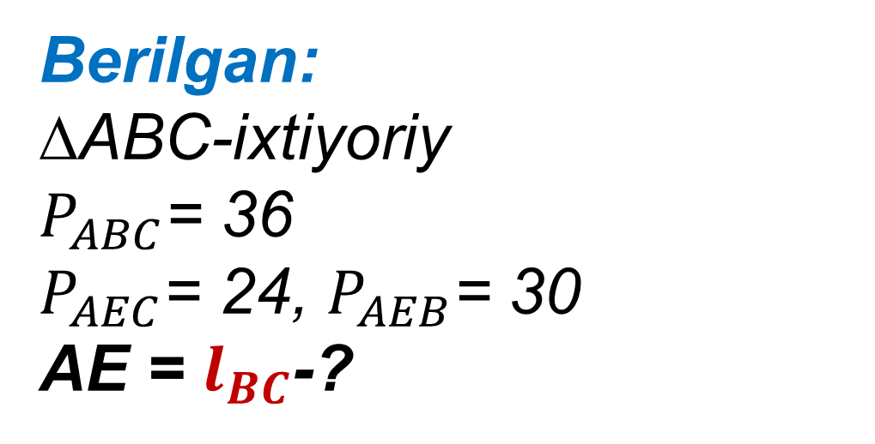
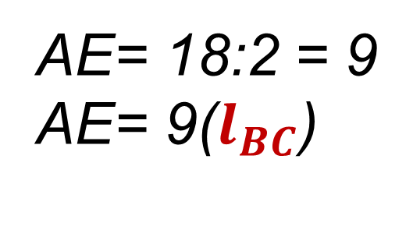
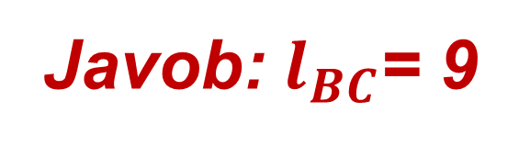

A
Berilgan:
∆ABC-ixtiyoriy
$P_{ABC}$= 36
$P_{AEC}$= 24, $P_{AEB}$= 30
AE = $l_{BC}$-?
$$l_{BC}$$
C
B
E
Yechish:
$P_{ABC}$=$P_{AEC}$ +${ P}_{AEB}$ - 2AE
36 = 24 + 30 - 2AE
2AE = 54 - 36
Javob: $l_{BC}$= 9
AE= 18:2 = 9
AE= 9($l_{BC}$)

Slide 12
Mustaqil bajarish uchun topshiriqlar:
Darslikning 57-betida berilgan
1- 5 - savollarga javob yozish,
7-10 - masalalarni yechish.

