Slide 1
GEOMETRIYA
7-
sinf
BURCHAK TURLARI:
TO‘G‘RI, O‘TKIR VA O‘TMAS BURCHAKLAR.
BISSEKTRISA
O‘qituvchi: Yusupjonova Shahnoza Mirzatillayevna

Slide 2
Bir nuqtadan chiqqan ikki nurdan iborat shakl burchak deb ataladi.
BURCHAK…
A
$∠$AOB – burchak,
O – burchak uchi,
OA, OB – burchak tomonlari.
O
B

Slide 3
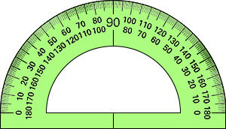
Mustahkamlash
Burchaklarning gradus o‘lchovi qanday
asbob yordamida o‘lchanadi?
Burchaklarning gradus o‘lchovi transportir deb ataladigan asbob yordamida o‘lchanadi .

Slide 4
Mustahkamlash
Yoyiq burchakning gradus
o‘lchovi necha gradus?
$∠AOB$ = 180⁰
.
A
O
B

Slide 5
Masalani yeching:
$∠$A = 45⁰31' va $∠$B = 45⁰29' burchaklar yigindisini $∠ C$ ni toping.
Yechish: $∠ C$ = $∠$A + $∠ B$
45⁰ 31'
34⁰ 29'
79⁰ 60' = 80⁰.
Javob: $∠ C$ = 80⁰
+

Slide 6
TO‘G‘RI BURCHAK
O‘TKIR BURCHAK
O‘TMAS BURCHAK
$$α$$
$$β$$
$$γ$$
$∠α$ = 43⁰
$∠β$= 90⁰
$∠γ$= 130⁰

Slide 7
103⁰, 20⁰, 89⁰
O‘TMAS BURCHAK
TO‘G‘RI BURCHAK
Burchaklarning gradus o‘lchovi
90⁰ dan katta.
O‘TKIR BURCHAK
Burchaklarning gradus o‘lchovi
90⁰ ga teng.
Burchaklarning gradus o‘lchovi
90⁰ dan kichik.
178⁰, 90⁰, 93⁰ .

Slide 8
Burchak yasash
80⁰li burchak yasang.
$∠C$ = 80⁰
.
.
80⁰
C
№4. OA nur chizing. Transportir yordamida gradus o‘lchovi mos ravishda 25⁰, 72⁰ va 146⁰ bo‘lgan $∠$AOB, $∠$AOC va $∠$AOD burchaklarni yasang.

Slide 9
Burchak bissektrisasi
Burchakning bir uchidan chiqib, uni teng ikki burchakka ajratuvchi nur burchak bissektrisasi deyiladi .
A
K
$∠$AOB – o‘tkir burchak
OK (l ) – bissektrisa,
$∠$AOK = $∠B$OK
B
O

Slide 10
4- masala (33- bet)
OA nur chizing. Transportir yordamida gradus o‘lchovi mos ravishda 25⁰, 72⁰ va 146⁰ bo‘lgan $∠$AOB, $∠$AOC va $∠$AOD burchaklarni yasang.

Slide 11
№4(2) - 72⁰
$∠AOC$ = 72⁰
O‘tkir burhak
C
I
.
72⁰
O
A

Slide 12
№4(3) - 146⁰
$∠AOC$ = 146⁰
O‘tmas burchak
$$C$$
I
.
146⁰
O
A
№4. OA nur chizing. Transportir yordamida gradus o‘lchovi mos ravishda 25⁰, 72⁰ va 146⁰ bo‘lgan $∠$AOB, $∠$AOC va $∠$AOD burchaklarni yasang.

Slide 13
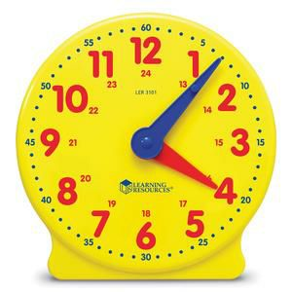
10- masala (33- bet)
Soatning soat mili :
a) 1 soatda;
b) 3,5 soatda
c) 6 soatda ;
d) 2 minutda necha gradusga buriladi?

Slide 14
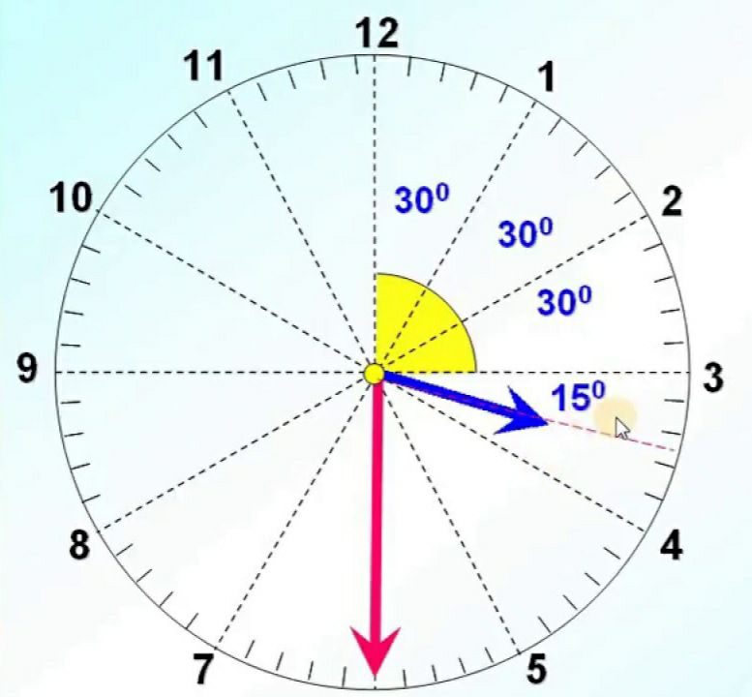
a) 1 soatda; b) 3,5 soatda ; c) 6 soatda; d) 2 minutda
1 soatda = 30⁰ ;
3,5 soatda = 105⁰
c) 6 soatda = 6∙30⁰=180⁰
d) 2 minut = 2∙ $\frac{ 30⁰}{60}$ =1⁰

Slide 15
Mustaqil bajarish uchun topshiriqlar:
Darslikda berilgan
8-, 10-, 12- topshiriqlarni
bajarish (33-bet).

Slide 16
teoremalar
xossalar
Masala
yechish
uchun…
chizma
formulalar
usullar

