Slide 1

ALGEBRA
8- sinf
Mavzu: Takrorlash (algebraik kasrlar ustida birgalikda bajariladigan amallar).

Slide 2
Algebraik kasrlar ustida birgalikda bajariladigan amallar
Algebraik kasrlar.
Qisqa ko‘paytirish formulalar.
Kasrlarni qisqartirish.
Algebraik kasrlarni umumiy maxrajga
keltirish.

Slide 3

ALGEBRAIK KASRLAR
Algebraik kasrlar deb, kasrning surati yoki maxrajida sonlar va harflar qatnashgan ifodaga aytiladi.
$\frac{ A}{B}$
- Algebraik kasrning umumiy ko‘rinishi

Slide 4

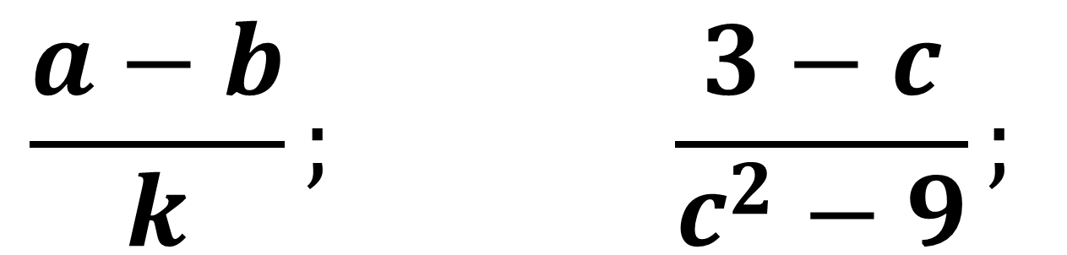
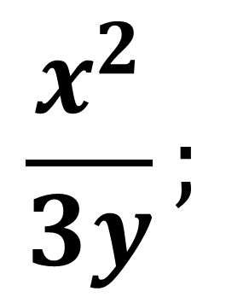
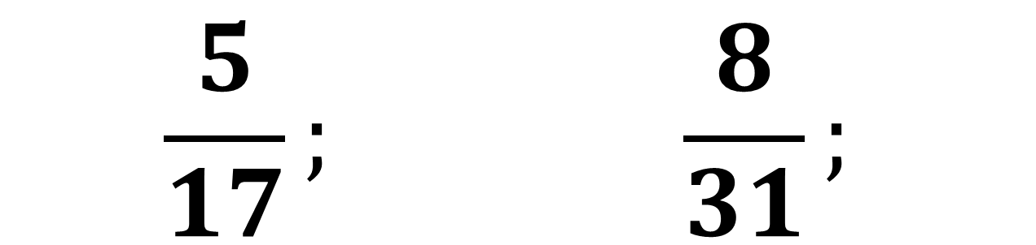



Algebraik kasrlarni aniqlang
$$\frac{5}{x};$$
$$\frac{21³}{3+7}$$
$$\frac{5}{17}; \frac{8}{31};$$
$\frac{7a}{b};$
$$\frac{x^{2}}{3y};$$
$$\frac{a−b}{k}; \frac{3−c}{c^{2}−9};$$
$$\frac{5}{{12}^{4}};$$

Slide 5
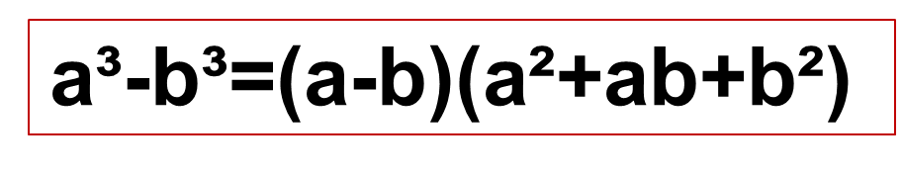
Formulalar
(a+b)³=a³+3a²b+3ab²+b³
(a+b)²=a²+2ab+b²
a³-b³=(a-b)(a²+ab+b²)
a³+b³=(a+b)(a²-ab+b²)
(a-b)²=a²-2ab+b²
(a - b)³= a³-3a²b+3ab²-b³
a²-b²=(a-b)(a+b)

Slide 6
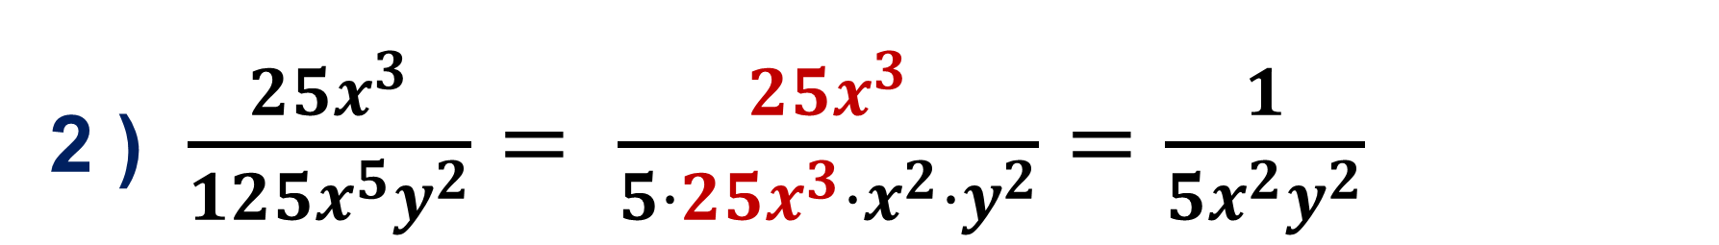
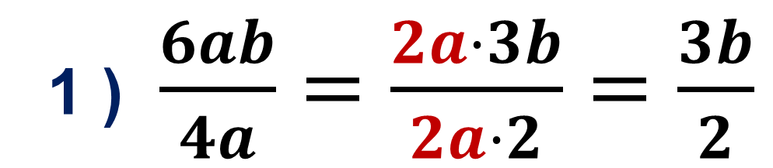
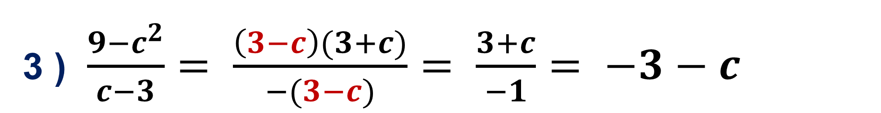
Algebraik kasrlarni qisqartirish
(ko‘paytirish va bo‘lish)
1 ) $\frac{6ab}{4a}=\frac{2a·3b}{2a·2}=\frac{3b}{2}$
2 ) $\frac{{25x}^{3}}{{125x}^{5}y^{2}}= \frac{{25x}^{3}}{5·25x^{3}·x^{2}·y^{2}}=\frac{1}{5x^{2}y^{2}}$
3 ) $\frac{9−c^{2}}{c−3}= \frac{\left(3−c\right)(3+c)}{−(3−c)}= \frac{3+c}{−1}= −3−c$

Slide 7
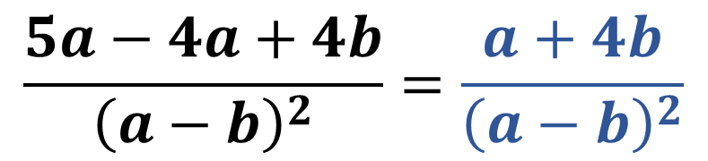
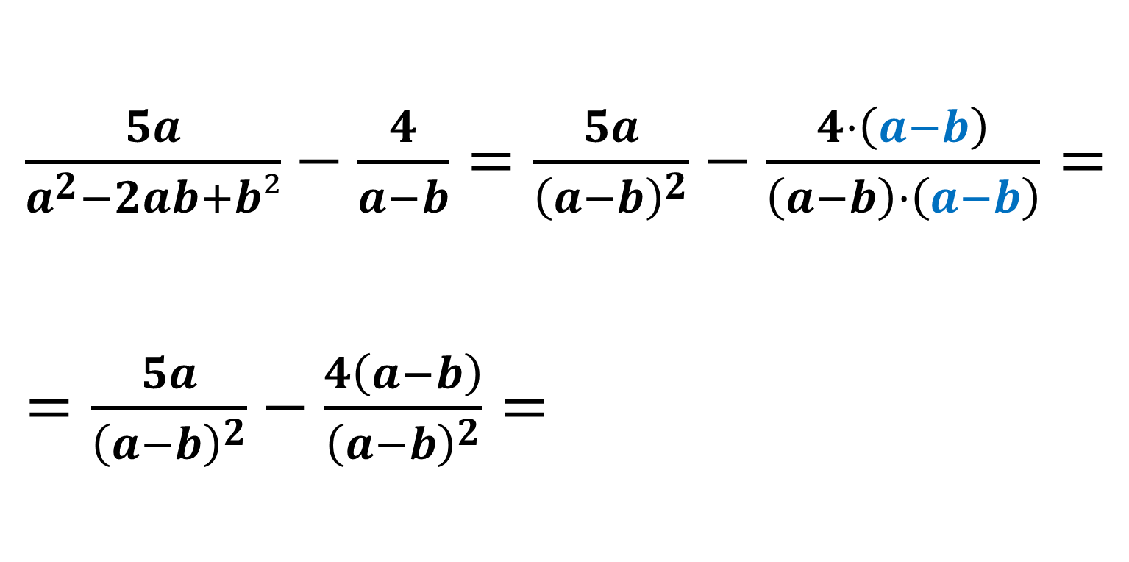
Algebraik kasrlarni umumiy maxrajga keltirish
(algebraik kasrlarni qo‘shish va ayirish)
$\frac{5a}{a^{2}−2ab+b²}−\frac{4}{a−b}=\frac{5a}{{\left(a−b\right)}^{2}}−\frac{4·\left(a−b\right)}{\left(a−b\right)·\left(a−b\right)}= =\frac{5a}{{\left(a−b\right)}^{2}}−\frac{4\left(a−b\right)}{{\left(a−b\right)}^{2}}=$
$$\frac{5a−4a+4b}{{\left(a−b\right)}^{2}}=\frac{a+4b}{{\left(a−b\right)}^{2}}$$

Slide 8
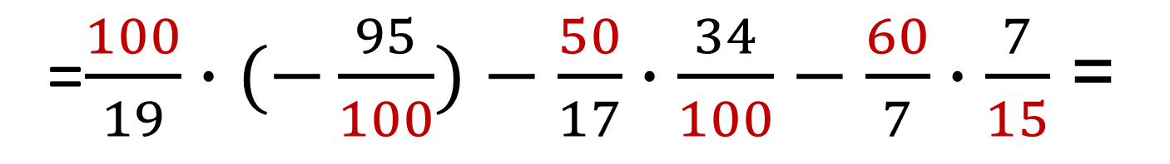
ESLATMA!
Arifmetik kasrlar ustida amallar bajarish qoidasi algebraik kasrlar ustida bajariladigan amallar uchun ham o‘rinlidir.
Masalan: 5$\frac{5}{19}$ ∙ (-0,95) + 2$\frac{16}{17}∙\left(−0,34\right)−8\frac{4}{7}∶2\frac{1}{7}$ =
=$\frac{100}{19}∙(−\frac{95}{100})−\frac{50}{17}∙\frac{34}{100}−\frac{60}{7}∙\frac{7}{15}$ =
- 5 - 1 - 4 = -10

Slide 9
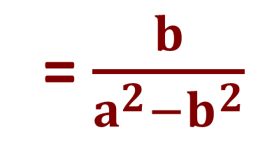
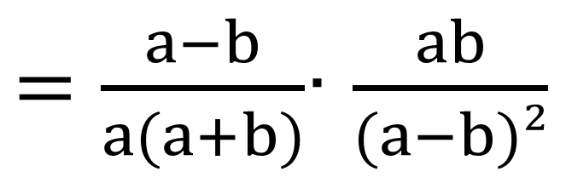

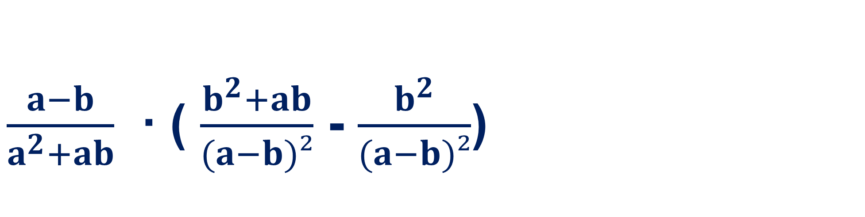

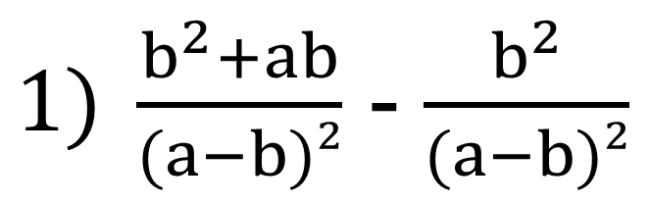
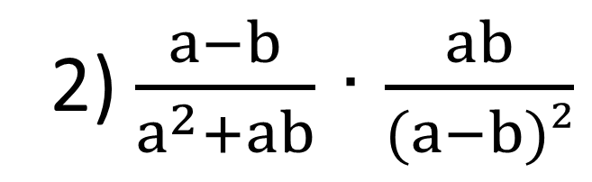
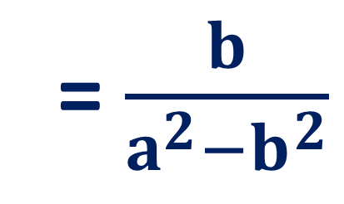
Amallarni bajaring:
$\frac{a−b}{a^{2}+ab}$ ∙ ( $\frac{b^{2}+ab}{(a−b)²}$ - $\frac{b^{2}}{(a−b)²}$)
= $\frac{b}{a^{2}−b^{2}}$
$1) \frac{b^{2}+ab}{(a−b)²}$ - $\frac{b^{2}}{(a−b)²}$
$= \frac{b^{2}+ab−b^{2}}{(a−b)²}$ =
$$\frac{ab}{(a−b)²}$$
2) $\frac{a−b}{a^{2}+ab}$ ∙ $\frac{ab}{(a−b)²}$
$=\frac{a−b}{a(a+b)}$∙ $\frac{ab}{(a−b)²}$
= $\frac{b}{a^{2}−b^{2}}$

Slide 10
Mustahkamlash uchun topshiriq:
№ 549
1
№ 550
220-sahifa
2
3
№ 552

