Slide 1
ALGEBRA
8- sinf
Mavzu: Misollar yechish

Slide 2
Tanlanmaning modasini toping.
2; 3; 5; 2; 6; 2.
5
2
3
6
0

Slide 3
Tanlanmaning medianasini toping.
6; 7; 3; 7; 1.
7
6
0
3
1

Slide 4
Tanlamaning kengligini toping.
-2; 4; 8; 0; -4.
6
4
10
-4
12

Slide 5
Tanlanmaning o‘rta qiymatini toping.
-2; 4; 5; -3; 5.
5
3,8
0,25
1,8
1,5

Slide 6
8- sinf o‘quvchilari orasida Alisher Navoiy g‘azallarini yoddan ifodali aytish bo‘yicha musobaqa bo‘lib o‘tdi. Unda 10 nafar qiz bola va 9 nafar o‘g‘il bola qatnashdi. X – qiz bolalar yodlagan g‘azallar soni, Y – o‘g‘il bolalar yodlagan g‘azallar soni bo‘lsin. X va Y sonlarining chastotalar bo‘yicha taqsimoti quyidagi jadvallarda berilgan:
Mustahkamlash

Slide 7
x – g‘azallar soni | 4 | 5 | 6 | 8 | 12
n - chastota | 3 | 2 | 3 | 1 | 1
y – g‘azallar soni | 4 | 5 | 6 | 8 | 9
n - chastota | 2 | 4 | 1 | 1 | 1
Jadvalga ko‘ra x va y miqdorlarning:
1) modalarini toping
2) medianalarini toping
3) jadvallarga mos chastotalar poligonini yasang.

Slide 8
x va y miqdorlarning jadval ko‘rinishida berilgan taqsimotini variantlarning quyidagi qatori ko‘rinishida yozish ham mumkin:
x: 4, 4, 4, 5, 5, 6, 6, 6, 8, 12
y: 4, 4, 5, 5, 5, 5, 6, 8, 9
1) X tanlanmada 2 ta moda bor:
$M_{0_{1}}=4 va$ $M_{0_{2}}=6$; Y tanlamada esa moda bitta: $M_{0}=5$
2) X qatorda 10 ta (juft sondagi) had bor. Bu holda mediana markazdagi ikkita hadning o‘rta arifmetigiga teng:
$M_{e}=\frac{5+6}{2}=\frac{11}{2}=$ 5,5

Slide 9
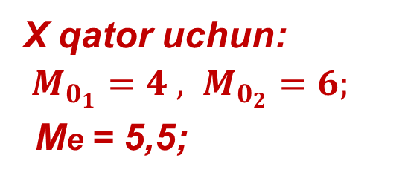
(X)chastotalar poligoni
x – g‘azallar soni | 4 | 5 | 6 | 8 | 12
n - chastota | 3 | 2 | 3 | 1 | 1
X qator uchun:
$M_{0_{1}}=4 , M_{0_{2}}=6;$
Me = 5,5;

Slide 10
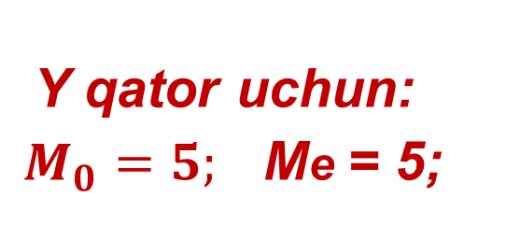
Y qatorning chastotalar poligoni
y – g‘azallar soni | 4 | 5 | 6 | 8 | 9
n - chastota | 2 | 4 | 1 | 1 | 1
Y qator uchun:
$M_{0}=5;$ Me = 5;

Slide 11
Mustaqil bajarish uchun topshiriqlar:
1
516- 518 -topshiriq
210 - sahifa
2
519- 520- topshiriq

