Slide 1

ALGEBRA
8-sinf
MAVZU: SONNING MODULI.
MODUL QATNASHGAN TENGLAMALAR

Slide 2
MODUL TUSHUNCHASI
Berilgan a haqiqiy sonning moduli deb, sonlar o‘qining markazi yoki koordinatalar boshidan
berilgan songacha bo‘lgan masofaga aytiladi.
-a
0
a
a, a ≥ 0
-a, a < 0
IaI =
∙
a birlik
a birlik

Slide 3
MODUL TUSHUNCHASI
I-4I = 4
I4I = 4
0
4
-4
∙
∙
∙
4 birlik
4 birlik
Qarama qarshi sonlarning modullari o‘zaro teng.
! Modulning qiymati hech qachon manfiy son
bo‘lmaydi.

Slide 4
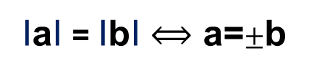

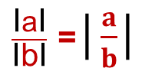
MODULNING XOSSALARI
I-aI=IaI
$\frac{\text{I}\text{a}\text{I}}{\text{I}\text{b}\text{I}}$ =│$\frac{a}{b}$│
IaI ≥ 0
I-8,5I = 8,5
I-8,5I ≠ -8,5
I-24I = I24I
24 = 24
$\frac{\text{I}\text{10}\text{I}}{\text{I}\text{−25}\text{I}}$ =│$\frac{10}{−25}$│= 0,4
IaI = IbI $⟺$ a=$±$b
Ia∙bI = IaI∙ IbI
I2021I = 2021
I-2021I = 2021
I-25∙4I = I-25I∙I4I

Slide 5
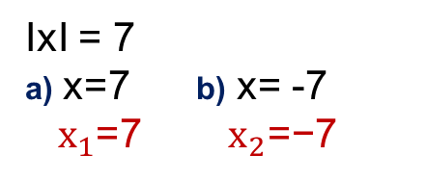
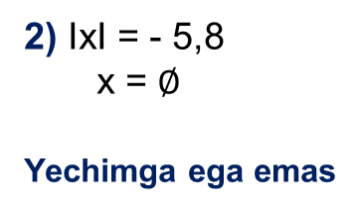

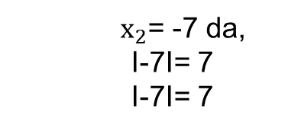
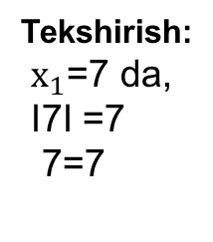
Modulli tenglama
IxI = a (a ≥ 0) ↔ x =$±$ a
1)
IxI = 7
a) x=7 b) x= -7
$x_{1}$=7 ${ x}_{2}\text{=−7}$
2) IxI = - 5,8
x = $∅$
Yechimga ega emas
Tekshirish:
$x_{1}$=7 da,
I7I =7
7=7
$x_{2}$= -7 da,
I-7I= 7
I-7I= 7

Slide 6

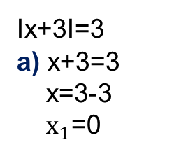
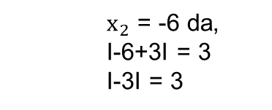
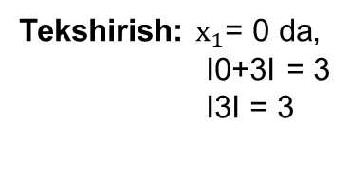
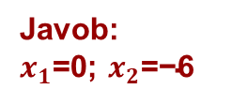
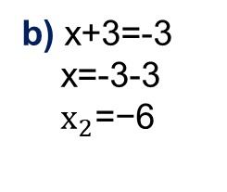
№267.(4) Tenglamani yeching
Ix+3I=3
a) x+3=3
x=3-3
$x_{1}$=0
IxI = a (a ≥ 0) ↔ x =$±$ a
b) x+3=-3
x=-3-3
$x_{2}\text{=−6}$
Tekshirish: $x_{1}$= 0 da,
I0+3I = 3
I3I = 3
${ x}_{2}$ = -6 da,
I-6+3I = 3
I-3I = 3
Javob:
$x_{1}$=0; $x_{2}\text{=−6}$

Slide 7
Modulli tenglama
IxI = a (a ≥ 0) ↔ x =$±$ a
1)
| 2х – 5 | = 13
Yechim: 2х – 5 = 13 va 2х – 5 = - 13
2х = 13 + 5 2х = - 13 + 5
2х = 18
2х = -8
х = 9
х = -4
Javob: х = 9 , х = - 4

Slide 8
Modulli tenglama
IxI = a (a ≥ 0) ↔ x =$±$ a
Tenglamani yeching: | |x| -2 | = 2
1) |x| -2 = 2 2) |x| -2 = - 2
|x| = 2+ 2 |x| = - 2 +2
|x| = 4 |x| = 0
x = 4, х = - 4 va x = 0

Slide 9


Modulli tenglama
IxI = a (a ≥ 0) ↔ x =$±$ a
Tenglamani yeching: | 2х – 3 | = 7
a) 2х – 3 = 7 b) 2х – 3 = - 7
2х = 7 + 3 2х = - 7 + 3
2х = 10 2х = - 4
х = 5 х = - 2
Javob: $x_{1}$=5; $x_{2}\text{=−}\text{2}$

Slide 10
Modulli tenglama
Tenglamani yeching:
|3 + х| = |х|
3 + х = х
3 = 0
yechimi yo‘q
3 + х = - х
2х = -3
х = -1,5
Javob: х = -1,5

Slide 11
Modulli tenglama
Tenglamani yeching: |х + 2| = |2х - 6|
1- usul: х + 2 = 2х – 6 va х + 2 = - (2х – 6)
х = 8 3х = 4
х = 4/3
2- usul: (|х + 2|)² = (|2х - 6|)² |а|²=а²
(х + 2)² = (2х - 6)²
3х² – 28х + 32 = 0 => х = 8, х = 4/3

Slide 12
Modulli tenglama
|2x+5|=|3x-1|
(2x+5)² =(3x-1)²
(2x+5)² -(3x-1)² =0
((2x+5)-(3x-1))((2x+5)+(3x-1))=0
(2x+5)-(3x-1)=0 va (2x+5)+(3x-1)=0
2x+5-3x+1=0 2x+5+3x-1=0
-x=-6 5x=-4
x=6 x=-0,8
Javob: 6; -0,8

Slide 13
MUSTAQIL BAJARISH UCHUN TOPSHIRIQLAR
№ 267-268
.
№ 269-270
109-bet
Omad!

