Slide 1
ALGEBRA
8-sinf
Mavzu: Misollar yechish

Slide 2
Bikvadrat tenglama
Tenglamani yeching:
9х⁴ - 6х² + 1 = 0
(3х²-1)² = 0
3х²-1 = 0
х²=
x = ±
Javob: х₁,₂ = ±

Slide 3

Keltirilgan kvadrat tenglama
(x²-2x)² - 4(x² - 2x) + 3 = 0 tenglamani yeching
Yechish:
1) х² - 2х = y bo‘lsin.
2) у² - 4у + 3 = 0
у₁= 1 у₂= 3.
3) х² - 2х = 1
х² - 2х -1 = 0
$x_{1 }$= 1+$\sqrt{2}$
$x_{2 }$= 1- $\sqrt{2}$
х² - 2х = 3
х² - 2х - 3 = 0
$x_{3 }$= -1
$x_{4}$= 3
Javob: 1+$\sqrt{2}$; 1- $\sqrt{2}$; -1 va 3.

Slide 4
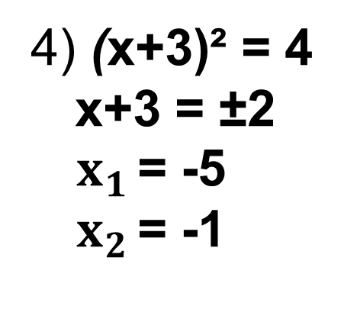

Keltirilgan kvadrat tenglama
№396. (x+3)⁴ - 13(x+3)² +36 = 0 tenglamani yeching
1) (х+3)² = t bo‘lsin.
2) t² – 13t + 36 = 0
t₁= 9 t₂= 4.
3) (х+3)² = 9
х+3 = ±3
$x_{1 }$= 0
$x_{2 }$= -6
4) (х+3)² = 4
х+3 = ±2
$x_{1 }$= -5
$x_{2 }$= -1
Javob: 0; -6; -5 va -1.

Slide 5
Kvadrat tenglamaga keltirilgan tenglamalar
(х² +4х+3) (х² +4х+1) = 48
х² +4х+1 = y bo‘lsin.
у₁= -8 у₂= 6.
1) х² + 4х + 1= -8
х² + 4х + 9 = 0
D < 0
Yechimga ega emas
(у+2)у = 48
y² + 2y – 48 = 0
2) х² + 4х + 1 = 6
х² + 4х – 5 = 0
х₁ = -5 х₂ = 1

Slide 6
397(2)- misol
(х-2)² ∙(х² - 4х) +3 = 0
(х²- 4x +4) ∙(х² - 4х + 4 - 4) +3 = 0
t ∙(t – 4) + 3 = 0
t
t - 4
(x-2)² = t bo‘lsin.
t₁= 1 t₂= 3.
1) х² - 4х + 4 = 1
х² - 4х + 3 = 0
х₁ = 3 х₂ = 1
2) х² - 4х + 4 = 3
х² - 4х + 1 = 0
х₃ = 2
t² – 4t + 3 = 0
Javob: 1; 2; 3.

Slide 7
Kvadrat tenglamaga keltirilgan tenglamalar
(х²- 5х + 7)²- 2(х - 2)(х - 3) = 1
х²- 5х + 6 = t bo‘lsin.
(t + 1)²- 2t = 1
х² - 5х + 6 = 0
x = 2, х = 3.
Javob: х₁= 2; х₂= 3
t² + 2t + 1 - 2t = 1
t² = 0
t = 0

Slide 8
401(2)- misol
Tenglamani yeching: x⁴- 2x³- 13x² + 14x + 24 = 0
x⁴- 2x³ + x² - 14x² + 14x + 24 = 0
(x²-x)²
14(x²-x)
x² - x = t bo‘lsin.
t₁= 2 t₂= 12.
2) х² - х = 12
х² - х -12 = 0
х₃ = -3;
х₄ = 4
1) х² - х = 2
х² - х - 2 = 0
х₁ = -1 х₂ = 2
t² – 14t + 24 = 0
Javob: -1; 2; -3 va 4.

Slide 9
Mustaqil bajarish uchun topshiriqlar:
1
399 - topshiriq
162 - sahifa
2
400 - topshiriq
3
401 - topshiriq
7ю16 javobini ochirish
10,47 dan- 13,37 gacha ochirish

