Slide 1
ALGEBRA
8-sinf
Mavzu: Bikvadrat tenglama. Kvadrat tenglamaga
keltiriladigan tenglamalar

Slide 2
Tanlash yo‘li bilan tenglamaning ildizlarini toping:
:
а) t²- 3t +2=0
t₁=1; t₂=2
х₁ + х₂ = -р
х₁ ∙ х₂ = q
b) t²-5t + 4=0
t₁=1; t₂=4
c) t²-20t + 64=0
t₁=4; t₂=16
d) t²-5t+6 = 0
t₁=2; t₂=3

Slide 3

Keltirilgan kvadrat tenglama
(x²-2x)² - 4(x² - 2x) + 3 = 0 tenglamani yeching
Yechish:
1) х² - 2х = y bo‘lsin.
2) у² - 4у + 3 = 0
у₁= 1 у₂= 3.
3) х² - 2х = 1
х² - 2х -1 = 0
$x_{1 }$= 1+$\sqrt{2}$
$x_{2 }$= 1- $\sqrt{2}$
х² - 2х = 3
х² - 2х - 3 = 0
$x_{3 }$= -1
$x_{4}$= 3
Javob: 1+$\sqrt{2}$; 1- $\sqrt{2}$; -1 va 3.

Slide 4
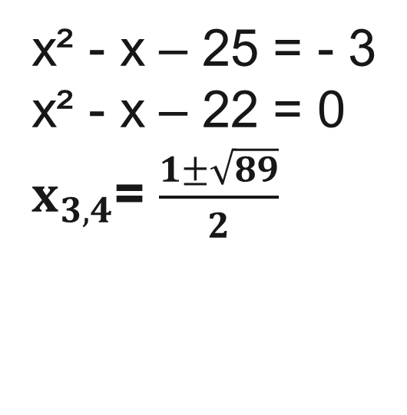
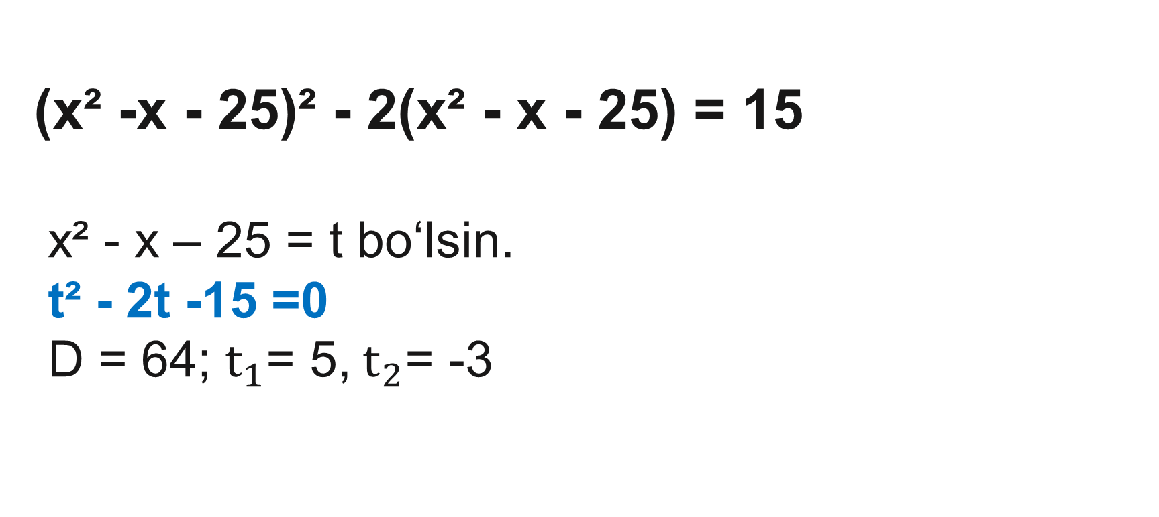

Tenglamani yeching:
(х² -х - 25)² - 2(х² - х - 25) = 15
х² - х – 25 = t bo‘lsin.
t² - 2t -15 =0
D = 64; $t_{1}$= 5, $t_{2}$= -3
t²
2t
х² - х – 25 = 5
х² - х – 30 = 0
$x_{1}$= -5, $x_{2}$= 6
х² - х – 25 = - 3
х² - х – 22 = 0
$x_{3,4}$= $\frac{1±\sqrt{89}}{2}$

Slide 5
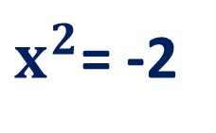

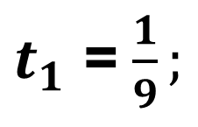
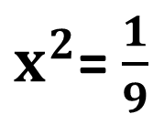
Bikvadrat tenglama
ах⁴ + bx² + c = 0 ko‘rinishidagi kvadrat tenglama
bikvadrat tenglama deyiladi.
Bunda, а ≠ 0, b va с - sonlar.
9х⁴ + 17х² - 2 = 0
х² = t belgilash kiritiladi va аt² + bt + c = 0
9t² + 17t - 2 = 0
$t_{1}$ = $\frac{1}{9};$
$t_{2}$ = -2;
$x^{2}$= $\frac{1}{9}$
$x_{1}$= - $\frac{1}{3}$, $x_{2}$= $\frac{1}{3}$
$x^{2}$= -2
Yechimga ega emas

Slide 6
Bikvadrat tenglama
Tenglamani yeching:
х⁴ - 4х² + 3 = 0
х² = t bo‘lsin.
1) x² = 3
2) x² = 1
t² - 4t + 3 = 0
x = ±
x = ±1
D = 16 - 12 = 4
t₁ = 3,
t₂ = 1.
Javob: х₁,₂ = ±$\sqrt{3}$;
х₃,₄=±1.

Slide 7
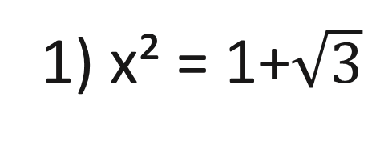

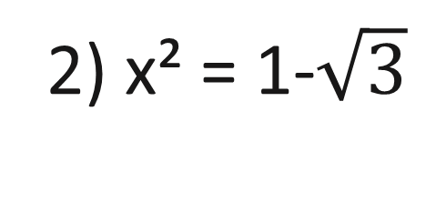
Bikvadrat tenglama
Tenglamani yeching:
x⁴ - 2x² - 2 = 0
x² = t bo‘lsin.
t² – 2t – 2 = 0
1) x² = 1+$\sqrt{3}$
2) x² = 1-$\sqrt{3}$
D = 4 + 8 = 12
t₁,₂=1 ± $\sqrt{3}$
x₁,₂=±
Yechimga ega emas
Javob: х₁,₂ = ±

Slide 8
Bikvadrat tenglama
Tenglamani yeching:
2х⁴ -3х² + 5 = 0
х² = t bo‘lsin.
2t² - 3t + 5 = 0
D = 9 - 4·2∙5 = 9 – 40 = -31
D < 0
yechimga ega emas
Javob: yechim yoq.

Slide 9
Bikvadrat tenglama
(х²-5х+7)² - 2(х-2)(х-3)=1
х²- 5х + 6 = t bo‘lsin.
(t+1)² - 2t = 1
t² + 2t + 1 - 2t = 1
х² - 5х + 6 = 0
x = 2 х = 3
Javob: х₁= 2; х₂= 3
t² = 0
t = 0

Slide 10
Mustaqil bajarish uchun topshiriqlar:
1
389 - topshiriq
160 - sahifa
2
390 - topshiriq
3
392 - topshiriq
4
Qoidalarni yod olish.

