Slide 1
ALGEBRA
8-sinf
Mavzu: Misollar yechish

Slide 2
Mustahkamlash
Keltirilgan kvadrat tenglamani yeching:
х² + px + q = 0
х² + 14x + 24 = 0
p = 14, q = 24
$x_{1,2}$ = - $\frac{14}{2}$±$\sqrt{{\left(\frac{−14}{2}\right)}^{2}−24}=−7±\sqrt{25}=−7±5;$
X₁ = -7 + 5 = -2;
X₂ = -7 - 5 = -12 .
Javob: -2 va -12

Slide 3
Mustahkamlash
х² - px - 3 = 0 tenglamaning ildizlaridan biri х₁ = -1.
Shu tenglamaning p koeffitsiyentini va х₂ ni toping.
х₁ + х₂ = -р
х₁ ∙ х₂ = q
Viyet teoremasi:
-1 + х₂ = - р
-1∙ х₂ = -3,
х₂ = 3,
p = -(х₁ + х₂)= -(-1+3) = -2
Javob: х₂ = 3, p = -2

Slide 4
Tanlash usuli bilan tenglamaning ildizlarini toping.
Mustahkamlash
x² + 8x + 7 = 0
х₁ + х₂ = -р
х₁ ∙ х₂ = q
p = 8, q = 7
-1 + (-7) = -8
-1 ⋅ (-7) = 7
х₁ + х₂ = -8
х₁ ∙ х₂ = 7
Javob: х₁ = -1, х₂ = -7

Slide 5

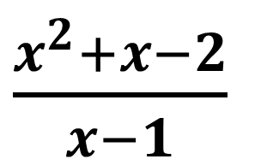
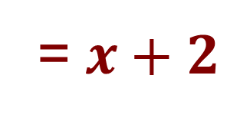
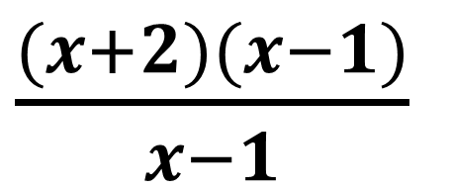
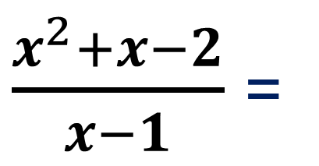
Kasrni qisqartiring:
384 - topshiriq
$\frac{x^{2}+x−2}{x−1}$
х² + px + q = (x- х₁ )(x- х₂ )
$x^{2}+x−2$ = 0
-2 + 1 = - 1
-2 ⋅ 1 = -2
х₁ + х₂ = -1
х₁ ∙ х₂ = -2,
х₁ = -2, х₂ = 1
$\frac{x^{2}+x−2}{x−1}$ =
$\frac{(x+2)(x−1)}{x−1}$
= $x+2$

Slide 6
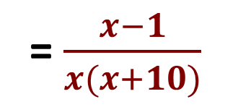
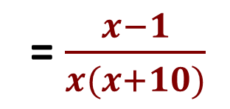
Ifodani soddalashtiring:
388 - topshiriq
$\frac{5x+1}{x^{2}+9x−10}$ : $\frac{5x²+x}{x^{2}−2x+1}$
= $\frac{x−1}{x(x+10)}$
$x^{2}+9x−10$ = 0
$x^{2}−2x+1$ = 0
-10 + 1 = - 9
-10 ⋅ 1 = -10
х₁ + х₂ = -9
х₁ ∙ х₂ = -10,
$x^{2}−2x+1$ = (x - 1)²
х₁ = -10, х₂ = 1
$x^{2}+9x−10$ = $(x+10)(x−1)$
$\frac{5x+1}{x^{2}+9x−10}$ : $\frac{5x²+x}{x^{2}−2x+1}$
= $\frac{5x+1}{(x+10)(x−1)}$ · $\frac{(x−1)²}{x(5x+1)}$
= $\frac{x−1}{x(x+10)}$

Slide 7
Mustaqil bajarish uchun topshiriqlar:
1
381 - topshiriq
155 - sahifa
2
382 - topshiriq
3
383 - topshiriq
4
Formulalarni yod olish.

