Slide 1

ALGEBRA
8-sinf
MAVZU: MISOLLAR YECHISH

Slide 2
Kvadrat tenglama ildizlari soni qanday aniqlaniladi?
ах² + bx + c = 0 – kvadrat tenglama
D = b² – 4ac
1) Agar D > 0 bo‘lsa, u holda
tenglama 2 ta ildizga ega:
2) Agar D = 0 bo‘lsa, u holda
tenglama yagona ildizga ega:
3) Agar D < 0 bo‘lsa, u holda tenglama haqiqiy ildizga ega emas.

Slide 3
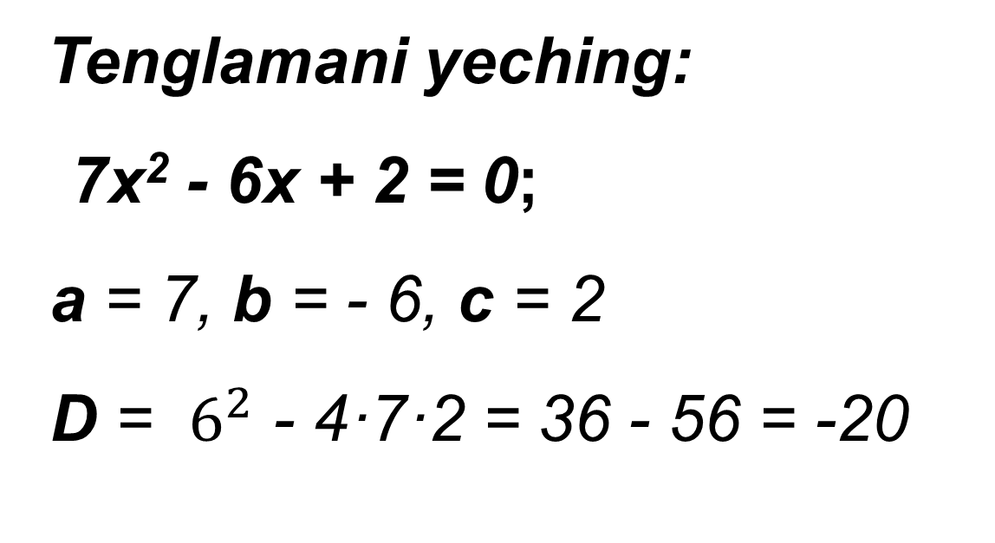
370 - misol
Tenglamani yeching:
7х² - 6x + 2 = 0;
a = 7, b = - 6, c = 2
D = $6^{2}$ - 4·7·2 = 36 - 56 = -20
D = b² – 4ac
< 0
Javob: Ø (haqiqiy yechimga emas)

Slide 4
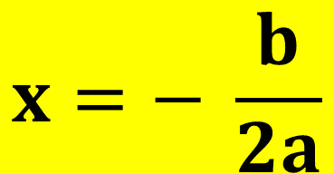
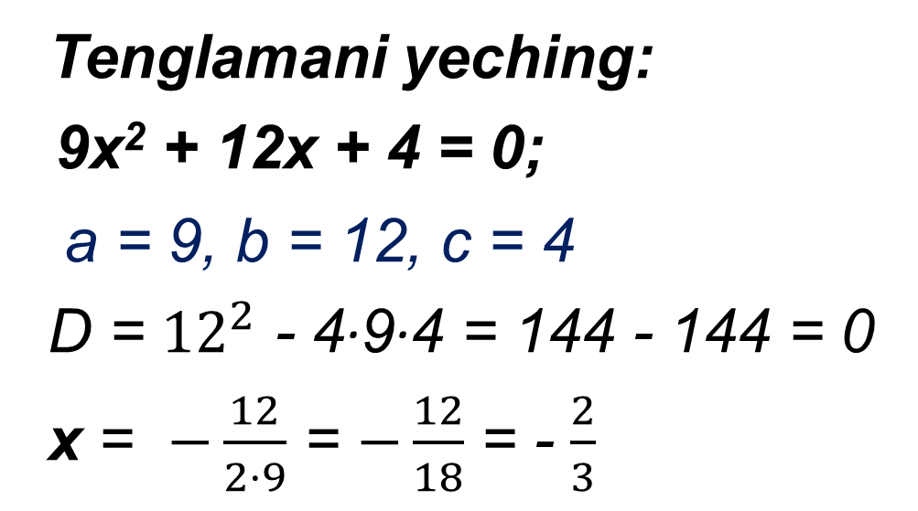
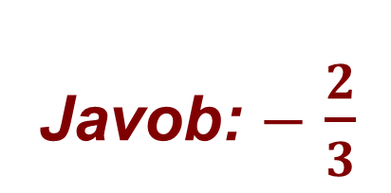
370 - misol
Tenglamani yeching:
9х² + 12x + 4 = 0;
a = 9, b = 12, c = 4
D = ${12}^{2}$ - 4·9·4 = 144 - 144 = 0
x = $−\frac{12}{2·9}$ = $−\frac{12}{18}$ = - $\frac{2}{3}$
Agar D = 0 bo‘lsa, u holda
tenglama yagona ildizga ega
$$x=− \frac{b}{2a}$$
Javob: $−$ $\frac{2}{3}$

Slide 5
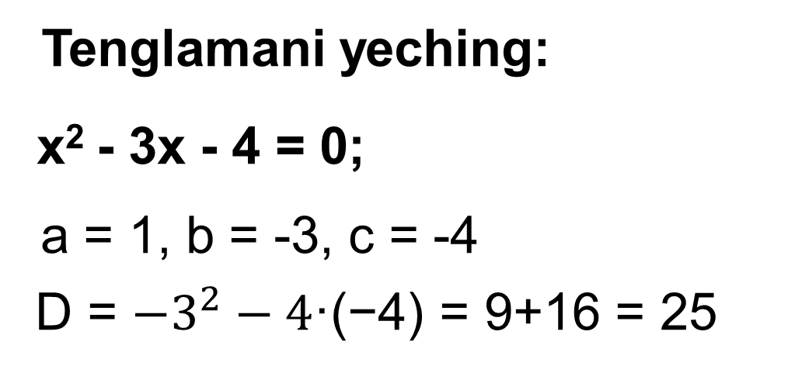
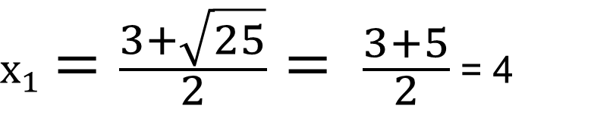
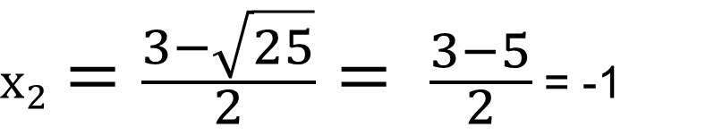
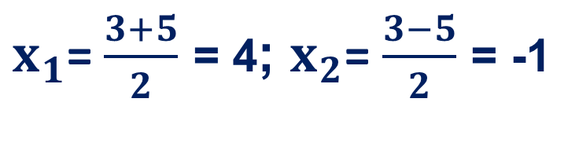
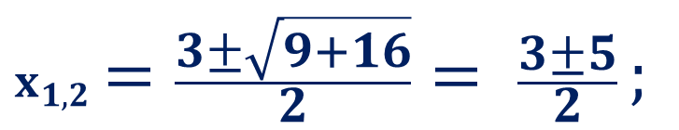
370 - misol
Tenglamani yeching:
х² - 3x - 4 = 0;
a = 1, b = -3, c = -4
D = ${−3}^{2}−4\text{·}\text{(−4) = 9+16 = 25}$
$x_{1,2}=\frac{3±\sqrt{9+16}}{2}= \frac{3±5}{2};$
$x_{1}=\frac{3+\sqrt{25}}{2}= \frac{3+5}{2}$ = 4
$x_{1}$= $\frac{3+5}{2}$ = 4; $x_{2}$= $\frac{3−5}{2}$ = -1
Javob: 4; -1.
$x_{2}=\frac{3−\sqrt{25}}{2}= \frac{3−5}{2}$ = -1

Slide 6
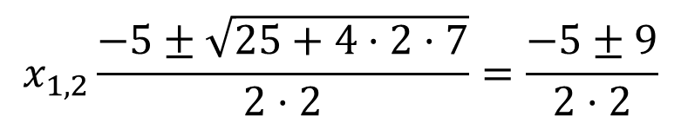
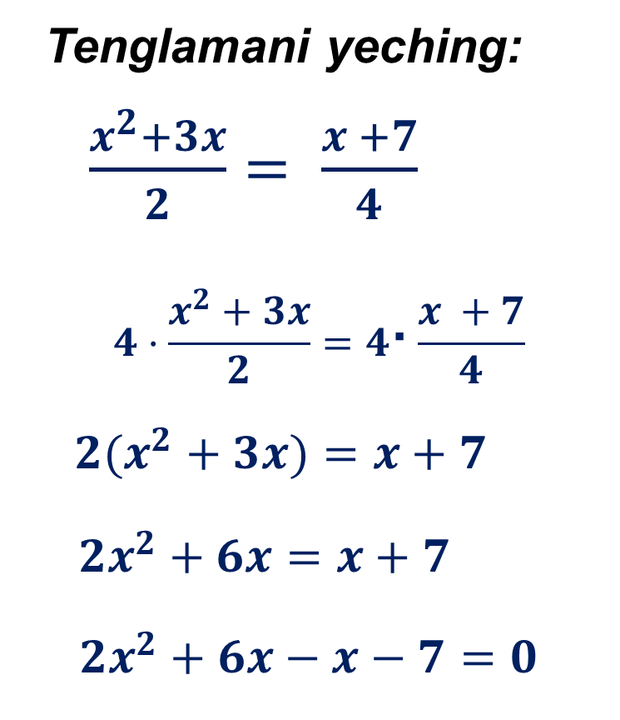
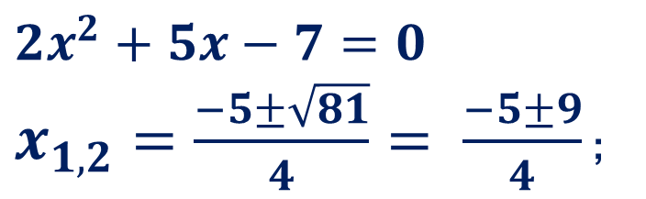
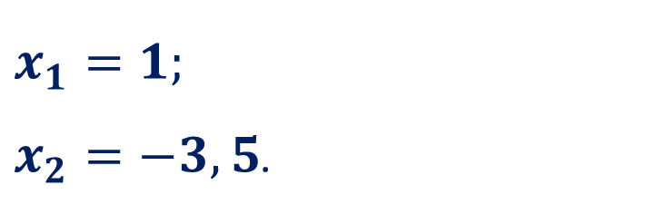
372 - misol
Tenglamani yeching:
$\frac{x^{2}+3x}{2}= \frac{x +7}{4}$
$$4·\frac{x^{2}+3x}{2}=4\text{·}\frac{x +7}{4}$$
${2(x}^{2}+3x)=x+7$
$2x^{2}+6x=x+7$
$2x^{2}+6x−x−7=0$
/· 4
$$2x^{2}+5x−7=0$$
$x_{1,2}=\frac{−5±\sqrt{81}}{4}= \frac{−5±9}{4}$ ;
2
$$x_{1}=1;$$
$x_{2}=−3,5$.
Javob: 1 va - 3,5.

Slide 7
374 - misol
Tenglamani to‘la kvadratga ajratish usuli bilan yeching: х² - 16x + 48 = 0.
х² -16x = - 48
х² - 2∙8·x = - 48 /+64
х² - 2∙8·x + 64 = - 48 + 64
(х - 8)² = 16.
х - 8 = -4 va х - 8 = 4.
х₁ = 4; х₂ = 12.
Javob: 4; 12.

Slide 8
374 - misol
Tenglamani to‘la kvadratga ajratish usuli bilan yeching: 2х² - 5x + 2 = 0.
2х² - 5x +2 = 0
2·8х² - 5·8x +2·8 = 0
(4х)² - 2∙5·4x + 5² = -16 +5²
(4х - 5)² = 25 – 16
(4х - 5)² = 3²
Har ikkala qismini 4a ga ko‘paytirish usuli:
/·8
4х - 5 = ± 3;
( )
4х - 5 = 3; 4х - 5 = - 3
x = 2; x = 0,5
Javob: х₁ = 2; х₂ = 0,5.

Slide 9
Mustaqil bajarish uchun topshiriqlar:
1
370 - 372
147 - sahifa
2
374 - 375
3
Formulalarni yod olish

