Slide 1
ALGEBRA
8-sinf
Mavzu: Misollar yechish

Slide 2
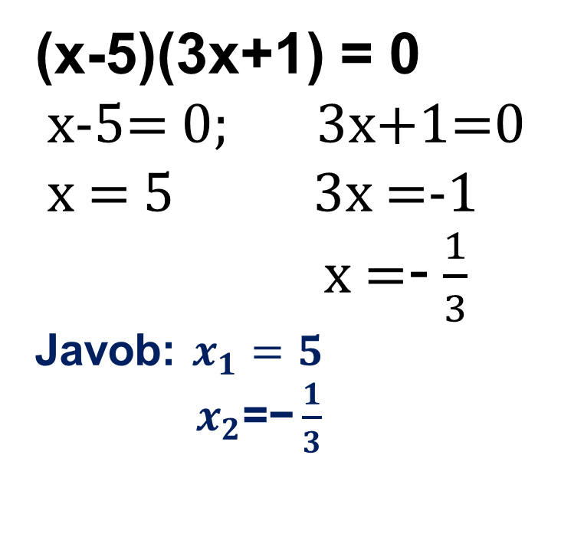
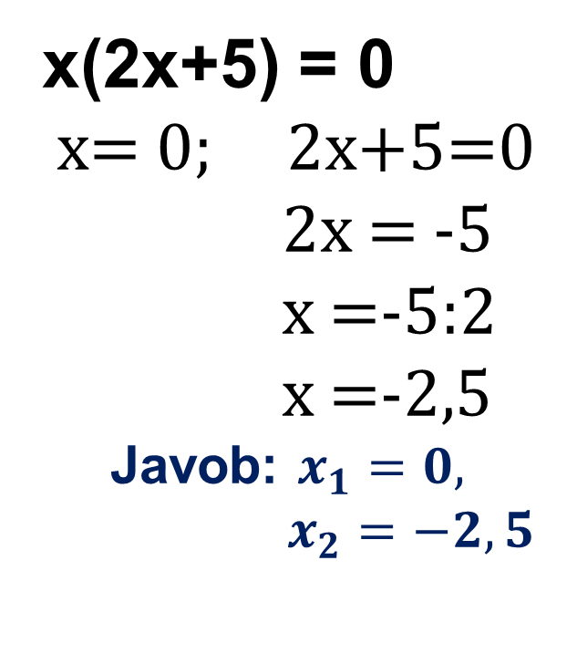
312- topshiriq (121-bet)
Tenglamani yeching:
1
x(2x+5) = 0
x= 0; 2x+5=0
2x = -5
x =-5:2
x =-2,5
Javob: $x_{1}=0,$
$x_{2}=−2,5$
(x-5)(3x+1) = 0
x-5= 0; 3x+1=0
x = 5 3x =-1
x =- $\frac{1}{3}$
Javob: $x_{1}=5$
$x_{2}\text{=−}\frac{1}{3}$
3

Slide 3
314 - topshiriq
Son o’qida a nuqta b nuqtadan chapda yotadi .
Quyidagi son musbatmi yoki manfiymi :
1) b-a 2) 2 +b-a 3) a-b 4) a-3-b
a
b
1) b>a
b-a - musbat
2) b>a
2+b-a - musbat
3) b>a
a-b - manfiy
4) b>a
a-3-b - manfiy

Slide 4
316- topshiriq
Tengsizliklar sistemasini yeching:
1) 0,5(x+3)-0,8 < 0,4(x+2)-0,3
0,7(2-x)+1,3<0,6(1-x)+2,2
0,5x+1,5-0,8 < 0,4x+0,8-0,3
1,4-0,7x+1,3 < 0,6-0,6x+2,2
$$⇒$$
$$⇒$$
0,5x+0,7< 0,4x+0,5
-0,7x+2,7< -0,6x+2,8
0,1x< -0,2
-0,1x< 0,1
x < -2
x > -1
$$⇒$$
$$⇒$$
-1
-2
Javob: yechimga ega emas.

Slide 5
317- misol
IxI = a (a ≥ 0) ↔ x =$±$ a
Tenglamani yeching: | 3х –2 | = 1
3x - 2= 1 3x – 2 = -1
3x = 1+2 3x = 2-1
x = 3:3 3x = 1
x=1 x = $\frac{1}{3}$
Javob: $x_{1}$=1; $x_{2}$= $\frac{1}{3}$

Slide 6
320 - masala
Uchburchakning bir tomoni 4 cm dan uzun , ikkinchi tomoni birinchisidan 1,5 marta uzun, uchinchi tomoni ikkinchisidan
1,5 marta uzun . Uchburchakning perimetri 19 cm dan uzun ekanini isbotlang .
4
4·1,5
Isbot qilish kerak:
P > 19 cm
Yechish:
a > 4
b > 6
c > 9
P> 19
+
6∙1,5

Slide 7
321 - topshiriq
x ning qanday qiymatlarida y=-x+1 va y=x+2 funksiyalrining qiymatlari
bir vaqtda :
1) musbat 2) manfiy 3)1 dan katta 4)2 dan katta bo‘ladimi ?
-x + 1 > 0
x+2 > 0
-x > -1
x > -2
x < 1
x > -2
$$⇒$$
$$⇒$$
Javob:- 2 < x < 1
4) -x + 1 > 2
x+2 > 2
-x > 2-1
x > 2-2
x < -1
x > 0
$$⇒$$
$$⇒$$
0
-1
Javob: Hech qanday qiymatida

Slide 8
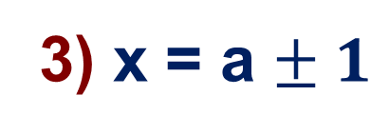
324- topshiriq
Qo‘sh tengsizlik ko‘rinishida yozing:
1) x = 12$± 0,3$
3) x = a $± 1$
12 - $0,3≤x≤12+0,3$
a - 1 $≤x≤$ a + 1
11,7 $≤x≤12,3$
5) z = 1,8 $± 0,01$
1,8 - 0,01 $≤z≤$ 1,8 + 0,01
1,79 $≤z≤$ 1,81

Slide 9
Mustaqil bajarish uchun topshiriqlar:
1
310 - masala
2
314 - topshiriq
104 - sahifa
3
“Ozingizni tekshirib ko‘ring“
4
Qoida

