Slide 1

ALGEBRA
8-sinf
Mavzu: Misollar yechish

Slide 2
Mustahkamlash
Agar a > 1 va b > 6 bo‘lsa, u holda
a² + b² > 37 bo‘lishini isbotlang:
1) a > 1
a² > 1²
a² > 1
2) b > 6
b² > 6²
b² > 36
3) a² > 1
b² > 36
a² + b² > 1+36
+
a² + b² > 37 ekanligi isbotlandi.

Slide 3
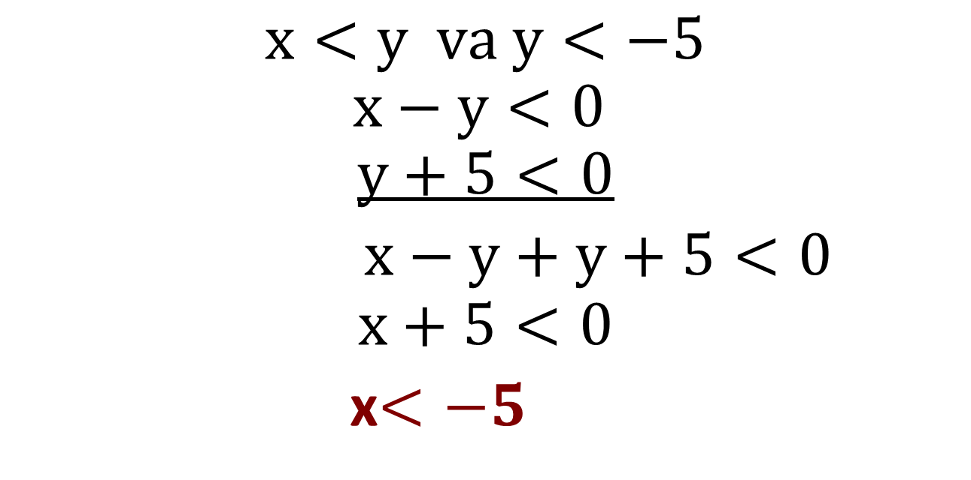
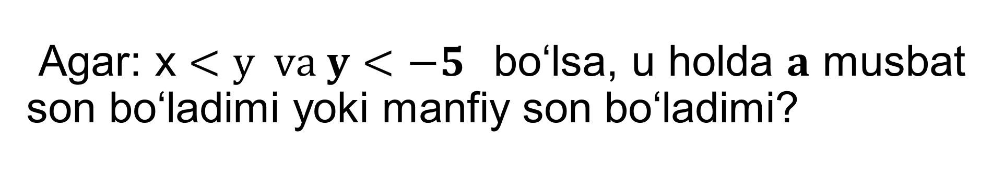
Agar: x $<y va y<−5$bo‘lsa, u holda $a$ musbat son bo‘ladimi yoki manfiy son bo‘ladimi?
Mustaxkamlash
$$x<y va y<−5$$
$$x−y<0$$
$$y+5<0$$
$x−y+y+5<0$
$$x+5<0$$
x$<−5$
Javob: a manfiy son bo‘ladi

Slide 4

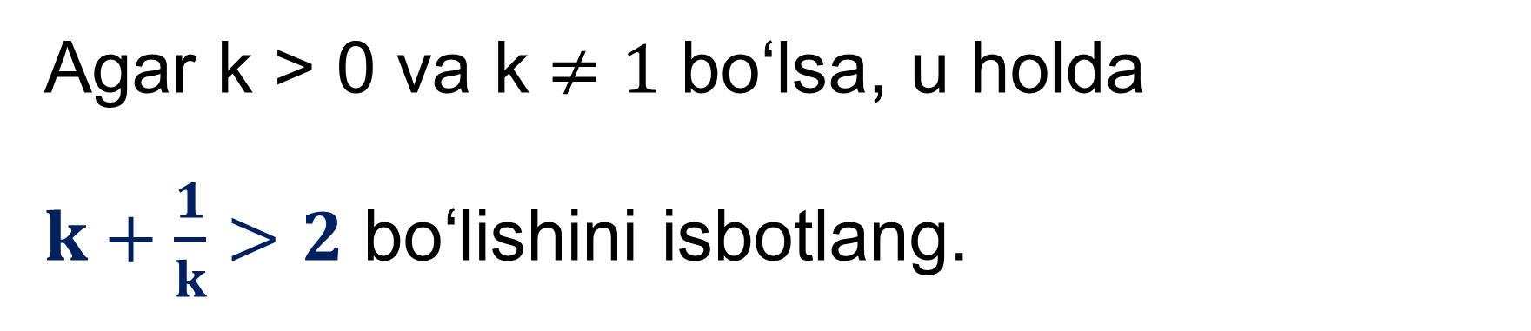
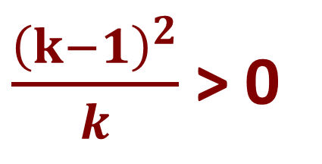
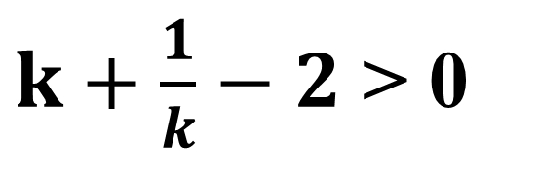
Agar k > 0 va k$≠1$ bo‘lsa, u holda
$k+\frac{1}{k}>2$ bo‘lishini isbotlang.
Masala
$k+\frac{1}{k}−2$ > 0
$$k+\frac{1}{k}−2=\frac{k^{2}+1−2k}{k}=\frac{{\left(k−1\right)}^{2}}{k}$$
$\frac{{\left(k−1\right)}^{2}}{k}$ > 0

Slide 5
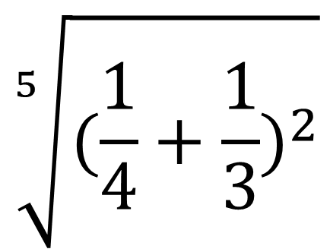
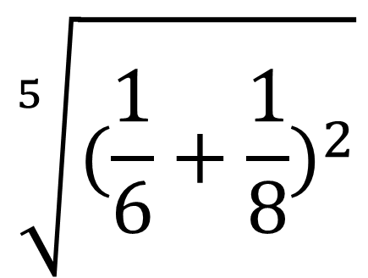
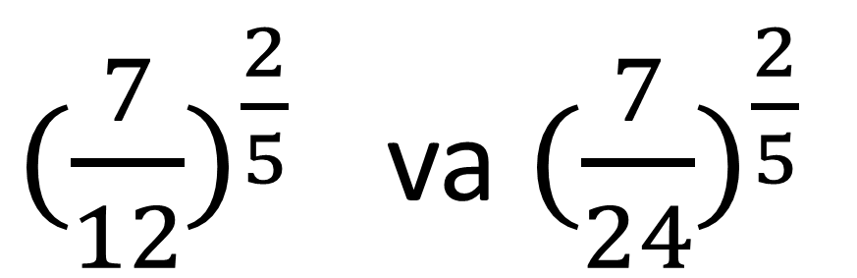
Taqqoslang:
$$\sqrt[5]{{(\frac{1}{4}+\frac{1}{3})}^{2}}$$
$$\sqrt[5]{{(\frac{1}{6}+\frac{1}{8})}^{2}}$$
>
va
${(\frac{7}{12})}^{\frac{2}{5}}$ ${\text{va} (\frac{7}{24})}^{\frac{2}{5}}$
>

Slide 6
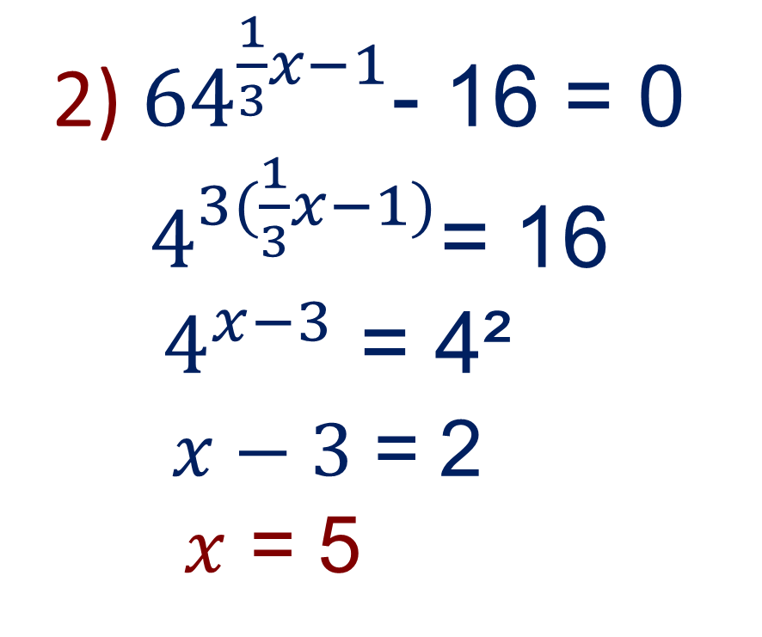
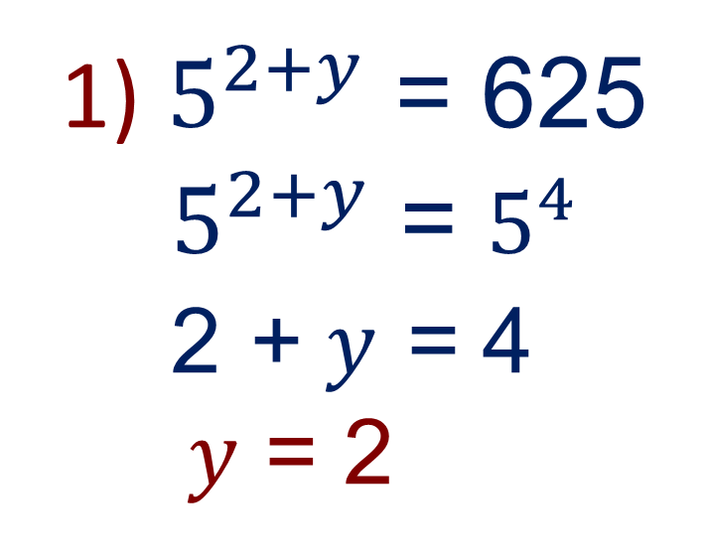
Tenglamani yeching:
2) ${64}^{\frac{1}{3}x−1}$- 16 = 0
$4^{3(\frac{1}{3}x−1)}$= 16
${ 4}^{x−3}$ = 4²
$x−3$= 2
$x$ = 5
1) $5^{2+y}$ = 625
$5^{2+y}$ = $5^{4}$
2 + $y$ = 4
$y$ = 2

Slide 7
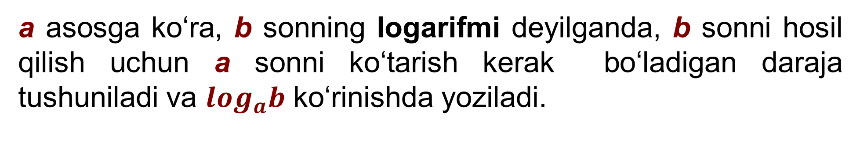
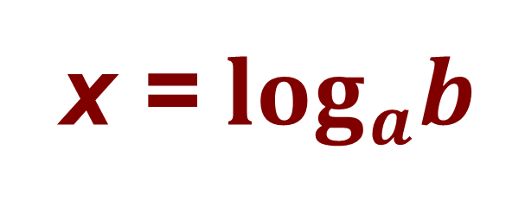
№217. Hisoblang
2
a asosga ko‘ra, b sonning logarifmi deyilganda, b sonni hosil qilish uchun a sonni ko‘tarish kerak bo‘ladigan daraja tushuniladi va $\log_{a}b$ ko‘rinishda yoziladi.
x = $\log_{a}b$
x
a b
=

Slide 8
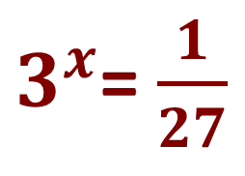
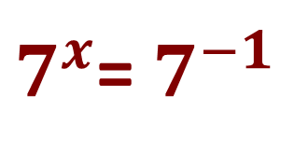
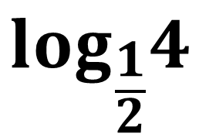
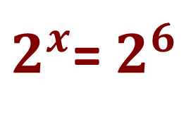
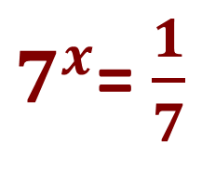
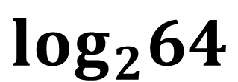
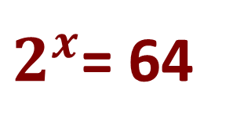
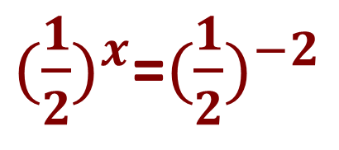
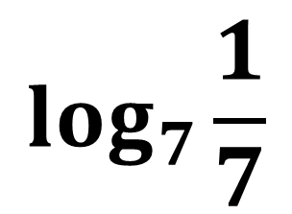
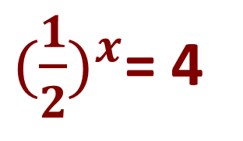
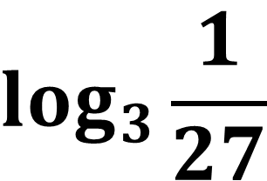
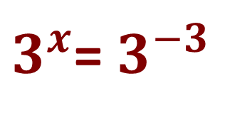
№217. Hisoblang
$$\log_{2}64$$
= 6
$2^{x}$= 64
$2^{x}$= $2^{6}$
$$\log_{3}\frac{1}{27}$$
= -3
$3^{x}$= $\frac{1}{27}$
$3^{x}$= $3^{−3}$
${(\frac{1}{2})}^{x}$= 4
${(\frac{1}{2})}^{x}$=${(\frac{1}{2})}^{−2}$
$$\log_{\frac{1}{2}}4$$
= -2
$$\log_{7}\frac{1}{7}$$
$7^{x}$= $\frac{1}{7}$
$7^{x}$= $7^{−1}$
= -1

Slide 9
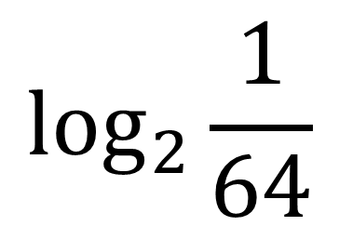
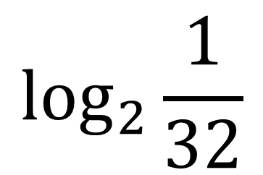
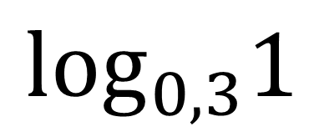
Hisoblang:
$$\log_{2}\frac{1}{64}$$
= 3
= -6
= 2
$$\log_{2}\frac{1}{32}$$
= -5
= 4
$$\log_{0,3}1$$
= 0
= 3

Slide 10
Darslikning 85 - betida berilgan
216 – 218- misollarni yechish.
Mustaqil bajarish uchun topshiriqlar:

