Slide 1

ALGEBRA
8-sinf
Mavzu: Sonli tengsizliklarni darajaga ko‘tarish

Slide 2
Taqqoslang:
1.
<
<
<

Slide 3
Taqqoslang:
2.
>
>

Slide 4
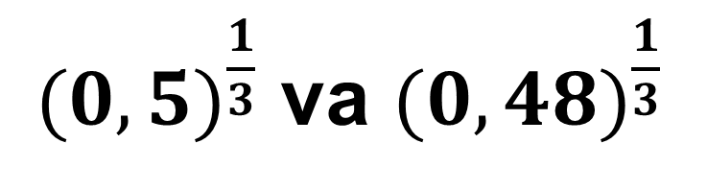
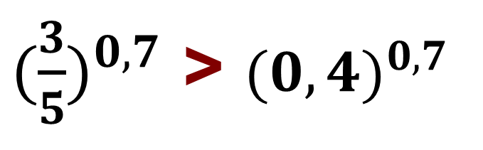
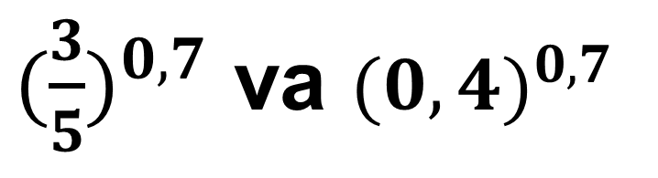
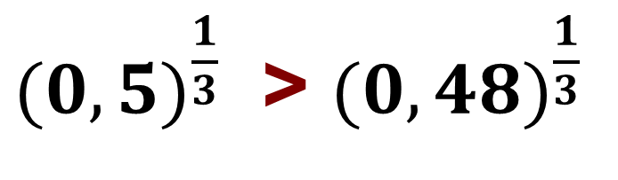
Sonli tengsizlikni darajaga ko‘tarish
Chap va o‘ng qismlari musbat bo‘lgan tengsizlikni istalgan ratsional darajaga ko‘tarish mumkin:
agar r — musbat son, а > b > 0 bo‘lsa, u holda
a^{r} > b^{r} bo‘ladi.
${(0,5)}^{\frac{1}{3}}$ va ${(0,48)}^{\frac{1}{3}}$
${(\frac{3}{5})}^{0,7}$ va ${(0,4)}^{0,7}$
${(0,5)}^{\frac{1}{3}}$ > ${(0,48)}^{\frac{1}{3}}$
${(\frac{3}{5})}^{0,7}$ > ${(0,4)}^{0,7}$

Slide 5
№ 211 Taqqoslang:
1.
>
2.
>

Slide 6
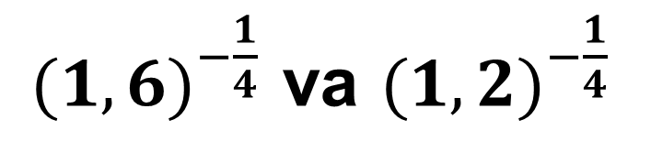
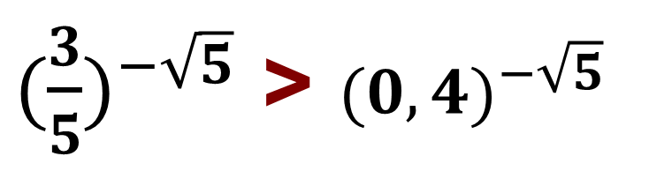
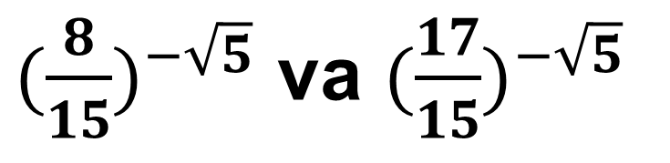
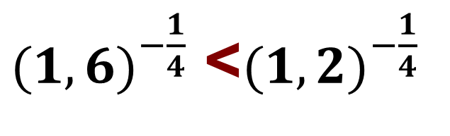
Sonli tengsizlikni darajaga ko‘tarish
Chap va o‘ng qismlari musbat bo‘lgan tengsizlikni istalgan ratsional darajaga ko‘tarish mumkin:
agar r < 0, а > b > 0 bo‘lsa, u holda
a^{r} < b^{r} bo‘ladi.
${(1,6)}^{−\frac{1}{4}}$ va ${(1,2)}^{−\frac{1}{4}}$
${(\frac{8}{15})}^{−\sqrt{5}}$ va $(\frac{17}{15})^{−\sqrt{5}}$
${(1,6)}^{−\frac{1}{4}}$ <${(1,2)}^{−\frac{1}{4}}$
${(\frac{3}{5})}^{−\sqrt{5}}$ > ${(0,4)}^{−\sqrt{5}}$

Slide 7
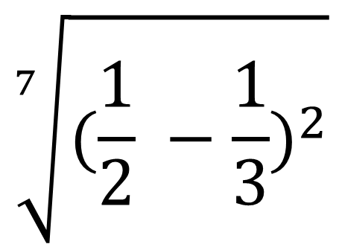
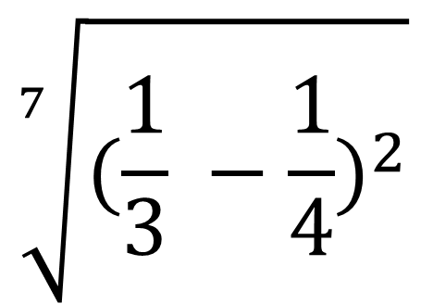
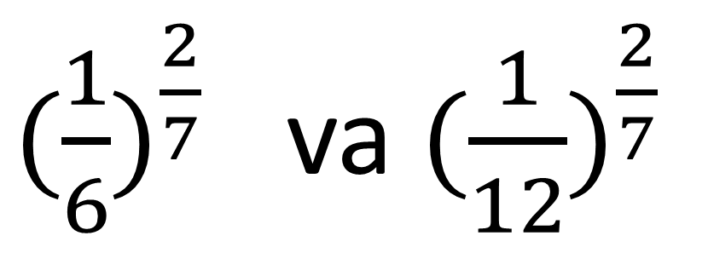
№ 213(1). Taqqoslang:
$$\sqrt[7]{{(\frac{1}{2} −\frac{1}{3})}^{2}}$$
$$\sqrt[7]{{(\frac{1}{3} −\frac{1}{4})}^{2}}$$
>
va
${(\frac{1}{6})}^{\frac{2}{7}}$ va ${(\frac{1}{12})}^{\frac{2}{7}}$
>

Slide 8
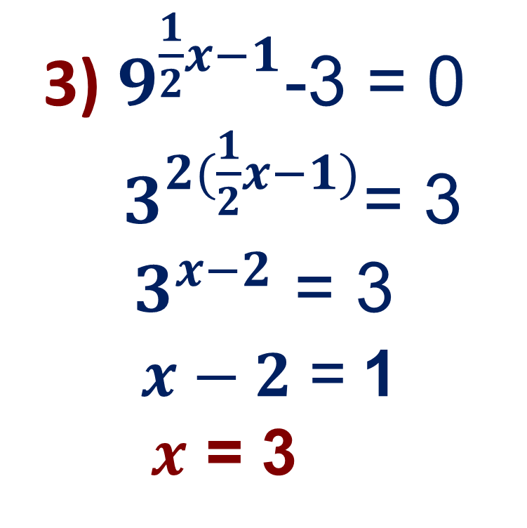
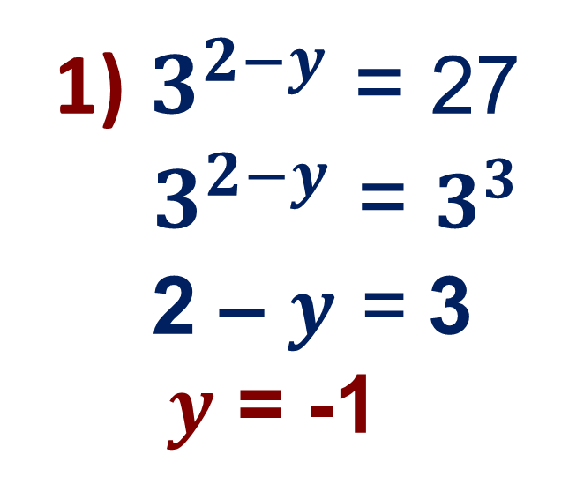
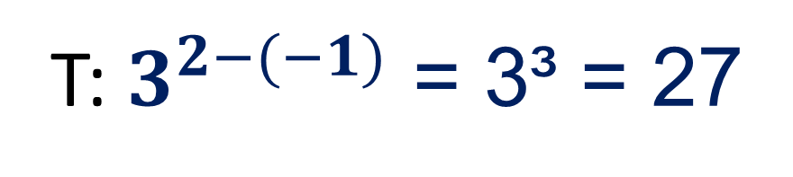
№215. Tenglamani yeching:
3) $9^{\frac{1}{2}x−1}$-3 = 0
$3^{2(\frac{1}{2}x−1)}$= 3
${ 3}^{x−2}$ = 3
$x−2$= 1
$x$ = 3
1) $3^{2−y}$ = 27
$3^{2−y}$ = $3^{3}$
2 – $y$ = 3
$y$ = -1
T: $3^{2−(−1)}$ = 3³ = 27

Slide 9
Darslikning 84 - betlarida berilgan
212 - 215 misollarni yechish.
Mustaqil bajarish uchun topshiriqlar:

