Slide 1

ALGEBRA
8-sinf
Mavzu: Sonli tengsizliklar

Slide 2
Ikki a va b sonlar taqqoslanganda:
a = b (bunda a – b = 0)
a > b (bunda a – b > 0)
a < b (bunda a – b < 0)
a ≥ b (a ≤ b)
“a katta yoki teng b dan” ,
“a kichik emas b dan”
a va b sonlarni taqqoslash, ular orasiga >,= yoki < ishoralaridan qaysinisi qo‘yilsa to‘g‘ri munosabat hosil bo‘lishini topish demakdir.

Slide 3
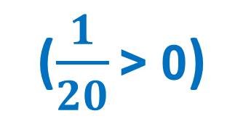
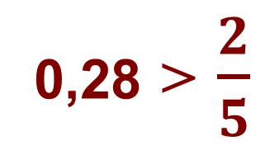
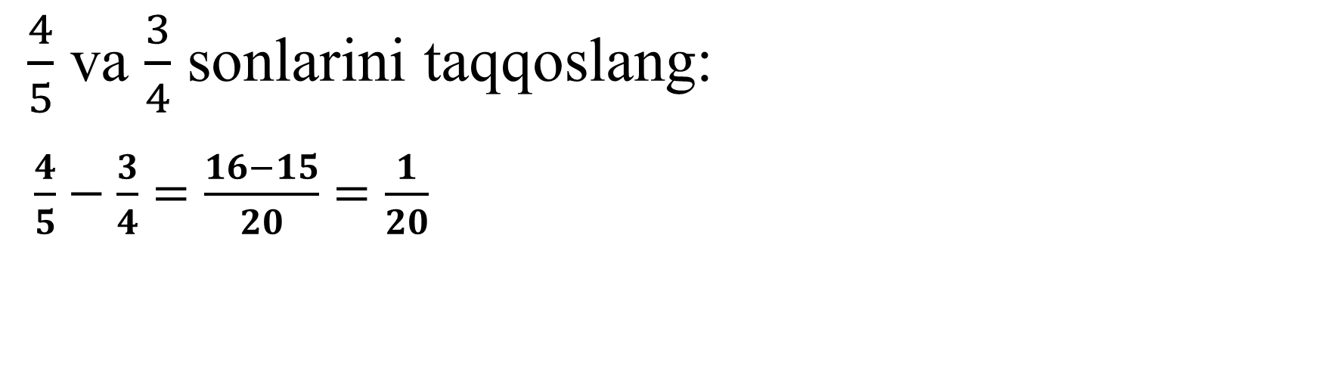
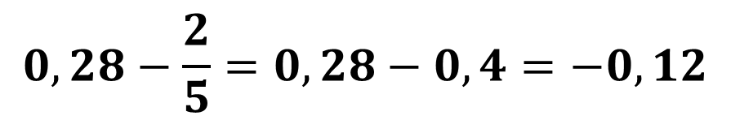
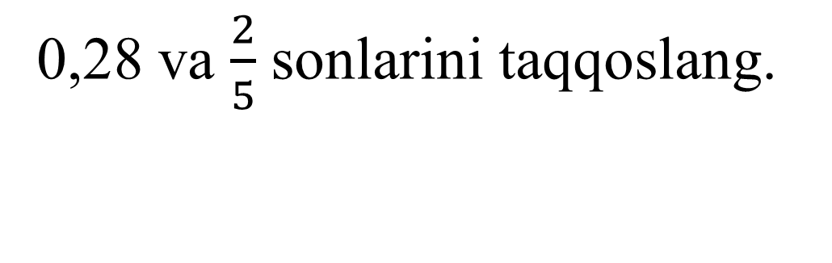
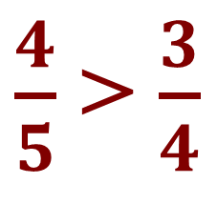
T a’ r i f. Agar a-b ayirma musbat bo‘lsa, u holda a son b sondan katta bo‘ladi. Agar a-b ayirma manfiy bo’lsa u holda a son b sondan kichik bo‘ladi.
$\frac{4}{5}$ va $\frac{3}{4}$ sonlarini taqqoslang:
$\frac{4}{5}−\frac{3}{4}=\frac{16−15}{20}=\frac{1}{20}$
$\frac{4}{5}$ > $\frac{3}{4}$
($\frac{1}{20}$ > 0)
0,28 va $\frac{2}{5}$ sonlarini taqqoslang.
0,28 > $\frac{2}{5}$
$$0,28−\frac{2}{5}=0,28−0,4=−0,12$$
(-0,12 < 0)

Slide 4
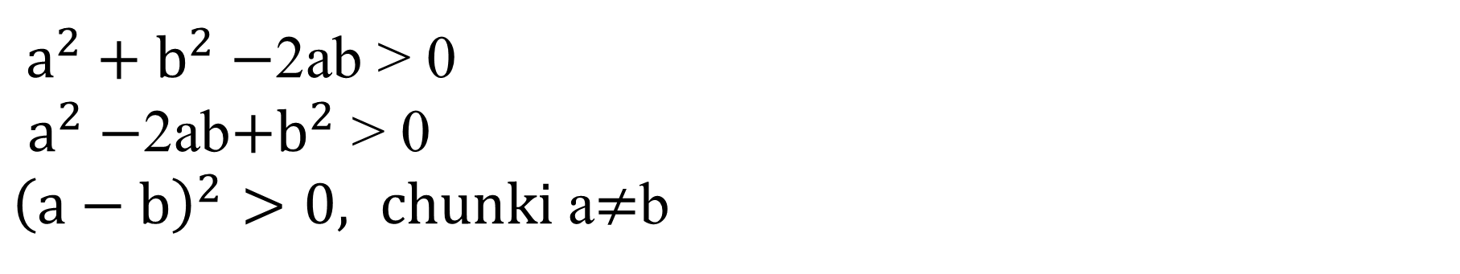
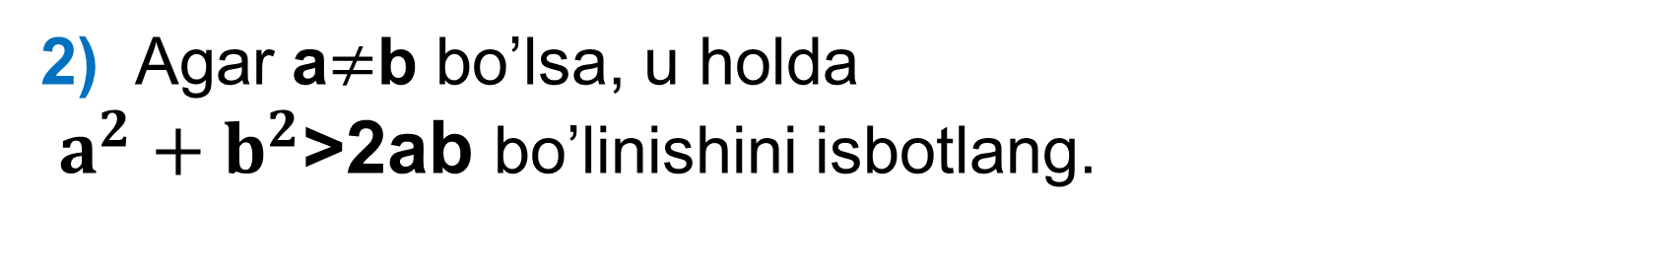
1) Agar a>b bo‘lsa, u holda b<a bo‘lishini isbotlang.
Masala
a > b tengsizlik a – b musbat son ekanini bildiradi. U holda b – a = – (a – b) – manfiy son, ya’ni b < a.
2) Agar a$≠$b bo’lsa, u holda
$a^{2}+b^{2}$>2ab bo’linishini isbotlang.
$a^{2}+b^{2}−$2ab > 0
$a^{2}−$2ab$+b^{2}$ > 0
${\left(a−b\right)}^{2}>0, chunki$a$≠$b

Slide 5
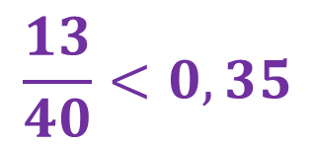
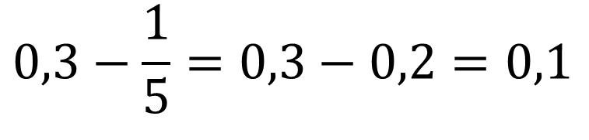

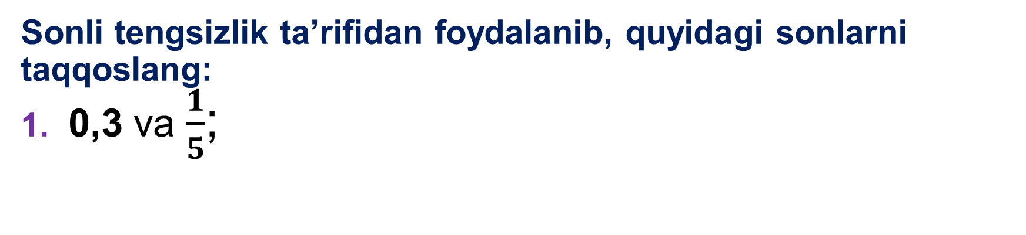
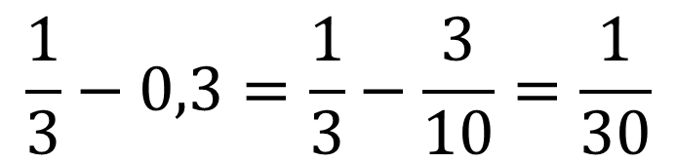
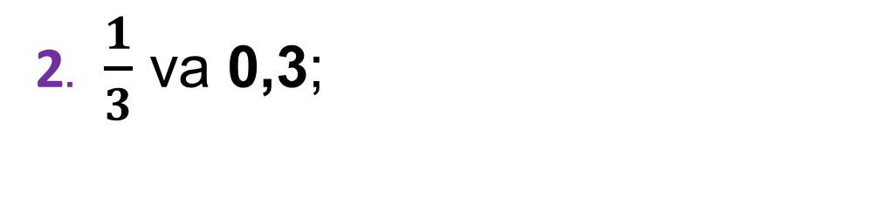
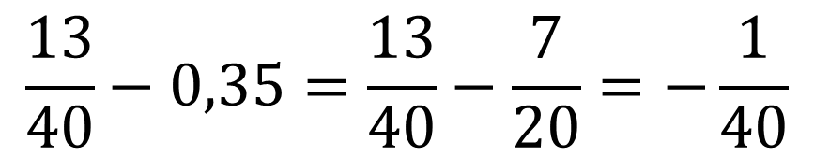

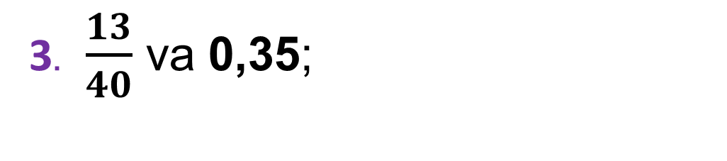
Sonli tengsizlik ta’rifidan foydalanib, quyidagi sonlarni taqqoslang:
1. 0,3 va $\frac{1}{5}$;
178-misol
$$0,3>\frac{1}{5}$$
$$0,3−\frac{1}{5}=0,3−0,2=0,1$$
$$\frac{1}{3}−0,3=\frac{1}{3}−\frac{3}{10}=\frac{1}{30}$$
$$\frac{1}{3}>0,3$$
2. $\frac{1}{3}$ va 0,3;
$$\frac{13}{40}−0,35=\frac{13}{40}−\frac{7}{20}=−\frac{1}{40}$$
$$\frac{13}{40}<0,35$$
3. $\frac{13}{40}$ va 0,35;

Slide 6


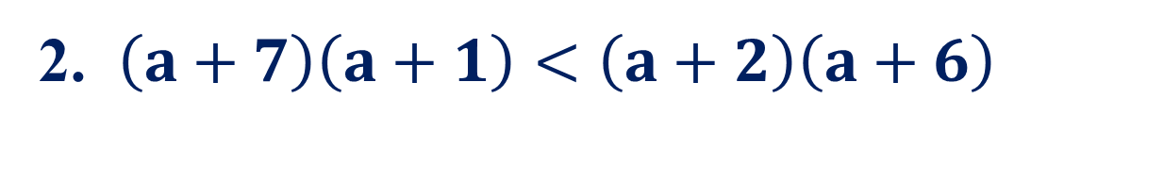

1. $a^{3}<(a+1)(a^{2}−a+1)$
181-misol
a ning istalgan qiymatida quyidagi tengsizlik o‘rinli ekanligini isbotlang:
$$−1<0$$
$$a^{3}−\left(a+1\right)\left(a^{2}−a+1\right)=a^{3}−a^{3}−1=−1;$$
2. $\left(a+7\right)\left(a+1\right)<\left(a+2\right)\left(a+6\right)$
$$−5<0$$
$$a^{2}+7a+a+7−\left(a^{2}+2a+6a+12\right)=$$
$$=a^{2}+8a+7−a^{2}−8a−12=−5;$$

Slide 7
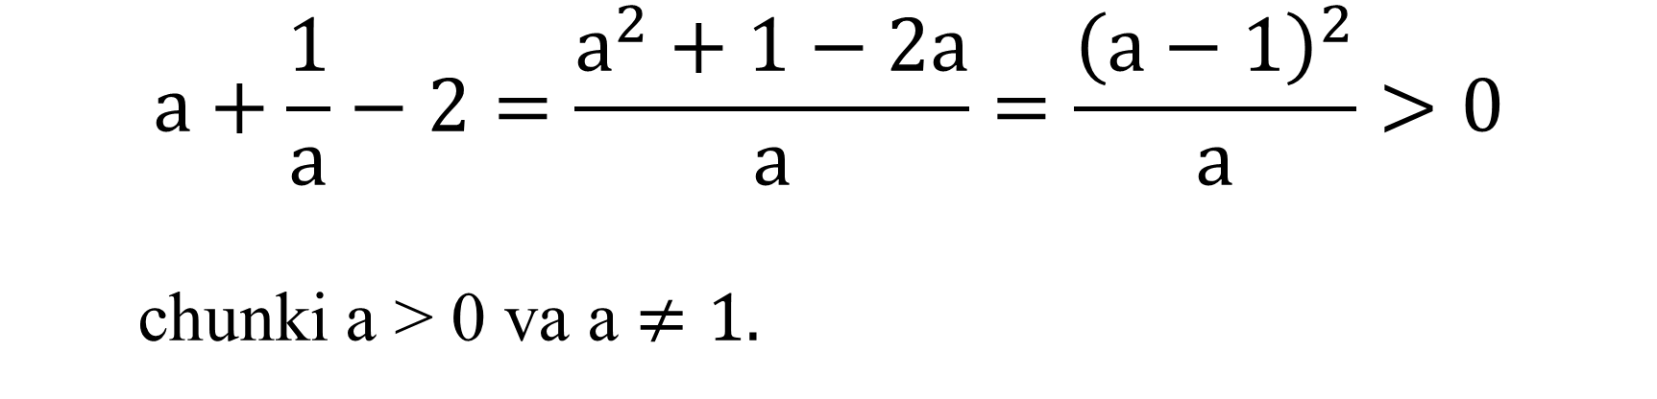
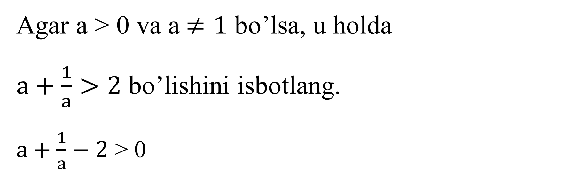
Agar a > 0 va a$≠1$ bo’lsa, u holda
$a+\frac{1}{a}>2$ bo’lishini isbotlang.
$a+\frac{1}{a}−2$ > 0
Masala
$$a+\frac{1}{a}−2=\frac{a^{2}+1−2a}{a}=\frac{{\left(a−1\right)}^{2}}{a}>0$$
chunki a > 0 va a $≠1.$

Slide 8
Darslikning 71- betida berilgan
179 - 182- topshiriqlarni bajarish.
Mustaqil bajarish uchun topshiriqlar:

