Slide 1

ALGEBRA
8- SINF
Mavzu: Misollar yechish

Slide 2
Taqqoslang:
1.
2.
<
>
<
>

Slide 3
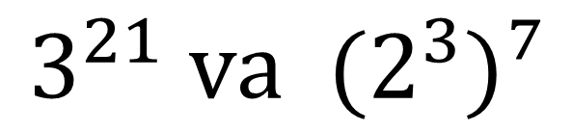
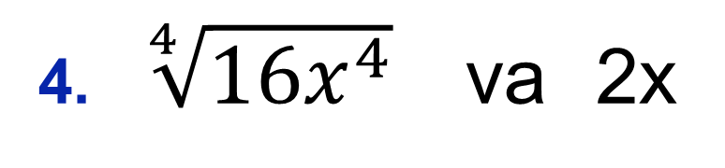
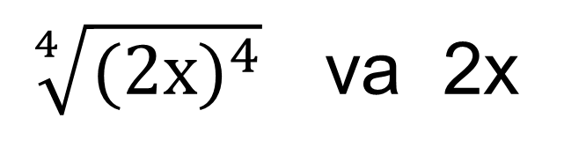
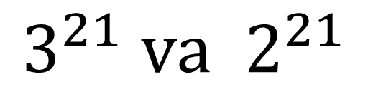
Taqqoslang:
3.
4. $\sqrt[4]{{16x}^{4}}$ va 2x
>
=
$$3^{21} va (2^{3})⁷$$
$\sqrt[4]{{(2x)}^{4}}$ va 2x
>
=
2x va 2x
$$3^{21} va 2^{21}$$
=
>

Slide 4
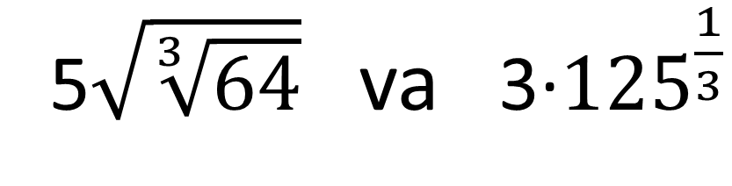
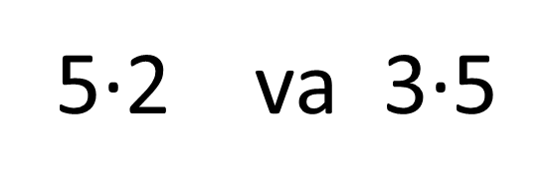
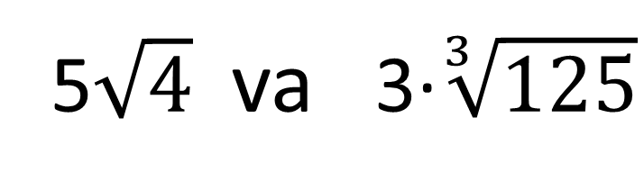
Taqqoslang:
5$\sqrt{\sqrt[3]{64}}$ va 3·${125}^{\frac{1}{3}}$
5.
<
5$\sqrt{4}$ va 3·$\sqrt[3]{125}$
<
5·2 va 3·5
<

Slide 5
Darajaning xossalaridan foydalanib hisoblang:
1.
2.
3

Slide 6
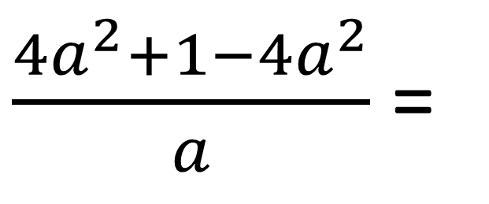

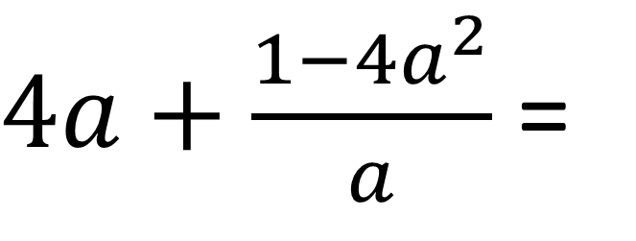
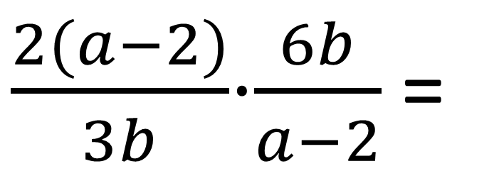
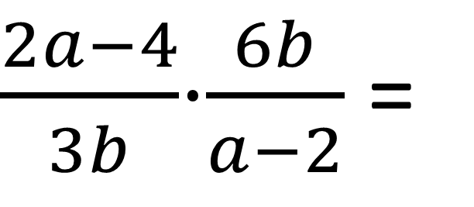
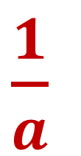
№2. Amallarni bajaring.
$4a+\frac{1−{4a}^{2}}{a}$ =
$\frac{{4a}^{2}+1−{4a}^{2}}{a}$ =
$\frac{1}{a}$
1.
$\frac{2a−4}{3b}$⋅$\frac{6b}{a−2}$ =
$\frac{2(a−2)}{3b}$⋅$\frac{6b}{a−2}$=
3.
$$4$$

Slide 7
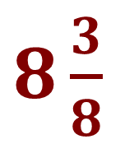
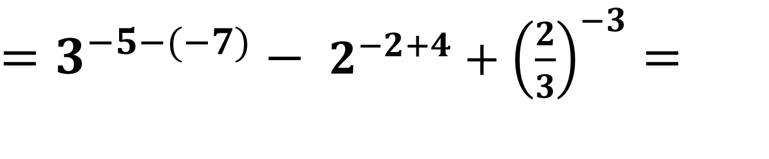
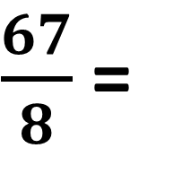
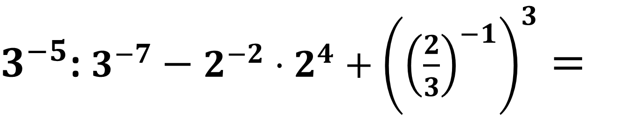
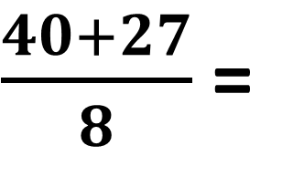
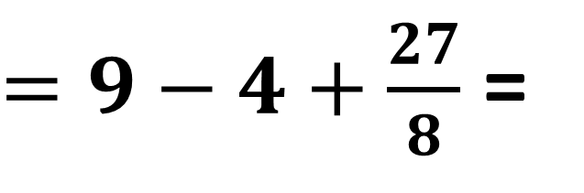
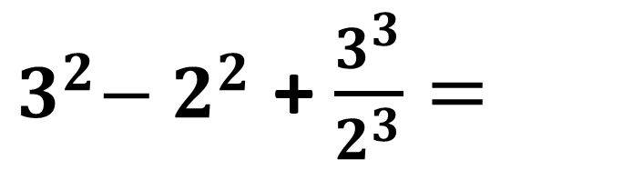
№4. Hisoblang:
$3^{−5}$: $3^{−7}−2^{−2}⋅2^{4}+{\left({\left(\frac{2}{3}\right)}^{−1}\right)}^{3}$ $=$
1.
${=3}^{−5−(−7)}$ $−$ $2^{−2+4}+{\left(\frac{2}{3}\right)}^{−3}=$
${ 3}^{2}−{ 2}^{2}$ + $\frac{3^{3}}{2^{3}}=$
$=9−4+\frac{27}{8}$ =
$\frac{40+27}{8}$ =
$\frac{67}{8}$ =
$8\frac{3}{8}$

Slide 8
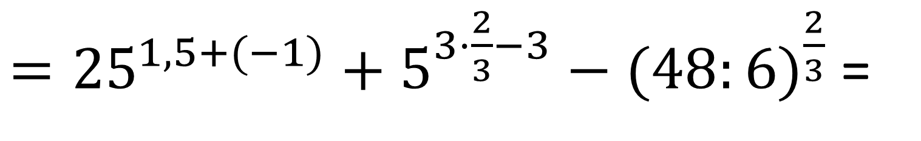
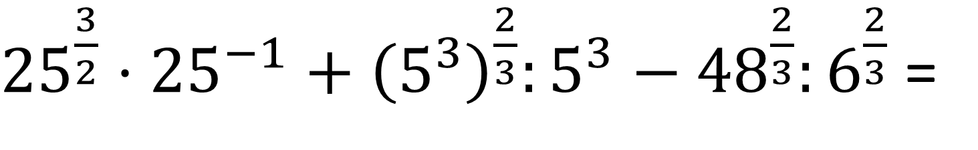
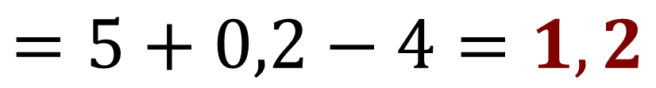
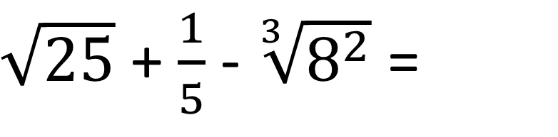
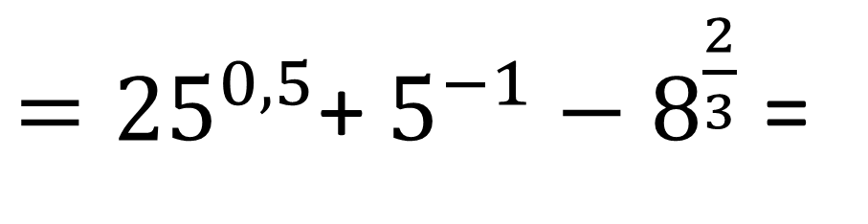
${25}^{\frac{3}{2}}⋅{25}^{−1}+{\left(5^{3}\right)}^{\frac{2}{3}}:5^{3}−{48}^{\frac{2}{3}}:6^{\frac{2}{3}}$ =
3.
$={25}^{1,5+(−1)}+5^{3⋅\frac{2}{3}−3}−(48:{6)}^{\frac{2}{3}}$ =
${=25}^{0,5}$+ $5^{−1}−$ $8^{\frac{2}{3}}$ =
$\sqrt{25}$ + $\frac{1}{5}$ - $\sqrt[3]{8^{2}}$ =
$$=5+0,2−4=1,2$$

Slide 9
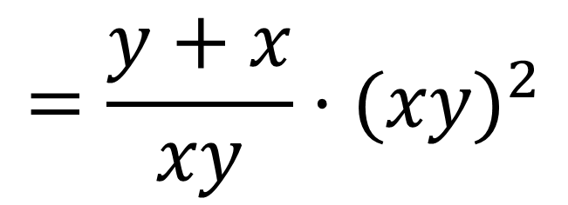
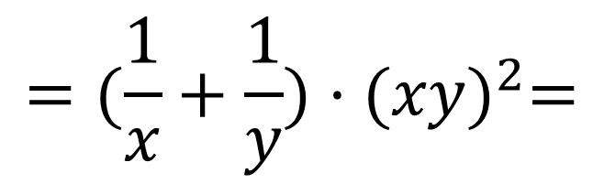
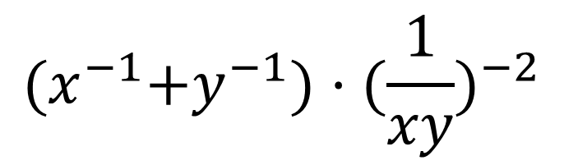
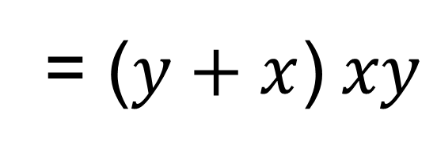
№5. Ifodani soddalashtiring:
1.
$${(x}^{−1}+y^{−1})·{(\frac{1}{xy})}^{−2}$$
$${=(\frac{1}{x}+\frac{1}{y})·(xy)}^{2}=$$
2.
$${=\frac{y+x}{xy}·(xy)}^{2}$$
= ($y+x$) $xy$

Slide 10
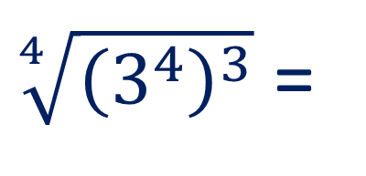
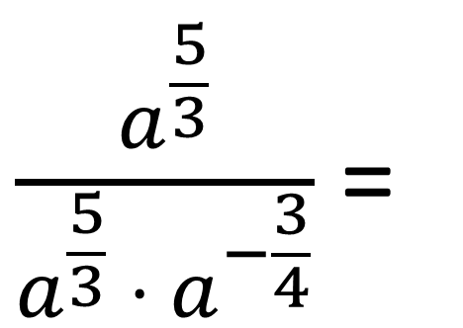
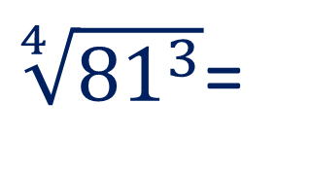
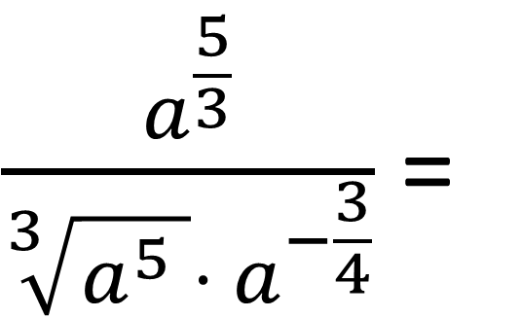
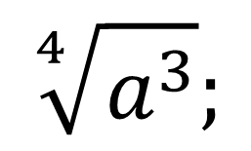
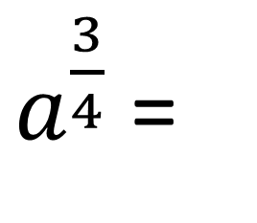
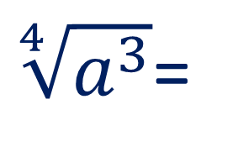
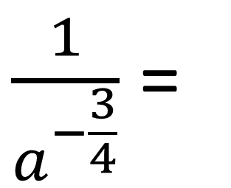
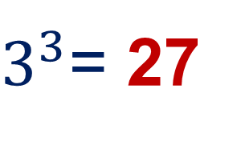
№6. ifodani soddalashtiring va a = 81
bo‘lganda son qiymatini toping:
$\frac{a^{\frac{5}{3}}}{\sqrt[3]{a^{5} }⋅ a^{−\frac{3}{4}}}$ =
$\frac{a^{\frac{5}{3}}}{a^{\frac{5}{3}} ⋅{ a}^{−\frac{3}{4}}}$ =
$\frac{1}{a^{−\frac{3}{4}}}$ =
$a^{\frac{3}{4}}$ =
$$\sqrt[4]{a^{3}};$$
$\sqrt[4]{a^{3}}$=
$\sqrt[4]{{81}^{3}}$=
$\sqrt[4]{{\left(3^{4}\right)}^{3}}$ =
$3^{3}$= 27

Slide 11
Darslikda berilgan
“O‘zingizni tekshirib ko‘ring” topshiriqlarni bajarish (57- bet).
Mustaqil bajarish uchun topshiriqlar:

