Slide 1

ALGEBRA
8- SINF
Mavzu: Ratsional
ko‘rsatkichli daraja
va uning xossalari

Slide 2
Kasrni qisqartiring:
1.
2.
3.

Slide 3
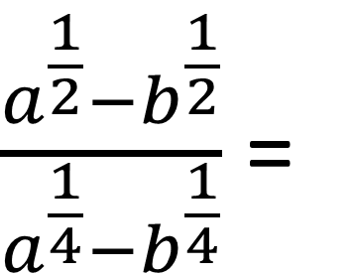
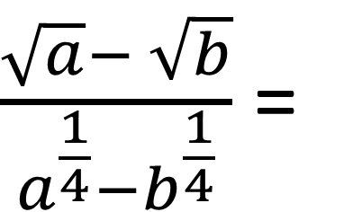
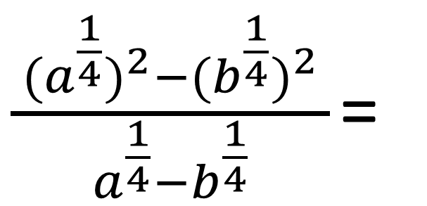
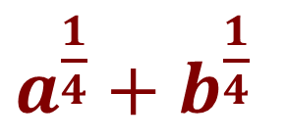
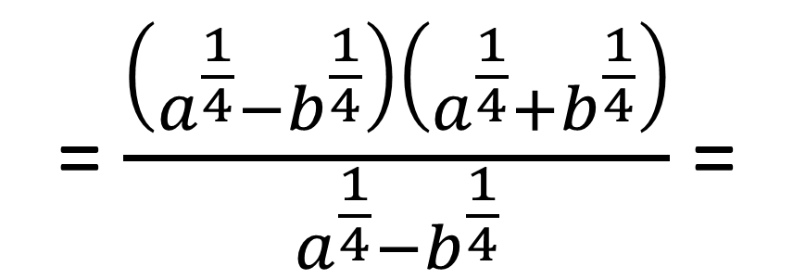
№126. Ifodani soddalashtiring:
$\frac{a^{\frac{1}{2}}−b^{\frac{1}{2}}}{a^{\frac{1}{4}}−b^{\frac{1}{4}}}$ =
$\frac{ (a^{\frac{1}{4}})^{2}−(b^{\frac{1}{4}})^{2} }{a^{\frac{1}{4}}−b^{\frac{1}{4}}}$ =
1
$\frac{\sqrt{a}− \sqrt{b}}{a^{\frac{1}{4}}−b^{\frac{1}{4}}}$ =
2
= $\frac{\left(a^{\frac{1}{4}}−b^{\frac{1}{4}}\right)\left(a^{\frac{1}{4}}+b^{\frac{1}{4}}\right)}{a^{\frac{1}{4}}−b^{\frac{1}{4}}}$ =
$a^{\frac{1}{4}}+b^{\frac{1}{4}}$

Slide 4
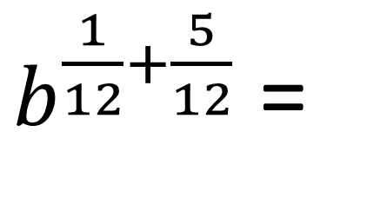
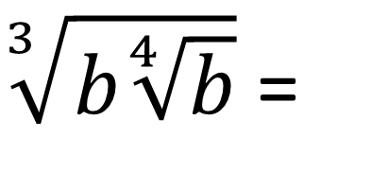
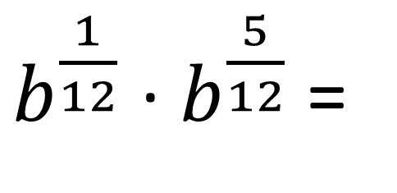
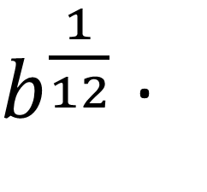
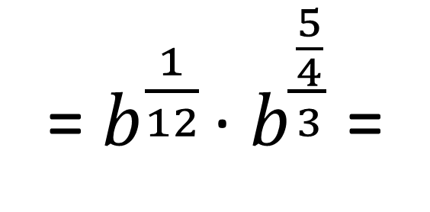
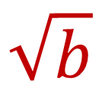
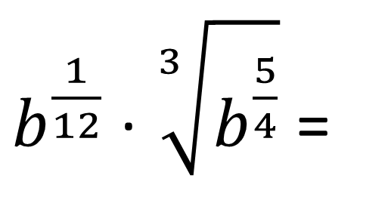
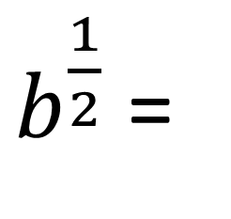
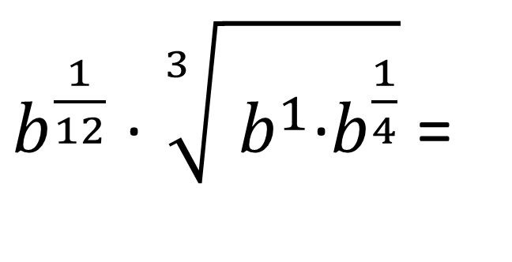
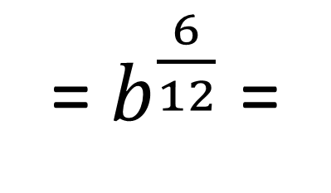
№126. Ifodani soddalashtiring:
$b^{\frac{1}{12}}$ · $\sqrt[3]{ b^{1}\text{·}b^{\frac{1}{4}}}$ =
$b^{\frac{1}{12}}$ · $\sqrt[3]{b^{\frac{5}{4}}}$ =
$b^{\frac{1}{12}}$ ·
$\sqrt[3]{b\sqrt[4]{b}}$ =
2
2
=${ b}^{\frac{1}{12}}$ · $b^{\frac{\frac{5}{4}}{3}}$ =
$b^{\frac{1}{12}}$ · $b^{\frac{5}{12}}$ =
$b^{\frac{1}{12}+\frac{5}{12}}$ =
= $b^{\frac{6}{12}}$ =
$b^{\frac{1}{2}}$ =
$$\sqrt{b}$$

Slide 5
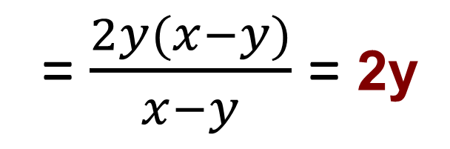
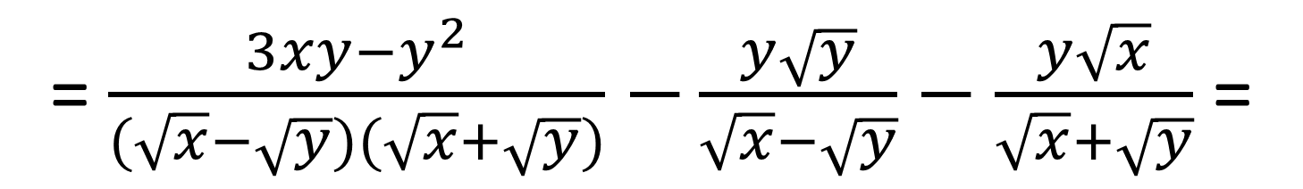
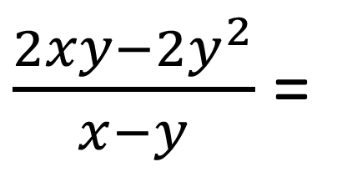
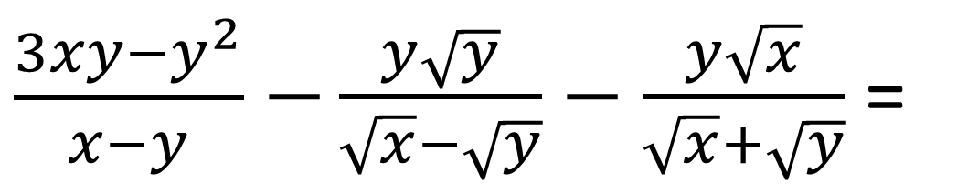
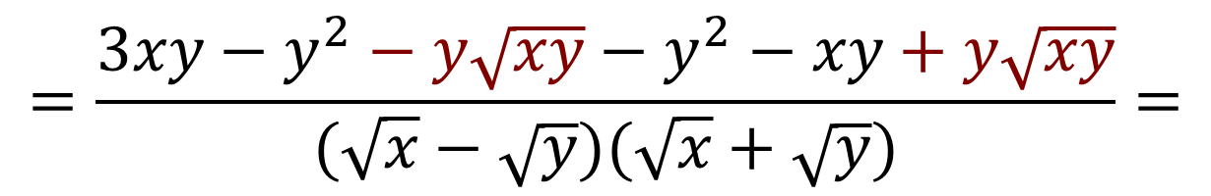
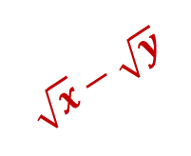
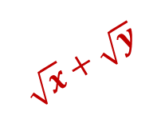
№128. Ifodani soddalashtiring:
$\frac{3xy−y^{2}}{x−y}$ $−\frac{y\sqrt{y}}{\sqrt{x}−\sqrt{y}}−\frac{y\sqrt{x}}{\sqrt{x}+\sqrt{y}}$ =
2
2
$$\sqrt{x}+\sqrt{y}$$
$$\sqrt{x}−\sqrt{y}$$
= $\frac{3xy−y^{2}}{(\sqrt{x}−\sqrt{y})(\sqrt{x}+\sqrt{y})}$ $−\frac{y\sqrt{y}}{\sqrt{x}−\sqrt{y}}−\frac{y\sqrt{x}}{\sqrt{x}+\sqrt{y}}$ =
$$=\frac{3xy−y^{2}−y\sqrt{xy}−y^{2}−xy+y\sqrt{xy}}{(\sqrt{x}−\sqrt{y})(\sqrt{x}+\sqrt{y})}=$$
$\frac{2xy−{2y}^{2}}{x−y}$ =
= $\frac{2y(x−y)}{x−y}$ = 2y

Slide 6
Ifodani soddalashtiring:
6

Slide 7

Darslikda berilgan
126- 128- topshiriqlarni bajarish (49- bet).
Mustaqil bajarish uchun topshiriqlar:

Slide 8
Nuqtalar o‘rnini to‘ldiring:
2
1.
2.

Slide 9
Taqqoslang:
1.
<
2.
>
3.
>

