Slide 1

ALGEBRA
8- SINF
Mavzu: Ratsional
ko‘rsatkichli daraja
va uning xossalari

Slide 2
To‘g‘ri javobni toping:
1.
2.
3.

Slide 3
Hisoblang:
Kasrnig kvadrat ildizi
1)
2)

Slide 4
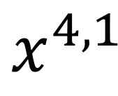
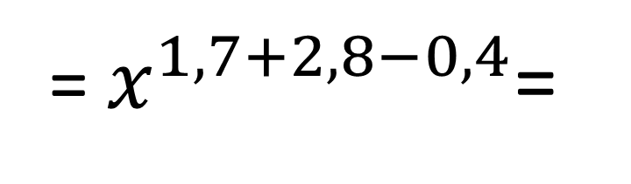
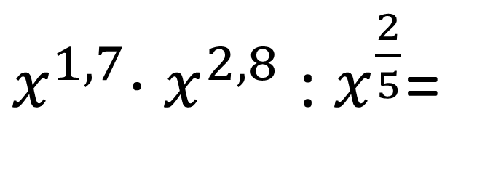
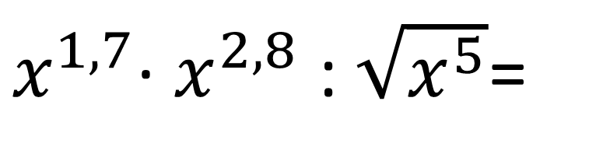
№122. Ratsional ko‘rsatkichli daraja ko‘rinishiga keltiring:
1.
3.
$x^{1,7}$∙ $x^{2,8}$ : $x^{\frac{2}{5}}$=
$x^{1,7}$∙ $x^{2,8}$ : $\sqrt{x^{5}}$=
5.
= $x^{1,7+2,8−0,4}$=
$$x^{4,1}$$

Slide 5
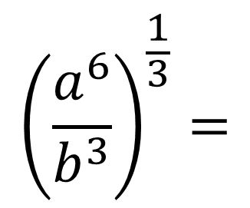

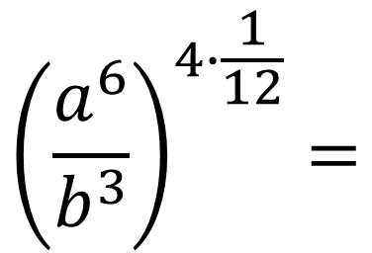
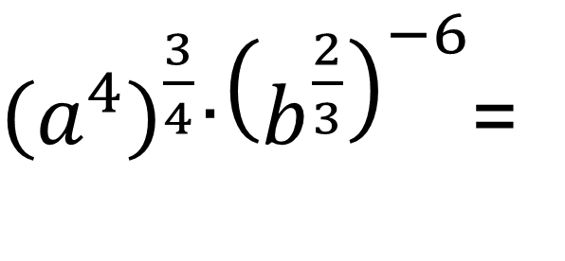
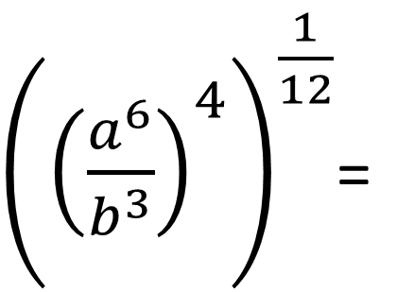
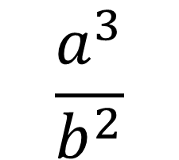

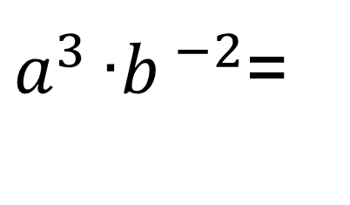
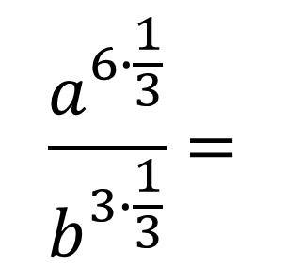
№123. Ifodani soddalashtiring:
${\left(a^{4}\right)}^{\frac{3}{4}}$∙${\left(b^{\frac{2}{3}}\right)}^{−6}$=
$$\frac{a^{3}}{b^{2}}$$
$a^{4 ∙ \frac{3}{4 }}$∙$b^{\frac{2}{3} ∙(−6)}$=
$a^{3 }$∙$b^{ −2}$=
1.
${\left({\left(\frac{a^{6}}{b^{3}}\right)}^{4}\right)}^{\frac{1}{12}}$=
$${\left(\frac{a^{6}}{b^{3}}\right)}^{4∙\frac{1}{12}}=$$
$${\left(\frac{a^{6}}{b^{3}}\right)}^{\frac{1}{3}}=$$
$$\frac{a^{6∙\frac{1}{3}}}{b^{3∙\frac{1}{3}}}=$$
$$\frac{a^{2}}{b}$$
2.

Slide 6
Kasrni qisqartiring:
1.
2.
3.

Slide 7
Nuqtalar o‘rnini to‘ldiring:
1.
2
2.

Slide 8
Ifodani soddalashtiring:
6

Slide 9

Darslikda berilgan
121 - 124 - topshiriqlarni bajarish (48-bet).
Mustaqil bajarish uchun topshiriqlar:

Slide 10
Taqqoslang:
1.
<
2.
>
3.
>

