Slide 1
ALGEBRA
8- SINF
MAVZU: NATURAL
KO‘RSATKICHLI DARAJANING ARIFMETIK ILDIZI
VA UNING XOSSALARI

Slide 2
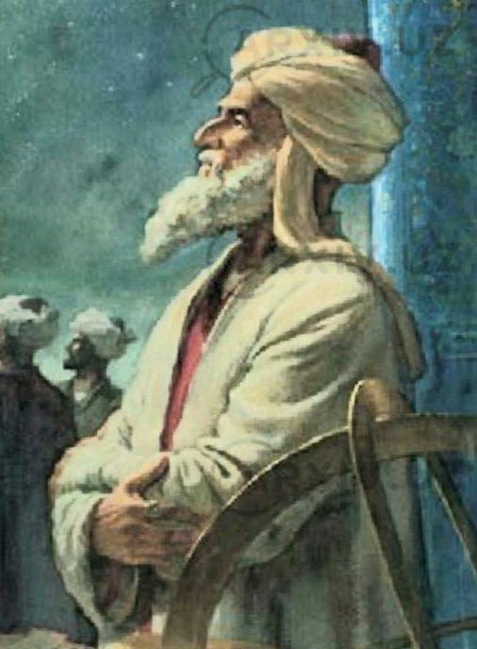
O‘rta osiyolik atoqli matematik va astronom Jamshid ibn Ma’sud ibn Mahmud G‘iyosiddin al-Koshiy sonlardan istalgan n- darajali ildiz chiqarish amalini kashf qildi.
“Arifmetika kaliti” nomli asarining beshinchi bobida natural ko‘rsatkichli darajaning arifmetik ildizi haqida fikr yuritiladi.
G‘iyosiddin al-Koshiy

Slide 3
Ta‘rif. a nomanfiy sonning n $≥$ 2 natural ko‘rsatkichli arifmetik ildizi deb, n- darajasi $a$ ga teng bo‘lgan nomanfiy songa aytiladi.
$$\sqrt[n]{a}$$
a sonning n - darajali arifmetik ildizi
$\sqrt{a}$ kvadrat ildiz
$\sqrt[3]{a}$ kub ildiz
$\sqrt[4]{a}$ 4- darajali ildiz

Slide 4
$$\sqrt[n]{a}=b$$
a = b∙b∙b∙b∙∙∙b
n marta
$$\sqrt{25}=5$$
$\sqrt[3]{27}=$ $\sqrt[3]{3∙3∙3}=3$
$\sqrt[4]{81}$ = $\sqrt[4]{3∙3∙3∙3}=$ $3$
$\sqrt[3]{8 }$ = 2
$$\sqrt[5]{32}=2$$
$$\sqrt[4]{16}=\sqrt[4]{2^{4}}=2$$

Slide 5
Agar a ≥ 0 bo‘lsa, u holda
( $\sqrt[n]{a}$ )^{n} = $a, \sqrt[n]{a^{n}}=a.$
( $\sqrt[5]{7}$ )⁵ = 7
$\sqrt[6]{{15}^{6}}$ = 15
$$\sqrt[3]{{(3}^{4})^{3}}= 3^{4}=81$$

Slide 6
Istalgan toq 2k+1 natural son uchun a<0 bo‘lganda x^{2k+1}=a tenglama faqat bitta manfiy ildizga ega. $\sqrt[2k+1]{a}$ - manfiy sonning toq darajali ildizi.
$\sqrt[3]{−27 }$= - 3
$\sqrt[5]{−32 }$ = -2
$$\sqrt[5]{−243 }=− \sqrt[5]{243 }=−3$$

Slide 7
Hisoblang:
106-mashq
$$\sqrt[6]{{(6}^{2})^{3}}=$$
1)$\sqrt[6]{{36}^{3}}=$
$$\sqrt[6]{6^{6}}$$
$$=6$$
3) $\sqrt[4]{({\frac{1}{25})}^{2}}=\sqrt[4]{({\frac{1}{5})}^{4}}=\frac{1}{5}$
5) $\sqrt[7]{{2∙4}^{3}}=\sqrt[7]{{2∙2}^{6}}=\sqrt[7]{2^{7}}=2$

Slide 8
Hisoblang:
107-mashq
1) $\sqrt[3]{{10}^{6}}=\sqrt[3]{{(10}^{2})^{3}}= {10}^{2}=100$
2) $\sqrt[3]{3^{12}}=\sqrt[3]{{(3}^{4})^{3}}= 3^{4}=81$
3) $\sqrt[4]{({\frac{1}{2})}^{12}}=\sqrt[4]{({\frac{1}{2})}^{3∙4}}=\frac{1}{8}$

Slide 9
Hisoblang:
111-mashq
1)$\sqrt[3]{−125}+\frac{1}{8}\sqrt[6]{64}$
= - 4,75
3)$−\frac{1}{3}\sqrt[4]{81}+\sqrt[4]{625}$
= 4
5) $\sqrt[4]{0,0001}$ - 2$\sqrt{0,25 }$+$\sqrt[5]{\frac{1}{32}}$
= - 0,4

Slide 10
Darslikda berilgan 106-, 108-,109 – topshiriqlarni bajarish (41-bet).
Mustaqil bajarish uchun topshiriqlar:

