Slide 1
ALGEBRA
8- SINF
Mavzu: Kasr-ratsional ifodalarni ayniy almashtirish

Slide 2
Kasr-ratsional ifoda
Arifmetik amallar belgilari bilan birlashtirilgan algebraik kasrlardan tuzilgan
ifoda kasr-ratsional ifoda deyiladi.
$\frac{a−b}{a^{2}}$ ∙ ( $\frac{b^{2}+ab}{b}$ - $\frac{b^{2}}{(a−b)²}$)
a ≠0, b≠0

Slide 3
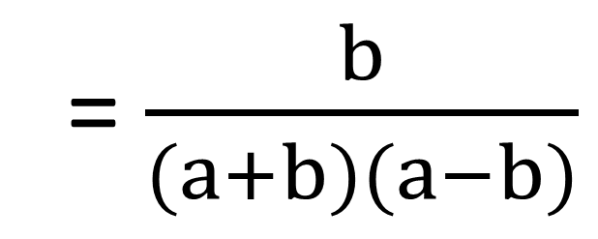
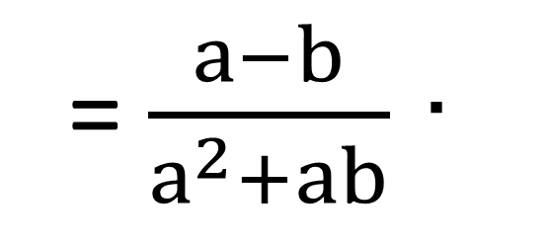
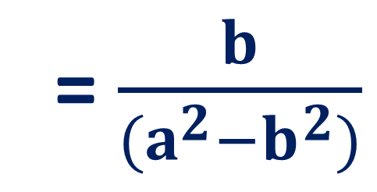
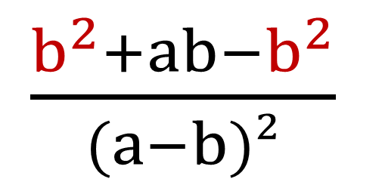
Kasr-ratsional ifoda
$\frac{a−b}{a^{2}+ab}$ ∙ ( $\frac{b^{2}+ab}{(a−b)²}$ - $\frac{b^{2}}{(a−b)²}$) =
= $\frac{a−b}{a^{2}+ab}$ ∙
$\frac{b^{2}+ab−b^{2}}{(a−b)²}$
$=\frac{a−b}{a(a+b)}$∙ $\frac{ab}{(a−b)²}=$
= $\frac{b}{(a+b)(a−b)}$
= $\frac{b}{(a^{2}−b^{2})}$

Slide 4
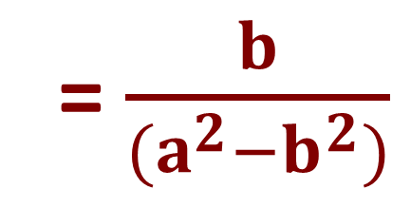


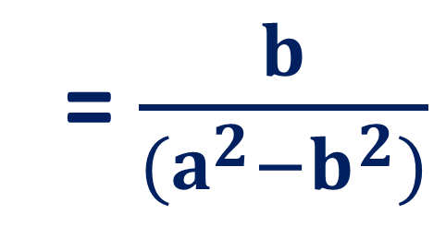
Kasr-ratsional ifoda
$\frac{a−b}{a^{2}+ab}$ ∙ ( $\frac{b^{2}+ab}{(a−b)²}$ - $\frac{b^{2}}{(a−b)²}$)
= $\frac{b}{(a^{2}−b^{2})}$
$1) \frac{b^{2}+ab}{(a−b)²}$ - $\frac{b^{2}}{(a−b)²}$
$= \frac{b^{2}+ab−b^{2}}{(a−b)²}$ =
$$\frac{ab}{(a−b)²}$$
2) $\frac{a−b}{a^{2}+ab}$ ∙ $\frac{ab}{(a−b)²}$
$=\frac{a−b}{a(a+b)}$∙ $\frac{ab}{(a−b)²}$
= $\frac{b}{(a^{2}−b^{2})}$

Slide 5
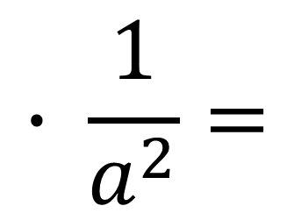
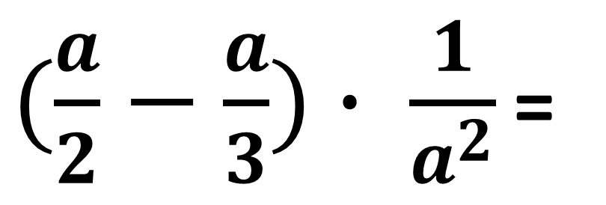
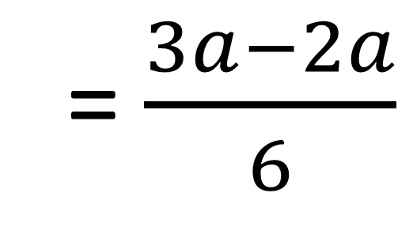
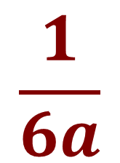
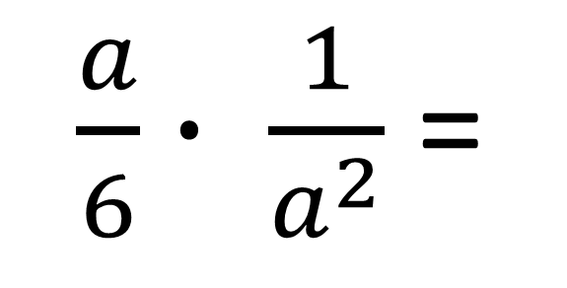
№87(1). Amallarni bajaring:
3
2
$(\frac{a}{2}−\frac{a}{3})∙ \frac{1}{a^{2}}$ =
$$( \frac{a}{2}−\frac{a}{3})∙ \frac{1}{a^{2}}=$$
= $\frac{3a−2a}{6}$
$$∙ \frac{1}{a^{2}}=$$
$\frac{a}{6}∙ \frac{1}{a^{2}}$ =
$$\frac{1}{6a}$$

Slide 6
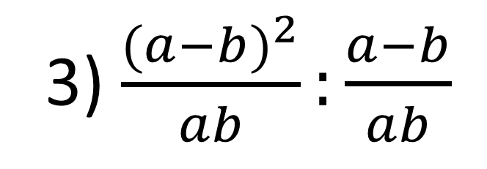
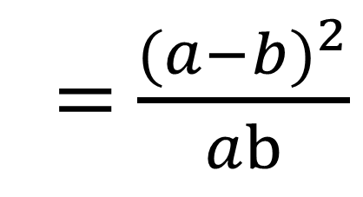
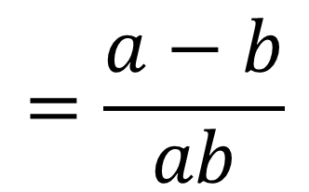
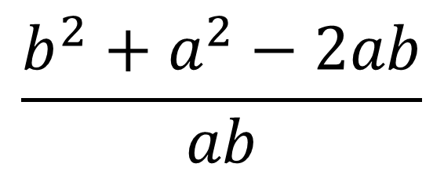
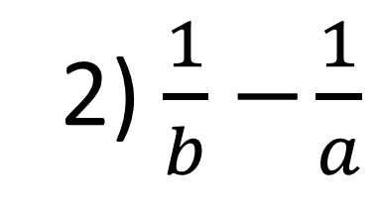
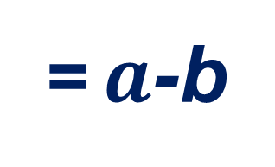
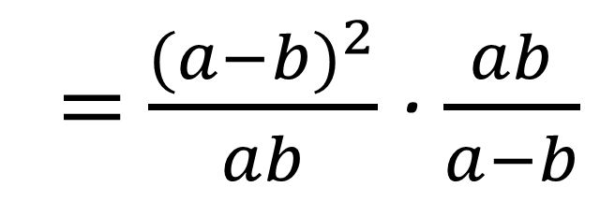
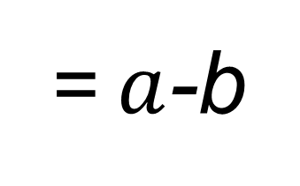
$№88\left(3\right). (\frac{b}{a}+\frac{a}{b}−2$):($\frac{1}{b}−\frac{1}{a})$ 1) $\frac{b}{a}+\frac{a}{b}−2$=
=$a$-b
b
a
ab
$$\frac{b^{2}+a^{2}−2ab}{ab}$$
= $\frac{{(a−b)}^{2}}{ab}$
a
b
2) $\frac{1}{b}−$ $\frac{1}{a}$
$$=\frac{a−b}{ab}$$
3) $\frac{{(a−b)}^{2}}{ab}:\frac{a−b}{ab}$
= $\frac{{(a−b)}^{2}}{ab}$ ∙ $\frac{ab}{a−b}$
=$a$-b

Slide 7
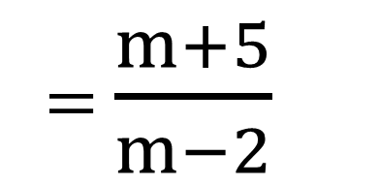
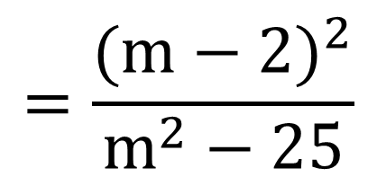
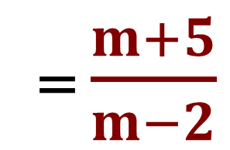
№ 90(4). $\frac{m−2}{m−5}:( \frac{m^{2}+24}{m^{2}−25}−\frac{4}{m−5} )$
= $\frac{m+5}{m−2}$
m+5
1) $\frac{m^{2}+24}{m^{2}−25}−\frac{4}{m−5}$ = $\frac{m^{2}+ 24}{(m−5)(m+5)}−\frac{4}{m−5}$ =
$$=\frac{m^{2}+24−4m−20}{(m−5)(m+5)}$$
$$=\frac{m^{2}−4m+4}{\left(m−5\right)\left(m+5\right)}$$
$$=\frac{{(m−2)}^{2}}{m^{2}−25}$$
2) $\frac{m−2}{m−5} : \frac{{(m−2)}^{2}}{m^{2}−25}$
= $\frac{m−2}{m−5}$ ∙ $\frac{(m−5)(m+5)}{{(m−2)}^{2}}$
= $\frac{m+5}{m−2}$

Slide 8
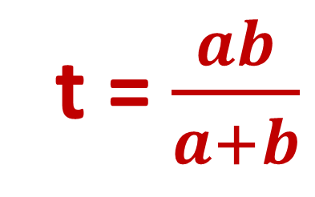
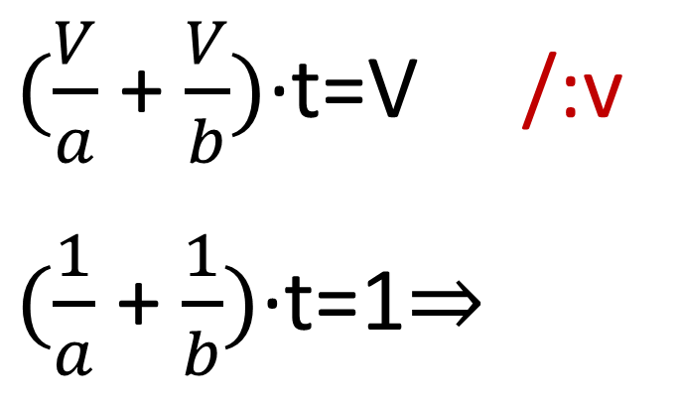
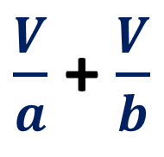
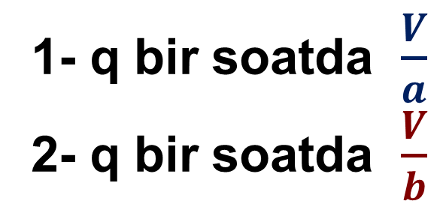
Hovuz birinchi quvur orqali a soatda, ikkinchi kuni
b soatda to‘ladi. Agar bir vaqtda ikkala quvur ochib
qo‘yilsa, hovuz necha soatda to‘ladi.
1- q bir soatda $\frac{V}{a}$
2- q bir soatda $\frac{V}{b}$
$\frac{V}{a}$ + $\frac{V}{b}$
b
a
V; t-?
$(\frac{V}{a}$ + $\frac{V}{b})$∙t=V /:v
$(\frac{1}{a}$ + $\frac{1}{b})$∙t=1$⇒$
t = $\frac{ab}{a+b}$
t =1:($\frac{1}{a}$ + $\frac{1}{b}$)= 1 : $\frac{a+b}{ab}$

Slide 9
Darslikda keltirilgan 88 – 90 - topshiriqlarni bajarish (33-34 betlar).
Mustaqil bajarish uchun topshiriqlar:

