Slide 1

ALGEBRA
8- SINF
Mavzu: Algebraik kasrlarni ko‘paytirish va bo‘lish mavzusida misollar yechish

Slide 2
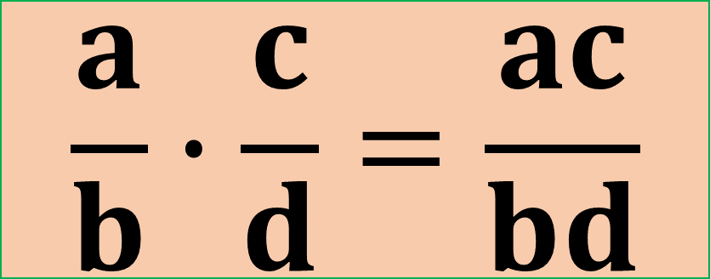

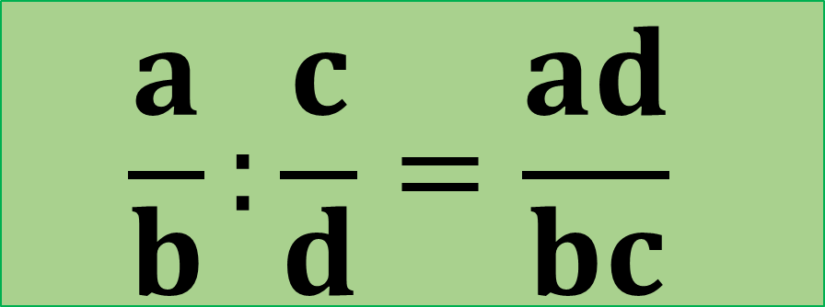
Mustahkamlash
$$\frac{a}{b}∙\frac{c}{d}=\frac{ac}{bd}$$
Oddiy (algebraik)
kasrlarni ko‘paytirish
$$\frac{a}{b}:\frac{c}{d}=\frac{ad}{bc}$$
Oddiy (algebraik)
kasrlarni bo‘lish

Slide 3
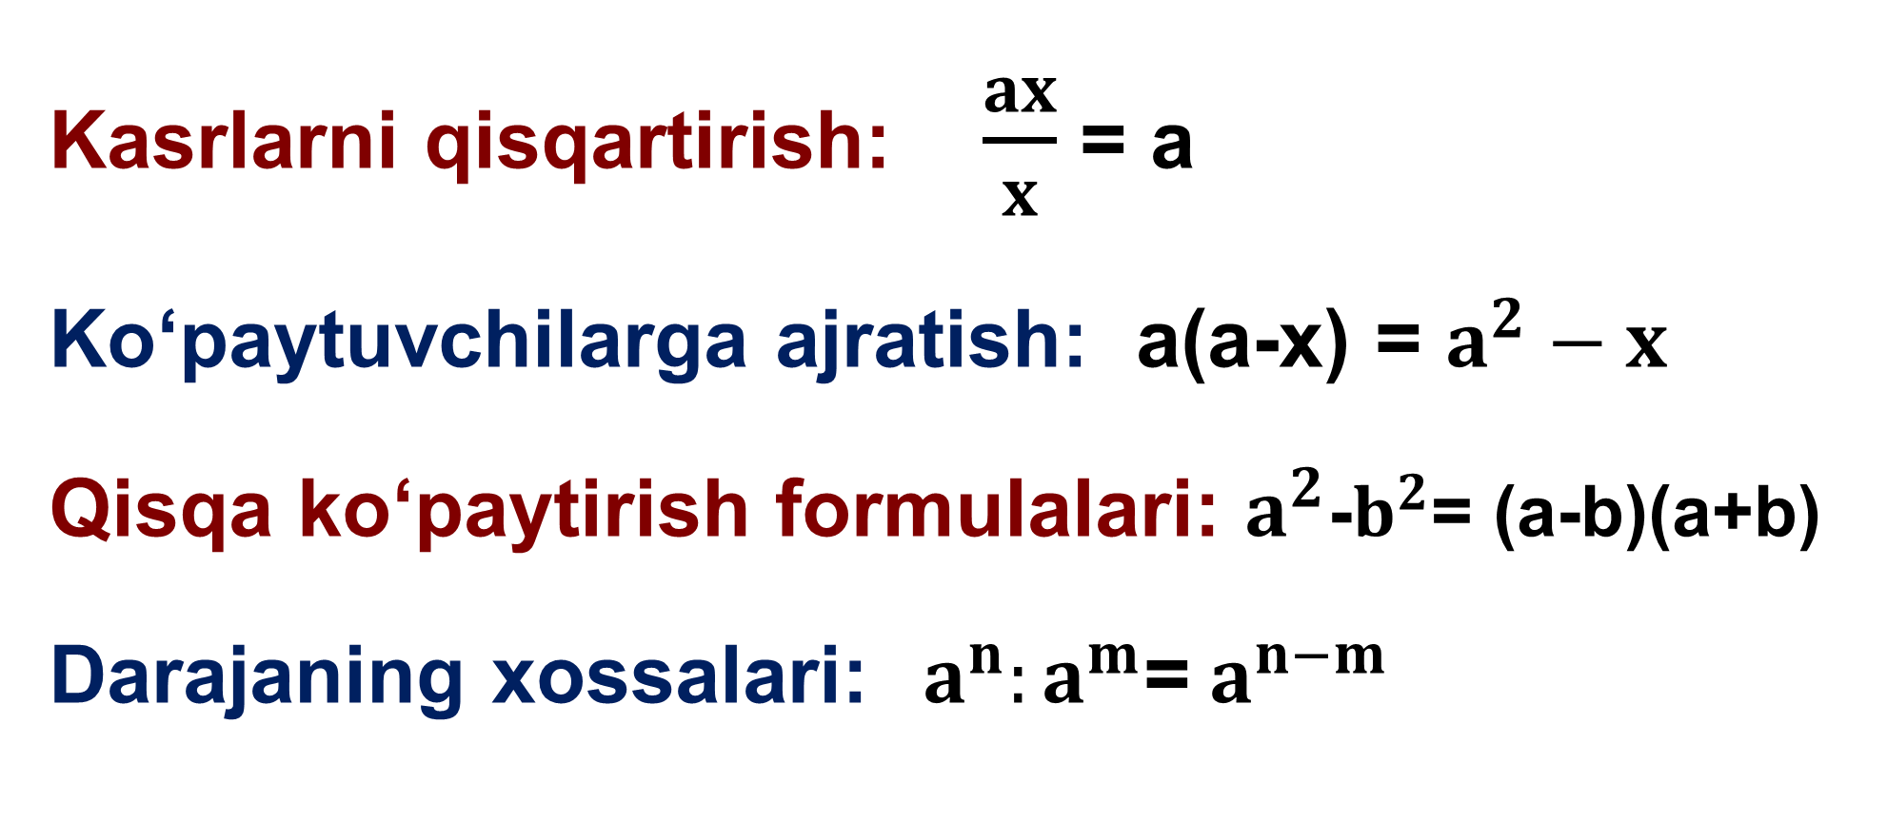
Kasrlarni ko‘paytirish va bo‘lish
Kasrlarni qisqartirish: $\frac{ax}{x}$ = a
Ko‘paytuvchilarga ajratish: a(a-x) = $a^{2}−x$
Qisqa ko‘paytirish formulalari: $a^{2}$-$b^{2}$= (a-b)(a+b)
Darajaning xossalari:$a^{n}:a^{m}$=${ a}^{n−m}$

Slide 4

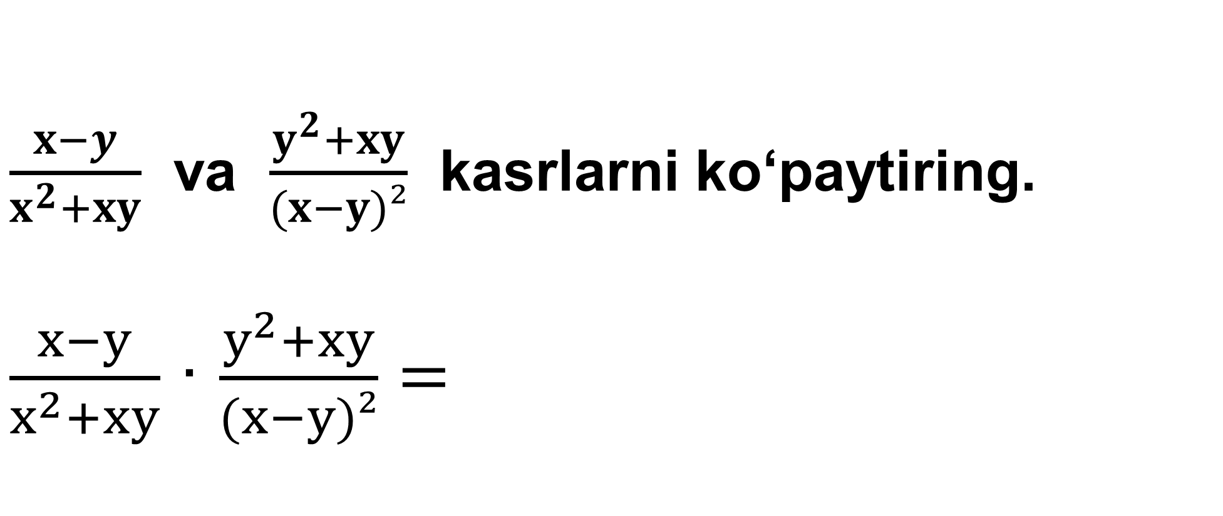
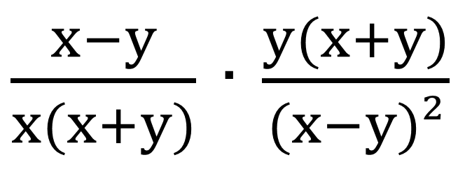
Kasrlarni ko‘paytirish va bo‘lish
$\frac{x−y}{x^{2}+xy}$ va $\frac{y^{2}+xy}{(x−y)²}$ kasrlarni ko‘paytiring.
$\frac{x−y}{x^{2}+xy}$ ∙ $\frac{y^{2}+xy}{(x−y)²}=$
$\frac{x−y}{x(x+y)}$ ∙ $\frac{y(x+y)}{(x−y)²}$
$$=\frac{y}{x(x−y)}$$

Slide 5
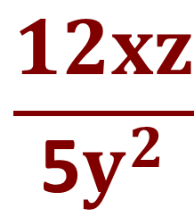
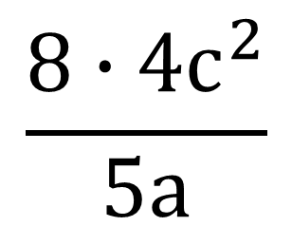
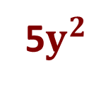
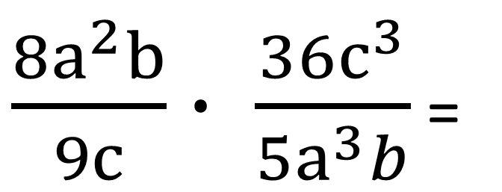
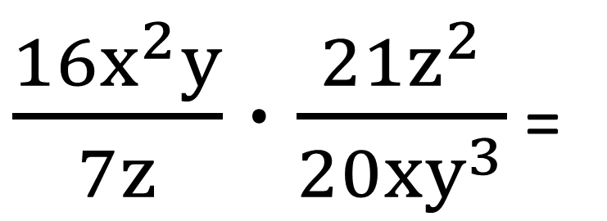
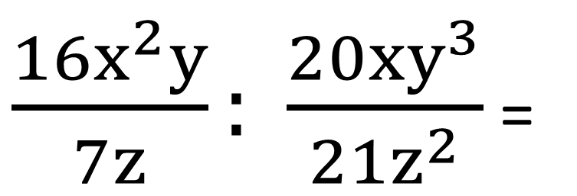
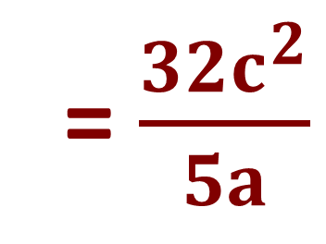
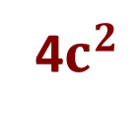

№ 81 (1;2). Amallarni bajaring:
4$c^{2}$
$\frac{{8a}^{2}b}{9c}∙ \frac{36c^{3}}{5a^{3}b}$ =
$$\frac{8∙4c^{2}}{5a}$$
= $\frac{32c^{2}}{5a}$
$$a^{2}$$
4x
3z
$\frac{{16x}^{2}y}{7z}: \frac{20xy^{3}}{{21z}^{2}}$ =
$\frac{{16x}^{2}y}{7z}∙\frac{{21z}^{2}}{20xy^{3}}$ =
$$\frac{12xz}{\text{5}y^{2}}$$
5$y^{2}$

Slide 6
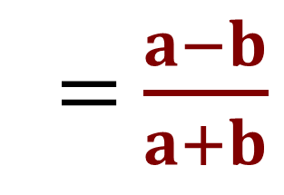
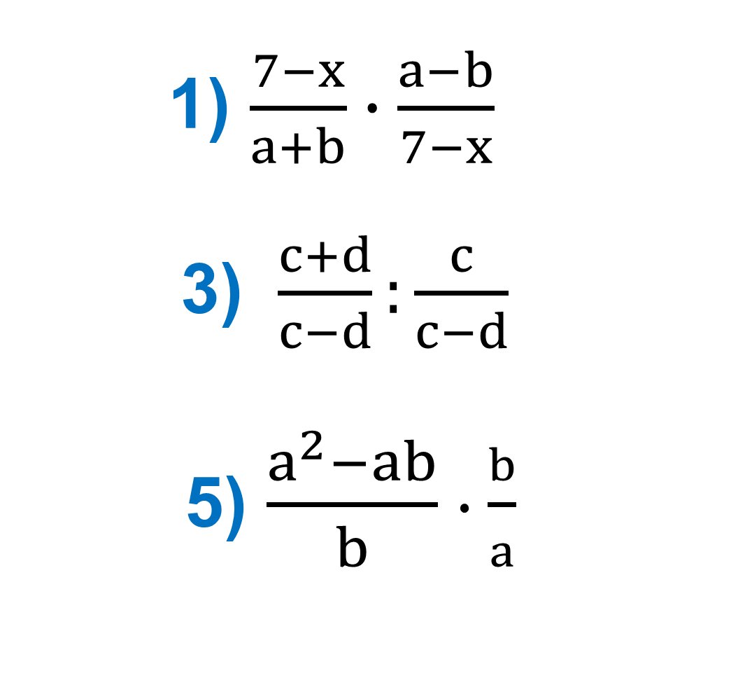
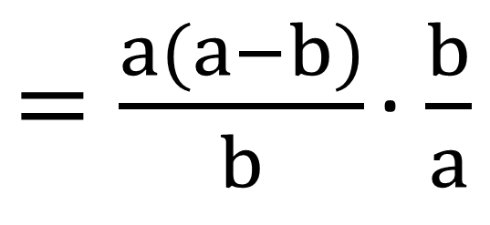
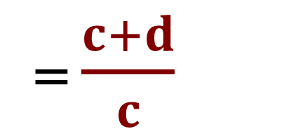
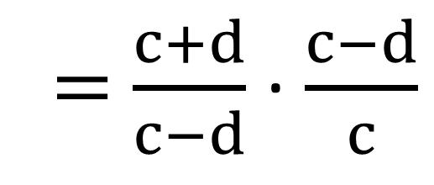
1) $\frac{7−x}{a+b}∙\frac{a−b}{7−x}$
3) $\frac{c+d}{c−d}:\frac{c}{c−d}$
5) $\frac{a^{2}−ab}{b}∙\frac{b}{a}$
№ 83. Amallarni bajaring:
= $\frac{a−b}{a+b}$
= $\frac{c+d}{c−d}$ ∙ $\frac{c−d}{c}$
= $\frac{c+d}{c}$
$=\frac{a(a−b)}{b}$ ∙ $\frac{b}{a}$
= a-b

Slide 7
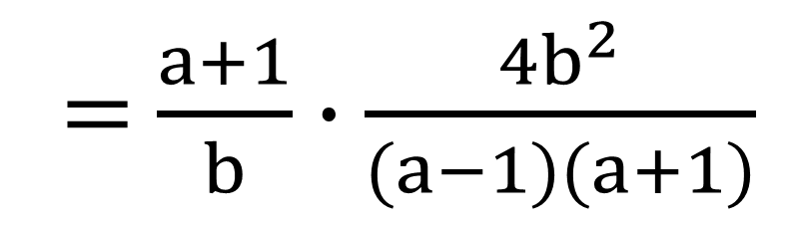

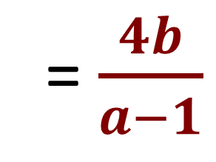
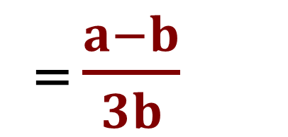
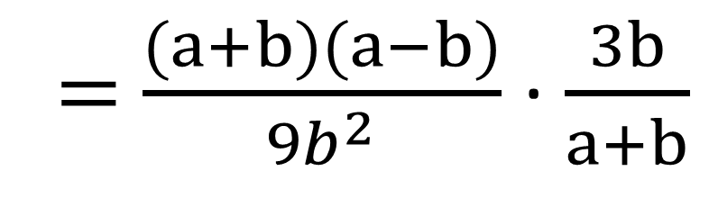
1) $\frac{a+1}{b}∙\frac{{4b}^{2}}{a^{2}−1}$
3) $\frac{a^{2}−b^{2}}{{9b}^{2}}:\frac{a+b}{3b}$
№ 84. Amallarni bajaring:
= $\frac{a+1}{b}∙\frac{{4b}^{2}}{(a−1)(a+1)}$
=$\frac{4b}{a−1}$
= $\frac{(a+b)(a−b)}{{9b}^{2}}$ ∙ $\frac{3b}{a+b}$
= $\frac{a−b}{3b}$
3b

Slide 8
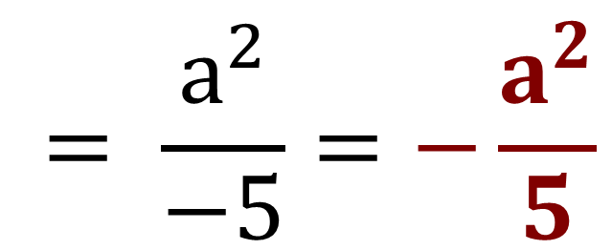
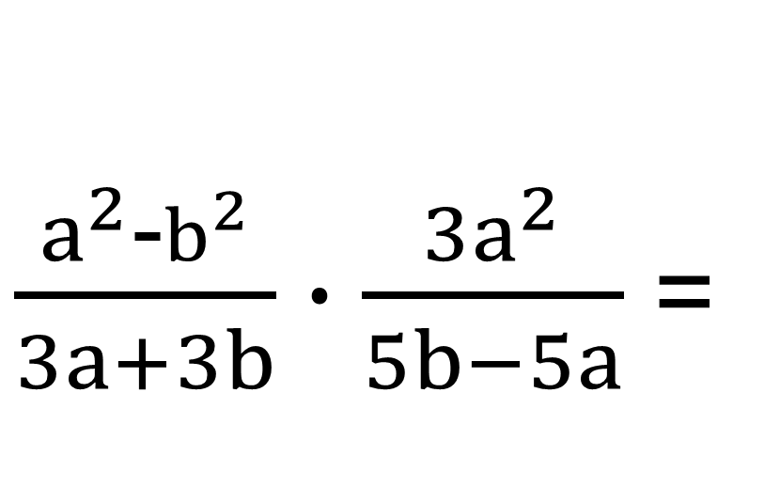
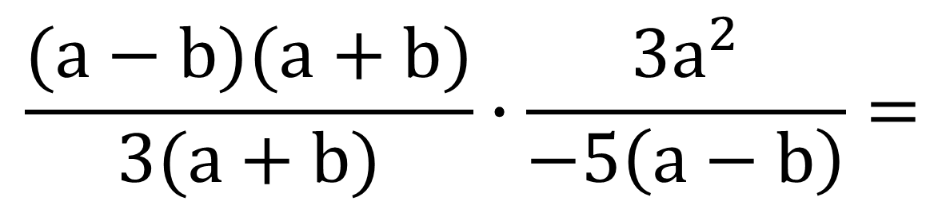
$\frac{a^{2}\text{−}b^{2}}{3a+3b}∙\frac{{3a}^{2}}{5b−5a}$ =
№ 85 (1). Ko‘rsatilgan amallarni bajaring:
$$\frac{(a−b)(a+b)}{3(a+b)}∙\frac{{3a}^{2}}{−5\left(a−b\right)}=$$
$$= \frac{a^{2}}{−5}=−\frac{a^{2}}{5}$$

Slide 9
Darslikda keltirilgan
81-, 83-, 84-, 85 - topshiriqlarni bajarish (29-30 betlar).
Mustaqil bajarish uchun topshiriqlar:

