Slide 1
ALGEBRA
8- SINF
MAVZU: Algebraik
kasrlarni qo‘shish va ayirish mavzusida misollar yechish
O‘qituvchi: Yusupjonova Shahnoza Mirzatillayevna

Slide 2
Mustahkamlash
Turli maxrajli kasrlarni qo‘shish yoki ayirish qanday tartibda bajariladi?
- kasrlarning umumiy maxraji topiladi; - kasrlar umumiy maxrajga keltiriladi; - hosil bo‘lgan kasrlar qo‘shiladi; - mumkin bo‘lsa, natija soddalashtiriladi.

Slide 3
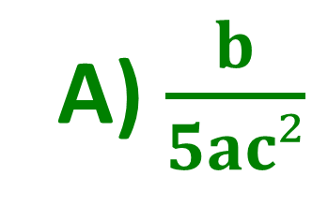
T E S T
Kasrni qisqartiring: $\frac{25a²b²c}{125a³bc³}$
A) $\frac{b}{5ac²}$
B) $\frac{b}{25ac²}$ C) $\frac{a}{5ac²}$
$$\frac{25a²b²c}{125a³bc³}= \frac{25a²bbc}{5∙25a^{2}abcc²}=\frac{b}{5ac²}$$
Javob: A

Slide 4
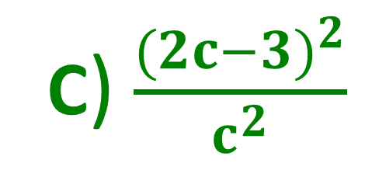
TEST
Amalni bajaring: $4−\frac{6}{c}+\frac{9}{c^{2}};$
A) $\frac{(4{c−9)}^{2}}{c^{2}}$ B) $\frac{(4{c−3)}^{2}}{c^{2}}$
C) $\frac{(2{c−3)}^{2}}{c^{2}}$
$4−\frac{6}{c}+\frac{9}{c^{2}}=\frac{4c^{2}}{c^{2}}−\frac{6c}{c^{2}}+\frac{9}{c^{2}}=\frac{4c^{2}−6c+9}{c^{2}}=$ $\frac{(2{c−3)}^{2}}{c^{2}}$
Javob: C

Slide 5
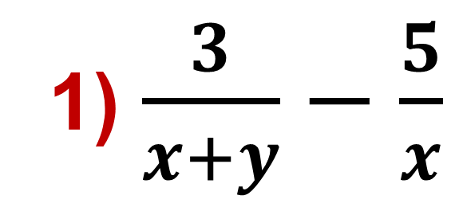
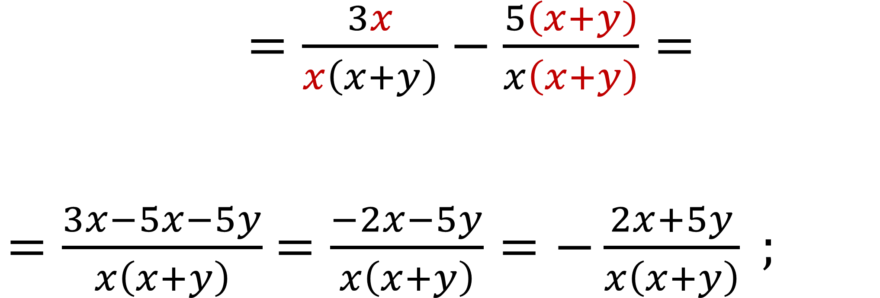
$=\frac{3x}{x\left(x+y\right)}−\frac{5\left(x+y\right)}{x\left(x+y\right)}=$ $=\frac{3x−5x−5y}{x\left(x+y\right)}$ $=\frac{−2x−5y}{x\left(x+y\right)}=−\frac{2x+5y}{x\left(x+y\right)} ;$
№64. Amallallarni bajaring:
1) $\frac{3}{x+y}−\frac{5}{x}$

Slide 6
№64. Amallallarni bajaring:
3) $\frac{1}{x(x−3)}+\frac{1}{x(x+3)}$ =
$$=\frac{x+3}{x(x−3)(x+3)}+\frac{x−3}{x(x−3)(x+3)}=$$
$$=\frac{x+3+x−3}{x(x−3)(x+3)}=\frac{2x}{x(x−3)(x+3)}=\frac{2}{x^{2}−9} ;$$

Slide 7
Moslashtirma topshiriq
a² - b² =
(a-b)² =
(a+b)² =
$\frac{1}{x^{2}−1}+ \frac{3}{x−1}$ = $\frac{1}{(x−1)(x+1)}+ \frac{3(x+1)}{(x−1)(x+1)}$ =
= $\frac{1+3x+3}{(x−1)(x+1)}$ = $\frac{4+3x}{x^{2}−1}$;
a²+2ab+b²
a²-2ab+b²
(a-b)(a+b)

Slide 8
№66. Amallallarni bajaring:
2) $\frac{12n−5}{n^{2}−49}+\frac{6}{7−n}$
$$=\frac{12n−5}{\left(n−7\right)(n+7)}−\frac{6}{n−7}=$$
= $\frac{12n−5}{\left(n−7\right)\left(n+7\right)}−\frac{6\left(n+7\right)}{\left(n−7\right)\left(n+7\right)}$ =
= $\frac{12n−5−6n−42}{\left(n−7\right)\left(n+7\right)}$ = $\frac{6n−47}{n^{2}−49} ;$

Slide 9
№66. Amallallarni bajaring:
4) $\frac{21y^{2}+1}{1−9y²}−\frac{y}{3y−1}$
$$=\frac{21y^{2}+1}{\left(1−3y\right)\left(1+3y\right)}−\frac{y}{−(1−3y)}=$$
= $\frac{21y^{2}+1}{\left(1−3y\right)\left(1+3y\right)}+\frac{y\left(1+3y\right)}{\left(1−3y\right)\left(1+3y\right)}$ =
= $\frac{21y^{2}+1+y+3y^{2}}{\left(1−3y\right)\left(1+3y\right)}=\frac{24y^{2}+y+1}{1−9y^{2}}$;

Slide 10
Moslashtirma topshiriq
(y-2)² =
№68(1). $\frac{2y+8}{y^{2}−4y+4}−\frac{7}{y−2}$
= $\frac{2y+8}{{\left(y−2\right)}^{2}}−\frac{7\left(y−2\right)}{{\left(y−2\right)}^{2}}$ =
y²- 4y+4
y²+2y+4
= $\frac{2y+8−7y+14}{{\left(y−2\right)}^{2}}=\frac{22−5y}{{\left(y−2\right)}^{2}};$
y²-4

Slide 11
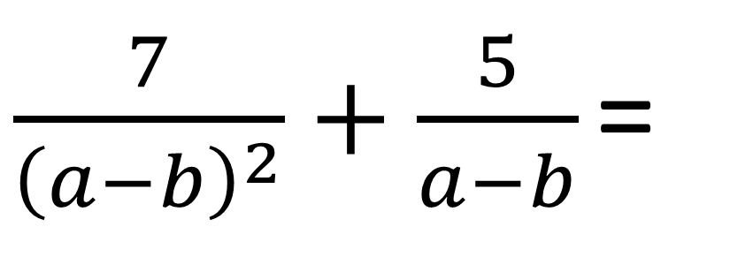
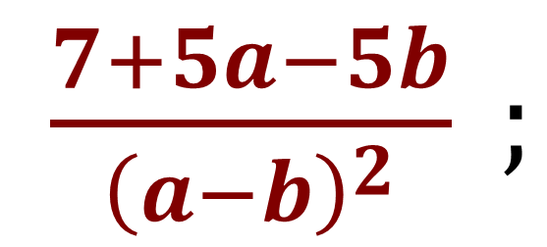
№68. Amallallarni bajaring:
3) $\frac{7}{{\left(a−b\right)}^{2}}−\frac{5}{b−a}$ =
$\frac{7}{{\left(a−b\right)}^{2}}+\frac{5}{a−b}$ =
$$=\frac{7}{{\left(a−b\right)}^{2}}+\frac{5\left(a−b\right)}{{\left(a−b\right)}^{2}}=$$
$\frac{7+5a−5b}{{\left(a−b\right)}^{2}} ;$

Slide 12
Moslashtirma topshiriq
(2c+5)²=
(2c+5)² = (2c)²+2·2c∙5+25 = 4c²+20c+25
$\frac{2y+8}{{4y}^{2}−20y+25}−\frac{7}{2y−5}$
= $\frac{2y+8}{{\left(2y−5\right)}^{2}}−\frac{7\left(2y−5\right)}{{\left(2y−5\right)}^{2}}$ =
4c²+25
4c²+20c+25
= $\frac{2y+8−14y+35}{{\left(2y−5\right)}^{2}}=\frac{43−12y}{{\left(2y−5\right)}^{2}};$
4c²+10c+25

Slide 13
Darslikda berilgan 67-, 69-,71- topshiriqlarni bajarish (26 – bet).
Mustaqil bajarish uchun topshiriqlar:

