Slide 1
ALGEBRA
8- SINF
MAVZU: Algebraik
kasrlarni
qo‘shish va ayirish
O‘qituvchi: Yusupjonova Shahnoza Mirzatillayevna

Slide 2
Bir hil maxrajli kasrlarni qo‘shish va ayirish
$\frac{a²}{a−b}−\frac{b^{2}}{a−b}=\frac{a^{2}−b^{2}}{a−b}$ = $\frac{(a−b)(a+b)}{a−b}$ = a+b
$\frac{a}{d}+\frac{b}{d}−\frac{c}{d}=\frac{a+b−c}{d}$, d ≠ 0
$\frac{c}{a+5}+\frac{2c}{a+5}=\frac{c+2c}{a+5}=$ $\frac{3c}{a+5}$

Slide 3
2) $\frac{a+2b}{3c²}+\frac{5a−2b}{3c²}=\frac{a+2b+5a−2b}{3c²}=\frac{6a}{3c²}=\frac{2a}{c²}$
$$55−misol. Amallarni bajaring:$$
4) $\frac{10a−b}{a³}−\frac{3a−b}{a^{3}}=\frac{10a−b−3a+b}{a^{3}}=\frac{7a}{a^{3}}=\frac{7}{a^{2}}$

Slide 4

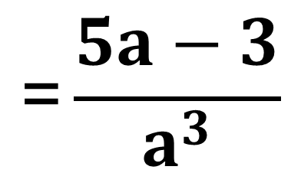

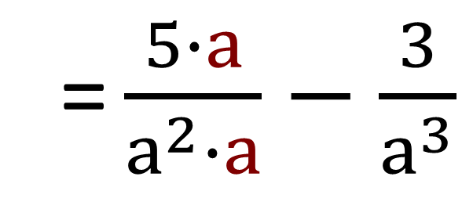
Turli maxrajli kasrlarni qo‘shish va ayirish
$\frac{5}{a²}−\frac{3}{a^{2}}=\frac{5−3}{a^{2}}=$ $\frac{2}{a^{2}}$
Umumiy maxraj:$a^{3}$
$\frac{5}{a²}−\frac{3}{a^{3}}$
= $\frac{5∙a}{a^{2}∙a}−\frac{3}{a^{3}}$
= $\frac{5a}{a^{3}}−\frac{3}{a^{3}}$
$$\text{=}\frac{5a−3}{a^{3}}$$

Slide 5
Qoida
Turli maxrajli kasrlarni qo‘shish yoki ayirish uchun:
1. Kasrlarning umumiy maxraji topiladi; 2. Kasrlar umumiy maxrajga keltiriladi; 3. Hosil bo‘lgan kasrlar qo‘shiladi; 4. Mumkin bo‘lsa, natija soddalashtiriladi.

Slide 6
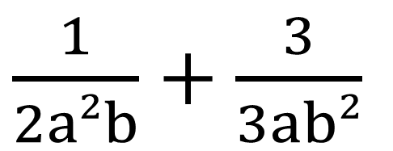
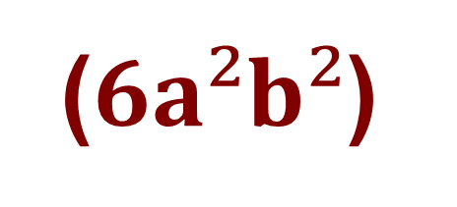
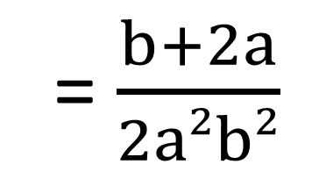
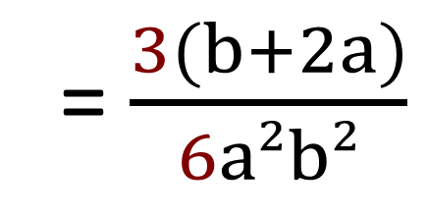
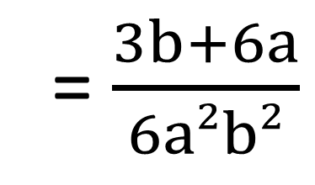
$\frac{1}{2a²b} va \frac{3}{3ab²}$ kasrlarni qo‘shing:
Turli maxrajli kasrlarni qo‘shish yoki ayirish
($6a²b²$)
$\frac{1}{2a²b}+\frac{3}{3ab²}$
= $\frac{1∙3b}{2a²b∙3b}+\frac{3∙2a}{2a∙3ab²}$
= $\frac{3b}{6a²b²}+\frac{6a}{6a²b²}$ =
= $\frac{3b+6a}{6a²b²}$
= $\frac{3(b+2a)}{6a²b²}$
= $\frac{b+2a}{2a²b²}$

Slide 7
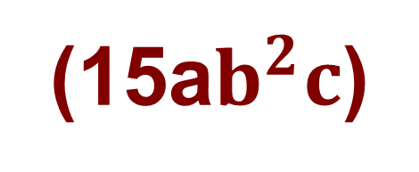
$\frac{a}{3b^{2}c} va \frac{c}{15ab²}$ kasrlarni ayiring.
Masalan:
(15a$b^{2}c$)
$\frac{a}{3b^{2}c} −\frac{c}{15ab^{2}}=\frac{5a∙a}{5a∙3b^{2}c} −\frac{c∙c}{15ab^{2}∙c}$ =
$=\frac{5a^{2}}{15ab^{2}c} −\frac{c^{2}}{15ab^{2}c} =\frac{5a^{2}−c^{2}}{15ab^{2}c}$

Slide 8
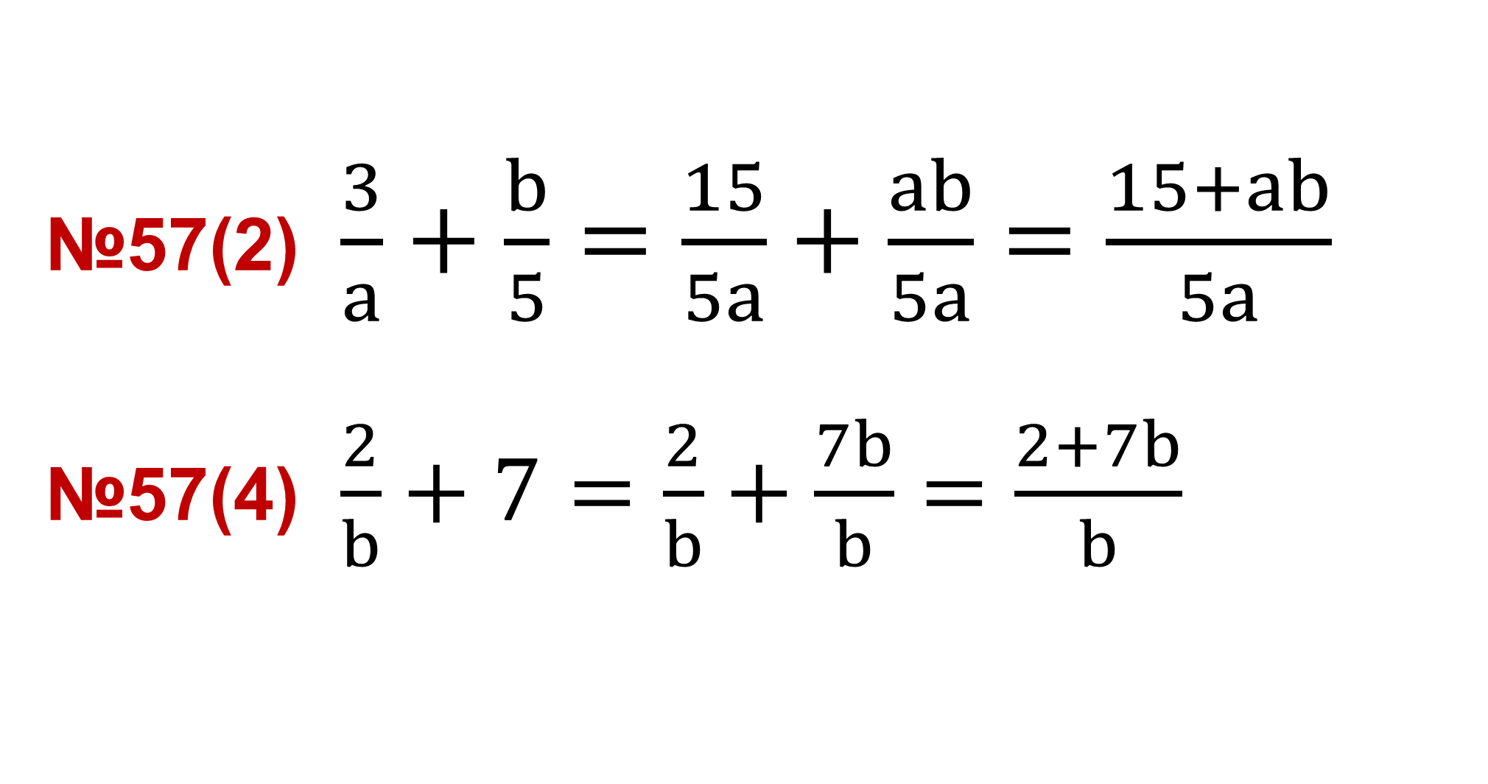
№57(2) $\frac{3}{a}+\frac{b}{5}=\frac{15}{5a}+\frac{ab}{5a}=\frac{15+ab}{5a}$ №57(4) $\frac{2}{b}+7=\frac{2}{b}+\frac{7b}{b}=\frac{2+7b}{b}$
$\frac{a}{m}+\frac{b}{n}=\frac{an+bm}{mn}$ $\frac{a}{m}−\frac{b}{n}=\frac{an−bm}{mn}$

Slide 9
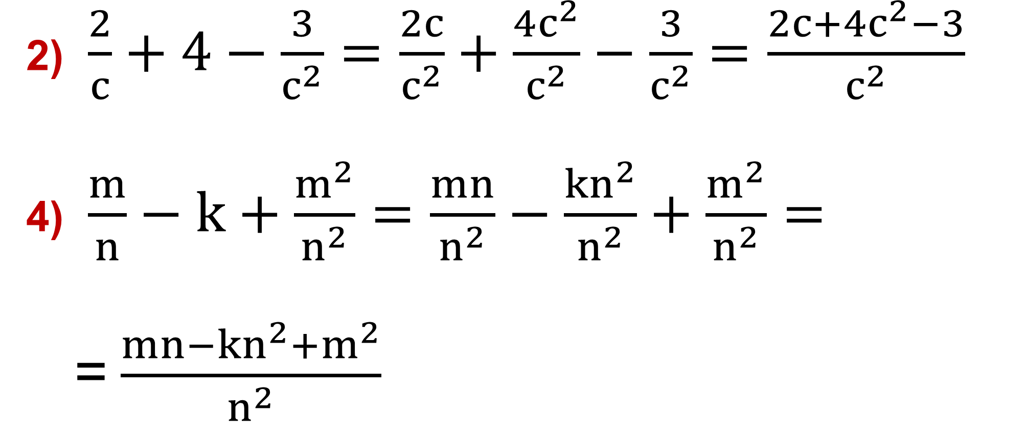
2) $\frac{2}{c}+4−\frac{3}{c^{2}}=\frac{2c}{c^{2}}+\frac{4c^{2}}{c^{2}}−\frac{3}{c^{2}}=\frac{2c+4c^{2}−3}{c^{2}}$ 4) $\frac{m}{n}−k+\frac{m^{2}}{n^{2}}=\frac{mn}{n^{2}}−\frac{kn^{2}}{n^{2}}+\frac{m^{2}}{n^{2}}=$ =$\frac{mn−kn^{2}+m^{2}}{n^{2}}$
$$58−misol. Amallarni bajaring:$$

Slide 10
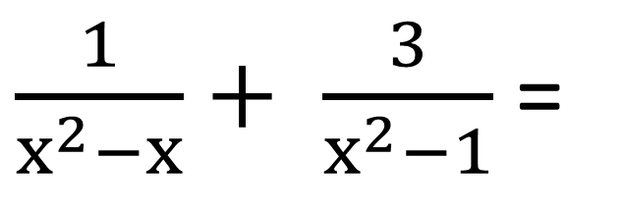
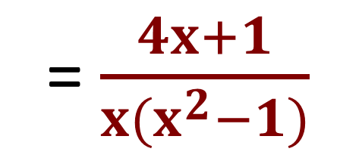

Algebraik kasrlarni qo‘shish va ayirish
$\frac{1}{x^{2}−x} va \frac{3}{x^{2}−1}$ kasrlarni qo‘shing:
$\frac{1}{x^{2}−x}+ \frac{3}{x^{2}−1}$=
$\frac{1}{x(x−1)}+\frac{3}{(x−1)(x+1)}$ =
= $\frac{x+1}{x(x^{2}−1)}+\frac{3x}{x(x^{2}−1)}$ =
$$\frac{x+1+3x}{x(x^{2}−1)}$$
= $\frac{4x+1}{x(x^{2}−1)}$

Slide 11
Darslikda berilgan 59-,60-,61 – topshiriqlarni bajarish (24-bet).
Mustaqil bajarish uchun topshiriqlar:

Slide 13
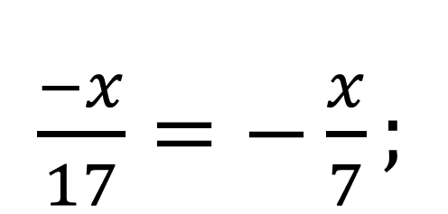
Qarama – qarshi kasrlar.
$\frac{−a}{b}$ va $\frac{a}{b}$ ; $\frac{ a}{−b}$ va $\frac{a}{b}$ .
$\frac{−a}{b}=−\frac{a}{b}$ ; $\frac{ a}{−b}=−\frac{a}{b}$ .
$\frac{−6}{1−y}=\frac{−6}{−(y−1)}$ = $\frac{6}{y−1}$.
$\frac{−x}{17}=−\frac{x}{7};$

Slide 14
Kasrni qisqartiring:
a) $\frac{3x²−3xy}{6x^{2}y−6x³}\text{=}\frac{3x(x−y)}{6x²(y−x)}\text{=}\frac{3x\left(x−y\right)}{−6x^{2}\left(x−y\right)}\text{=}−\frac{1}{2x}$
b) $\frac{4a^{2}−4ab+b²}{b^{2}−4a²}=\frac{(2a−b)²}{−({\left(2a\right)}^{2}−b^{2})}=$
= $−$ $\frac{{\left(2a−b\right)}^{2}}{\left(2a−b\right)\left(2a+b\right)}=−\frac{2a−b}{2a+b}$

