Slide 1
ALGEBRA
8-SINF
MAVZU:Algebraik kasrlar. Kasrlarni qisqartirish
mavzusida misollar yechish
O‘qituvchi : Yusupjonova Shahnoza Mirzatillayevna

Slide 2
Mustahkamlash
Algebraik kasr …
Surat va maxraji algebraik ifodalardan iborat bo‘lgan kasr algebraik kasr deyiladi.

Slide 3
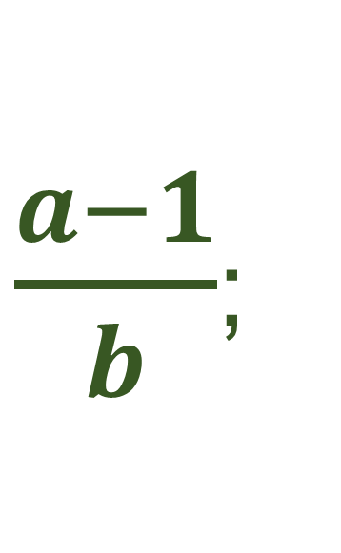
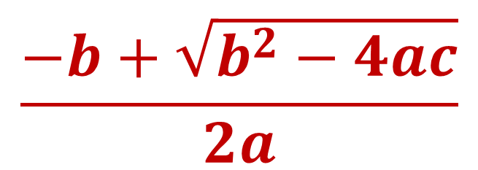
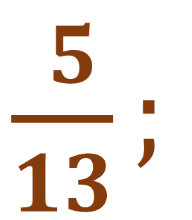
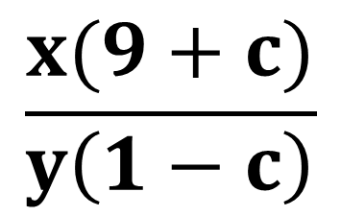
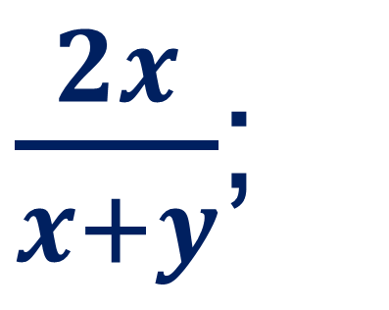
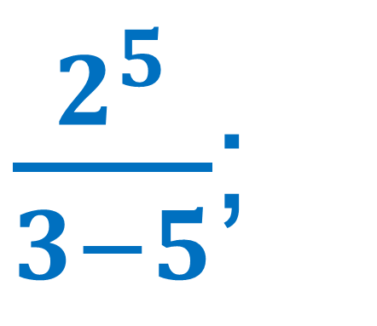
Algebraik kasrlarni aniqlang:
$\frac{ 5}{13};$
$$\frac{x(9+c)}{y\left(1−c\right)}$$
$$\frac{−b+\sqrt{b^{2}−4ac}}{2a}$$
x-0,5;
$\frac{a−1}{b}$;
$\frac{2^{5}}{3−5}$;
$\frac{2x}{x+y}$;
3a-b;

Slide 4
Mustahkamlash
Algebraik kasrlarni qisqartirish uchun …
Kasrning surat va maxrajini umumiy ko‘paytuvchisiga bo‘lish kerak va qisqa ko‘paytirish formulalaridan foydalaniladi.

Slide 5
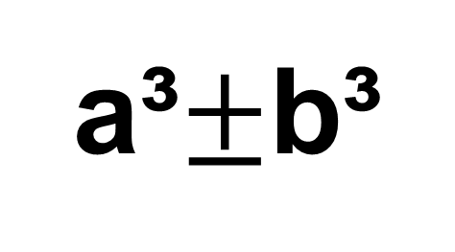
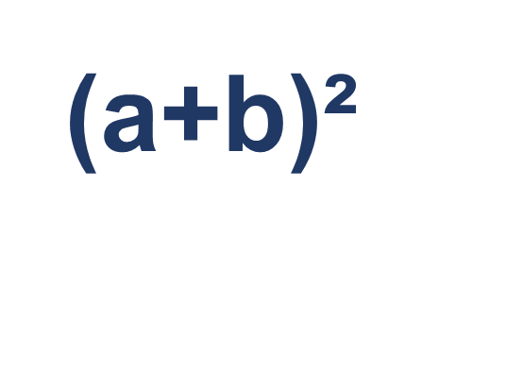
(a+b)²
=a²+2ab+b²
(a-b)²
=a²-2ab+b²
a²-b²
=(a-b)(a+b)
(a+b)³
=a³+3a²b+3ab²+b³
(a-b)³
=a³-3a²b+3ab²-b³
a³$±$b³
=(a$±$b)(a²$∓$ab+b²)

Slide 6
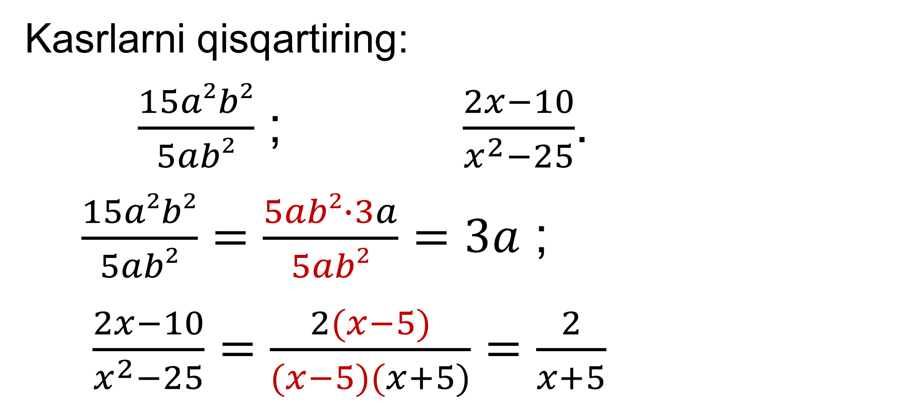
Mustahkamlash
Kasrlarni qisqartiring:
$\frac{15a²b²}{5ab²}$ ; $\frac{2x−10}{x^{2}−25}$.
$\frac{15a²b²}{5ab²}=\frac{5ab²∙3a}{5ab²}=3a$ ;
$\frac{2x−10}{x^{2}−25}=\frac{2(x−5)}{(x−5)(x+5)}=\frac{2}{x+5}$

Slide 7
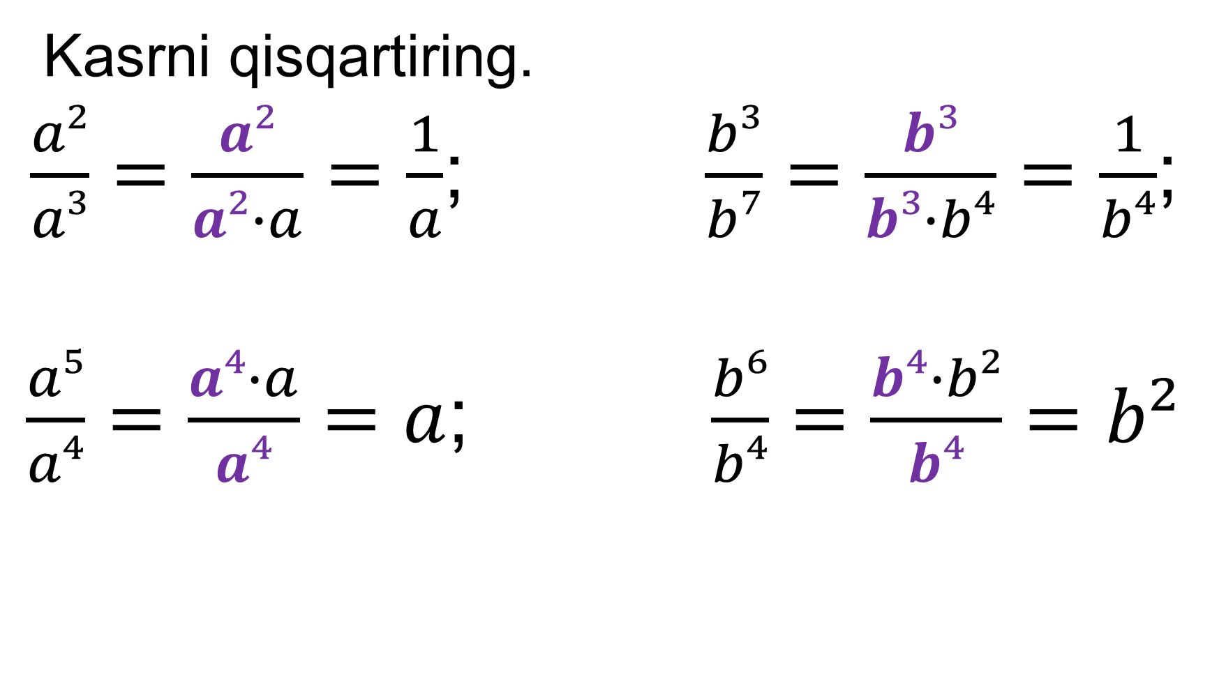
32-misol.
Kasrni qisqartiring.
$\frac{a²}{a³}=\frac{a²}{a²∙a}=\frac{1}{a}$; $\frac{b³}{b⁷}=\frac{b³}{b³∙b⁴}=\frac{1}{b⁴}$;
$\frac{a⁵}{a⁴}=\frac{a⁴∙a}{a⁴}=a$;$\frac{b⁶}{b⁴}=\frac{b⁴∙b²}{b⁴}=b²$

Slide 8
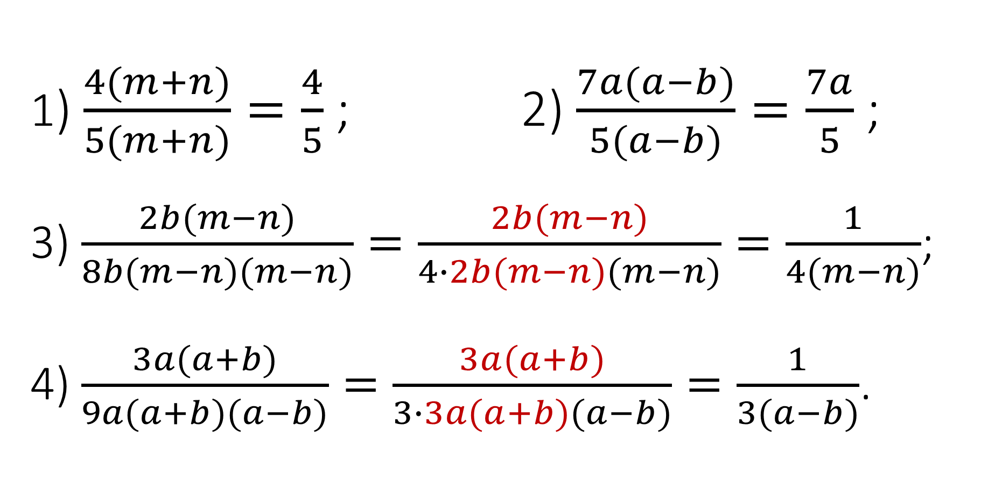
34-misol. Kasrni qisqartiring:
1) $\frac{4(m+n)}{5(m+n)}=\frac{4}{5}$ ; 2) $\frac{7a(a−b)}{5(a−b)}=\frac{7a}{5}$ ;
3) $\frac{2b(m−n)}{8b(m−n)(m−n)}=\frac{2b(m−n)}{4∙2b(m−n)(m−n)}=\frac{1}{4(m−n)}$;
4) $\frac{3a(a+b)}{9a(a+b)(a−b)}=\frac{3a(a+b)}{3∙3a(a+b)(a−b)}=\frac{1}{3(a−b)}$.

Slide 9
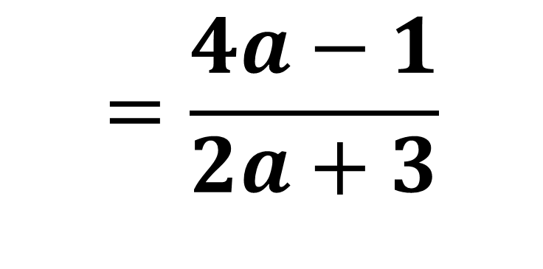
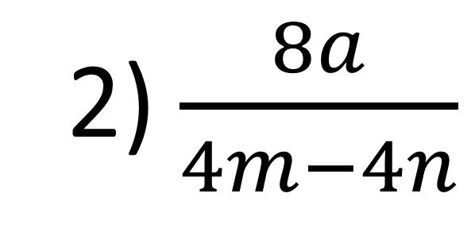
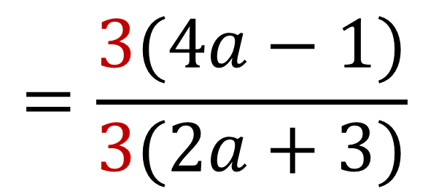
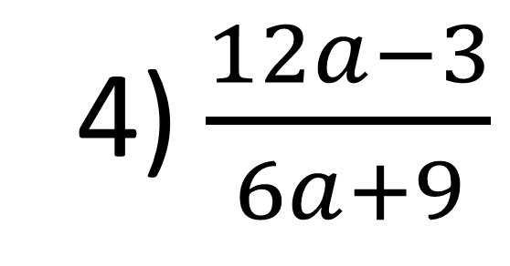
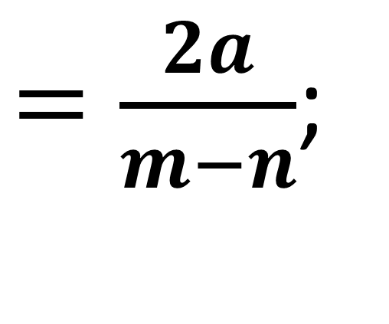
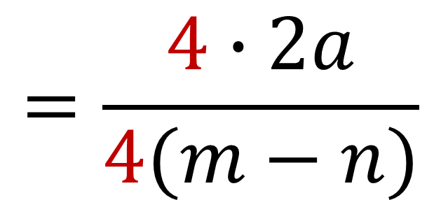
$36$−misol. Kasrni qisqartiring:
2) $\frac{8a}{4m−4n}$
$$=\frac{4∙2a}{4(m−n)}$$
$=\frac{2a}{m−n}$;
$$=\frac{4a−1}{2a+3}$$
4) $\frac{12a−3}{6a+9}$
$$=\frac{3(4a−1)}{3(2a+3)}$$

Slide 10
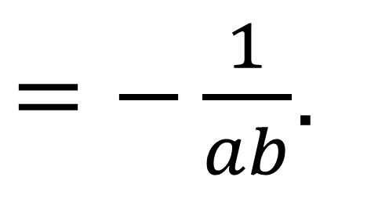
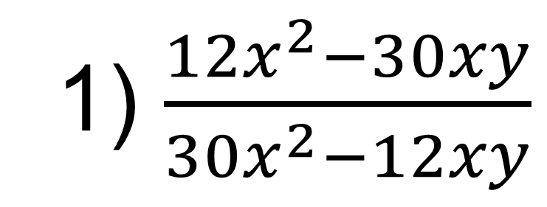
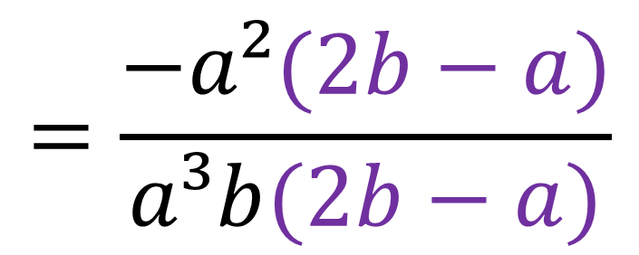
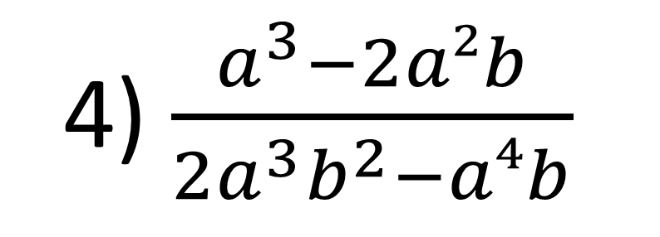
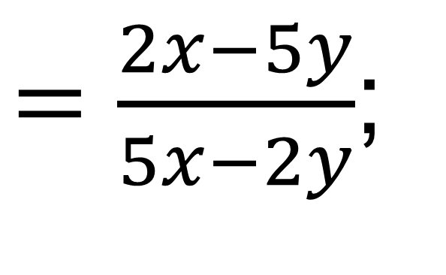
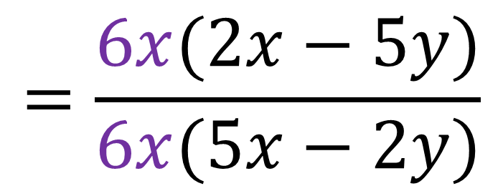
$38$−misol. Kasrni qisqartiring:
1) $\frac{12x^{2}−30xy}{30x^{2}−12xy}$
$$=\frac{6x(2x−5y)}{6x(5x−2y)}$$
$=\frac{2x−5y}{5x−2y}$;
4) $\frac{a^{3}−2a²b}{2a^{3}b^{2}−a⁴b}$
$$=\frac{−a²(2b−a)}{a³b(2b−a)}$$
$=−\frac{1}{ab}$.

Slide 11
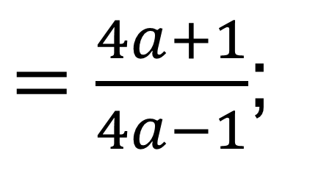



42-misol. Kasrni qisqartiring:
$$1) \frac{4y^{2}−4y+1}{4y^{2}−1}$$
$$=\frac{(2y−1)²}{(2y−1)(2y+1)}$$
$=\frac{2y−1}{2y+1}$;
2) $\frac{16a^{2}−1}{16a^{2}−8a+1}$
$$=\frac{(4a−1)(4a+1)}{(4a−1)²}$$
$=\frac{4a+1}{4a−1}$;

Slide 12
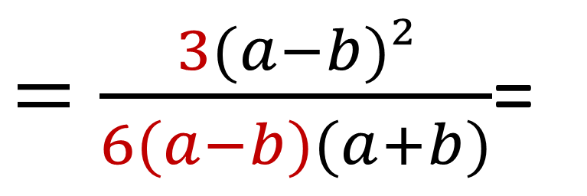
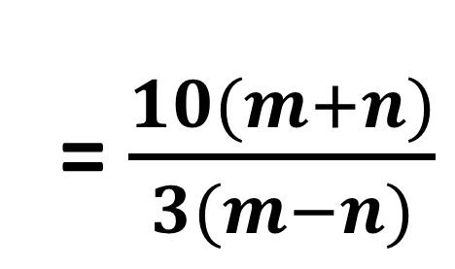
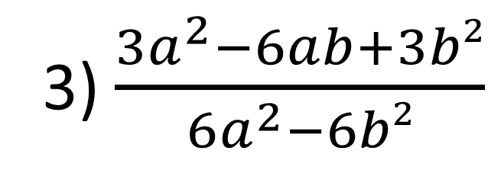
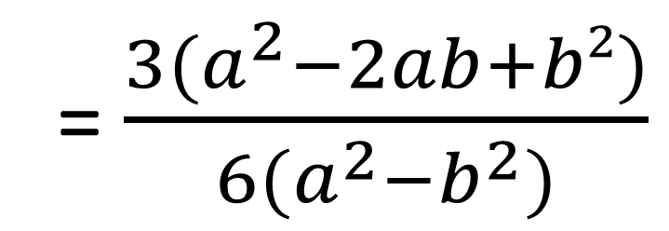
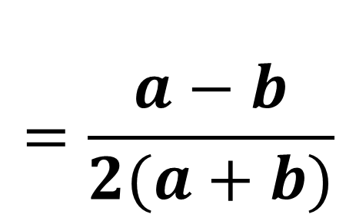
3) $\frac{3a^{2}−6ab+3b²}{6a^{2}−6b²}$
= $\frac{3{(a}^{2}−2ab+b²)}{6(a^{2}−b^{2})}$
$=\frac{3(a−b)²}{6(a−b)(a+b)}$=
$$=\frac{a−b}{2(a+b)}$$
4) $\frac{50m^{2}+100mn+50n²}{15m^{2}−15n²}$
$$=\frac{50(m+n)²}{15(m−n)(m+n)}=$$
= $\frac{10(m+n)}{3(m−n)}$

Slide 13
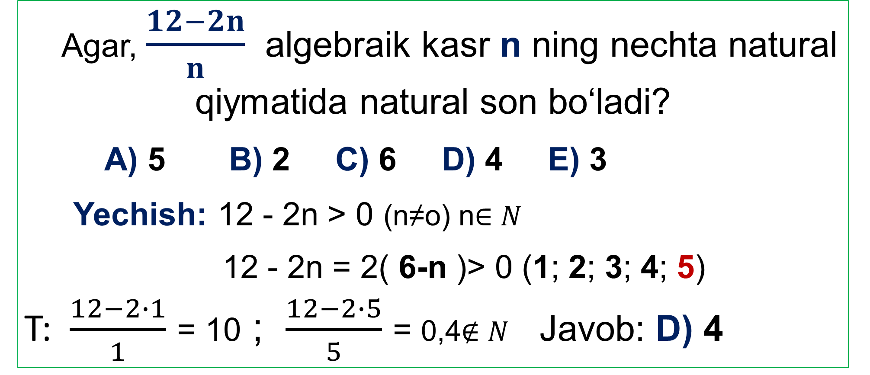
TEST
Agar, $\frac{12−2n}{n}$ algebraik kasr n ning nechta natural qiymatida natural son bo‘ladi?
A) 5 B) 2 C) 6 D) 4 E) 3
Yechish: 12 - 2n > 0 (n≠o) n$∈N$
12 - 2n = 2( 6-n )> 0 (1; 2; 3; 4; 5)
T: $\frac{12−2∙1}{1}$ = 10 ; $\frac{12−2∙5}{5}$ = 0,4$∉N$ Javob: D) 4

Slide 14
Mustaqil bajarish uchun topshiriqlar:
Darslikning 17, 18- sahifasida keltirilgan
37-,39-, 41-topshiriqlarni bajarish.

Slide 15
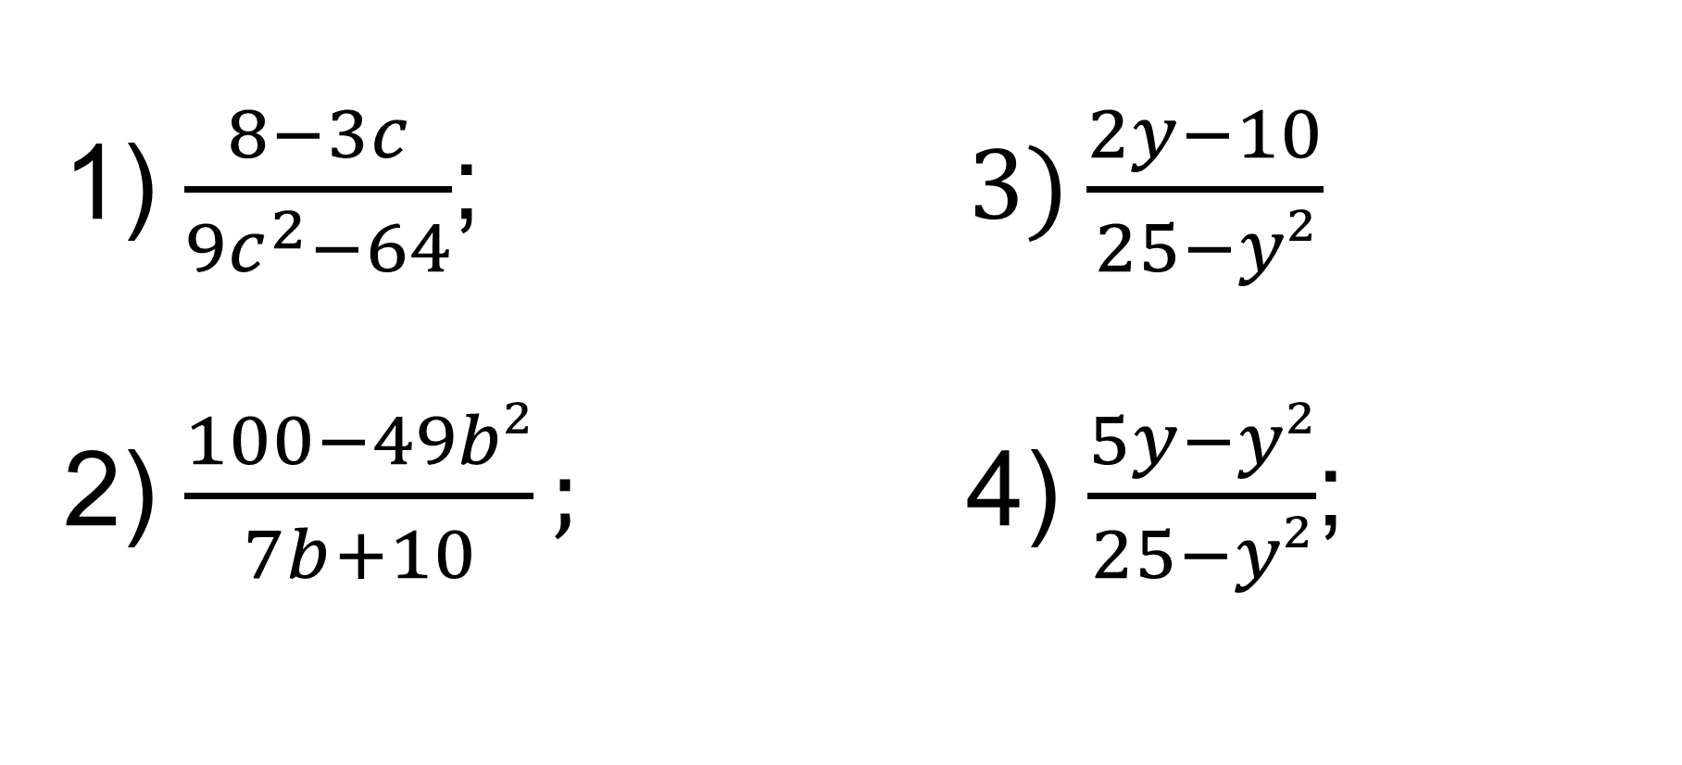
1) $\frac{8−3c}{9c^{2}−64}$; $3)\frac{2y−10}{25−y²}$ 2) $\frac{100−49b²}{7b+10};$ 4) $\frac{5y−y²}{25−y²}$;
40-misol. Kasrni qisqartiring.

