Slide 1
ALGEBRA
8-SINF
Mavzu:Algebraik kasrlar.
Kasrlarni qisqartirish.
O‘qituvchi: Yusupjonova Shahnoza Mirzatillayevna

Slide 2
ALGEBRAIK KASRLAR
Algebraik kasrlar deb, kasrning surati yoki maxrajida sonlar va harflar qatnashgan ifodaga aytiladi.
$\frac{ A}{B}$
-Algebraik kasrning umumiy ko‘rinishi
$\frac{a}{b}$; $\frac{2}{x+y}$; $\frac{a−b}{c}$; $\frac{x(9+c)}{y(1−c)}$.

Slide 3
MASALA
Katerning turg’un suvdagi tezligi soatiga a kilometrga, daryo oqimining tezligi soatiga b kilometrga teng. Katerning daryo oqimi bo‘yicha harakat tezligi uning daryo oqimiga qarshi harakat tezligidan necha marta ortiq?

Slide 4
Katerning daryo oqimi bo’yicha tezligi soatiga (a+b) kilometr Oqimga qarshi tezligi soatiga (a-b) kilometr Daryo oqimi bo‘yicha harakat tezligi oqimga qarshi harakat tezligidan $\frac{a+b}{a−b}$ marta ortiq bo‘ladi. $\frac{a+b}{a−b}$ - ifoda algebraik kasr deyiladi.
MASALANING YECHIMI

Slide 5
Agar algebraik kasrga kiruvchi harflar o‘rniga biror sonlar qo‘yilsa, u holda zarur hisoblashlar bajarilgandan keyin shu algebraik kasrning son qiymati hosil bo‘ladi. a=10, b=8 bo’lganda , $\frac{a+b}{a−b}$=? $\frac{a+b}{a−b}$ = $\frac{10+8}{10−8}=\frac{18}{2}=9$.
Algebraik kasr.

Slide 6
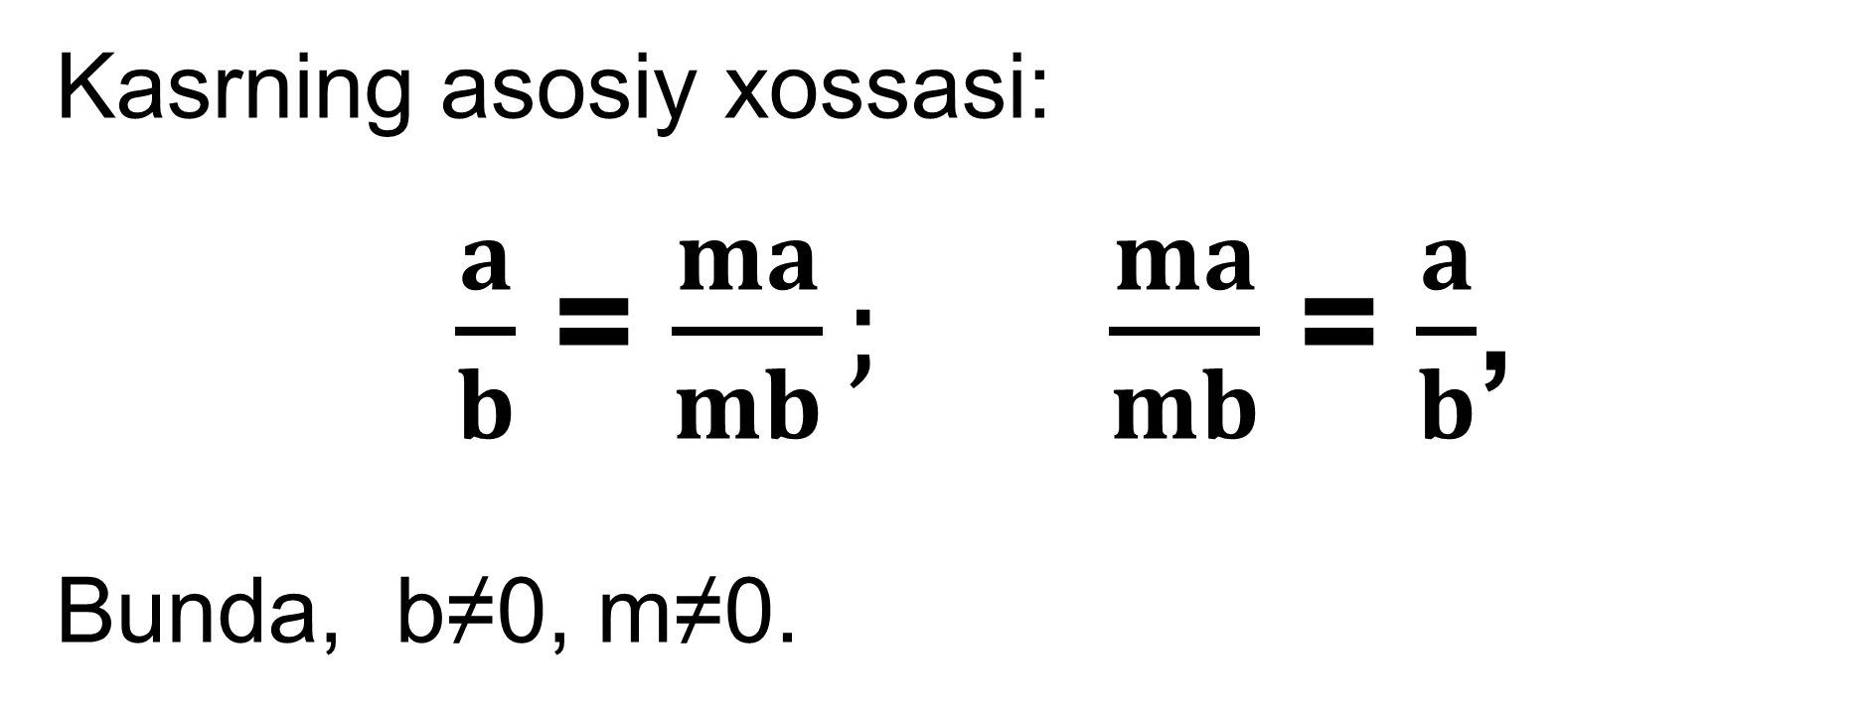
Algebraik kasr.
Kasrning asosiy xossasi:
$\frac{a}{b}$ = $\frac{ma}{mb};$ $\frac{ma}{mb}$ = $\frac{a}{b}$,
Bunda, b≠0, m≠0.
Masalan: $\frac{5+d}{b}=\frac{(5+d)∙c}{bc}$

Slide 7
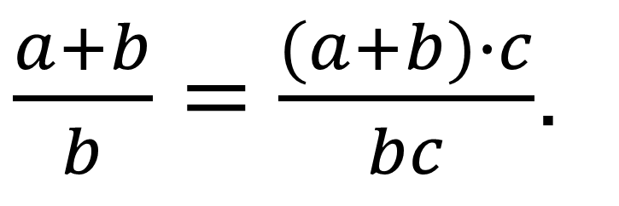
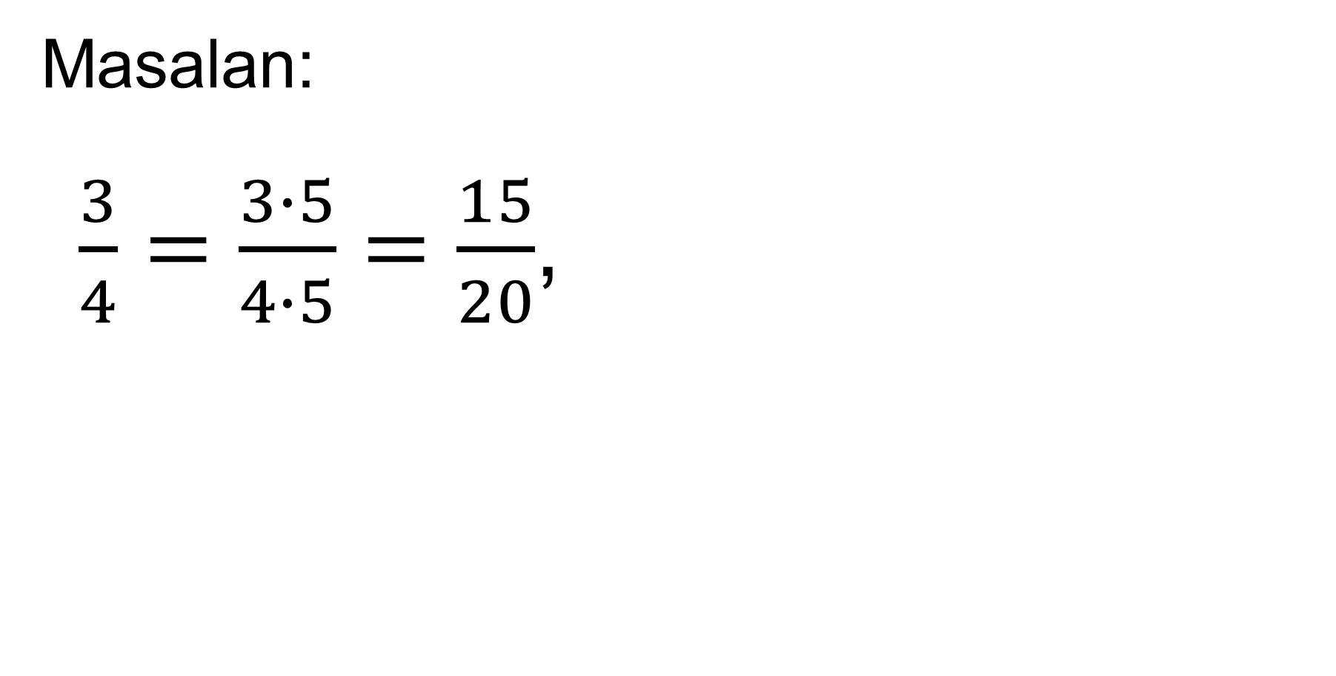

Masalan: $\frac{3}{4}=\frac{3∙5}{4∙5}=\frac{15}{20}$,
Algebraik kasr. Kasrlarni qisqartirish.
$\frac{a+b}{b}=\frac{(a+b)∙c}{bc}$.
$$\frac{a(b+c)}{a(b−c)}=\frac{b+c}{b−c} ;$$
$\frac{\left(a+b\right)c}{\left(a+b\right)d}=\frac{c}{d}$.

Slide 8
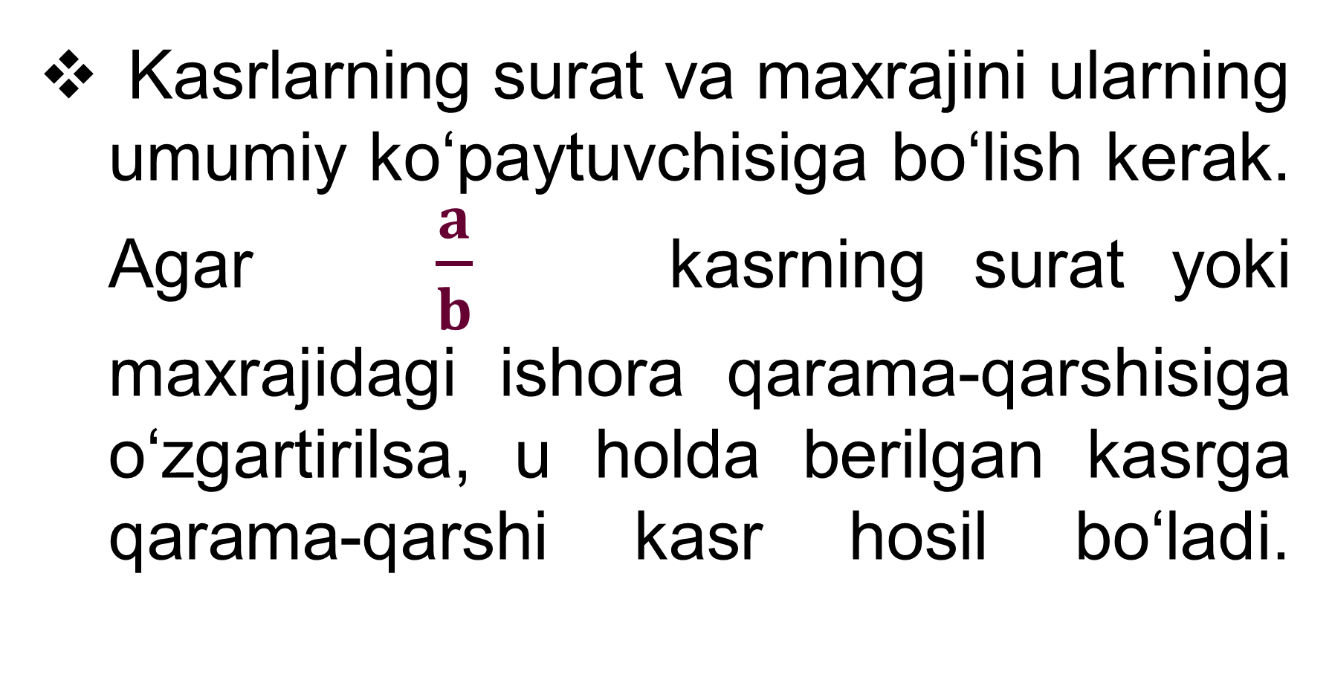
Kasrlarning surat va maxrajini ularning umumiy ko‘paytuvchisiga bo‘lish kerak. Agar $\frac{a}{b}$ kasrning surat yoki maxrajidagi ishora qarama-qarshisiga o‘zgartirilsa, u holda berilgan kasrga qarama-qarshi kasr hosil bo‘ladi.
Kasrlarni qisqartirish.

Slide 9
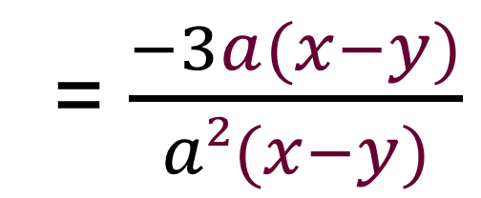

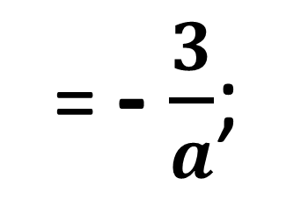

Masala
$\frac{3a(y−x)}{a²(x−y)}$ kasrni qisqartiring.
$\frac{ 3a(y−x)}{a²(x−y)}$
= $\frac{−3a(x−y)}{a²(x−y)}$
= $\frac{−3}{a}$
= - $\frac{3}{a}$;

Slide 10
Qarama – qarshi kasrlar.
$\frac{−a}{b}$ va $\frac{a}{b}$ ; $\frac{a}{−b}$ va $\frac{a}{b}$ .
$\frac{−a}{b}=−\frac{a}{b}$ ; $\frac{a}{−b}=−\frac{a}{b}$ .
$\frac{−a}{1−a}=\frac{−a}{−(a−1)}$ = $\frac{a}{a−1}$.
Masalan: $\frac{−3}{7}=−\frac{3}{7};$

Slide 11
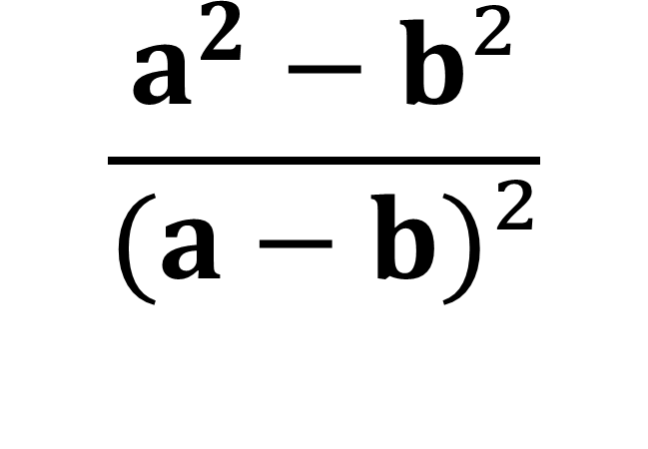
23-masala
Surati a va b sonlar kvadratlarining ayirmasiga, maxraji esa shu sonlar ayirmasining kvadratiga teng bo‘lgan algebraik kasrni yozing.
$$\frac{a^{2}−b²}{(a−b)²}$$

Slide 12
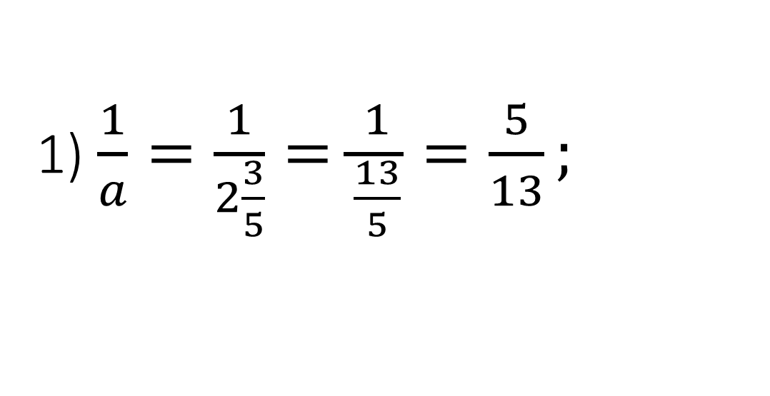
№25. Algebraik kasrning son qiymatini toping:
1) $\frac{1}{a}$, bunda $a=2\frac{3}{5}$; 2) $\frac{b+1}{b−1}$, bunda b=1,5;
3) $\frac{a^{2}+1}{2a}$, bunda $a$ =-3.
1) $\frac{1}{a}=\frac{1}{2\frac{3}{5}}=\frac{1}{\frac{13}{5}}=\frac{5}{13};$
$$2)\frac{b+1}{b−1}=\frac{1,5+1}{1,5−1}=\frac{2,5}{0,5}=5$$
3) $\frac{a^{2}+1}{2a}=\frac{{(−3)}^{2}+1}{2∙(−3)}=\frac{10}{−6}=−\frac{5}{3}=−1\frac{2}{3}$

Slide 13
27- masala
Har bir yuk mashinasiga a tonnadan kartoshka yuklash mumkin bo‘lsa, har birida p kilogrammdan kartoshka bo‘lgan n qop kartoshkani tashib ketish uchun nechta yuk mashinasi (x) kerak bo‘ladi? x ni n=90, p=50, a=1,5 bo‘lganda toping.

Slide 14

Berilgan:
Yuk mashinasi – a tonnadan,
p kg dan - n qop kartoshka
Yuk mashinasi – x? ta kerak bo‘ladi
n=90, p=50, a=1,5 da ?
Yechish: a tonna = 1000a kg,
$x=\frac{np}{1000a}=\frac{90∙50}{1000∙1,5}=\frac{4500}{1500}=3 (ta)$
$$\frac{np}{1000a}$$
J$avob:$ 3 ta yuk mashinasi kerak bo‘ladi.

Slide 15


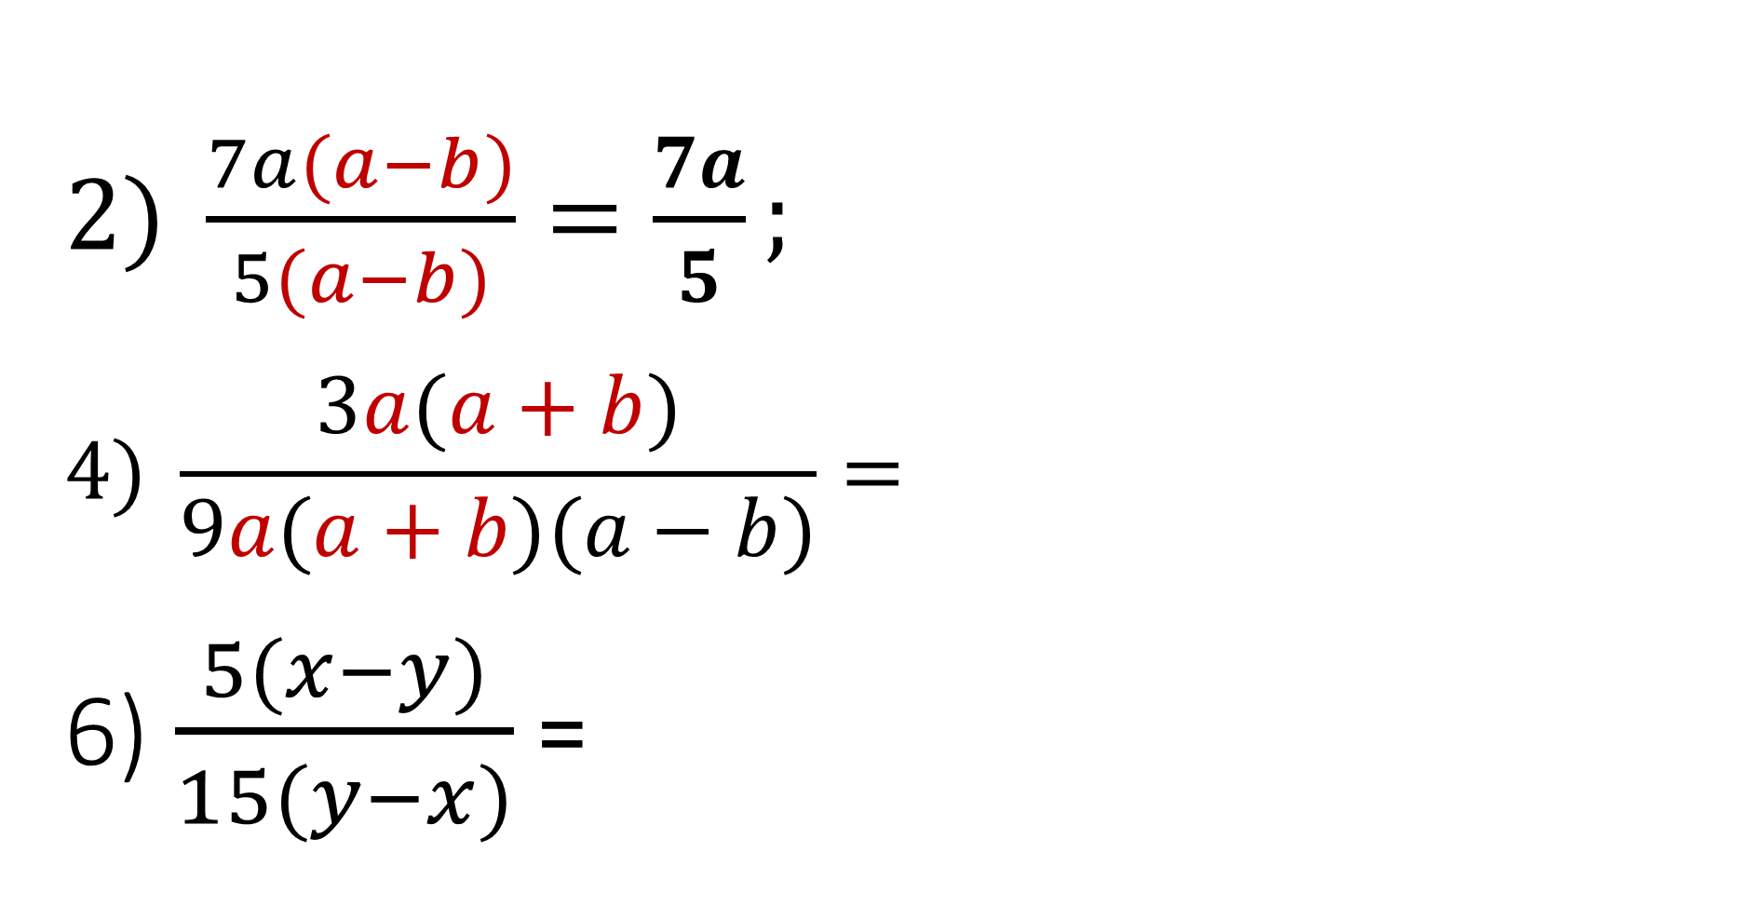

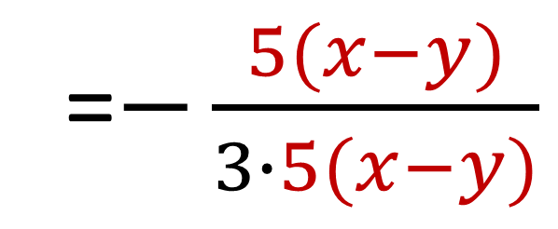
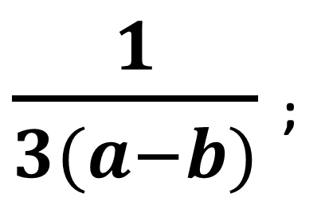
№34(2,4,6). Kasrni qisqartiring:
$2) \frac{7a(a−b)}{5(a−b)}=\frac{7a}{5};$
$$4) \frac{3a(a+b)}{9a(a+b)(a−b)}=$$
6)$\frac{5(x−y)}{15(y−x)}$ =
$$\frac{3}{9(a−b)}=$$
$\frac{1}{3(a−b)}$ ;
$$\frac{5(x−y)}{−15(x−y)}$$
=$−\frac{5(x−y)}{3∙5(x−y)}$
$=−\frac{1}{3}$ .

Slide 16
Darslikning 15-16-sahifasida keltirilgan 26-, 28-, 31 – topshiriqlar.
Mustaqil bajarish uchun topshiriqlar

