Slide 1
ALGEBRA
8-sinf
MAVZU: Algebraik ifodalar mavzusida masalalar yechish
O‘qituvchi: Yusupjonova Shahnoza Mirzatillayevna

Slide 2
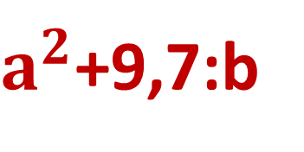
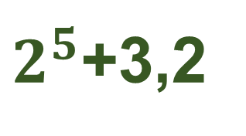
Sonli ifoda sonlardan tuzilib, amallar belgilari bilan birlashtiriladi.
1,3+5:8,2;
-6;
$2^{5}$+3,2
Algebraik ifoda sonli ifodadan qanday farqlanadi?
0,7+45n;
2b-6;
$a^{2}$+9,7:b
Algebraik ifoda sonlar va harflardan tuzilib, amallar belgilari bilan birlashtiriladi.

Slide 3
№10(1) - topshiriq
Kichigi n ga teng bo‘lgan ikkita ketma-ket natural sonning yig‘indisini algebraic ifoda ko‘rinishida yozing:
Yechish: 1 - son: n
2 - son: n+1
n+n+1= 2n+1

Slide 4
№10(2) – topshiriq.
Kattasi m ga teng bo‘lgan ikkita ketma-ket natural sonning ko‘paytmasini algebraik ifoda shaklida yozing:
Yechish: 1- son: m
2- son: m-1
(m-1)∙m= $m^{2}$- m

Slide 5
№10(4) – topshiriq.
Kichigi 2p +1 ga teng bo‘lgan uchta ketma-ket toq natural sonning ko‘paytmasini algebraik ifoda shaklida yozing:
Yechish: 1-son: 2p +1
2-son: 2p +3
3-son: 2p +5
(2p+1)(2p+3)(2p+5)

Slide 6
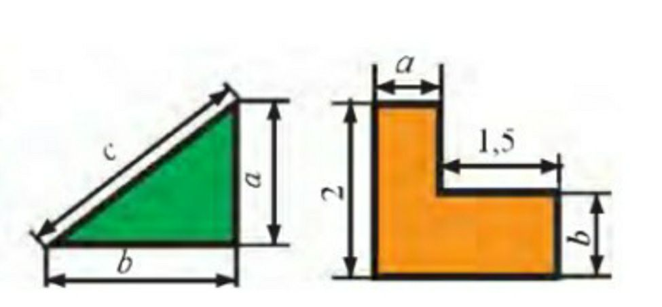
№11
Shaklning perimetri va yuzini algebraik
ifoda ko‘rinishida yozing:
3,5
d

Slide 7
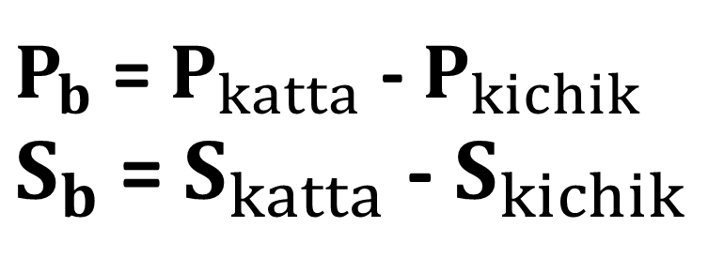
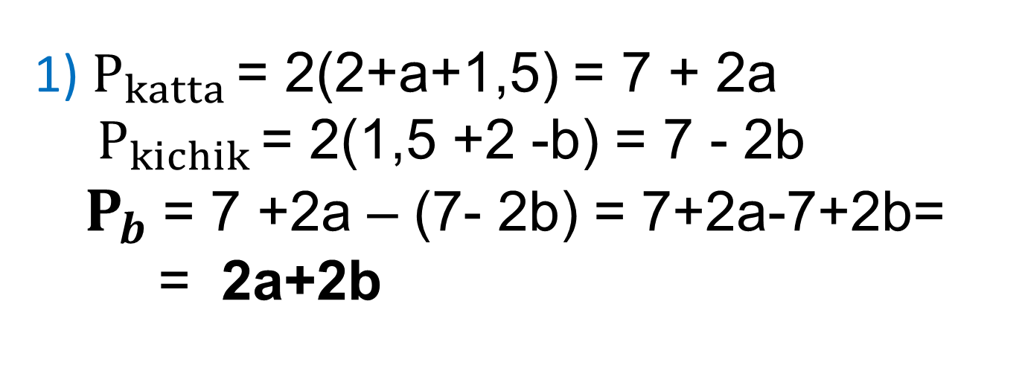
$P_{b}$ - ?, $S_{b}$ - ?
a
$P_{b}$= $P_{katta}$ - $P_{kichik}$
$S_{b}$= $S_{katta}$ - $S_{kichik}$
1) $P_{katta}$ = 2(2+a+1,5) = 7 + 2a
$P_{kichik}$ = 2(1,5 +2 -b) = 7 - 2b
$P_{b}$= 7 +2a – (7- 2b) = 7+2a-7+2b=
= 2a+2b
1,5
2
b
2) $S_{katta}$ = 2(a+1,5) = 2a +3
$S_{kichik}$ = 1,5(2 -b) = 3 - 1,5b
$S_{b}$= 2a + 3 - 3 + 1,5b = 2a +1,5b
Javob: 2a + 2b;
2a + 1,5 b.

Slide 8
№16 – topshiriq.
Geologlar o‘z yo‘nalishi bo‘yicha harakat qilib, otda soatiga c km tezlik bilan 3 soat-u 10 minut yurishdi; oqimning tezligi soatiga a km bo‘lgan daryoda oqim bo‘yicha 1 soat-u 40 minut solda suzishdi va soatiga
b km tezlik bilan 2 soat-u 30 minut piyoda yurishdi. Yo‘nalishning uzunligini s harfi bilan belgilab, geologlar bosib o‘tgan yo‘l formulasini yozing.
Agar a = 3,3 km/h, b = 5,7 km/h, c =10,5 km/h bo‘lsa,
Yonalishning uzunligini hisoblang.

Slide 9
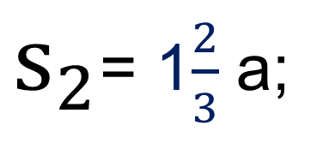
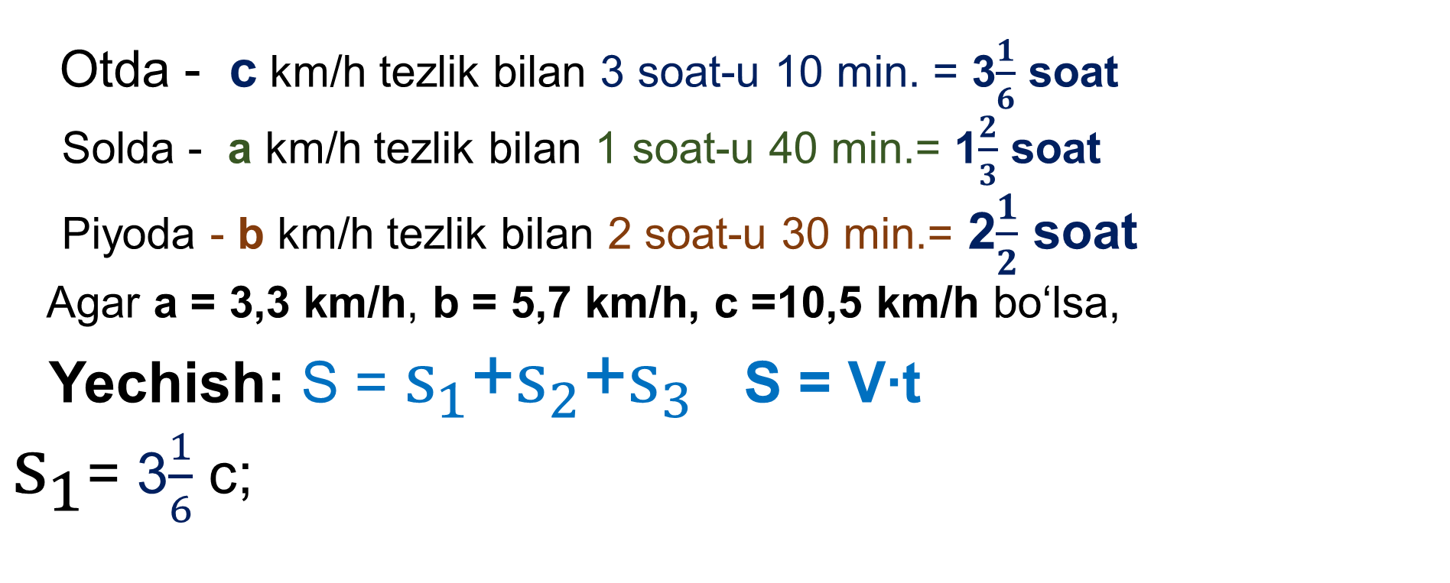
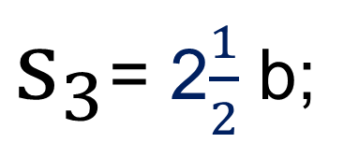
Otda - c km/h tezlik bilan 3 soat-u 10 min. = 3$\frac{1}{6}$ soat
Solda - a km/h tezlik bilan 1 soat-u 40 min.= 1$\frac{2}{3}$ soat
Piyoda - b km/h tezlik bilan 2 soat-u 30 min.= 2$\frac{1}{2}$ soat
Agar a = 3,3 km/h, b = 5,7 km/h, c =10,5 km/h bo‘lsa,
Yechish: S = $s_{1}$+$s_{2}$+$s_{3}$ S = V∙t
$s_{1}$= 3$\frac{1}{6}$ c;
S -? km
$s_{2}$= 1$\frac{2}{3}$ a;
$s_{3}$= 2$\frac{1}{2}$ b;
S = 3$\frac{1}{6}$ c + 1$\frac{2}{3}$ a +2$\frac{1}{2}$ b
= 3$\frac{1}{6}$ ∙10,5 + 1$\frac{2}{3}$ ∙ 3,3 +2$\frac{1}{2}$ ∙5,7=
= $\frac{19}{6}$ ∙ $\frac{21}{2}$ + $\frac{5}{3}$ ∙ $\frac{33}{10}$ + $\frac{5}{2}$ ∙ $\frac{57}{10}$ = 33,25 + 5,5 + 14,25 = 53(km)

Slide 10
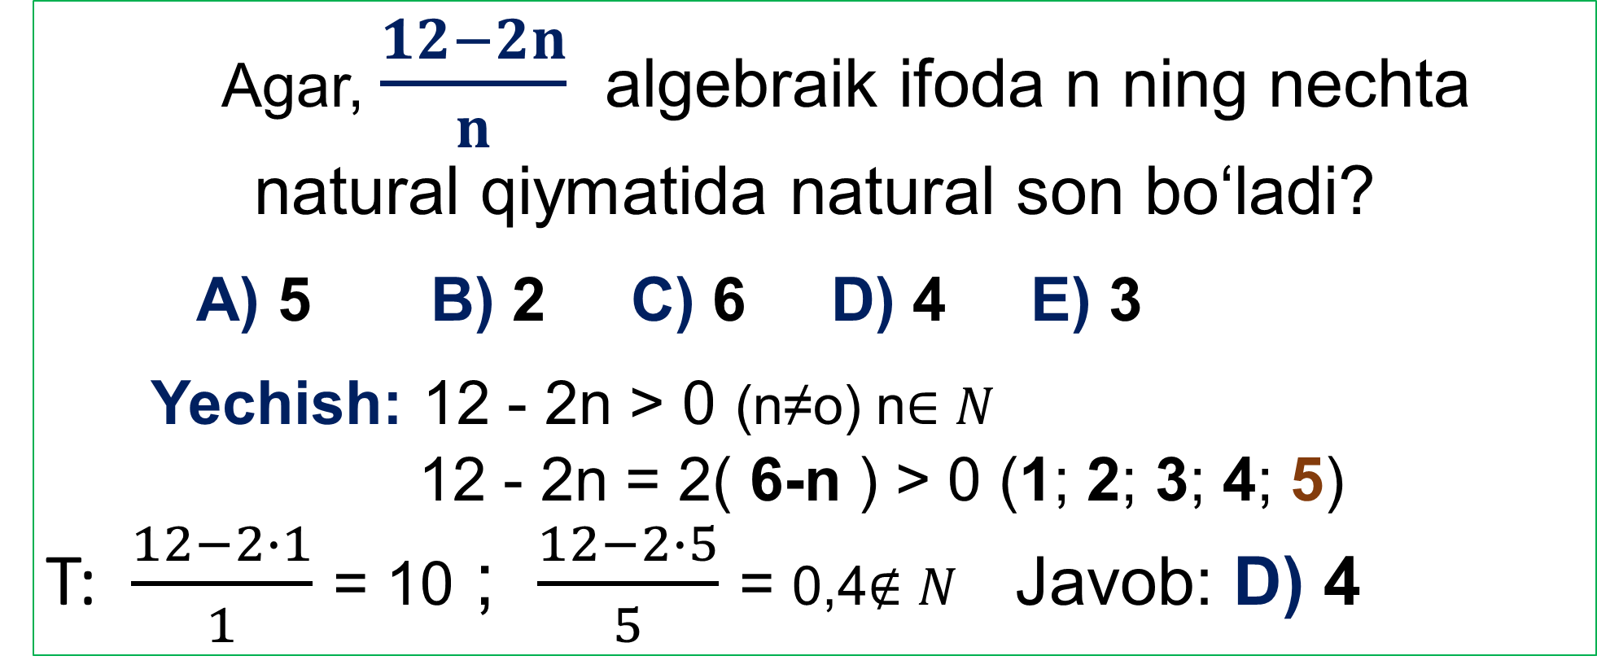
TEST
Agar, $\frac{12−2n}{n}$ algebraik ifoda n ning nechta natural qiymatida natural son bo‘ladi?
A) 5 B) 2 C) 6 D) 4 E) 3
Yechish: 12 - 2n > 0 (n≠o) n$∈N$
12 - 2n = 2( 6-n ) > 0 (1; 2; 3; 4; 5)
T: $\frac{12−2∙1}{1}$ = 10 ; $\frac{12−2∙5}{5}$ = 0,4$∉N$ Javob: D) 4

Slide 11
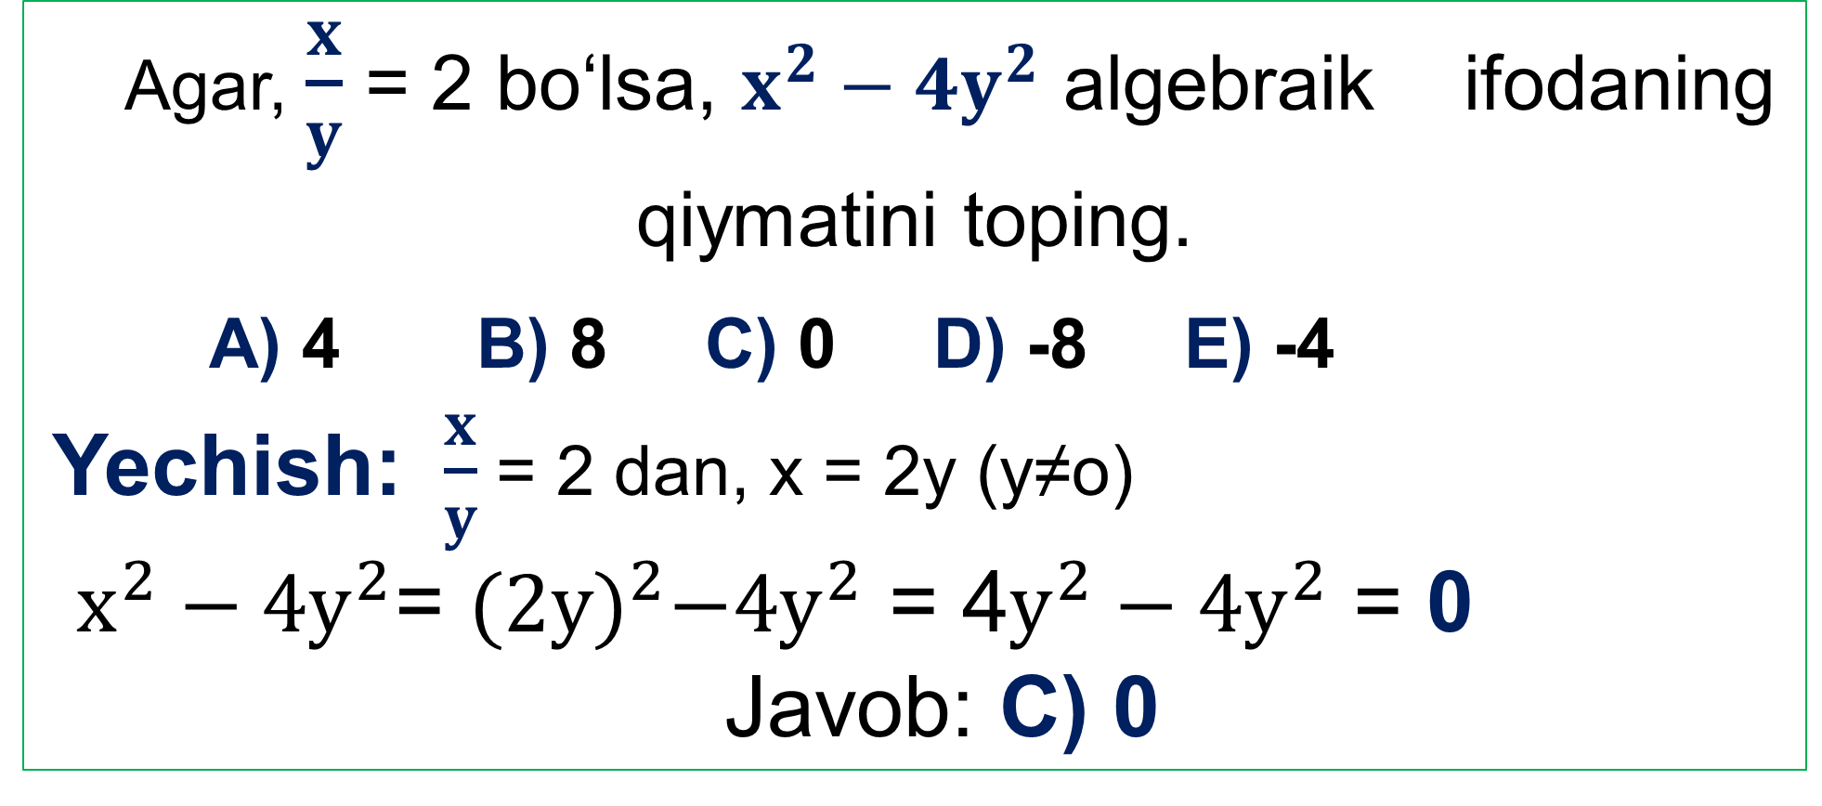
TEST
Agar, $\frac{x}{y}$ = 2 bo‘lsa, $x^{2}−{4y}^{2}$ algebraik ifodaning qiymatini toping.
A) 4 B) 8 C) 0 D) -8 E) -4
Yechish: $\frac{x}{y}$ = 2 dan, x = 2y (y≠o)
$x^{2}−{4y}^{2}$= ${(2y)}^{2}−{4y}^{2}$ = 4$y^{2}−{4y}^{2}$ = 0
Javob: C) 0

Slide 12
Mustaqil bajarish uchun topshiriqlar:
Darslikning 11- sahifasida
keltirilgan
12-,13-,15- topshiriqlarni bajarish.

