Slide 1

ALGEBRA
8-
sinf
MAVZU:ALGEBRAIK IFODALAR
:
O‘qituvchi: Yusupjonova Shahnoza Mirzatillayevna

Slide 2
Mustahkamlash
Sonli ifoda deb qanday birlashmaga aytiladi?
Sonli ifoda sonlardan tuzilib, amallar belgilari bilan birlashtiriladi.
2∙5- 45:(-5)+37; -2,5:10+2020

Slide 3
Mustahkamlash
Sonli ifodaning qiymati deb nimaga aytiladi?
Sonli ifodaning qiymati deb, shu sonli ifodada ko‘rsatilgan amallarni bajarish natijasida hosil bo‘lgan songa aytiladi.
-25∙5- 4,5:(-0,5)+37= -125+9+37= -79

Slide 4
Mustahkamlash
74; -5,4; 6021… sonlari
sonli ifoda bo‘lishi mumkinmi?
Sonli ifoda bitta sondan iborat bo‘lishi ham mumkin.
Uning qiymati shu sonning o‘zi bo‘ladi.

Slide 5
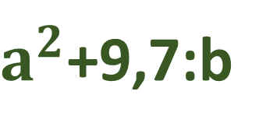
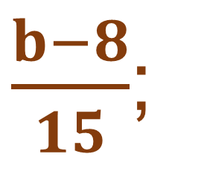
ALGEBRAIK IFODALAR
Algebraik ifoda sonlar va harflardan tuzilib, amallar belgilari bilan birlashtirilgan ifodadir.
$\frac{b−8}{15}$;
2a-6;
0,3+5n;
$a^{2}$+9,7:b

Slide 6
Algebraik ifodalar
Agar algebraik ifodaga kirgan harflar o‘rniga biror son qo‘yilsa va ko‘rsatilgan amallar bajarilsa, natijada, hosil qilingan son berilgan algebraik ifodaning son qiymati deyiladi.
a = 2, b = 5 bo‘lganda,
3a + 2b – 7= 3∙2 + 2 ∙5 – 7=16-7= 9

Slide 7
Algebraik ifodalar
Qo‘shish, ayirish va ko‘paytirish belgilari yordamida birlashtirilgan bir nechta ko‘phad-lardan iborat algebraik ifoda butun ifoda deyiladi.
5a²- 2ab + 6a -7ab - 6a²- 6a=
= 5a²- 6a²+ 6a- 6a -2ab- 7ab=
= - a²-9ab

Slide 8
Masala
Ikki sonning yig‘indisi 30 ga teng, sonlardan biri a. Shu sonlar ko‘paytmasini yozing.
Shu ko‘paytmaning qiymatini
a = -2 bo‘lganda hisoblang.

Slide 9
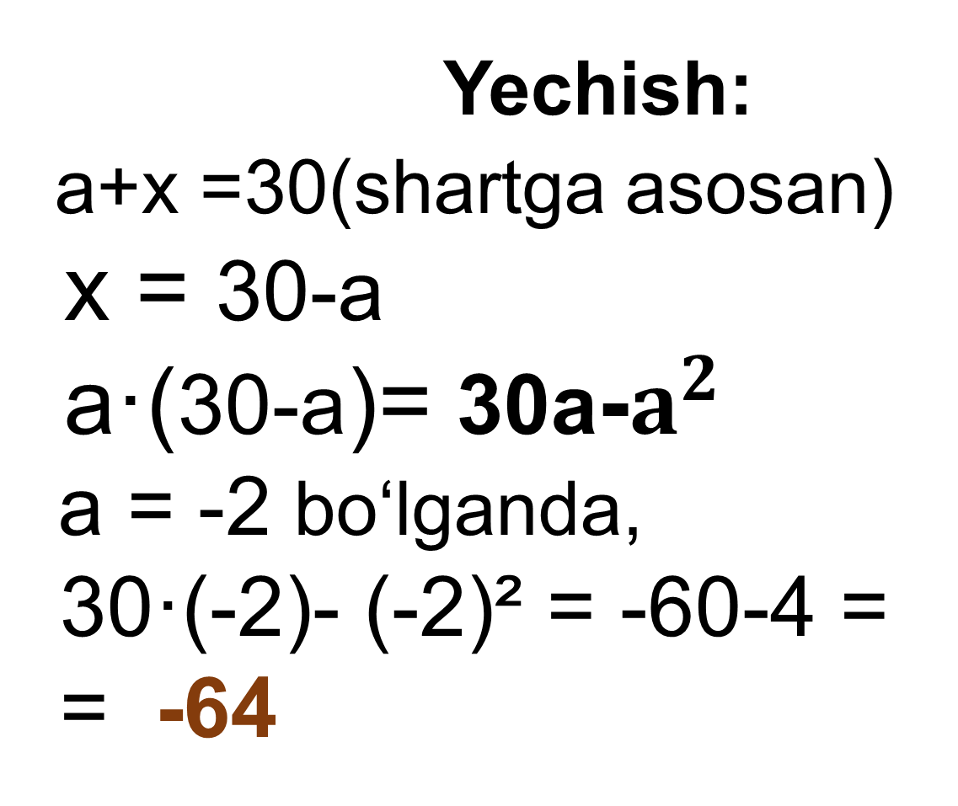
Masala
Yechish:
a+x =30(shartga asosan)
x = 30-a
a·(30-a)= 30a-$a^{2}$
a = -2 bo‘lganda,
30·(-2)- (-2)² = -60-4 =
= -64
Berilgan:
I son - a
II son - X
a·x - ?
30

Slide 10
№6 (3) Topshiriq:
x va y sonlar yig‘indisi bilan ular ayirmasining ko‘paytmasini yozing.
Hosil bo‘lgan algebraik ifodaning
x= 0,15, y= -0,75 da son qiymatini
toping.
(x+y)(x-y) - algebraik ifoda

Slide 11
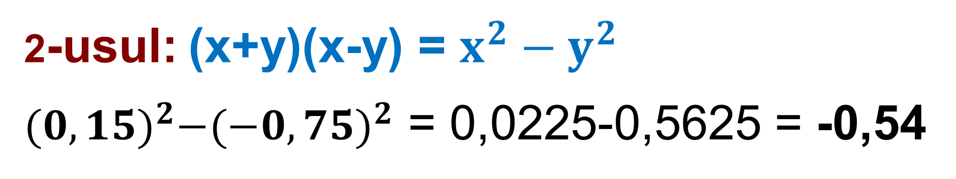
№6 (3) x= 0,15, y= -0,75
Yechish: 1- usul: (x+y)(x-y)
(0,15 + (-0,75) ∙ (0,15 - (-0,75)) =
= (0,15 - 0,75) ∙ (0,15 + 0,75) =
= -0,6 ∙ 0,9 = -0,54
2-usul: (x+y)(x-y) = $x^{2}−y^{2}$
${(0,15)}^{2}−{(−0,75)}^{2}$ = 0,0225-0,5625 = -0,54

Slide 12


№7(2). p = $\frac{1}{3}$, $l$ =1da hisoblang.
$\frac{\left(3p+ 1\right)∙2∙p}{\frac{1}{3} −l}$ + $\frac{1}{3}$= $\frac{\left(3∙ \frac{1}{3} + 1\right)∙2∙ \frac{1}{3}}{\frac{1}{3} −1}$ + $\frac{1}{3}$ =
= $\frac{2∙2∙\frac{1}{3}}{−\frac{2}{3} }\text{ + }\frac{1}{3}$ = $\frac{\frac{4}{3}}{−\frac{2}{3} }\text{ + }\frac{1}{3}$ =
= $\frac{4}{−2}+\frac{1}{3}=−\frac{5}{3}=−1\frac{2}{3}$

Slide 13

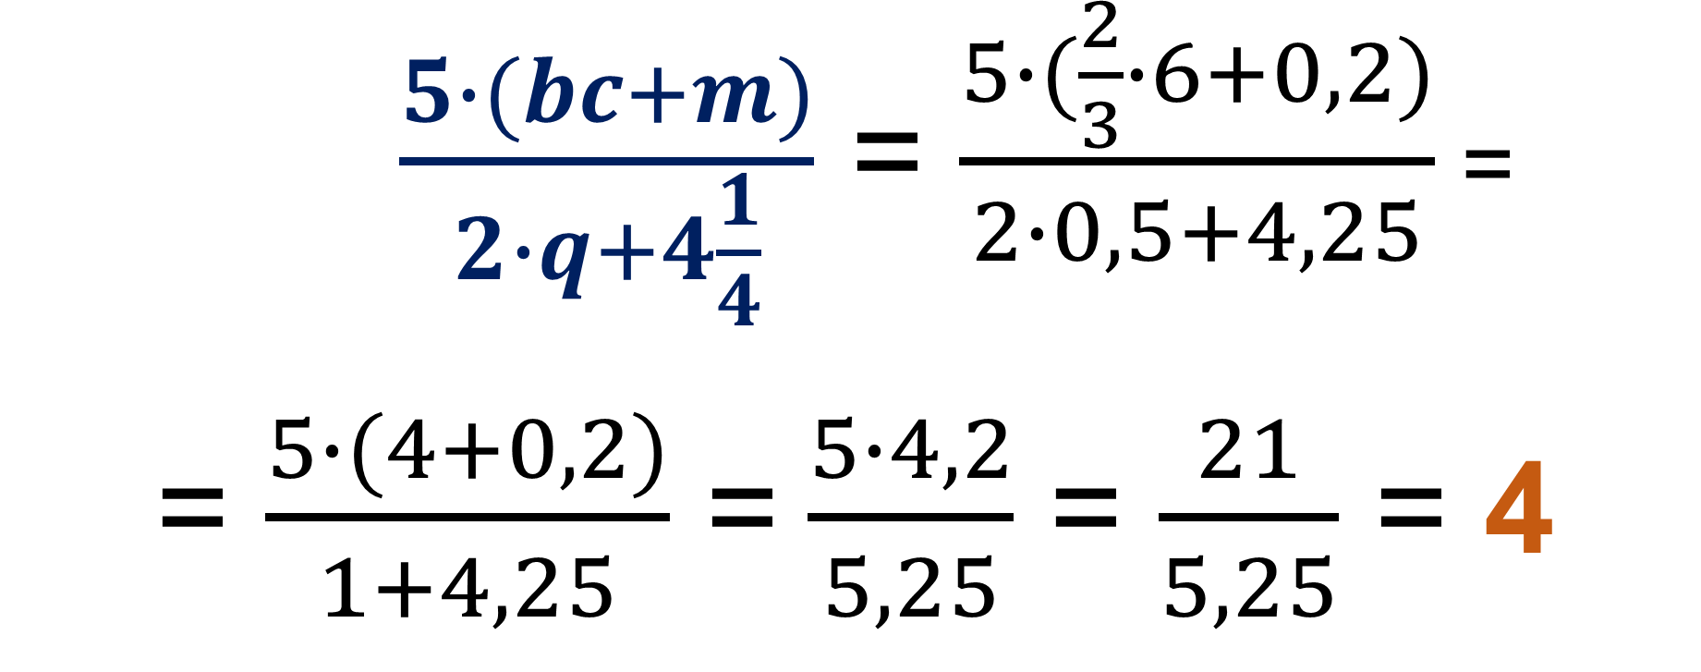
№8(2). b= $\frac{2}{3}$; c=6; q=0,5; m=0,2$.$
$\frac{5∙(bc+m)}{2∙q+4\frac{1}{4}}$ = $\frac{5∙(\frac{2}{3}∙6+0,2)}{2∙0,5+4,25}$ =
= $\frac{5∙(4+0,2)}{1+4,25}$ = $\frac{5∙4,2}{5,25}$ = $\frac{21}{5,25}$ = 4

Slide 14
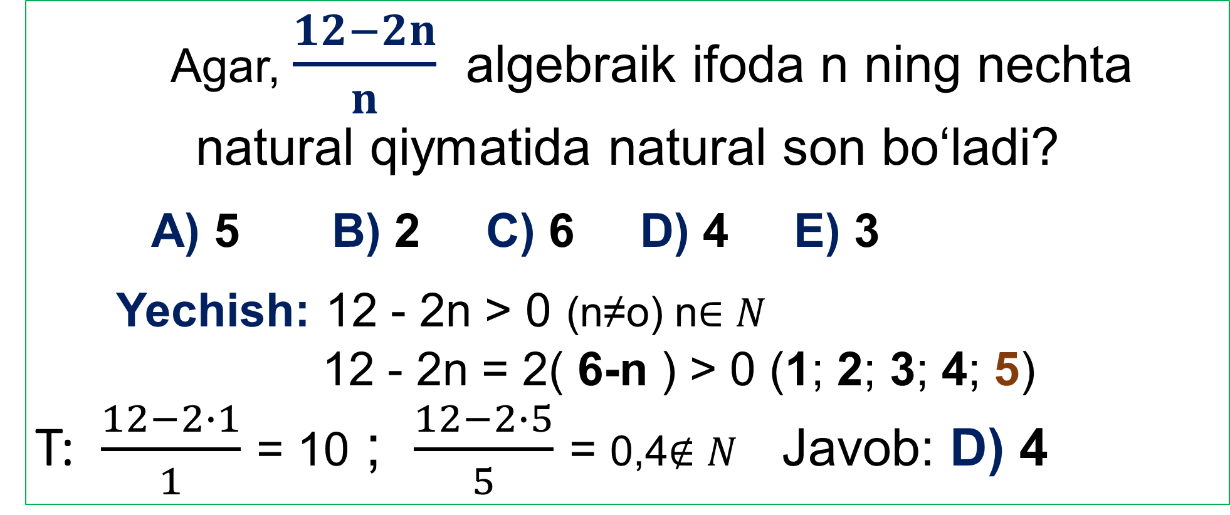
TEST
Agar, $\frac{12−2n}{n}$ algebraik ifoda n ning nechta natural qiymatida natural son bo‘ladi?
A) 5 B) 2 C) 6 D) 4 E) 3
Yechish: 12 - 2n > 0 (n≠o) n$∈N$
12 - 2n = 2( 6-n ) > 0 (1; 2; 3; 4; 5)
T: $\frac{12−2∙1}{1}$ = 10 ; $\frac{12−2∙5}{5}$ = 0,4$∉N$ Javob: D) 4

Slide 15
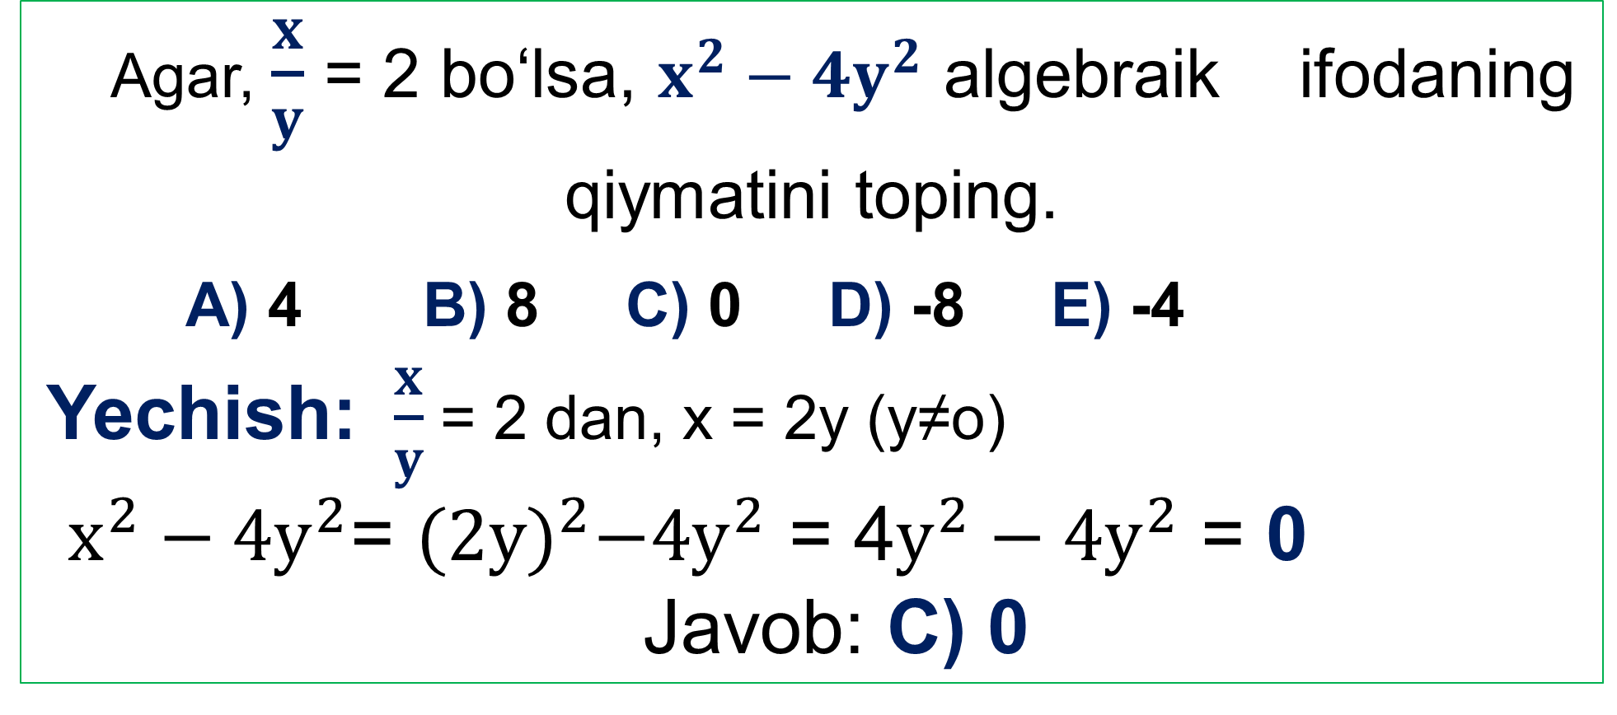
TEST
Agar, $\frac{x}{y}$ = 2 bo‘lsa, $x^{2}−{4y}^{2}$ algebraik ifodaning qiymatini toping.
A) 4 B) 8 C) 0 D) -8 E) -4
Yechish: $\frac{x}{y}$ = 2 dan, x = 2y (y≠o)
$x^{2}−{4y}^{2}$= ${(2y)}^{2}−{4y}^{2}$ = 4$y^{2}−{4y}^{2}$ = 0
Javob: C) 0

Slide 16
Mustaqil bajarish uchun topshiriqlar:
Darslikning 10- sahifasida
keltirilgan
6-,8-,10- topshiriqlarni bajarish.

Slide 17
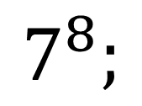
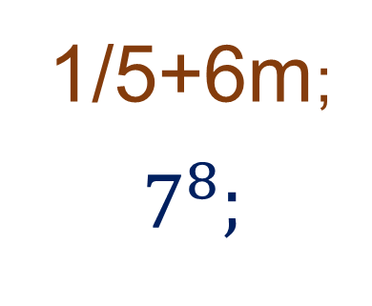
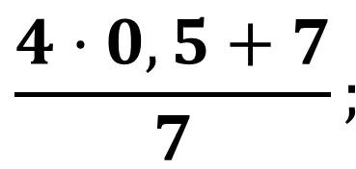
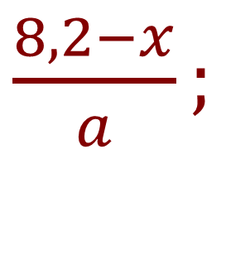
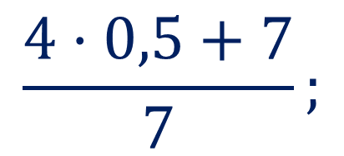
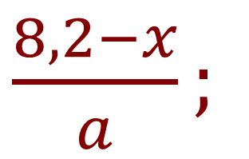
Sonli ifodalar
Algebraik ifodalar
-7,8·5;
$$\frac{4·0,5+7}{7};$$
7k-4,2m ;
3a-1;
$\frac{8,2−x}{a};$
1000!;
0,5;
2020b²;
$$7^{8};$$
1/5+6m;
-7,8·5;
7k-4,2m ;
1000!;
3a-1;
1/5+6m;
$$7^{8};$$
$\frac{8,2−x}{a};$
$$\frac{4·0,5+7}{7};$$
0,5;
2020b²;

