Slide 1
ALGEBRA
8-
sinf
Mavzu: 7-sinf ’’Algebra’’
kursini takrorlash
O‘qituvchi:Yusupjonova Shaxnoza
Mirzatillayevna

Slide 2
Masalalarni tenglamalar
yordamida yechish uchun:
Noma’lum son harf bilan belgilanadi;
Shartdan foydalanib, tenglama tuziladi;
Tenglama yechiladi;
Qiymat shartga muvofiq talqin qilinadi.

Slide 3
7- Masala
Sayyoh 3 km masofani va qolgan yo‘lning 1/3 qismini o‘tgach , hisoblab ko‘rsa, jami yo‘lning yarmiga yetish uchun yana 1 km masofa qolibdi. Jami yo‘l necha kilometr ekan?

Slide 4

Qismga doir masalalar №7
Berilgan :
Bosib o‘tdi- 3 km va yo‘lning 1/3 qismi
Yarmiga borish uchun qoldi - 1 km
Jami yo‘l- ? km
X km
3 km
$$\frac{x−3}{3}$$
1 km
0,5 x

Slide 5
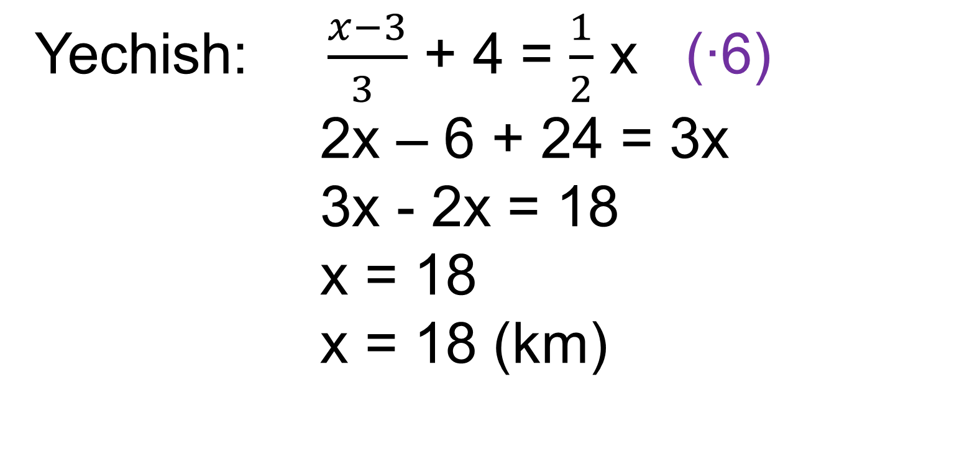
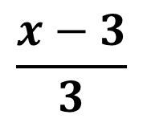
$$\frac{x−3}{3}$$
4 km
0,5 x
Yechish: $\frac{x−3}{3 }$ + 4 = $\frac{1}{2}$ x (∙6)
2x – 6 + 24 = 3x
3x - 2x = 18
x = 18
x = 18 (km)
Javob: Jami 18 km

Slide 6
№9 (1) Masala
Bir son ikkinchisining 45% ini tashkil
qiladi. Sonlardan biri ikkinchisidan
66 taga ko‘p bo‘lsa,shu sonlarni toping.

Slide 7
№9 (1). Yechim
1- son x bo‘lsin
2-son 45%x= 0,45x bo‘ladi.
1) x-0,45x=66
0,55x=66
x=66:0,55
x=120
2) 0,45∙120=54
Javob: 120 va 54

Slide 8
Masala
To‘g‘ri to‘rtburchakning bo‘yi 30% ga orttirilsa va eni 30% ga kamaytirilsa, uning yuzi qanday o‘zgaradi?

Slide 9
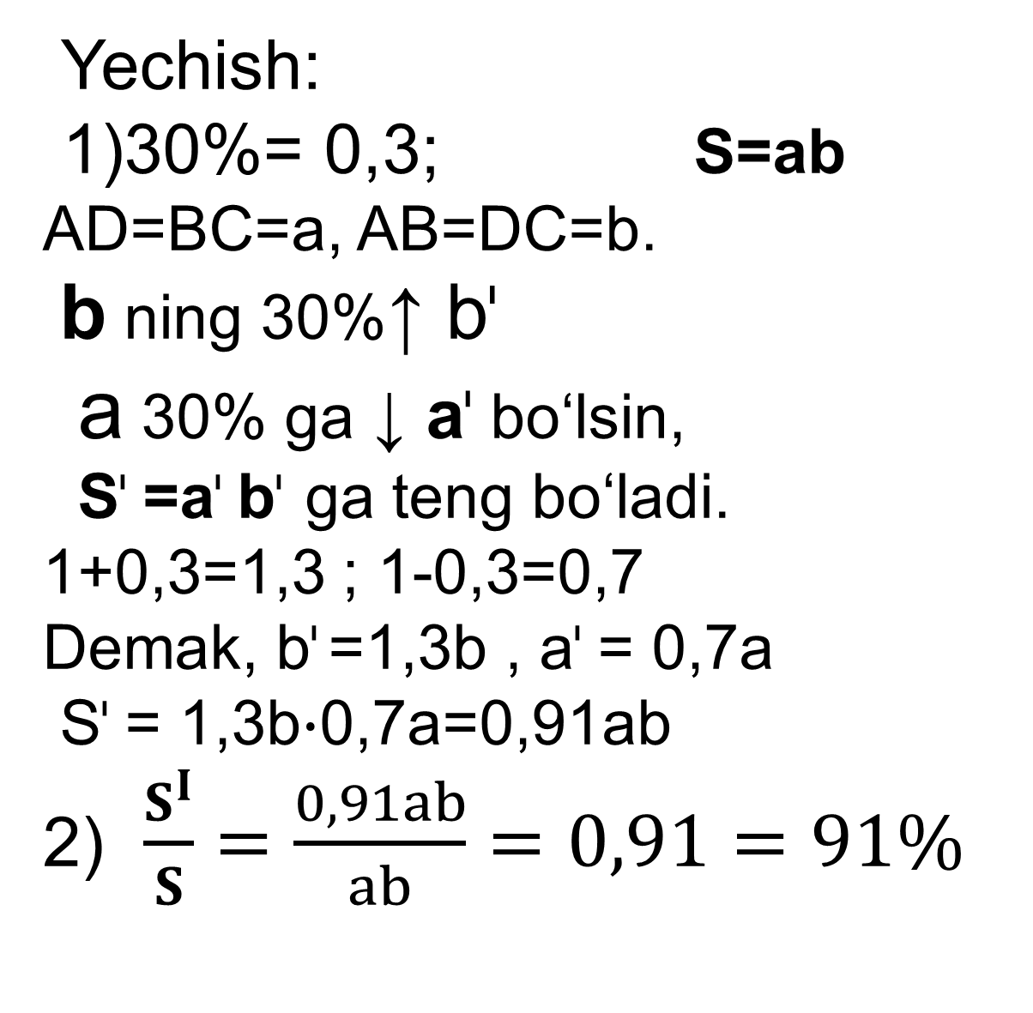
Yechish:
1)30%= 0,3; S=ab
AD=BC=a, AB=DC=b.
b ning 30%↑ b^{ᶥ}
a 30% ga ↓ a^{ᶥ} bo‘lsin,
S^{ᶥ} =a^{ᶥ} b^{ᶥ} ga teng bo‘ladi.
1+0,3=1,3 ; 1-0,3=0,7
Demak, b^{ᶥ} =1,3b , a^{ᶥ} = 0,7a
S^{ᶥ} = 1,3b$∙$0,7a=0,91ab
2) $\frac{S^{I}}{S}=\frac{0,91ab}{ab}=0,91=91\%$
A^{ᶥ}
a^{ᶥ}
D^{ᶥ}
A
D
a
b
b^{ᶥ}
b
a^{ᶥ}
D^{ᶥ}
B
a
C^{ᶥ}
C
3) 100% - 91%= 9%
Javob: 9% ga
o‘zgaradi.

Slide 10
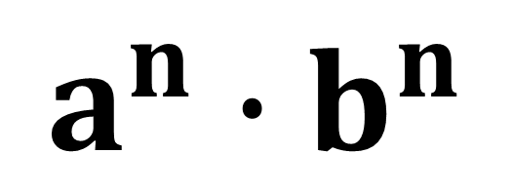
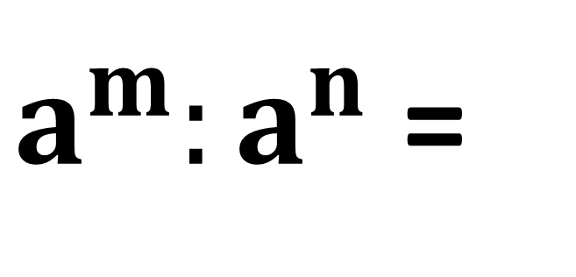
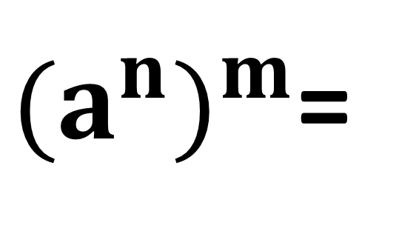
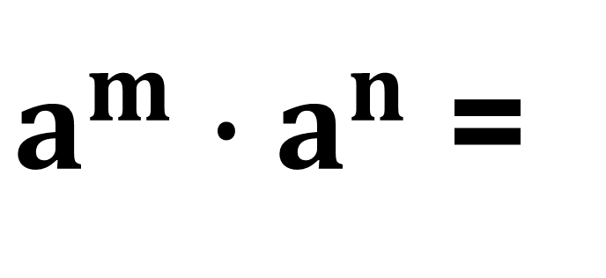
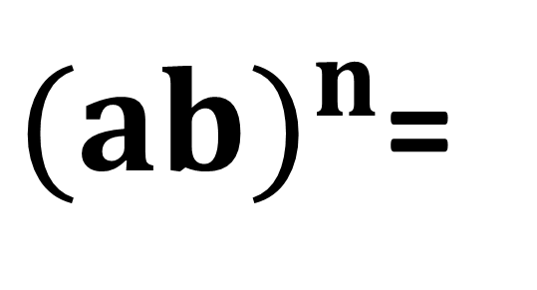
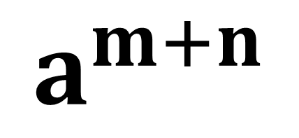
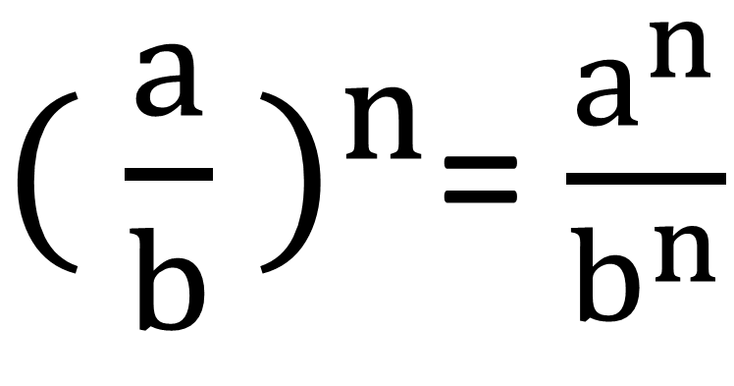
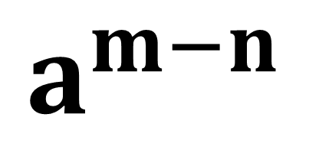
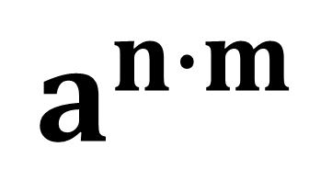
Ko‘rsatkichli daraja xossalari
$a^{m}∙a^{n}$ =
$$a^{m+n}$$
${( \frac{a}{b} )}^{n}$= $\frac{a^{n}}{b^{n}}$
$a^{m}:a^{n}$ =
$$a^{m−n}$$
${(ab)}^{n}$=
$$a^{n}{∙b}^{n}$$
${(a^{n})}^{m}$=
$$a^{n∙m}$$

Slide 11
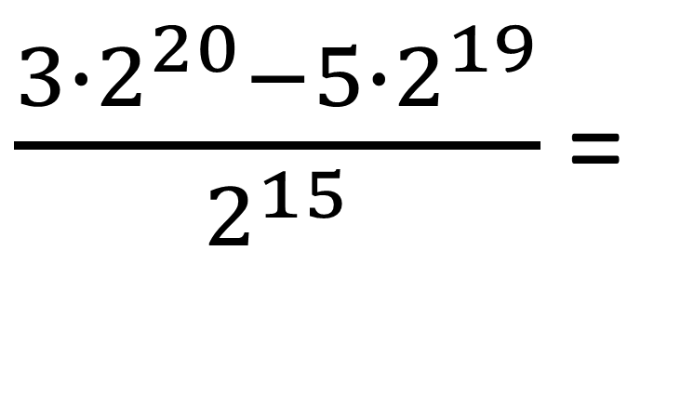
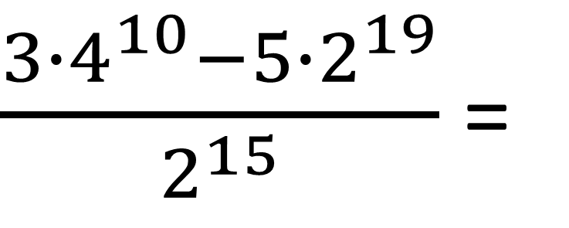
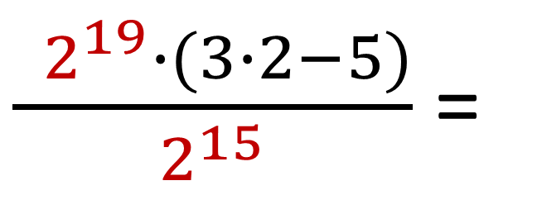
№11(1) Hisoblang:
$\frac{3{∙4}^{10}−5∙2^{19}}{2^{15}}$=
$\frac{3{∙2}^{20}−5∙2^{19}}{2^{15}}$ =
$\frac{ 2^{19}∙(3∙2−5)}{2^{15}}$ =
$2^{19−15}$ = $2^{4}=$ 16

Slide 12
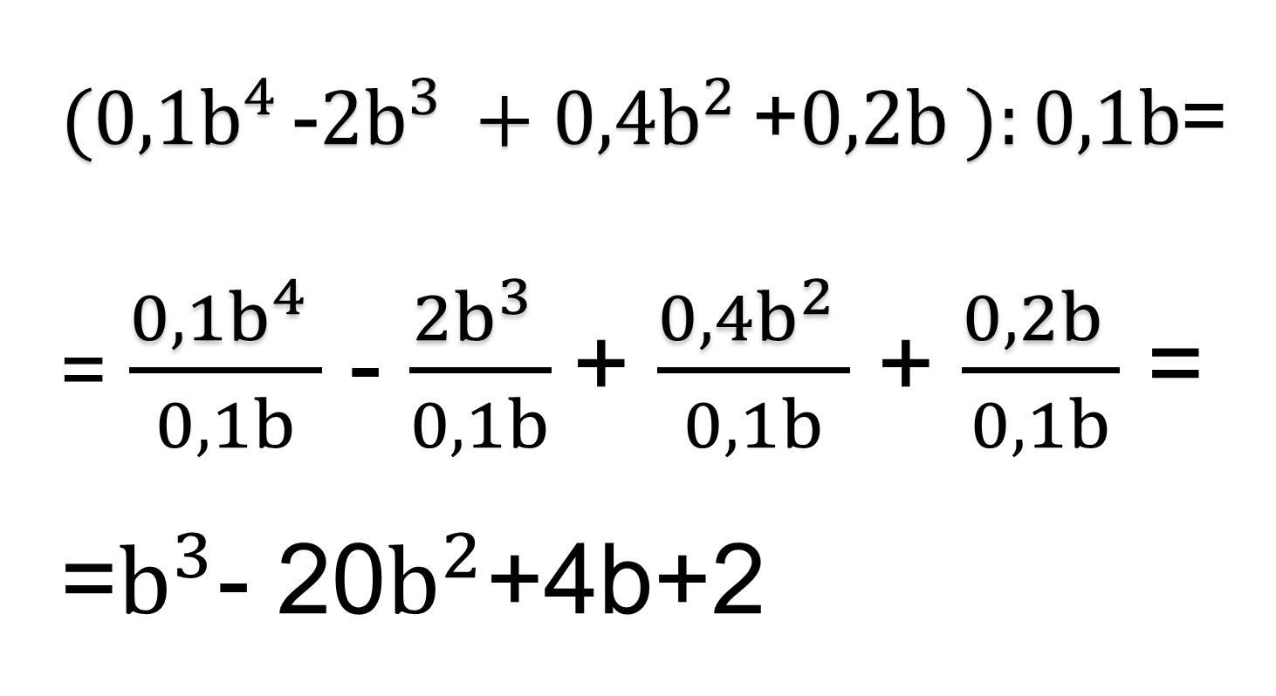
№16(3) Ifodani soddalashtiring:
${(0,1b}^{4 }$-${2b}^{3 }+{0,4b}^{2 }$+${0,2b}^{ }):0,1b$=
= $\frac{{0,1b}^{4 }}{0,1b}$ - $\frac{{2b}^{3 }}{0,1b}$+ $\frac{{0,4b}^{2 }}{0,1b}$ + $\frac{{0,2b}^{ }}{0,1b}$ =
=$b^{3}$- 20$b^{2}$+4b+2

Slide 13
Qisqa ko‘paytirish formulalari
(a+b)²=a²+2ab+b²
(a-b)²=a²-2ab+b²
a²-b²=(a-b)(a+b)
a³-b³=(a-b)(a²+ab+b²)
a³+b³=(a+b)(a²-ab+b²)
(a-b)³=a³-3a²b+3ab²-b³
(a+b)³=a³+3a²b+3ab²+b³

Slide 14
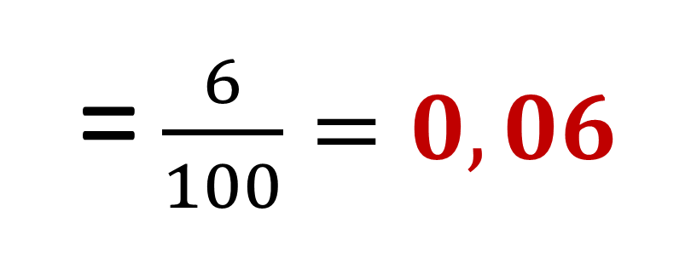
№19(4) Hisoblang:
$\frac{{53}^{2}−53∙94+{47}^{2}}{{53}^{2}−{47}^{2}}$=
$\frac{{53}^{2}−2∙53∙47+{47}^{2}}{{53}^{2}−{47}^{2}}$=
$=\frac{(53−{47)}^{2}}{(53−47)(53+47)}=\frac{53−47}{53+47}=$
= $\frac{6}{100}=0,06$

Slide 15
Darslikning 4-5- sahifasida joylashgan 10,-11-,16-,19– topshiriqlarni bajarish.
Mustaqil bajarish uchun topshiriqlar

