Slide 1

GEOMETRIYA
7- sinf
MAVZU: MUSTAHKAMLASH DARSI

Slide 2





TEST
Kesmalarning uzunliklari a, b va c larning qaysi qiymatlarida
bu kesmalardan uchburchak yasash mumkin emas?
A) a = 1, b = 2, c = 3;
B) a = 2, b = 3, c = 4;
D) a = 3, b = 4, c = 5;
E) a = 6, b = 4, c = 3.
b
c
3 $=$ 1 + 2
4 $<$ 2 + 3
a < b + c
5 $<$ 3 + 4
6 $<$ 4 + 3
a

Slide 3
TEST
Geometrik yasashlarni bajarish uchun qaysi o‘quv qurollaridan foydalanishga ruxsat beriladi?
A) Transportir;
B) Transportir, chizg‘ich;
D) Sirkul, chizg‘ich;
E) Sirkul, transportir.

Slide 4
TEST
Geometrik yasashlarni bajarishda chizg‘ichdan qanday vazifalarni bajarishga ruxsat beriladi.
A) Kesmani o‘lchashga;
B) Kesma, to‘g‘ri chiziq chizishga;
D) Nuqtadan o‘tuvchi va berilgan to‘g‘ri chiziqqa perpendikulyar to‘g‘ri chiziqni chamalab chizishga;
E) Kesmani o‘lchab, uni o‘rtasini topishga.

Slide 5
TEST
Uchburchakning perimetri tomonlaridan mos ravishda 14 cm, 16 cm va 24 cm uzun bo‘lsa, uchburchakning eng katta tomonini toping.
A) 12 cm;
B) 13 cm;
D) 15 cm;
E) 16 cm.

Slide 6
Uchburchakning perimetri tomonlaridan mos ravishda
14 cm, 16 cm va 24 cm uzun bo‘lsa, uchburchakning eng
katta tomonini toping.
P = a + b + c
a
b
a = P -14
+
b = P -16
c
c = P -24
P = 3P - 54
2P = 54
P = 54:2
P = 27 (cm)
a = 27- 14 = 13 (cm),
b = 27- 16 = 11 (cm),
c = 27 – 24 = 3 (cm).

Slide 7
TEST
Uchburchakning perimetri tomonlaridan mos ravishda 14 cm, 16 cm va 24 cm uzun bo‘lsa, uchburchakning eng katta tomonini toping.
A) 12 cm;
B) 13 cm;
D) 15 cm;
E) 16 cm.

Slide 8
TEST
Teng yonli ABC uchburchakda (AB = BC) BH - balandlik. Agar ABC va BHC uchburchaklarning perimetrlari mos ravishda 48 cm va 32 cm bo‘lsa, BH balandlikning
uzunligini toping.
A) 4 cm;
B) 6 cm;
D) 5 cm;
E) 8 cm

Slide 9
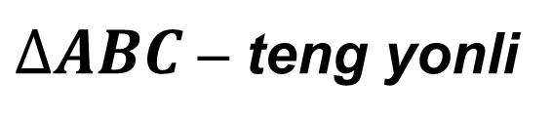
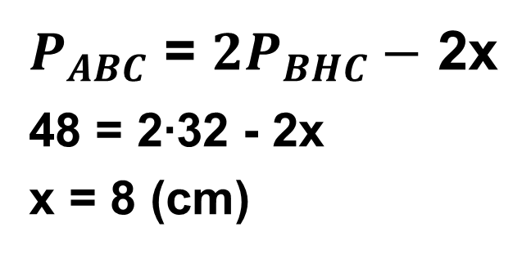
Teng yonli ABC uchburchakda (AB = BC) BH - balandlik. Agar ABC va BHC uchburchaklarning perimetrlari mos ravishda 48 cm va 32 cm bo‘lsa, BH balandlikning
uzunligini toping.
$∆ABC$ – teng yonli
B
$P_{ABC}$ = $2P_{BHC}−$ 2x
48 = 2∙32 - 2x
x = 8 (cm)
x
A
H
C

Slide 10
TEST
Teng yonli ABC uchburchakda (AB = BC) BH - balandlik. Agar ABC va BHC uchburchaklarning perimetrlari mos ravishda 48 cm va 32 cm bo‘lsa, BH balandlikning
uzunligini toping.
A) 4 cm;
B) 6 cm;
D) 5 cm;
E) 8 cm

Slide 11
AMALIY TOPSHIRIQ
1. Ixtiyoriy uchburchak chizing. Transportirdan foydalanib, uning bissektrisalarini o‘tkazing. Nimani payqadingiz? Tajribani yana ikkita uchburchak uchun bajarib ko‘ring va aniqlangan xossani faraz ko‘rinishida ifodalang.
2. Ixtiyoriy o‘tkir burchakli uchburchak chizing. Go‘niyadan foydalanib, uning baland liklarini o‘tkazing. Nimani payqadingiz? Tajribani yana ikkita uchburchak uchun bajarib ko‘ring va aniqlangan xossani faraz ko‘rinishida ifodalang.

Slide 12
AMALIY TOPSHIRIQ
3. Ixtiyoriy uchburchak chizing. Uning medianalarini o‘tkazing. Nimani payqadingiz? Tajribani yana ikkita uchburchak uchun bajarib ko‘ring va aniqlanga
xossani faraz ko‘rinishida ifodalang.
A

Slide 13
Mustaqil bajarish uchun topshiriqlar:
123-betdagi VI bob bo‘yicha
1-6 topshiriqlarni bajarish.
(137- bet)

