Slide 1

GEOMETRIYA
7- sinf
MAVZU: MASALALAR YECHISH

Slide 2
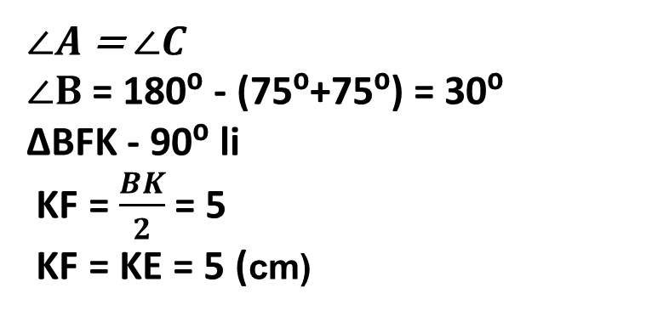
MASALA
Teng yonli ABC uchburchakda (AB = BC) asosdagi burchak 75⁰, AK - uchburchakning bissektrisasi, BK = 10 sm. K nuqtadan uchburchakning AC asosigacha bo‘lgan masofani toping.
$∠A$ = $∠C$
$∠B$ = 180⁰ - (75⁰+75⁰) = 30⁰
∆BFK - 90⁰ li
KF = $\frac{BK}{2}$ = 5
KF = KE = 5 (cm)
B
30⁰
10
F
K
75⁰
Javob: 5 cm
A
C
E

Slide 3
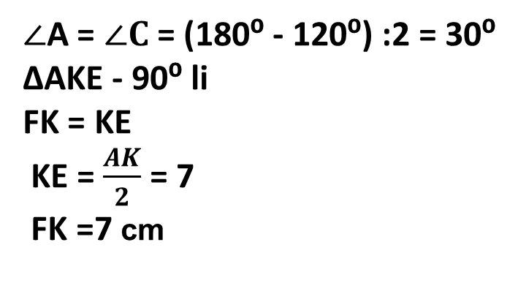
MASALA
Teng yonli ABC uchburchakning (AB = BC) uchidagi burchagi 120⁰ ga teng, CK - bissektrisa, AK =14sm. K nuqtadan BC to‘g‘ri chiziqqacha masofani toping.
F
$∠$A = $∠C$ = (180⁰ - 120⁰) :2 = 30⁰
∆AKE - 90⁰ li
FK = KE
KE = $\frac{AK}{2}$ = 7
FK =7 cm
B
?
120⁰
K
14
C
30⁰
A
E
Javob: 7 cm

Slide 4
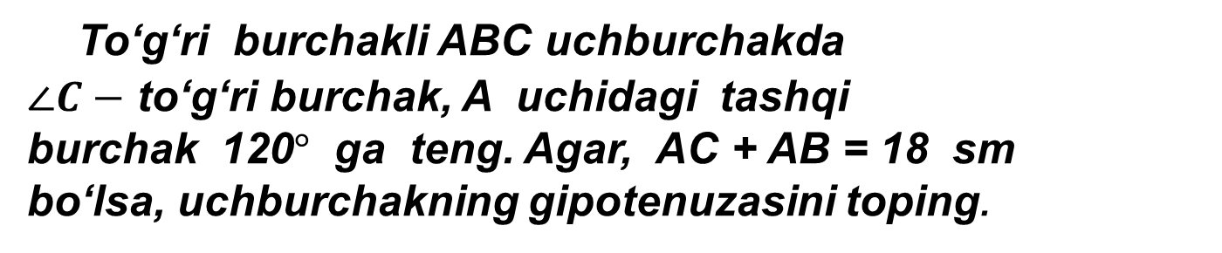
Masala
To‘g‘ri burchakli ABC uchburchakda
$∠C−$ to‘g‘ri burchak, A uchidagi tashqi
burchak 120$°$ ga teng. Agar, AC + AB = 18 sm
bo‘lsa, uchburchakning gipotenuzasini toping.
c
120°
?
A
B
4
120°
60°
A
C
b

Slide 5
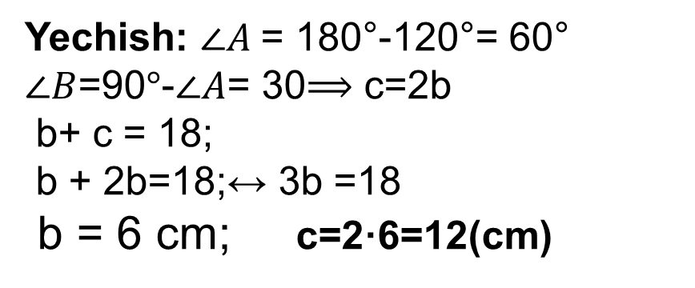
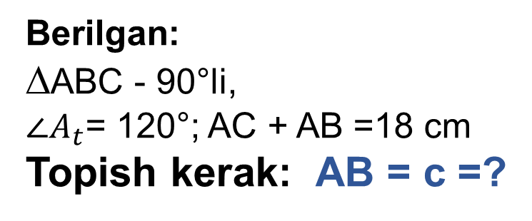
Berilgan:
∆ABC - 90°li,
${∠A}_{t}$= 120°; AC + AB =18 cm
Topish kerak: AB = c =?
B
30°
c
Yechish: $∠A$= 180°-120°= 60°
$∠B$=90$°$-$∠A$= 30$⟹$ c=2b
b+ c = 18;
b + 2b=18;↔ 3b =18
b = 6 cm; c=2·6=12(cm)
120°
60°
A
C
b
Javob: 12 cm

Slide 6


Masala
A, B, C nuqtalar bir to‘g‘ri chiziqda yotadi. Agar
AB = 2,7 m va AC=3,2 m bo‘lsa, BC kesma uzunligini toping. Masala nechta yechimga ega?
C $∈$AB
A $∈B$C
1)
2)
A
B
C
B
A
C

Slide 7
1)
2)
A
B
C
B
A
C
Berilgan:
AB = 2,7 m
AC = 3,2 m
BC =?
Yechish:
BC = AC – AB
BC = 3,2 – 2,7 = 0,6 m.
Berilgan:
AB = 2,7 m
AC = 3,2 m
BC = ?
Yechish:
BC = AB + AC
BC = 2,7+ 3,2 = 5,9 m
Javob: 0,6 m yoki 5,9 m

Slide 8
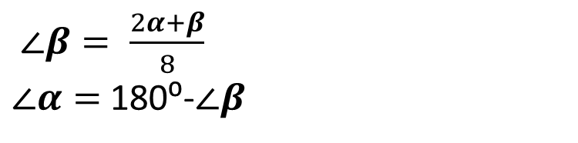




MASALA
Ikki to‘g‘ri chiziqning kesishishidan hosil bo‘lgan burchaklardan biri qolgan burchaklar yig‘indisidan
8 marta kichik. Bu burchaklar har birining kattaligini toping.
$∠β= \frac{2α+β}{8}$
$∠α=$180⁰-$∠β$
$$β$$
$$α$$
140⁰ va 40⁰.
$$α$$
$$β$$

Slide 9
MASALA
ABC uchburchakda AK va BM balandliklar O nuqtada kesishadi. Agar uchburchakning A va B burchaklari mos ravishda 72⁰ va 60⁰ ga teng bo‘lsa, AOB burchakni toping
B
K
60⁰
x
O
Javob: 132⁰
C
A
72⁰
N

Slide 10

MUSTAQIL BAJARISH UCHUN TOPSHIRIQLAR:
№ 10, № 12, № 14 (136-bet).

Slide 11
Chizma aosida noma’lumni toping
60 см
А
Найти расстояние от точки А до прямой а.
В
30°
а

Slide 12
Chizma aosida noma’lumni toping
28 см
В
С
45°
45°
Найти расстояние от точки А до прямой а.
А

