Slide 1

GEOMETRIYA
7-
sinf
Mavzu:
Masalalar yechish

Slide 2
ESLATMA!
Masala yechishni
o’rganish uchun
ko’proq
masala yechish kerak!
Masalaga oid chizmani to’g’ri chiza olish va qo’shimcha chizmalarni topa olish- masalaning yarmini yechish demakdir

Slide 3
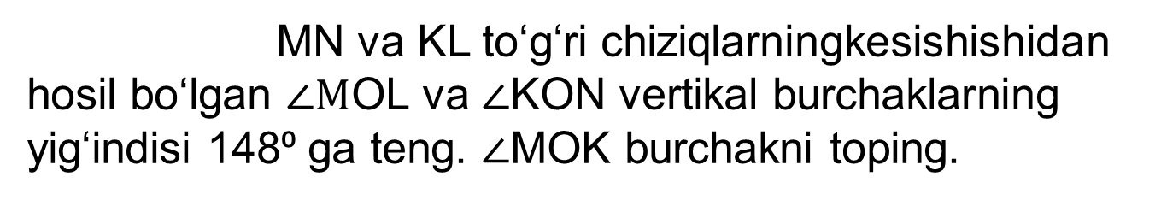
MN va KL to‘g‘ri chiziqlarningkesishishidan hosil bo‘lgan $∠M$OL va $∠$KON vertikal burchaklarning yig‘indisi 148⁰ ga teng. $∠$MOK burchakni toping.
1- masala
L
N
М
О
K

Slide 4
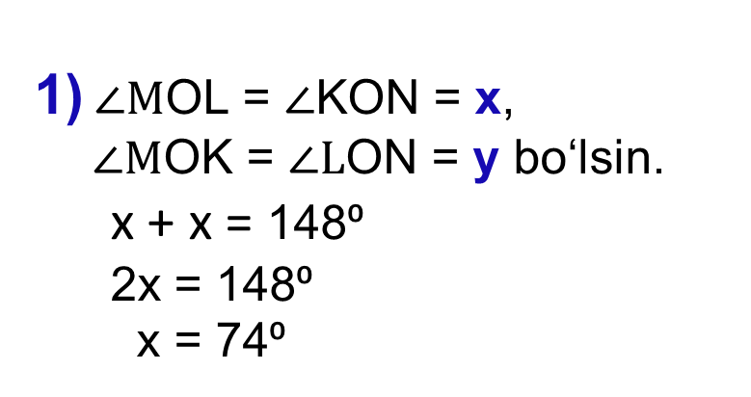
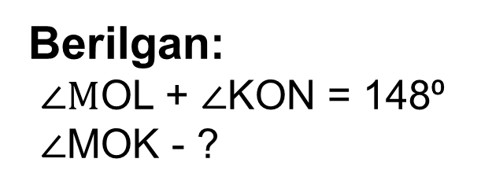
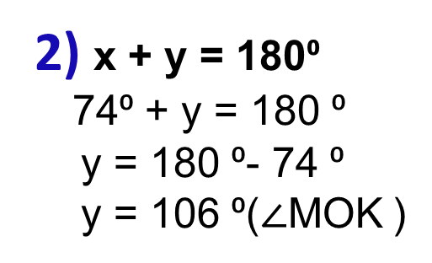
Berilgan:
$∠M$OL + $∠$KON = 148⁰
$∠$MOK - ?
N
y
L
x
О
K
М
Yechish:
1)$∠M$OL = $∠$KON = x,
$∠M$OK = $∠L$ON = y bo‘lsin.
x + x = 148⁰
2x = 148⁰
x = 74⁰
2) x + y = 180⁰
74⁰ + y = 180 ⁰
y = 180 ⁰- 74 ⁰
y = 106 ⁰($∠$MOK )
Javob: 106⁰

Slide 5
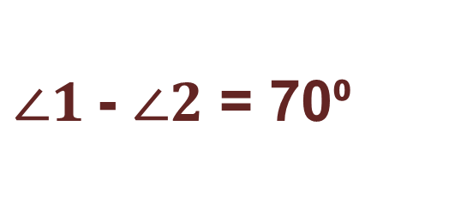
2- masala
Qo‘shni burchaklarning ayirmasi
70⁰ ga teng bo‘lsa, bu burchaklarning kichigini toping.
$∠1$- $∠2$ = 70⁰
1
2

Slide 6
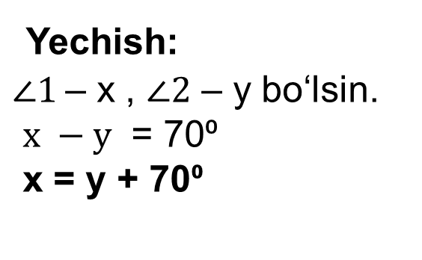
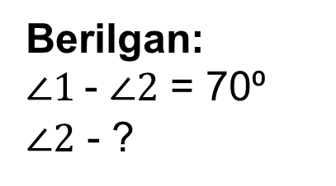
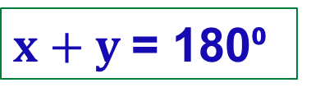
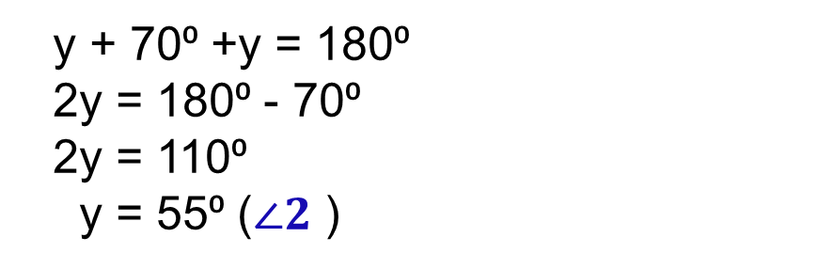
Berilgan:
$∠1$- $∠2$ = 70⁰
$∠2$ - ?
x
y
$x+y$= 180⁰
Yechish:
$∠1$– x , $∠2$ – y bo‘lsin.
$x −y$ = 70⁰
x = y + 70⁰
y + 70⁰ +y = 180⁰
2y = 180⁰ - 70⁰
2y = 110⁰
y = 55⁰ ($∠2$ )
Javob: 55⁰

Slide 7
3- masala
Burchak bissektrisasi shu burchakning tomoni bilan 56⁰ li burchak hosil qiladi. Bu burchakka qo‘shni bo‘lgan burchakni toping.
B
C
x
56⁰
A
D
O

Slide 8
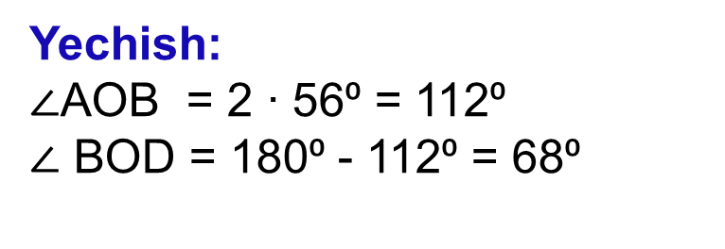
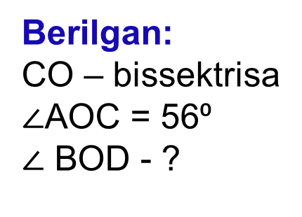
B
Berilgan:
CO – bissektrisa
$∠$AOC = 56⁰
$∠$ BOD - ?
C
x
56⁰
A
D
O
Yechish:
$∠$AOB = 2 ∙ 56⁰ = 112⁰
$∠$ BOD = 180⁰ - 112⁰ = 68⁰
(bissektrisa xossasiga asosan),
(qo‘ni burchak xossasiga asosan).
Javob: 68⁰

Slide 9


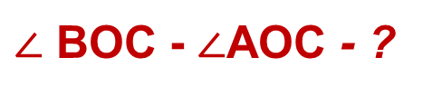
4- masala
Qo‘shni burchaklarning bissektrisalari ajratgan burchaklar 4:5 kabi nisbatda bo‘lsa, ikki qo‘shni burchak ayirmasini toping.
С
$$O_{2}$$
$$O_{1}$$
$∠$ BOC - $∠$AOC - ?
α
β
α
β
B
О
А

Slide 10


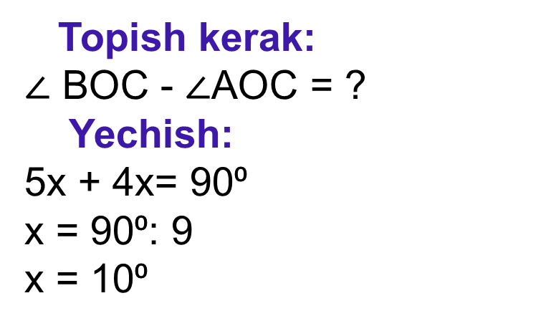
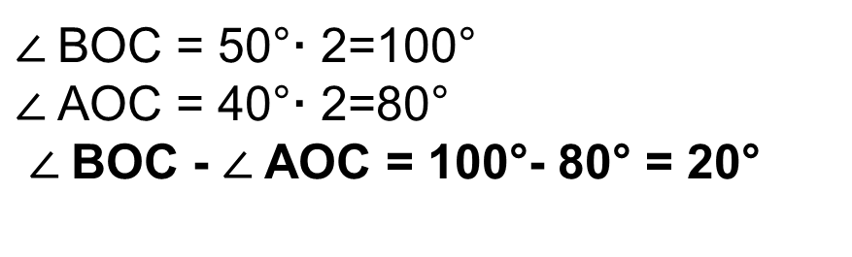

Berilgan:
$∠$AOC va $∠$BOC – qo‘shni burchaklar,
${OO}_{1}va{OO}_{2}$- bissektrisalar.
α : β = 4 : 5
C
$$O_{2}$$
$$O_{1}$$
5x
4x
β
α
Topish kerak:
$∠$ BOC - $∠$AOC = ?
Yechish:
5x + 4x= 90⁰
x = 90⁰: 9
x = 10⁰
B
O
A
$∠$BOC = 50°· 2=100°
$∠$AOC = 40°· 2=80°
$∠$BOC - $∠$AOC = 100°- 80° = 20°
Javob: 20°

Slide 11
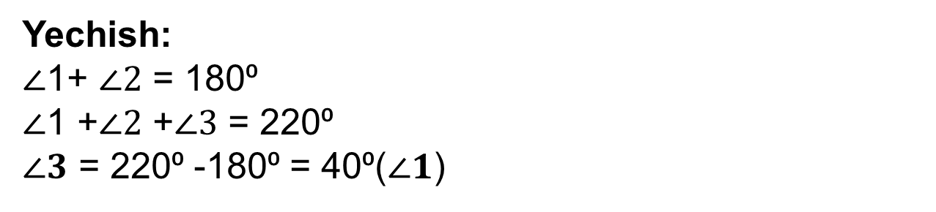
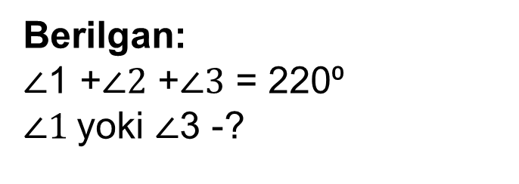
5- masala
Ikki to‘g‘ri chiziqning kesishishidan hosil bo‘lgan burchaklardan uchtasining yig‘indisi 220⁰ ga teng. Burchaklardan kichigini toping.
Berilgan:
$∠$1 +$∠2$ +$∠3$ = 220⁰
$∠1$yoki $∠$3 -?
2
3
1
4
Yechish:
$∠$1+ $∠2$ = 180⁰
$∠$1 +$∠2$ +$∠3$ = 220⁰
$∠3$ = 220⁰ -180⁰ = 40⁰($∠1$)

Slide 12

№.5 Chimadagi burchaklarning tomonlariga ularning A va B nuqtalari orqali perpendikulyar to‘g‘ri chiziqlar o‘tkazing. Bu to‘g‘ri chiziqlar kesishish nuqtasida qanday burchaklar hosil qiladi?
a)
b)
$$B$$
C=90⁰
В
С> 90⁰
О
∟
А
A

Slide 13
P
AB kesmaning o‘rtasini aniqlang.
В
А
О
Q

Slide 14
P
AB kesmaning o‘rtasini aniqlang.
AO = OB
В
А
О
Q

Slide 15
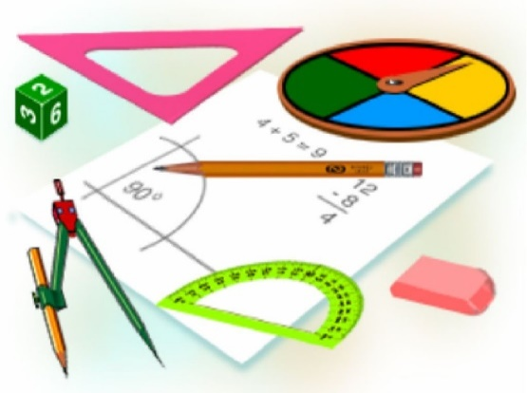
Mustaqil bajarish uchun topshiriqlar:
Darslikda berilgan
yakuniy yozma nazorat ishi:
1 – 5 masallarni yechish
(154 - bet).

Slide 16
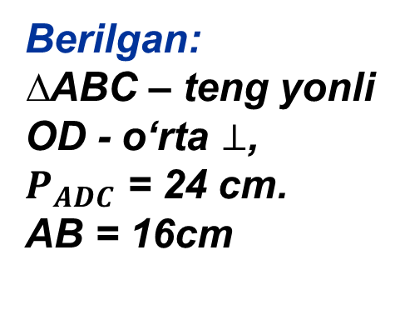
№7.ABC teng yonli uchburchakning AB yon tomoniga o‘tkazilgan
o‘rta perpendikulyar BC tomonni D nuqtadakesib o‘tadi. Agar ADC
uchburchakning perimetri 24 cm ga teng va AB = 16 cm bo‘lsa,
AC asosni toping.
B
Berilgan:
∆ABC – teng yonli
OD - o‘rta $⊥$,
$P_{ADC}$ = 24 cm.
AB = 16cm
O
Topish kerak:
AC - ? cm
D
A
C

Slide 17
Kesma o‘rta perpendikulyarini yasash
P
В
А
О
Q

Slide 18
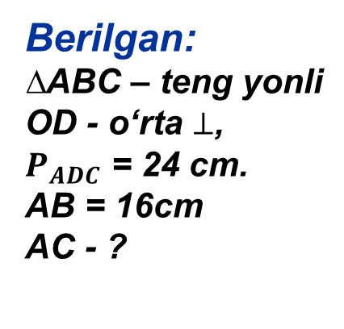
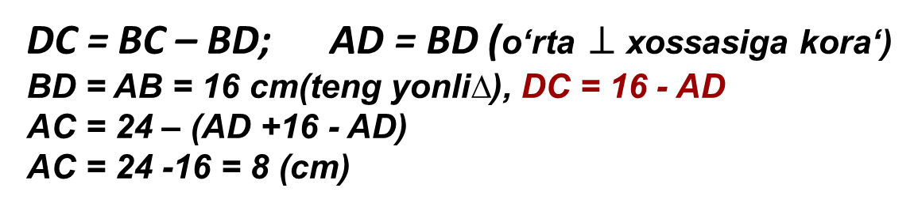
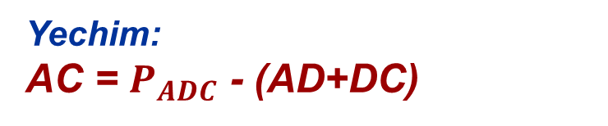
B
Berilgan:
∆ABC – teng yonli
OD - o‘rta $⊥$,
$P_{ADC}$ = 24 cm.
AB = 16cm
AC - ?
O
D
Yechim:
AC = $P_{ADC}$ - (AD+DC)
A
C
DC = BC – BD; AD = BD (o‘rta $⊥$ xossasiga kora‘)
BD = AB = 16 cm(teng yonli∆), DC = 16 - AD
AC = 24 – (AD +16 - AD)
AC = 24 -16 = 8 (cm)
Javob: 8 cm

