Slide 1

ALGEBRA
7-sinf
Mavzu: Birhad va ko‘phadni birhadga bo‘lish mavzusida misollar yechish

Slide 2
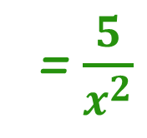
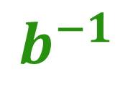
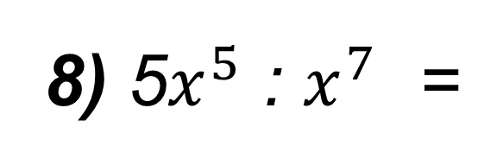
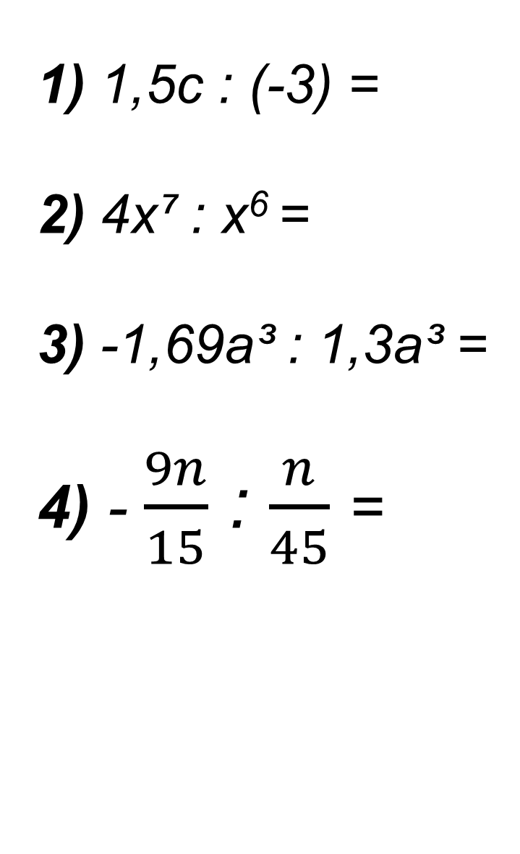
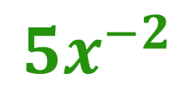
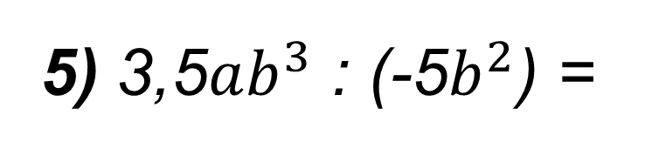
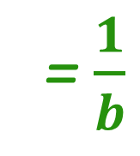
Mustahkamlash
1) 1,5c : (-3) =
2) 4x⁷ : x⁶ =
3) -1,69a³ : 1,3a³ =
4) - $\frac{9n}{15}$ : $\frac{n}{45}$ =
- 0,5c
5) 3,5$ab^{3}$ : (-5$b^{2}$) =
-0,7ab
4x
6) - 0,24abc : (-0,6abc) =
4
-1,3
7) b : b² =
= $\frac{1}{b}$
$$b^{−1}$$
-27
8) 5$x^{5}$ : $x^{7}$ =
= $\frac{5}{x^{2}}$
$${5x}^{−2}$$

Slide 3
Xatolikni aniqlang
х⁶ : х³= х² 5. х¹⁰ : х⁵= х²
х²¹ : х³= х¹⁸ 6. (4х⁵) : х⁵= 4
(4х⁵) : х³= 4х³ 7. (8х) : 4х= 2x
(–3х⁶) : х³= 3х³ 8. (–6х⁹) : х³= -6х⁶
х³
х⁵
4х²
2
-3х³

Slide 4
Ko‘phadni birhadga bo‘lish
(А + B + C) : D = A : D + B : D + C : D
(6 a³ b + 6а²b² – 12аb²) : 6ab =
= 6 a³ b:6ab + 6а²b²:6ab- 12аb²:6ab =
a² + ab – 2b
Tekshirish:
(a² + ab – 2b)∙ 6аb = 6аb ∙ a² + 6аb ∙ ab – 6аb ∙ 2b=
= 6 a³ b + 6а²b² – 12аb²

Slide 5
№ 310. Bo‘lishni bajaring
(6a – 8b + 10) : 2 = 6a:2 – 8b:2 + 10:2 =
(8x+12y-16) : (-4) = 8x:(-4)+12y:(-4)-16(-4) = (10a² - 12ab + 8a) : (2a) =
(2ab + 6a²b² -4b): (2b) =
3a – 4b + 5
-2x-3y+4
5a – 6b +4
a + 3a²b-2

Slide 6
312 - masala
Dala hovli to‘g‘ri to‘rtburchak shaklida bo‘lib, uning bo‘yi endian 1,5 marta uzun.Kanal qazish zarurati bo‘lgani uchun hovlining bo‘yini 6 m ga kamaytirishdi, enini esa 6 metrga uzaytirishdi. Natijada dala hovlining yuzi avvalgi yuziga qaraganda 84 m² ga ortdi. Dala hovlining avvalgi perimetri va yuzini toping.
b^{ᶥ}
b
a
a^{ᶥ}
a
b

Slide 7
312 - masala
Berilgan:
a = x
b = 1,5x
a^{ᶥ}= x+6
b^{ᶥ}= 1,5x - 6
S^{ᶥ} - S= 84m²
S - ?, P - ?
b^{ᶥ}
b
Yechish:
1) 1,5x ·x +84 = (1,5x-6)(x+6)
1,5x² + 84 = 1,5x²+9x -6x -36
3x = 120
x = 40(a)
b =1,5∙40 = 60
a^{ᶥ}
a
a
b
2) S = 40·60 = 2400m²
P = (40+60)∙2 = 200m
Javob: 2400 m² va 200 m

Slide 8
Mustaqil bajarish uchun topshiriqlar:
1
№ 311-312
2
“ O‘zingizni tekshirib ko‘ring ”
1 – 4 - topshiriqlar
94 - Bet
3
Qoidalarni yod olish

