Slide 1
ALGEBRA
7-sinf
Mavzu: Ko‘phadni ko‘phadga ko‘paytirish
mavzusida misollar yechish

Slide 2
Tenglamani yeching:
(y+1)(y - 5) = y² + 2,6
y² - 5y + y – 5 = y² + 2,6
y² - 4y – 5 = y² + 2,6
- 4y = 2,6 + 5
- 4y = 7,6
y =7,6 : (- 4)
y = - 1,9

Slide 3
Mustahkamlash
(х − 2)(х − 3)
х² + 5x + 6
х² - 5x + 6
х² - 5x - 6
1
2
3
(х − 2)(х − 3) = x² - 3x -2x + 6 = x² - 5x + 6

Slide 4
Mustahkamlash
(х - 2)(х + 5)
х² + 7x - 10
х² - 3x + 10
х² + 3x - 10
1
2
3
(х − 2)(х + 5) = x² + 5x -2x - 10 = x² + 3x - 10

Slide 5
289 - misol
Nuqtqlar o‘rniga qanday birhadlarni yozsangiz
tenglik to‘g‘ri bo‘ladi:
(2a- 5b)( … - …) = 6a³- 15a²b- 14ab+ …
35b²
3a²
7b )
(3a+ 4c)( …+ …) = 20ac + 8bc + 6ab + …
5a
2b
15a²

Slide 6
№288. Ko‘phadlarni ko‘paytiring
(2a - b)(4a² + 2ab + b²) =
(5x + 3y)(25x² - 15xy + 9y²) =
= 125x³ - 75x²y + 45xy² + 75x²y – 45xy²- 27y³ =
1
= 8a³ + 4a²b + 2ab² - 4a²b - 2ab²- b³ =
8a³ - b³;
3
=125x³ - 27y³;

Slide 7
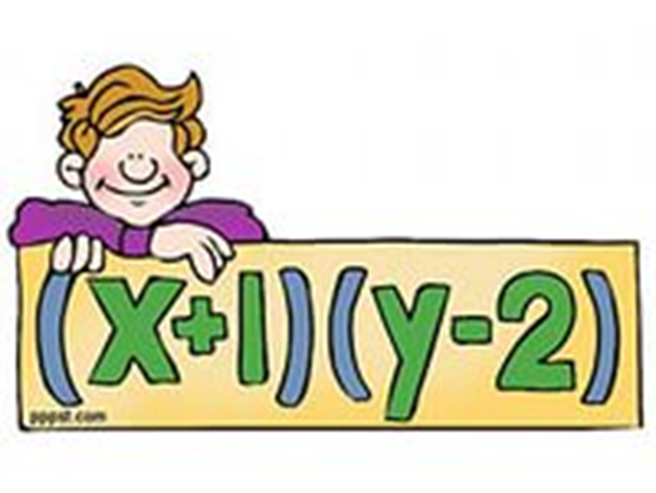
Mustaqil bajarish uchun topshiriqlar:
Darslikning 89- sahifasida berilgan 288- 293- misollarni
yechish.

