Slide 1

ALGEBRA
7-sinf
Mavzu: Ko‘phadlarni qo‘shish va ayirish mavzusida masalalar yechish

Slide 2
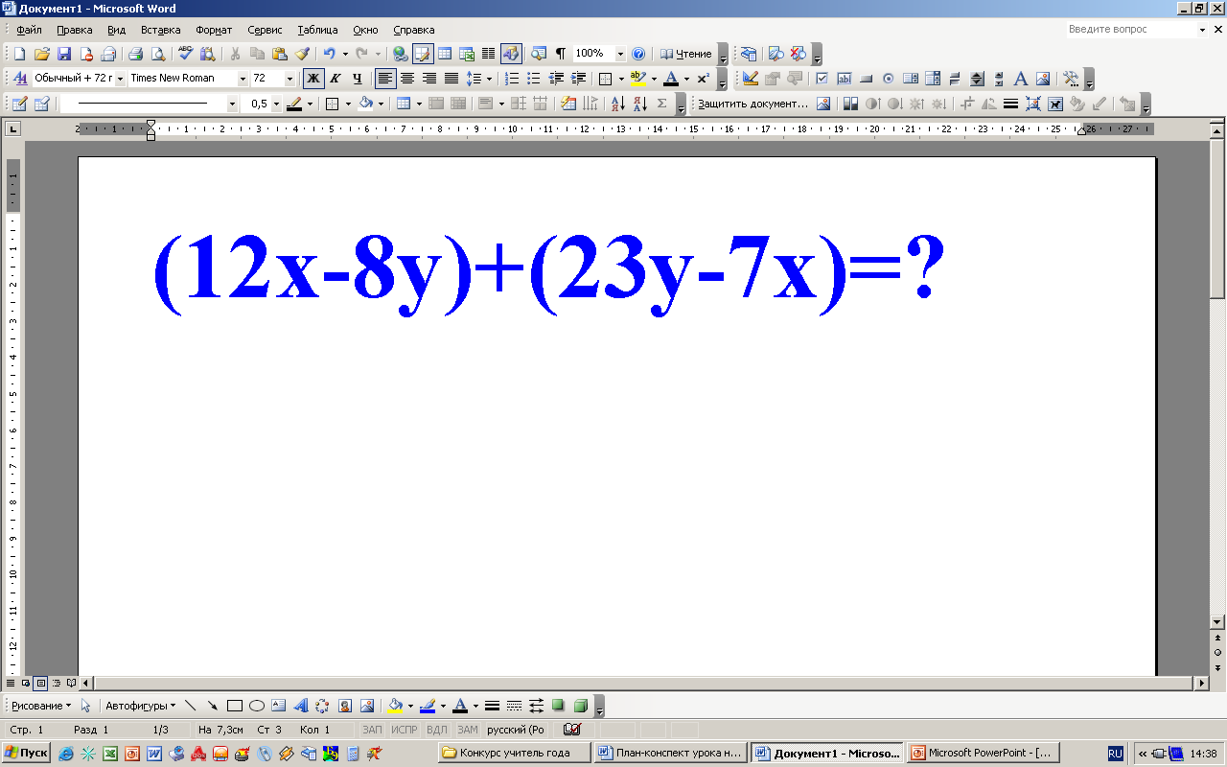
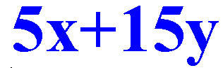
Javob:

Slide 3
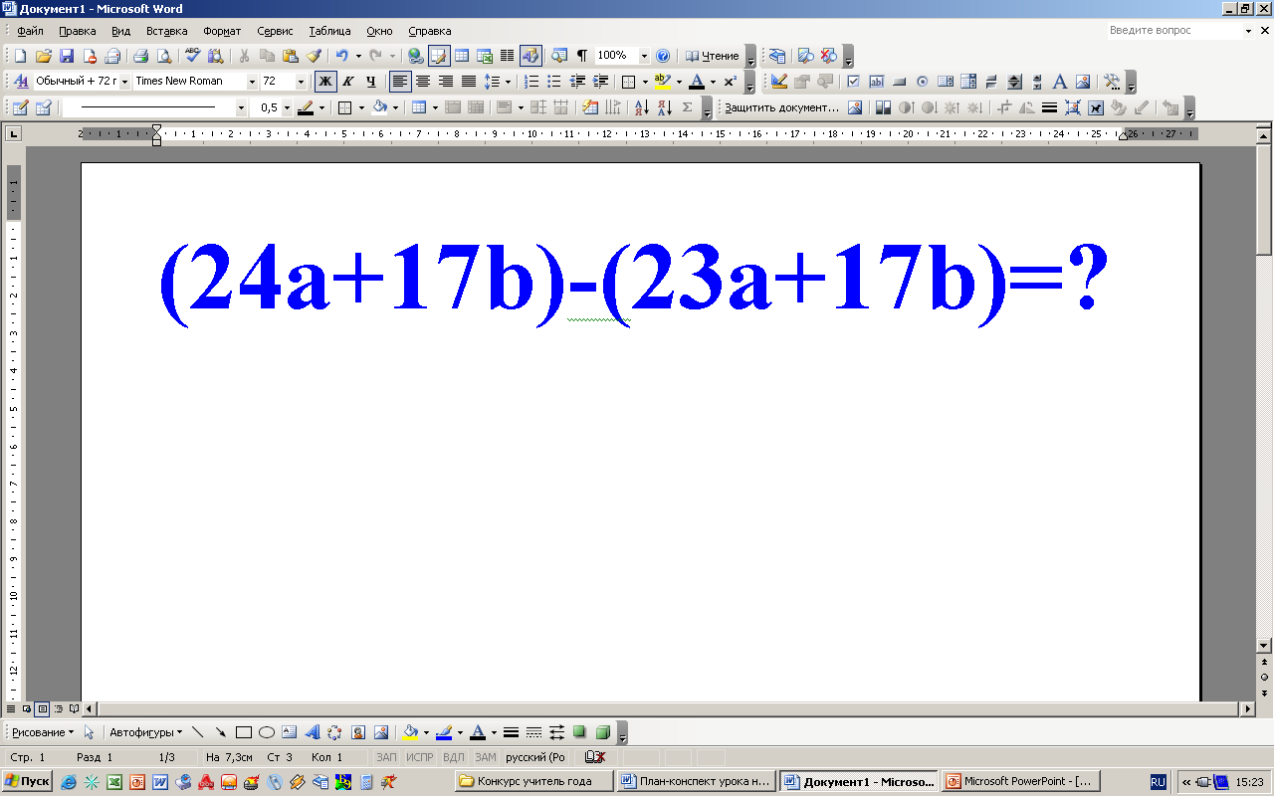
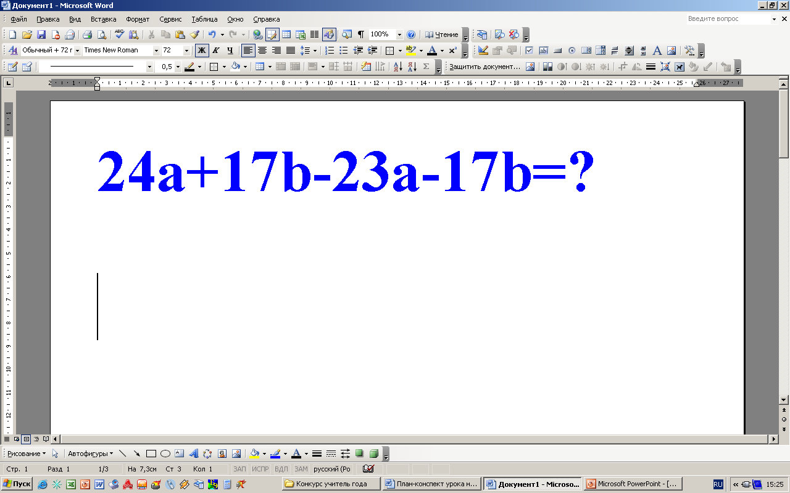
Mustahkamlash
Javob: а

Slide 4
Xatolikni aniqlang
1 (2а+5)–(3а-7) = 2а + 5 - 3а - 7 = - а - 2
+
+12
5x
2 (7х- 6)–(2х+3) = 7х– 6+ 2х– 3 = 9х- 9
–
3
x +1,5y
1,5x – y
1,5x+0,5
4
14a + 7b - d
13a – 7b - d
a – 2d
+
–
2,5x+0,5y
a+14b

Slide 5
270- misol
Ko‘phadlarning ayirmasini “ustun” usulida hisoblang:
3a² + 8a -4 va 3 + 8a - 5a²;
b³ - 3b² + 4b va b + 2b² + b³;
_
3a² + 8a – 4
- 5a² + 8a + 3
8a² - 7
_
b³ - 3b² + 4b
b³ + 2b² + b
- 5b² + 3b

Slide 6
Ko‘phadlarni qo‘shish va ayirish
Beshta ketma –ket natural sonning yig‘indisi
5 ga bo‘linishini isbotlang.
5 ta son: n, n+1, n+2, n+3, n+4 bo‘lsin.
n+(n + 1)+(n + 2)+(n + 3)+(n + 4) =
= n+n+1+n+2+n+3+n+4
= 5n+10
= 5·(n+2);

Slide 7
Mustaqil bajarish uchun topshiriqlar:
Darslikning 83- sahifasida berilgan 262- 266- misollarni
yechish.

