Slide 1
Fizika
11-sinf
Mavzu:
Masalalar yechish.
O‘qituvchi:
Toshkent shahar Uchtepa tumani
287-maktab fizika fani o‘qituvchisi
Xodjayeva Maxtuma Ziyatovna.

Slide 2
Tinchlikdagi energiya: $E_{0}=m_{0}c^{2}$
Tinchlikdagi energiya: 𝐸_0=𝑚_0 𝑐^2
Kinetik energiya: $E_{k}=\frac{m_{0}c^{2}}{\sqrt{1−\frac{θ^{2}}{c^{2}}}}−m_{0}c^{2}$
Kinetik energiya: 𝐸_𝑘=(𝑚_0 𝑐^2)/√(1−𝜗^2/𝑐^2 )−𝑚_0 𝑐^2
To‘la energiya: $E=mc^{2}=E_{k}+E_{0}$
To‘la energiya: 𝐸=𝑚𝑐^2=𝐸_𝑘+𝐸_0

Slide 3
5-mashq 3-masala
0,6c tezlik bilan harakatlanayotgan zarraning kinetik energiyasi uning tinchlikdagi energiyasidan necha marta kichik?

Slide 4
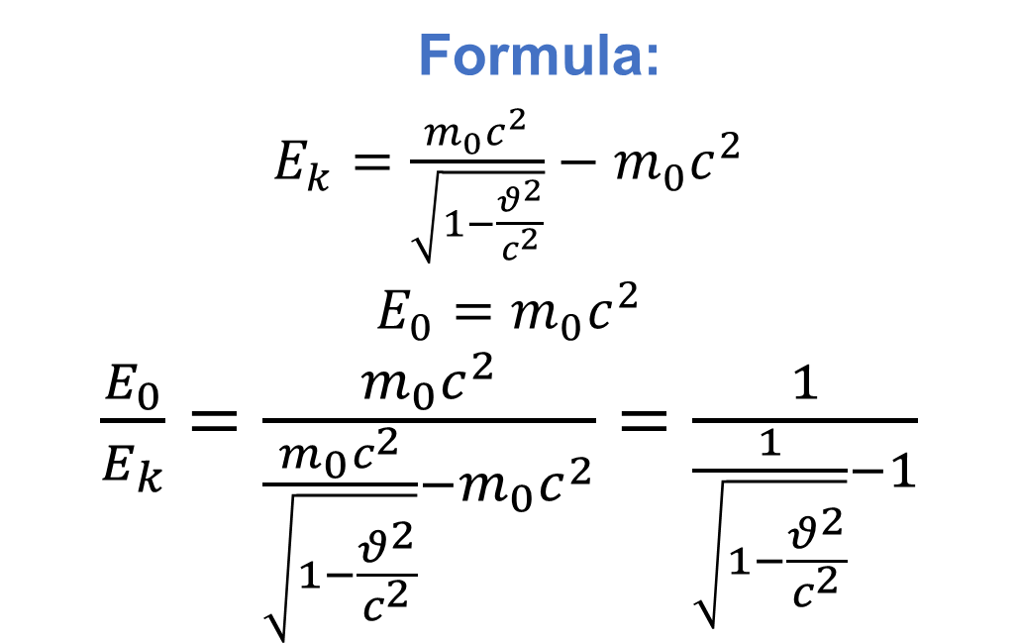
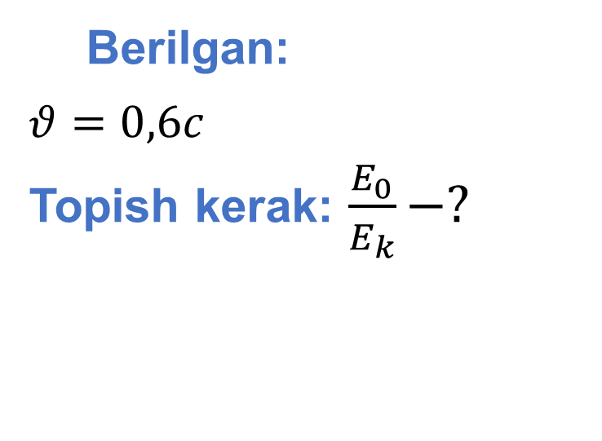
Berilgan:
$θ=0,6c$
Topish kerak: $\frac{E_{0}}{E_{k}}−?$
Formula:
$E_{k}=\frac{m_{0}c^{2}}{\sqrt{1−\frac{θ^{2}}{c^{2}}}}−m_{0}c^{2}$
$E_{0}=m_{0}c^{2}$
$\frac{E_{0}}{E_{k}}=\frac{m_{0}c^{2}}{\frac{m_{0}c^{2}}{\sqrt{1−\frac{θ^{2}}{c^{2}}}}−m_{0}c^{2}}=\frac{1}{\frac{1}{\sqrt{1−\frac{θ^{2}}{c^{2}}}}−1}$
Yechish: $\frac{E_{0}}{E_{k}}=\frac{1}{\frac{1}{\sqrt{1−\frac{{(0,6c)}^{2}}{c^{2}}}}−1}=4$
Javob: 4 marta kichik

Slide 5
5-mashq 5-masala
Elastiklik koeffitsiyenti 20 kN/m bo‘lgan prujina 30 cm ga cho‘zilsa, uning massasi qanchaga ortadi?

Slide 6
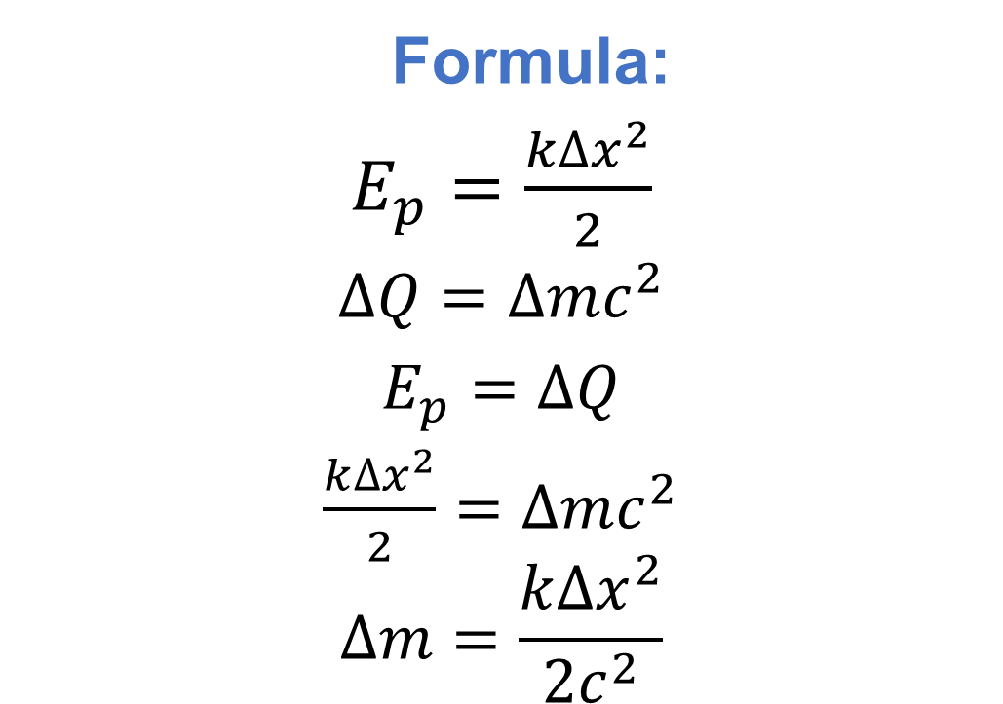
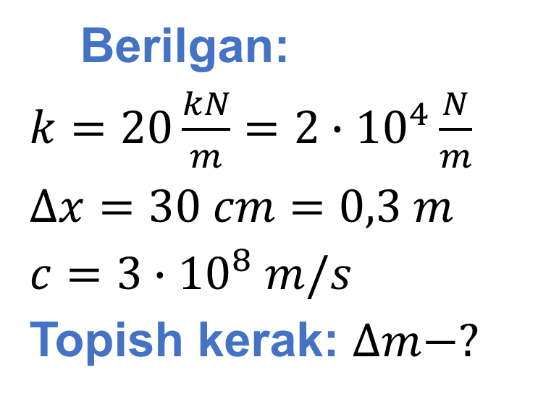
Berilgan:
$k=20\frac{kN}{m}=2∙{10}^{4}\frac{N}{m}$
$∆x=30 cm=0,3 m$
$c=3∙{10}^{8} m/s$
Topish kerak: $∆m−?$
Formula:
$E_{p}=\frac{k{∆x}^{2}}{2}$
$∆Q=∆mc^{2}$
$E_{p}=∆Q$
$\frac{k{∆x}^{2}}{2}=∆mc^{2}$
$$∆m=\frac{k{∆x}^{2}}{2c^{2}}$$
Yechish: $∆m=\frac{2∙{10}^{4}\frac{N}{m}∙{(0,3 m)}^{2}}{2∙{(3∙{10}^{8}\frac{m}{s})}^{2}}={10}^{−14}kg$
Javob: ${10}^{−14}kg$ ga ortadi.

Slide 7
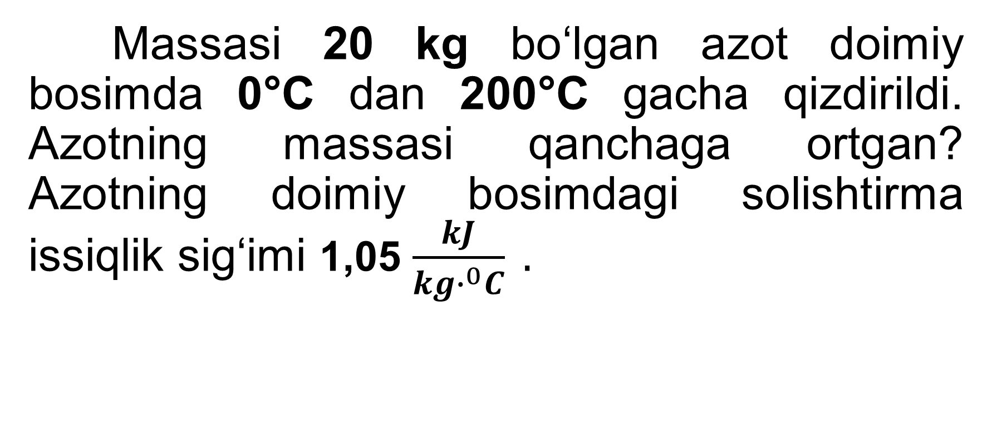
5-mashq 7-masala
Massasi 20 kg bo‘lgan azot doimiy bosimda 0°C dan 200°C gacha qizdirildi. Azotning massasi qanchaga ortgan? Azotning doimiy bosimdagi solishtirma issiqlik sig‘imi 1,05 $\frac{kJ}{kg∙^{0}C} .$

Slide 8
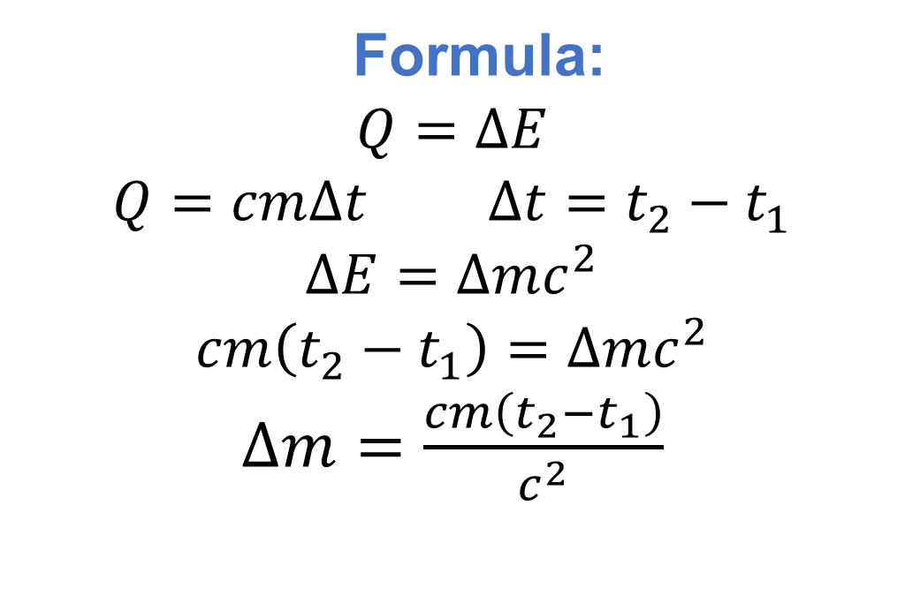
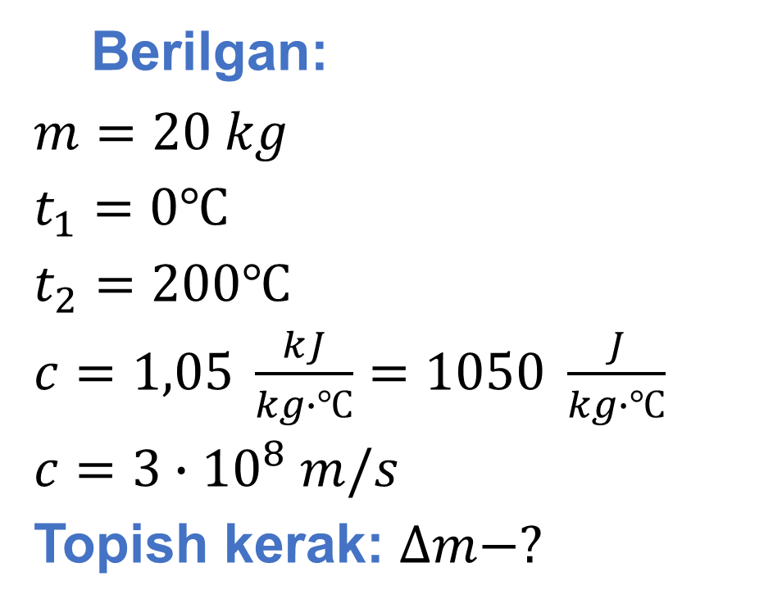
Berilgan:
$m=20 kg$
$t_{1}=0℃$
$t_{2}=200℃$
$c=1,05 \frac{kJ}{kg∙℃}=1050 \frac{J}{kg∙℃}$
$c=3∙{10}^{8} m/s$
Topish kerak: $∆m−?$
Formula:
$Q=∆E$
$Q=cm∆t$ $∆t=t_{2}−t_{1}$
$∆E=∆mc^{2}$
$cm\left(t_{2}−t_{1}\right)=∆mc^{2}$
$∆m=\frac{cm\left(t_{2}−t_{1}\right)}{c^{2}}$
Yechish: $∆m=\frac{1050 \frac{J}{kg∙℃}∙20 kg∙(200℃−0℃)}{{(3∙{10}^{8}\frac{m}{s})}^{2}}≈4,7∙{10}^{−11}kg$
Javob: $≈4,7∙{10}^{−11}kg$ ga ortadi.

Slide 9
Masala
Zarraning tinchlikdagi energiyasi 1,2 TJ ga teng. Bu zarra 0,6c tezlik bilan harakatlansa, uning to‘la energiyasi qanday (TJ) bo‘ladi?

Slide 10
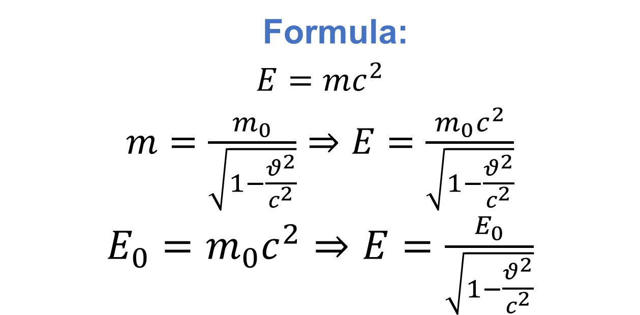
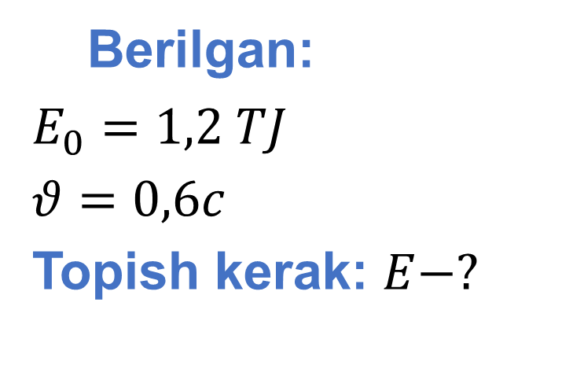
Berilgan:
$E_{0}=1,2 TJ$
$θ=0,6c$
Topish kerak: $E−?$
Formula:
$E=mc^{2}$
$m=\frac{m_{0}}{\sqrt{1−\frac{θ^{2}}{c^{2}}}}⇒E=\frac{m_{0}c^{2}}{\sqrt{1−\frac{θ^{2}}{c^{2}}}}$
$E_{0}=m_{0}c^{2}⇒E=\frac{E_{0}}{\sqrt{1−\frac{θ^{2}}{c^{2}}}}$
Yechish: $E=\frac{1,2 TJ}{\sqrt{1−\frac{{(0,6c)}^{2}}{c^{2}}}}=1,5 TJ$
Javob: E=1,5 TJ

Slide 11
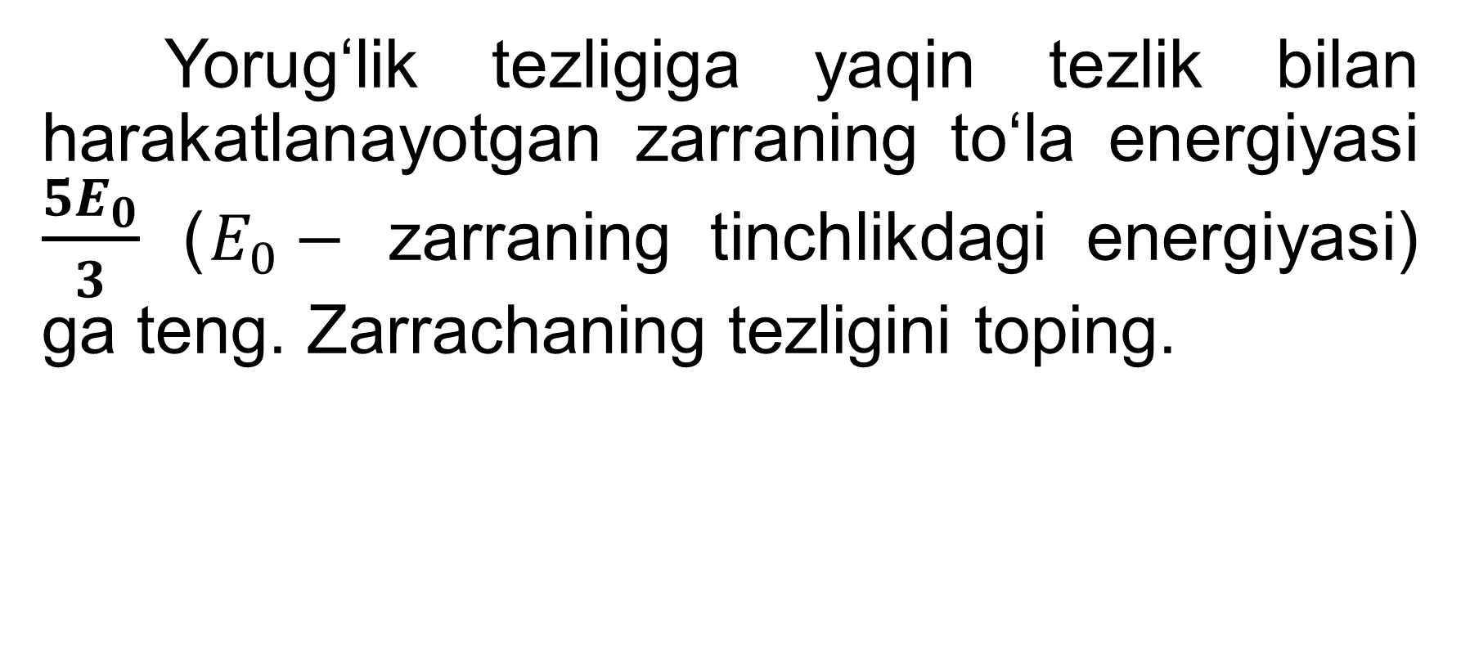
Masala
Yorug‘lik tezligiga yaqin tezlik bilan harakatlanayotgan zarraning to‘la energiyasi $\frac{5E_{0}}{3}$ ($E_{0}−$ zarraning tinchlikdagi energiyasi) ga teng. Zarrachaning tezligini toping.

Slide 12
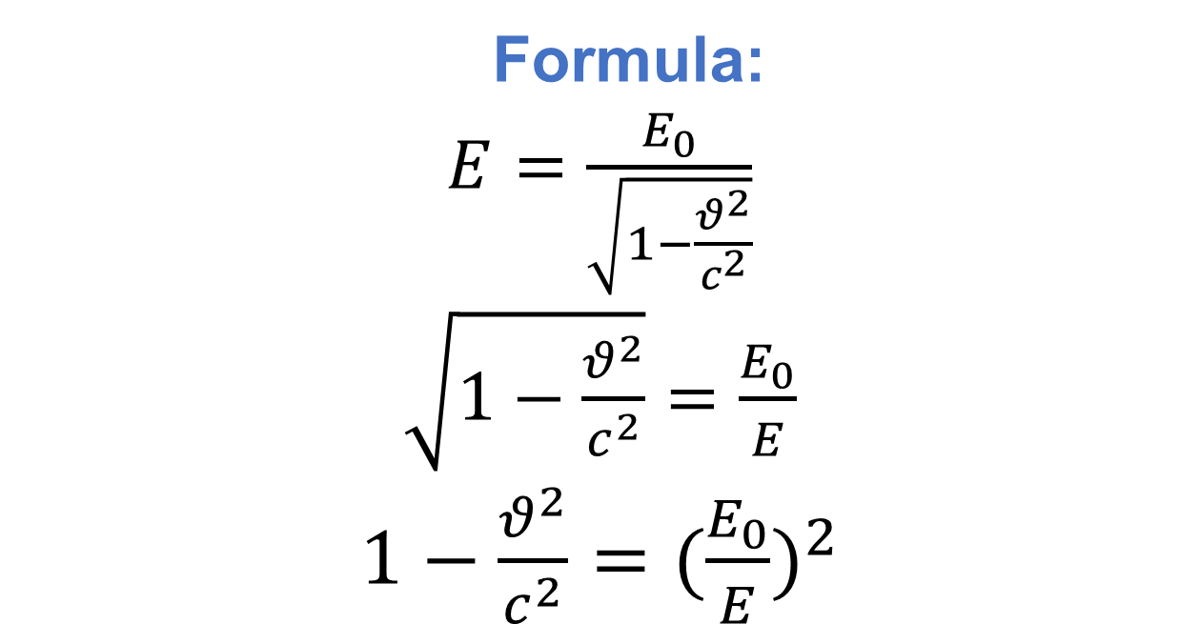
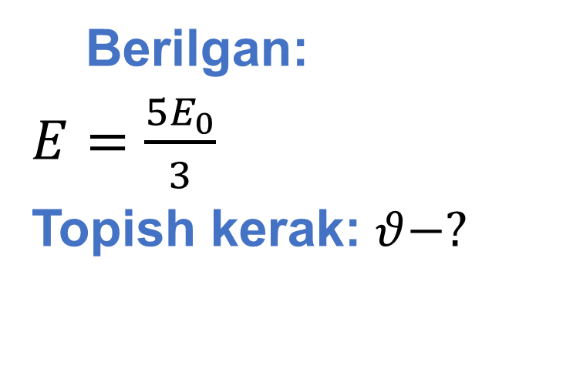
Berilgan:
$E=\frac{5E_{0}}{3}$
Topish kerak: $θ−?$
Formula:
$E=\frac{E_{0}}{\sqrt{1−\frac{θ^{2}}{c^{2}}}}$
$\sqrt{1−\frac{θ^{2}}{c^{2}}}=\frac{E_{0}}{E}$
$1−\frac{θ^{2}}{c^{2}}={(\frac{E_{0}}{E})}^{2}$
${\frac{θ^{2}}{c^{2}}=1−(\frac{E_{0}}{E})}^{2}$
$θ^{2}={(1−(\frac{E_{0}}{E})}^{2})c^{2}$

Slide 13
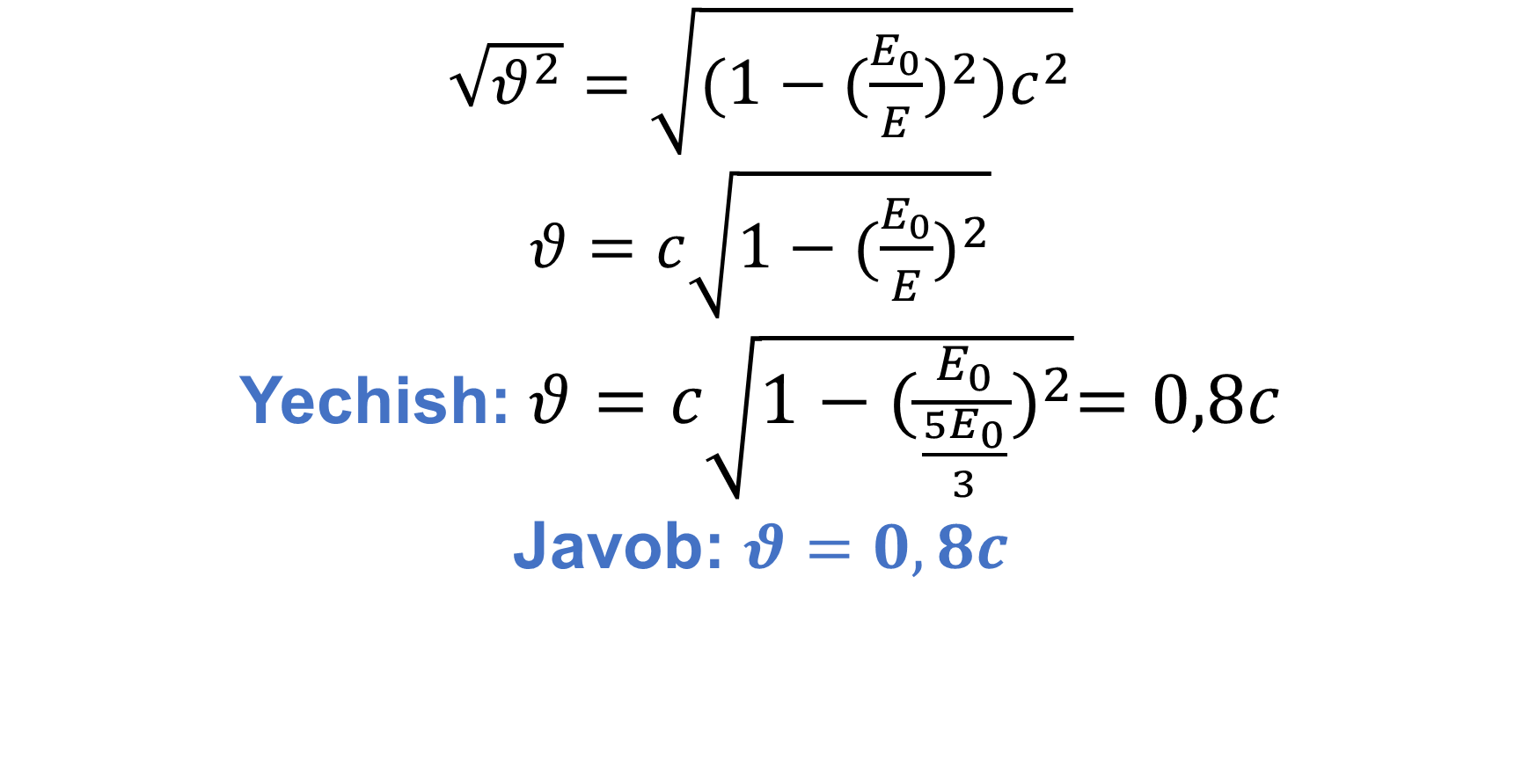
$\sqrt{θ^{2}}=\sqrt{{(1−(\frac{E_{0}}{E})}^{2})c^{2}}$
$θ=c\sqrt{{1−(\frac{E_{0}}{E})}^{2}}$
Yechish: $θ=c\sqrt{1−{(\frac{E_{0}}{\frac{5E_{0}}{3}})}^{2}}=0,8c$
Javob: $θ=0,8c$

Slide 14
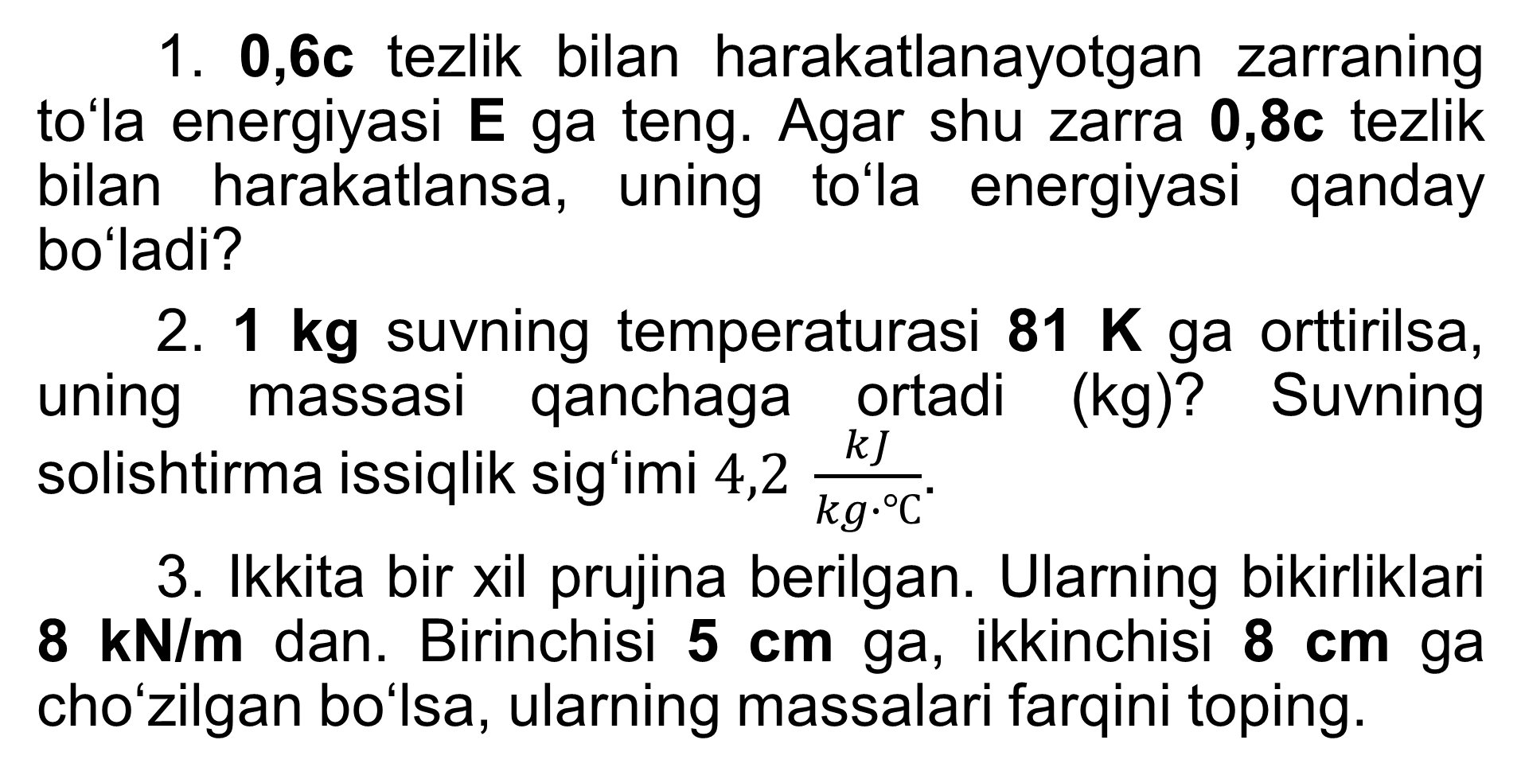
Mustaqil bajarish uchun topshiriqlar
1. 0,6c tezlik bilan harakatlanayotgan zarraning to‘la energiyasi E ga teng. Agar shu zarra 0,8c tezlik bilan harakatlansa, uning to‘la energiyasi qanday bo‘ladi?
2. 1 kg suvning temperaturasi 81 K ga orttirilsa, uning massasi qanchaga ortadi (kg)? Suvning solishtirma issiqlik sig‘imi $4,2 \frac{kJ}{kg∙℃}$.
3. Ikkita bir xil prujina berilgan. Ularning bikirliklari 8 kN/m dan. Birinchisi 5 cm ga, ikkinchisi 8 cm ga cho‘zilgan bo‘lsa, ularning massalari farqini toping.

