Slide 1
Fizika
11-sinf
Mavzu:
Massaning tezlikka bog‘liqligi. Relyativistik dinamika. Massa va energiyaning o‘zaro bog‘liqlik qonuni.
O‘qituvchi:
Toshkent shahar Uchtepa tumani 287-maktab fizika fani o‘qituvchisi
Xodjayeva Maxtuma Ziyatovna.

Slide 2
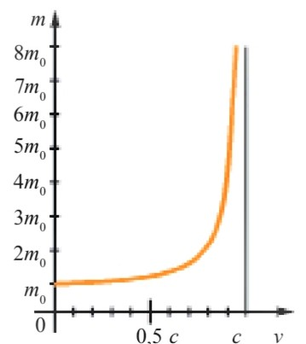
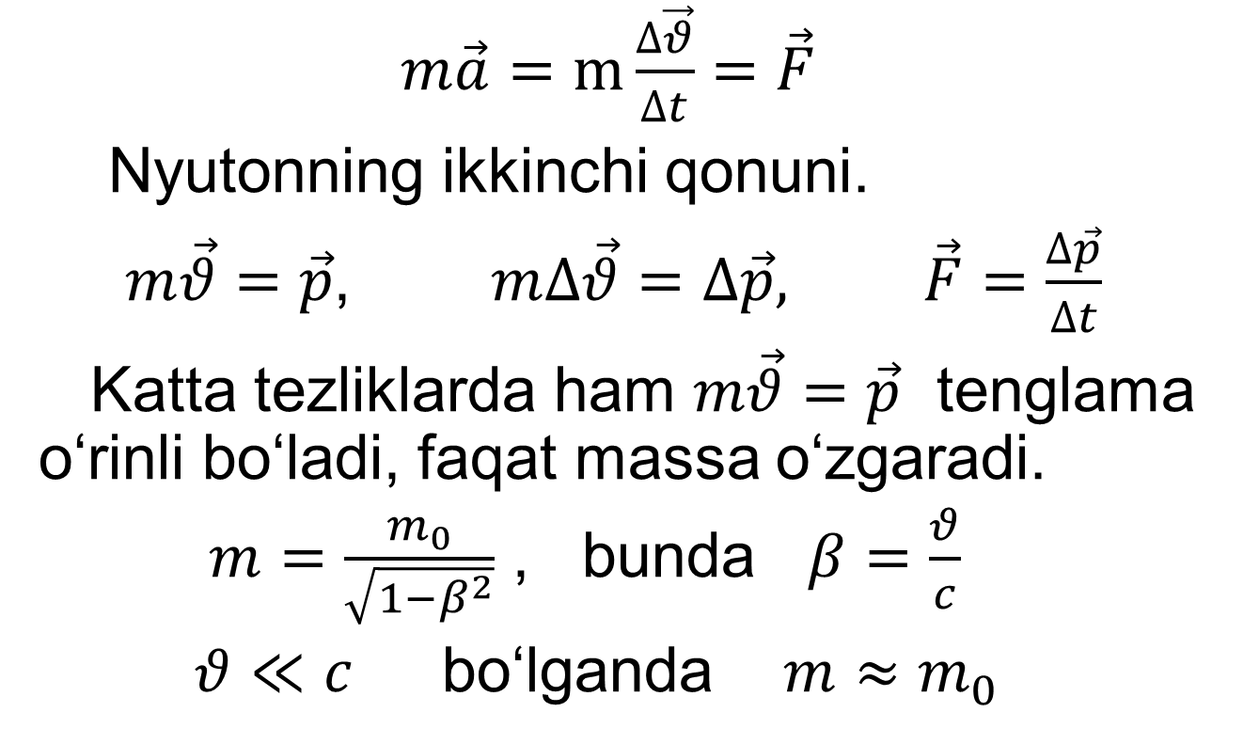
Massaning tezlikka bog‘liqligi
$m\vec{a}=m\frac{∆\vec{θ}}{∆t}=\vec{F}$
Nyutonning ikkinchi qonuni.
$m\vec{θ}=\vec{p}$, $m∆\vec{θ}=∆\vec{p},$ $\vec{F}=\frac{∆\vec{p}}{∆t}$
Katta tezliklarda ham $m\vec{θ}=\vec{p}$ tenglama o‘rinli bo‘ladi, faqat massa o‘zgaradi.
$m=\frac{m_{0}}{\sqrt{1−β^{2}}}$ , bunda $β=\frac{θ}{c}$
$θ≪c$ bo‘lganda $m≈m_{0}$

Slide 3
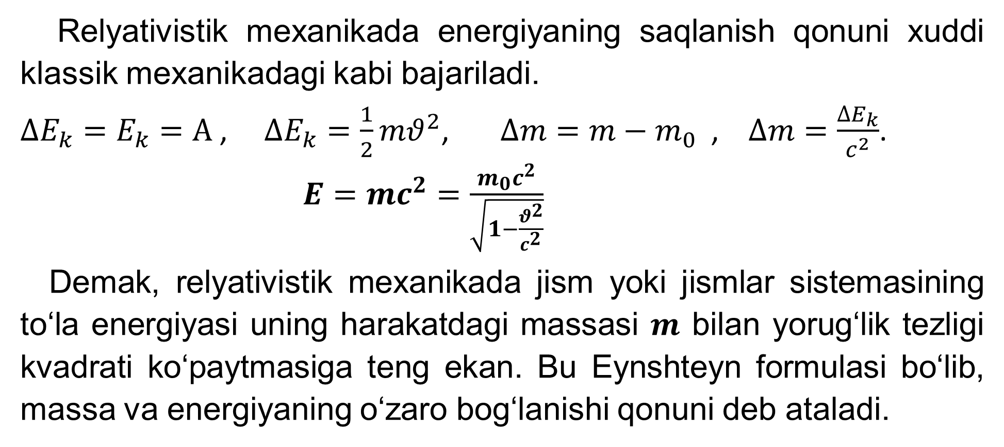
Energiyaning saqlanish qonuni
Relyativistik mexanikada energiyaning saqlanish qonuni xuddi klassik mexanikadagi kabi bajariladi.
$∆E_{k}=E_{k}=A$ , $∆E_{k}=\frac{1}{2}mθ^{2}$, $∆m=m−m_{0}$ , $∆m=\frac{∆E_{k}}{c^{2}}$.
$E=mc^{2}=\frac{m_{0}c^{2}}{\sqrt{1−\frac{θ^{2}}{c^{2}}}}$
Demak, relyativistik mexanikada jism yoki jismlar sistemasining to‘la energiyasi uning harakatdagi massasi $m$ bilan yorug‘lik tezligi kvadrati ko‘paytmasiga teng ekan. Bu Eynshteyn formulasi bo‘lib, massa va energiyaning o‘zaro bog‘lanishi qonuni deb ataladi.

Slide 4
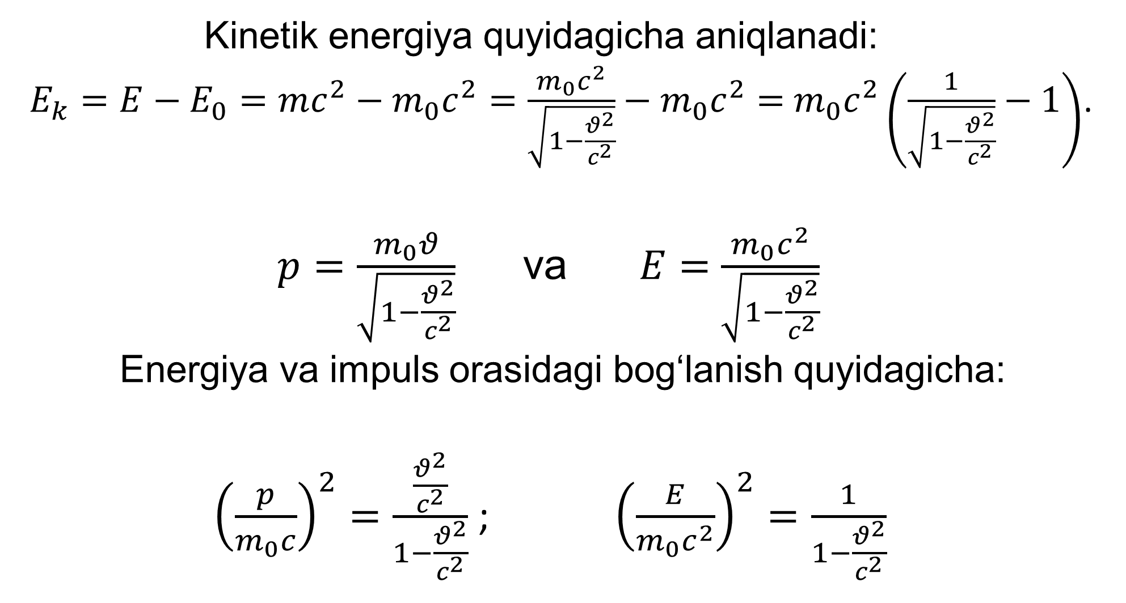
Kinetik energiya quyidagicha aniqlanadi:
$E_{k}=E−E_{0}=mc^{2}−m_{0}c^{2}=\frac{m_{0}c^{2}}{\sqrt{1−\frac{θ^{2}}{c^{2}}}}−m_{0}c^{2}=$ $m_{0}c^{2}\left(\frac{1}{\sqrt{1−\frac{θ^{2}}{c^{2}}}}−1\right)$.
$p=\frac{m_{0}θ}{\sqrt{1−\frac{θ^{2}}{c^{2}}}}$ va $E=$ $\frac{m_{0}c^{2}}{\sqrt{1−\frac{θ^{2}}{c^{2}}}}$
Energiya va impuls orasidagi bog‘lanish quyidagicha:
${\left(\frac{p}{m_{0}c}\right)}^{2}=\frac{\frac{θ^{2}}{c^{2}}}{1−\frac{θ^{2}}{c^{2}}}$ ; ${\left(\frac{E}{m_{0}c^{2}}\right)}^{2}=\frac{1}{1−\frac{θ^{2}}{c^{2}}}$

Slide 5
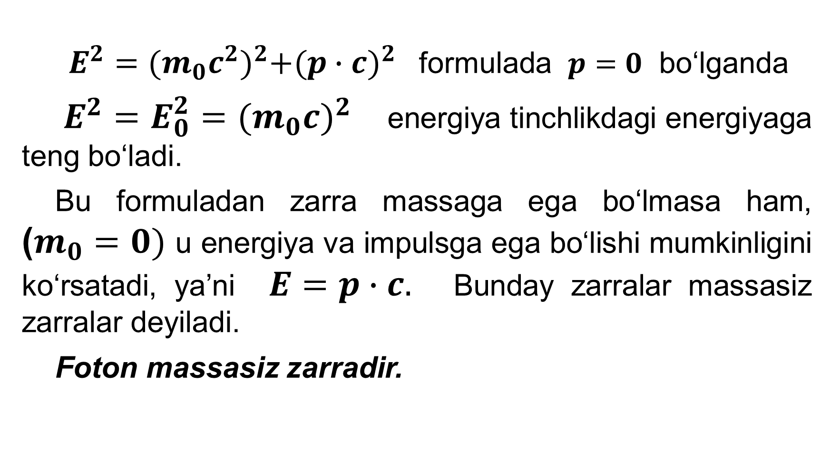
$E^{2}={(m_{0}c^{2})}^{2}+{(p∙c)}^{2}$ formulada $p=0$ bo‘lganda
$E^{2}=E_{0}^{2}={(m_{0}c)}^{2}$ energiya tinchlikdagi energiyaga teng bo‘ladi.
Bu formuladan zarra massaga ega bo‘lmasa ham, ($m_{0}=0)$ u energiya va impulsga ega bo‘lishi mumkinligini ko‘rsatadi, ya’ni $E=p∙c.$ Bunday zarralar massasiz zarralar deyiladi.
Foton massasiz zarradir.

Slide 6
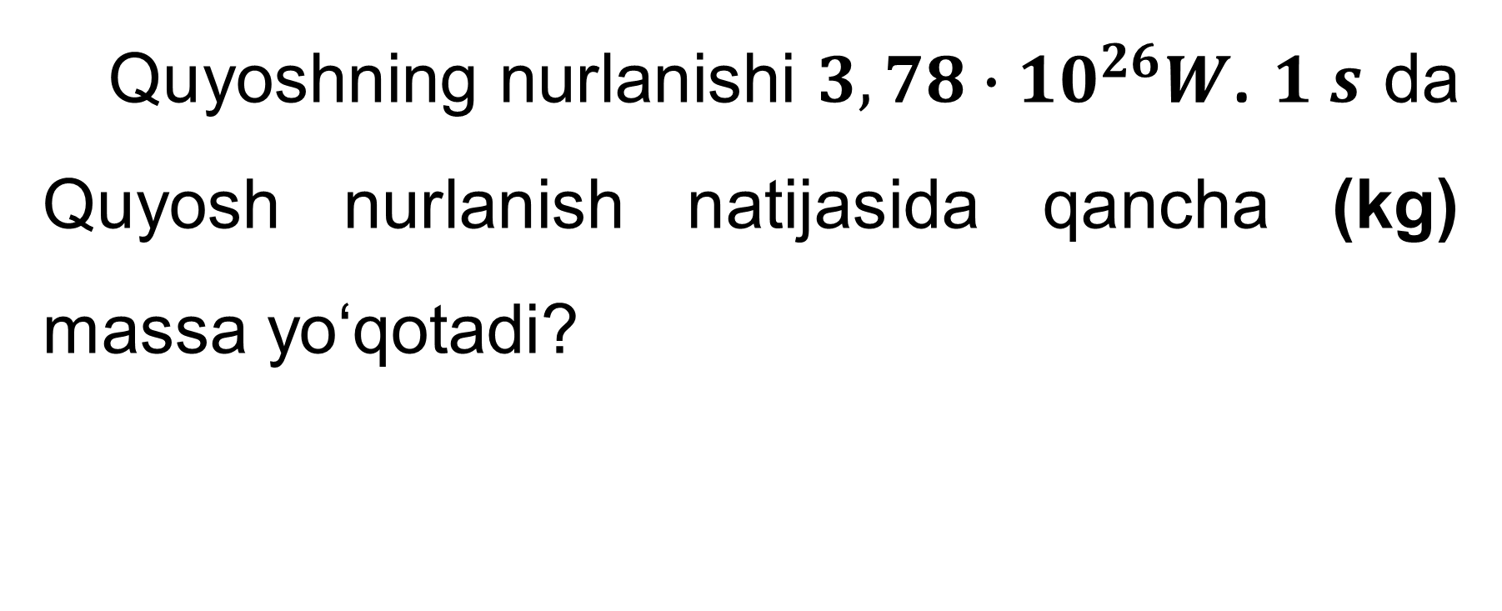
5-mashq 8-masala
Quyoshning nurlanishi $3,78∙{10}^{26}W$. $1 s$ da Quyosh nurlanish natijasida qancha (kg) massa yo‘qotadi?

Slide 7
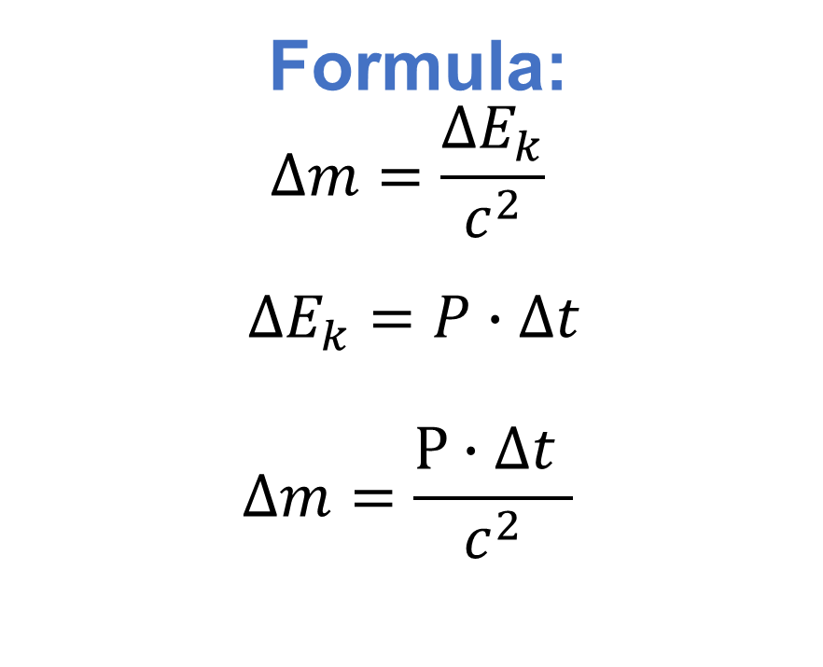
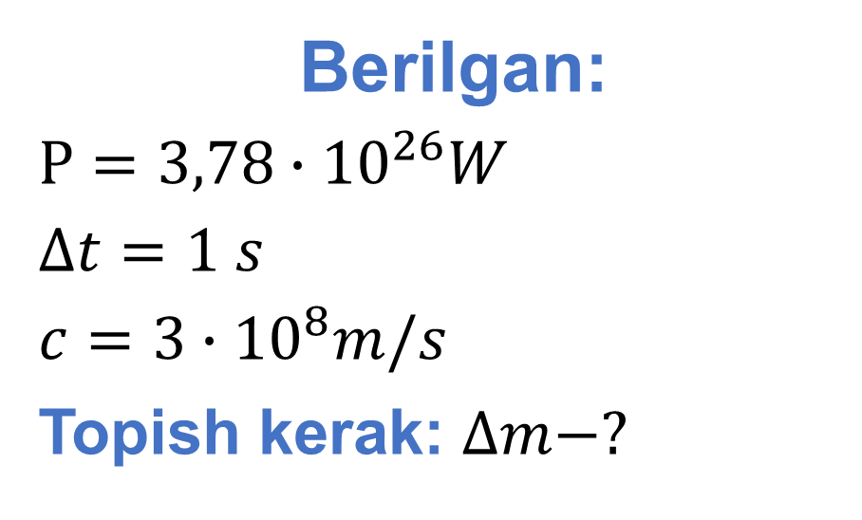
Berilgan:
$P=3,78∙{10}^{26}W$
$∆t=1 s$
$c=3∙{10}^{8}m/s$
Topish kerak: $∆m−?$
Formula:
$$∆m=\frac{∆E_{k}}{c^{2}}$$
$∆E_{k}=P∙∆t$
$$∆m=\frac{P∙∆t }{c^{2}}$$
Yechish: $∆m=\frac{3,78∙{10}^{26}W∙1 s}{{(3∙{10}^{8}\frac{m}{s})}^{2}}=0,42∙{10}^{10}kg$
Javob: $∆m=$ $0,42∙{10}^{10}kg=4,2∙{10}^{9}kg$

Slide 8
5-mashq 15-masala
Zarraning relyativistik impulsi Nyuton (klassik) impulsidan 2 marta katta bo‘lsa, zarraning tezligini aniqlang.

Slide 9
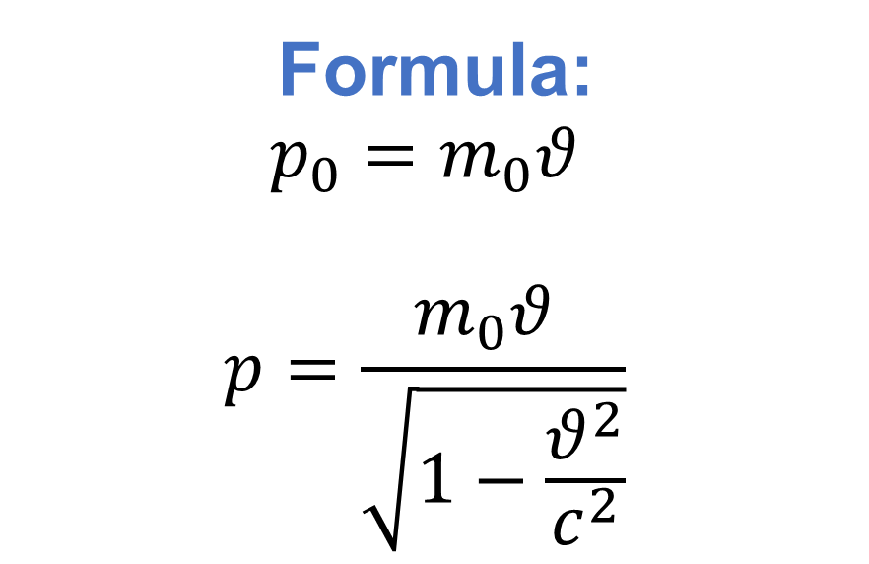
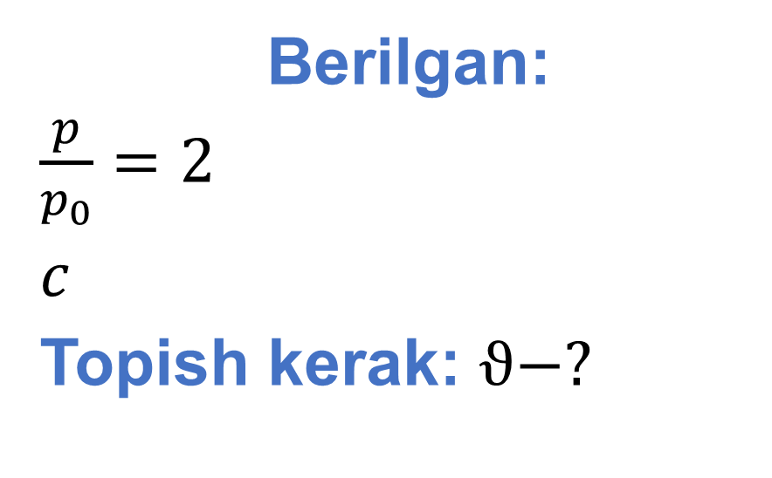
Berilgan:
$\frac{p}{p_{0}}=2$
$c$
Topish kerak: $ϑ−?$
Formula:
$$p_{0}=m_{0}θ$$
$$p=\frac{m_{0}θ }{\sqrt{1−\frac{θ^{2}}{c^{2}}}}$$
Yechish: $\frac{p}{p_{0}}=\frac{m_{0}θ}{m_{0}θ\sqrt{1−\frac{θ^{2}}{c^{2}}}}=\frac{1}{\sqrt{1−\frac{θ^{2}}{c^{2}}}}=2$
1=2∙$\sqrt{1−\frac{θ^{2}}{c^{2}}}$ $⟹ 1=4∙(1−$ $\frac{θ^{2}}{c^{2}}$)$=4−4∙\frac{θ^{2}}{c^{2}}$

Slide 10

$\frac{4θ^{2}}{c^{2}}=3$ $⟹$ $θ^{2}=\frac{3}{4}c^{2}$ $⇒$ $\sqrt{θ^{2}}=\sqrt{\frac{3}{4}c^{2}}$
Javob: $θ=\frac{\sqrt{3}}{2}c$

Slide 11
Mustaqil bajarish uchun topshiriqlar
1. Mavzuni o‘qish va savollarga javob yozish.(130-bet)
2. 5-mashqning 17-masalasini yechish.

