Slide 1
Fizika
10-sinf
Mavzu:
Elektr maydon energiyasi.
O‘qituvchi:
Toshkent shahar Uchtepa tumani 287-maktab fizika fani o‘qituvchisi
Xodjayeva Maxtuma Ziyatovna.

Slide 2
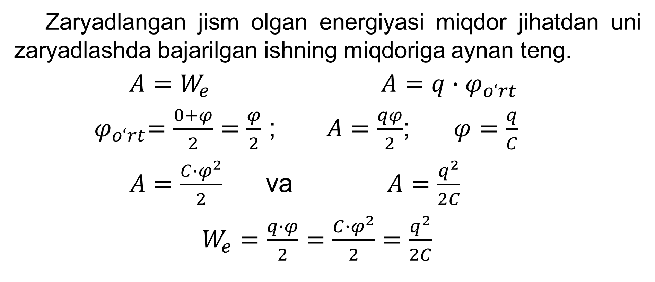
Elektr maydon energiyasi
Zaryadlangan jism olgan energiyasi miqdor jihatdan uni zaryadlashda bajarilgan ishning miqdoriga aynan teng.
$A=W_{e}$ $A=q∙φ_{o‘rt}$
${ φ}_{o‘rt}=\frac{0+φ}{2}=\frac{φ}{2}$ ; $A=\frac{qφ}{2}$; $φ=\frac{q}{C}$
$A=\frac{C∙φ^{2}}{2}$ va $A=\frac{q^{2}}{2C}$
$W_{e}=\frac{q∙φ}{2}=\frac{C∙φ^{2}}{2}=\frac{q^{2}}{2C}$

Slide 3
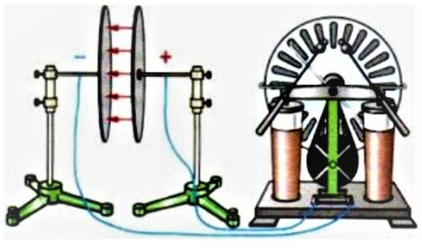

Zaryadlangan kondensatorning elektr energiyasi
$W_{kon}=\frac{q∙(φ_{1}−φ_{2})}{2}=\frac{C∙{(φ_{1}−φ_{2})}^{2}}{2}=\frac{q^{2}}{2C}$
$W_{kon}=\frac{qU}{2}=\frac{CU^{2}}{2}=\frac{q^{2}}{2C}$

Slide 4
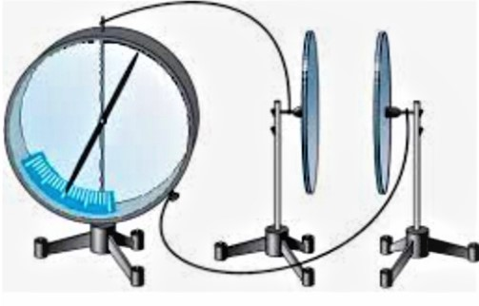
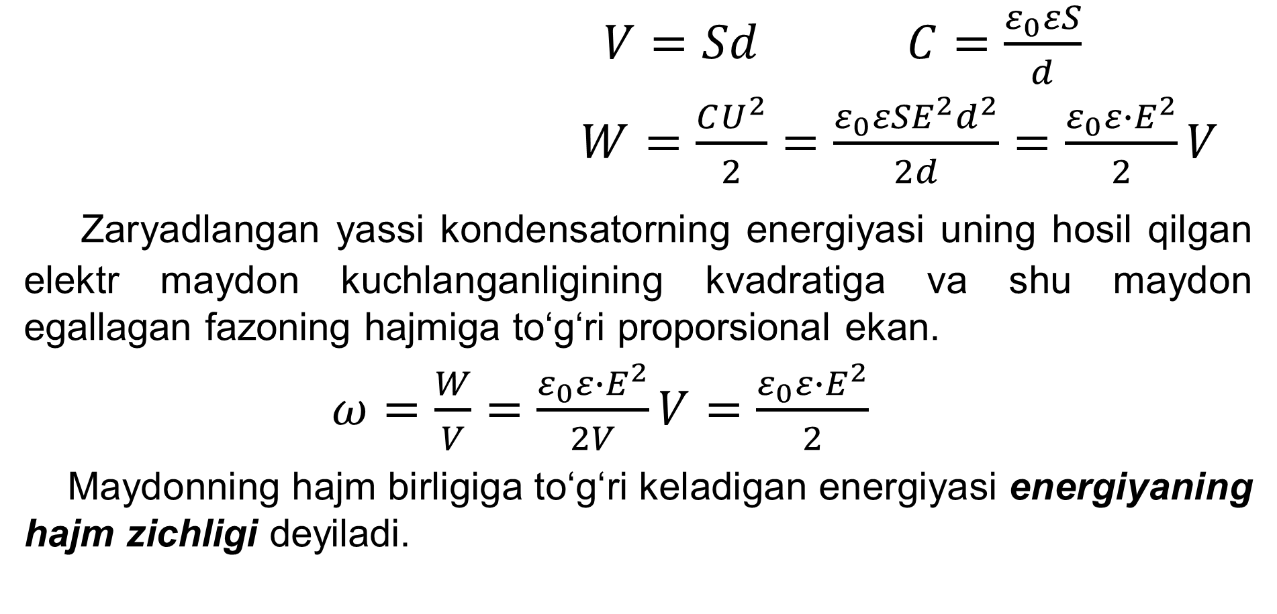
Zaryadlangan yassi kondensator energiyasi
$V=Sd$ $C=\frac{ε_{0}εS}{d}$
$W=\frac{CU^{2}}{2}=\frac{ε_{0}εSE^{2}d^{2}}{2d}=\frac{ε_{0}ε∙E^{2}}{2}V$
Zaryadlangan yassi kondensatorning energiyasi uning hosil qilgan elektr maydon kuchlanganligining kvadratiga va shu maydon egallagan fazoning hajmiga to‘g‘ri proporsional ekan.
$ω=\frac{W}{V}=\frac{ε_{0}ε∙E^{2}}{2V}V=\frac{ε_{0}ε∙E^{2}}{2}$
Maydonning hajm birligiga to‘g‘ri keladigan energiyasi energiyaning hajm zichligi deyiladi.

Slide 5
7-mashq 9-masala
Yassi kondensator qoplamalaridagi kuchlanish 150 V, zaryadi 80 $μC$ bo‘lsa, kondensatordagi maydon energiyasi nimaga teng?

Slide 6
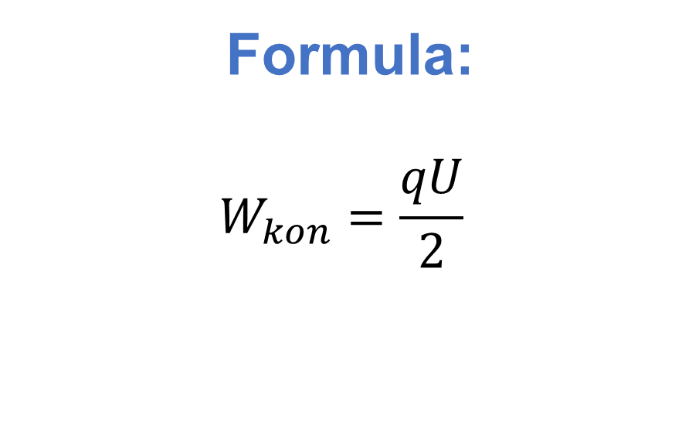
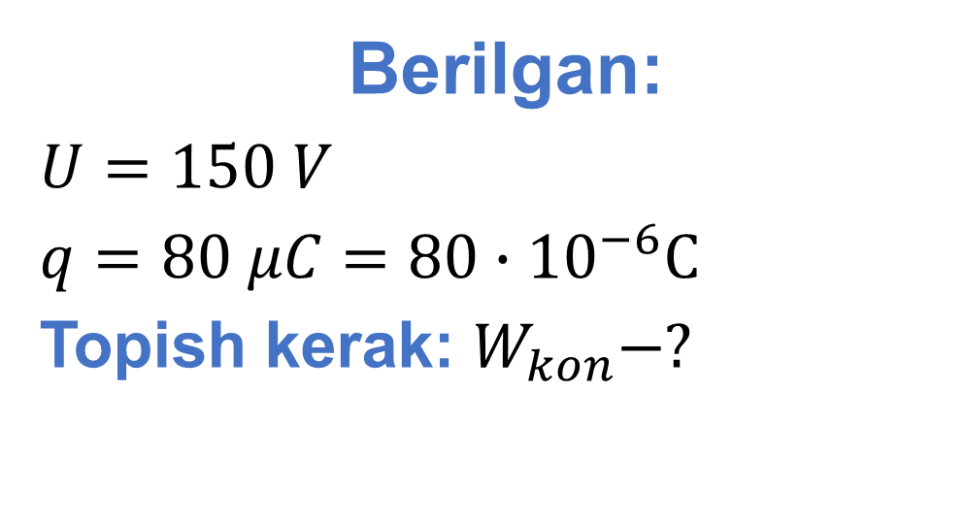
Berilgan:
$U=150 V$
$q=80 μC=80∙{10}^{−6}C$
Topish kerak: $W_{kon}−?$
Formula:
$$W_{kon}=\frac{qU}{2}$$
Yechish: ${ W}_{kon}=\frac{80∙{10}^{−6}C∙150V}{2}=6∙{10}^{−3}$J=6 mJ
Javob: $W_{kon}=6 mJ$

Slide 7

7-mashq 11-masala
Yassi kondensatorga $4∙{10}^{−5}C$ zaryad berilganda, uning energiyasi 20 $mJ$ ga teng bo‘ldi. Kondensator qoplamalari orasidagi kuchlanish qanday bo‘lgan?

Slide 8

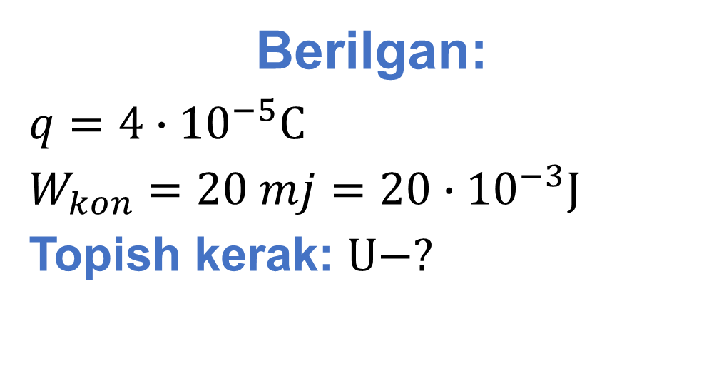
Berilgan:
$q=4∙{10}^{−5}C$
$W_{kon}=20 mj=20∙{10}^{−3}J$
Topish kerak: $U−?$
Formula:
$$W_{kon}=\frac{qU}{2}$$
$$U=\frac{2W_{kon}}{q}$$
Yechish:$U=\frac{2∙20{∙10}^{−3}J}{4∙{10}^{−5}C}=1000 V$
Javob:$U=1000 V$

Slide 9
Mustaqil bajarish uchun topshiriqlar
1. Mavzuni o‘qish va mavzuga oid savollarga javob yozish. (127-bet)
2. 7-mashqning 10, 12-masalalarini yechish.

