Slide 1
Fizika
10-sinf
Mavzu:
Masalalar yechish.
O‘qituvchi:
Toshkent shahar Uchtepa tumani 287-maktab fizika fani o‘qituvchisi
Xodjayeva Maxtuma Ziyatovna.

Slide 2
$F=k\frac{\left|q_{1}\right|\left|q_{2}\right|}{εr^{2}}$
𝐹=𝑘 |𝑞_1 ||𝑞_2 |/(𝜀𝑟^2 )
$E=k\frac{\left|q\right|}{{εr}^{2}}$
𝐸=𝑘 |𝑞|/〖𝜀𝑟〗^2
$k=\frac{1}{4πε_{0}}$
𝑘=1/(4𝜋𝜀_0 )

Slide 3
Masala
Ikkita nuqtaviy zaryad $8 mN$kuch bilan o‘zaro ta’sirlashadi, har bir zaryadning miqdorini 2 marta orttirilgandan so‘ng zaryadlar o‘zaro qanday kuch bilan ta’sirlashadi?

Slide 4
Berilgan:
$F_{1}=8 mN$
$q_{1}=q_{2}=q$
$q_{1}^{′}=q_{2}^{′}=2q$
Topish kerak: $F_{2}−?$
Formula:
$F_{1}=k\frac{\left|q_{1}\right|\left|q_{2}\right|}{εr^{2}}$ $F_{2}=k\frac{\left|q_{1}^{′}\right|\left|q_{2}^{′}\right|}{εr^{2}}$
$\frac{F_{1}}{F_{2}}=\frac{\left|q_{1}\right|\left|q_{2}\right|}{\left|q_{1}^{′}\right|\left|q_{2}^{′}\right|}$
$$F_{2}=F_{1}\frac{\left|q_{1}^{′}\right|\left|q_{2}^{′}\right|}{\left|q_{1}\right|\left|q_{2}\right|}$$
Yechish: $F_{2}=8 mN∙\frac{\left|2q\right|∙\left|2q\right|}{\left|q\right|∙\left|q\right|}=32 mN$
Javob: $F_{2}=32 mN$

Slide 5
Masala
$1 μC$ nuqtaviy zaryad o‘zidan $10 cm$uzoqda joylashgan ikkinchi zaryad bilan kerosin ichida (ε=2) 1,8 N kuch bilan o‘zaro ta’sirlashadi. Ikkinchi zaryadning miqdori qanday?
$k=9∙{10}^{9} \frac{N∙m^{2}}{C^{2}}$

Slide 6
Berilgan:
$q_{1}=1 μC={10}^{−6} C$
$r=10 cm=0,1 m$
$ε=2$
$F=1,8 N$
$k=9∙{10}^{9} \frac{N∙m^{2}}{C^{2}}$
Topish kerak: $q_{2}−?$
Formula:
$F=k\frac{\left|q_{1}\right|\left|q_{2}\right|}{εr^{2}}$
$q_{2}=\frac{Fεr^{2}}{kq_{1}}$
Yechish: $q_{2}=\frac{1,8 N∙2∙{(0,1 m)}^{2}}{9∙{10}^{9} \frac{N∙m^{2}}{C^{2}}∙{10}^{−6} C}=4∙{10}^{−6}C=4 μC$
Javob: $q_{2}=4 μC$

Slide 7
Masala
Kuchlanganlik vektori vertikal yuqoriga yo‘nalgan bir jinsli elektr maydonda massasi $0,03 mg$bo‘lgan $3 nC$zaryadli chang zarrachasi muvozanat holatida turibdi. Maydon kuchlanganligini aniqlang.
$g=10 \frac{m}{s^{2}}$

Slide 8
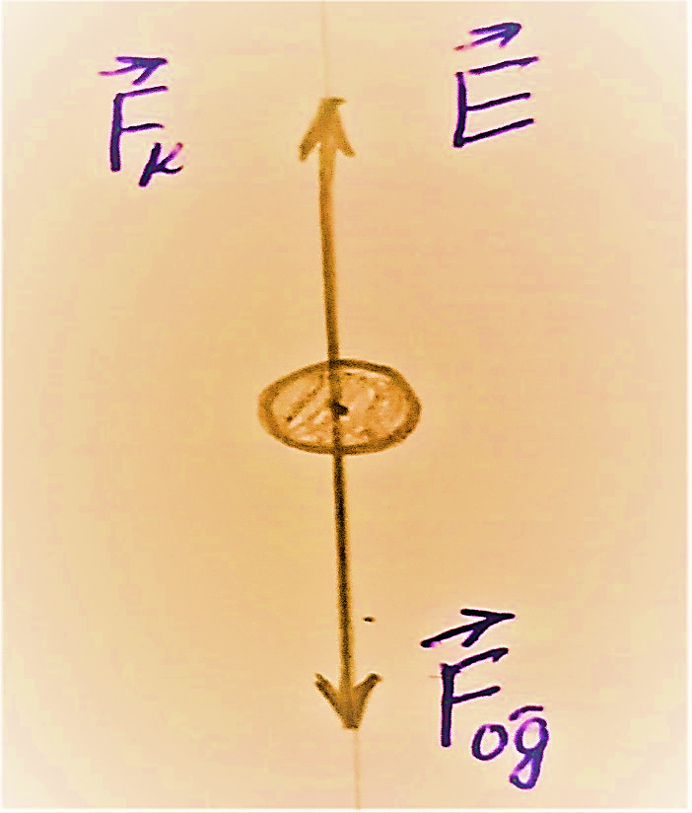
Berilgan:
$m=0,03 mg=3∙{10}^{−8} kg$
$q=3 nC=3∙{10}^{−9} C$
$g=10 \frac{m}{s^{2}}$
Topish kerak: $E−?$
Formula:
$F_{og‘}−F_{k}=0⇒F_{k}=F_{og‘}$
$E=\frac{F_{k}}{q}=\frac{F_{og‘}}{q}$
$F_{og‘}=mg$

Slide 9
$E=\frac{mg}{q}$
Yechish: $E=\frac{3∙{10}^{−8}kg∙10 m/s^{2}}{3∙{10}^{−9}C}=100 N/C$
Javob: $E=100 N/C$

Slide 10
Masala
$90 g$massali sharcha zaryad o‘tkazmaydigan ipga osilgan va $10 nC$zaryadga ega. Sharchaning ostida undan $10 cm$masofada boshqa ishorali zaryadlangan sharcha joylashtirilgach ipning tarangligi 2 marta ortdi. Shu zaryadning miqdorini toping.
$k=9∙{10}^{9} \frac{N∙m^{2}}{C^{2}}$ ; $g=10 \frac{m}{s^{2}}$

Slide 11
Berilgan:
$m=90 mg=9∙{10}^{−5} kg$
$q_{1}=10 nC={10}^{−8}C$
$r=10 cm=0,1 m$
$T_{2}=2T_{1}$
$k=9∙{10}^{9} \frac{N∙m^{2}}{C^{2}}$
$g=10 \frac{m}{s^{2}}$
$ε=1$
Topish kerak: $q_{2}−?$
Formula:
$T_{1}−mg=0$
$T_{1}=mg$

Slide 12
$T_{2}−mg−F_{k}=0$
$F_{k}=T_{2}−mg$ , $T_{2}=2T_{1}$ , $T_{1}=mg$ dan
$F_{k}=2T_{1}−mg=2mg−mg=mg$
$F_{k}=k\frac{\left|q_{1}\right|\left|q_{2}\right|}{εr^{2}}$ dan $k\frac{\left|q_{1}\right|\left|q_{2}\right|}{εr^{2}}=mg$
$q_{2}=\frac{mgεr^{2}}{kq_{1}}$
Yechish:
$q_{2}=\frac{9∙{10}^{−5}kg∙10 \frac{m}{s^{2}}∙1∙{(0,1 m)}^{2}}{9∙{10}^{9} \frac{N∙m^{2}}{C^{2}}∙{10}^{−8}C}={10}^{−7}C=100 nC$
Javob: $q_{2}=100 nC$

Slide 13
Masala
$q, q$va $2q$ zaryadlar bir to‘gri chiziqda ketma-ket, bir-biridan bir xil masofada joylashgan. O‘rtadagi zaryadaga $8 N$kuch ta’sir qiladi. $2q$ zaryadga qanday kuch ta’sir qiladi.

Slide 14
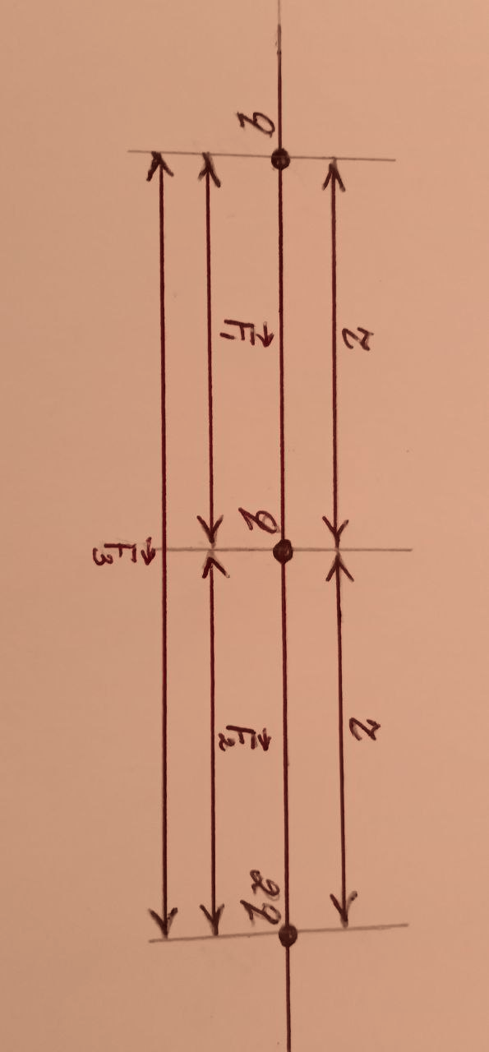
Berilgan:
$q_{1}=q$
$q_{2}=q$
$q_{3}=2q$
$∆F_{2}=8 N$
$r_{1}=r_{2}=r$
Topish kerak: $∆F_{3}−?$
Formula va yechish:
$F_{1}=k\frac{\left|q_{1}\right|\left|q_{2}\right|}{εr^{2}}=k\frac{q∙q}{εr^{2}}=\frac{kq^{2}}{εr^{2}}$ ; $F_{2}=k\frac{q∙2q}{εr^{2}}=\frac{2kq^{2}}{εr^{2}}$
$F_{3}=k\frac{q∙2q}{ε{(2r)}^{2}}=\frac{2kq^{2}}{4εr^{2}}=\frac{kq^{2}}{2εr^{2}}$

Slide 15
$F_{1}=\frac{kq^{2}}{εr^{2}}$ ; $F_{2}=\frac{2kq^{2}}{εr^{2}}$ ;$F_{3}=\frac{kq^{2}}{2εr^{2}}$
$∆F_{2}=F_{2}−F_{1}$
$∆F_{2}=\frac{2kq^{2}}{εr^{2}}−\frac{kq^{2}}{εr^{2}}=\frac{kq^{2}}{εr^{2}}$
${∆F}_{3}=F_{2}+F_{3}=\frac{2kq^{2}}{εr^{2}}+\frac{kq^{2}}{2εr^{2}}=\frac{5kq^{2}}{2εr^{2}}$
$∆F_{2}=\frac{kq^{2}}{εr^{2}}$ dan:
${∆F}_{3}=\frac{5}{2}∙∆F_{2}=\frac{5}{2}∙8 N=20 N$
Javob: ${∆F}_{3}=20 N$

Slide 16
Mustaqil bajarish uchun topshiriqlar:
1. Zaryadlardan biri 4 marta orttirilganda o‘zaro ta’sir kuchi avvalgidek qolishi uchun ular orasidagi masofani qanday o‘zgartirish zarur?
2. Zaryadlari $1 μC$ dan bo‘lgan 2 ta zaryad suvda o‘zaro qanday kuch bilan itarishishini toping.
$ε=81; k=9∙{10}^{9} \frac{N∙m^{2}}{C^{2}}$
3. $q, 2q$va $2q$ zaryadlar bir to‘gri chiziqda ketma-ket, bir-biridan bir xil masofada joylashgan, $q$ zaryadaga $20 N$kuch ta’sir qiladi. O‘rtadagi $2q$ zaryadga qanday kuch ta’sir qiladi?

