Slide 1
Fizika
10-sinf
Mavzu:
Zaryadlangan sharning elektr maydoni.
Dielektrik singdiruvchanlik.
O‘qituvchi:
Toshkent shahar Uchtepa tumani 287-maktab fizika fani o‘qituvchisi
Xodjayeva Maxtuma Ziyatovna.

Slide 2
Zaryadlangan sharning elektr maydoni
$q=q_{1}+q_{2}+$ $q_{3}+…+q_{1}^{′}+$ $q_{2}^{′}+$ $q_{3}^{′}…$
Zaryadlangan sferaning ichida maydon kuchlanganligi nolga teng.
$E=\frac{q}{4πε_{0}R^{2}}$ ; $E=\frac{\left|q\right|}{4πε_{0}r^{2}}=k∙\frac{\left|q\right|}{r^{2}}$

Slide 3
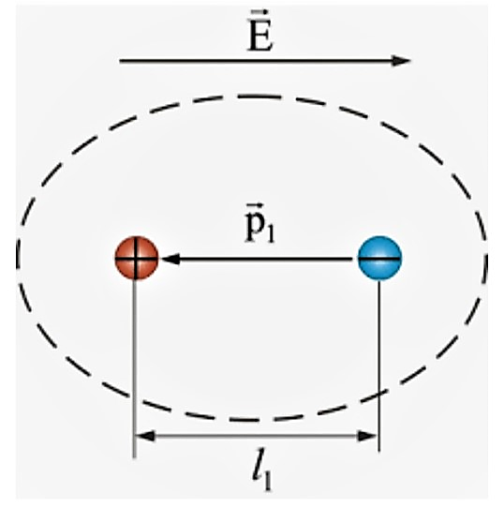
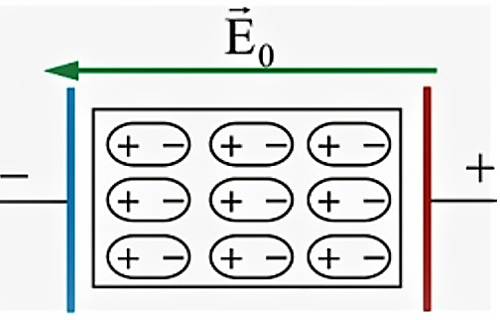
Dielektrikning qutblanishi
Musbat va manfiy zaryadlarning markazlari ustma-ust tushmasligi dielektrikning qutblanishi deyiladi.

Slide 4
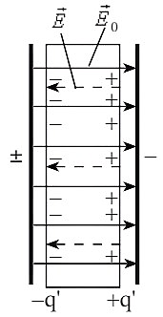
Dielektrik singdiruvchanlik
Dielektrik tufayli maydonning necha marta susayganligini ko‘rsatadigan kattalik dielektrik singdiruvchanlik deyiladi.
$ε=\frac{E_{0}}{E}$ $E=k\frac{\left|q\right|}{ε∙r^{2}}$ $F=k\frac{\left|q_{1}\right|∙\left|q_{2}\right|}{ε∙r^{2}}$
Dielektrik singdiruvchanlik o‘lchamsiz kattalikdir.

Slide 5
Masala
Radiusi $6 cm$bo‘lgan sharga $25 nC$zaryad berilgan, shar sirtidan $4 cm$uzoqlikdagi elektr maydon kuchlanganligini toping.
$k=9∙{10}^{9}N∙\frac{m^{2}}{C^{2}}$

Slide 6
Berilgan:
$q=25 nC=25∙{10}^{−9}C$
$R=6 cm=0,06 m$
$r=4 cm=0,04 m$
$k=9∙{10}^{9}N∙\frac{m^{2}}{C^{2}}$
Topish kerak: $E−?$
Formula:
$E=k\frac{q}{{(R+r)}^{2}}$
Yechish: $E=9∙{10}^{9}N∙\frac{m^{2}}{C^{2}}∙\frac{25∙{10}^{−9}C}{{\left(0,06 m+0,04 m\right)}^{2}}=2250 N/C$
Javob: $E=2250\frac{N}{C}=2,25\frac{kN}{C}$

Slide 7
Masala
Ikkita nuqtaviy zaryad dielektrikning ichida $5 cm$masofada qanday kuch bilan ta’sirlashsa, vakuumda $10 cm$masofada shunday kuch bilan ta’sirlashadi. Dielek-trikning dielektrik singdiruvchanligini aniqlang.

Slide 8
Berilgan:
$r_{1}=5 cm$
$r_{2}=10 cm$
$ε_{2}=1$
$F_{1}=F_{2}$
Topish kerak: $ε_{1}−?$
Formula:
$F_{1}=F_{2}$
$k\frac{\left|q_{1}\right|∙\left|q_{2}\right|}{ε_{1}∙r_{1}^{2}}=k\frac{\left|q_{1}\right|∙\left|q_{2}\right|}{ε_{2}∙r_{2}^{2}}$
$ε_{1}∙r_{1}^{2}=ε_{2}∙r_{2}^{2}$
$ε_{1}=\frac{ε_{2}∙r_{2}^{2}}{r_{1}^{2}}$
Yechish: $ε_{1}=\frac{1∙{(10 cm)}^{2}}{{(5 cm)}^{2}}=4$
Javob: $ε_{1}=4$

Slide 9
Mustaqil bajarish uchun topshiriqlar
1. Mavzuni o‘qish va mavzuga oid savollarga javob yozish. (120-bet)
2. Radiusi $15 cm$bo‘lgan sharga $5 nC$zaryad berilgan, shar sirtidan $5 cm$uzoqlikdagi elektr maydon kuchlanganligini toping. $k=9∙{10}^{9}N∙\frac{m^{2}}{c^{2}}$
3.Ikkita nuqtaviy zaryad dielektrikning ichida $7,5 cm$masofada qanday kuch bilan ta’sirlashsa, vakuumda $25 cm$masofada shunday kuch bilan ta’sirlashadi. Dielektrikning dielektrik singdiruvchanligini aniqlang.

