Slide 1
Fizika
10-sinf
Mavzu:
Prujinali va matematik mayatniklar.
O‘qituvchi:
Toshkent shahar Uchtepa tumani 287-maktab fizika fani o‘qituvchisi
Xodjayeva Maxtuma Ziyatovna.

Slide 2
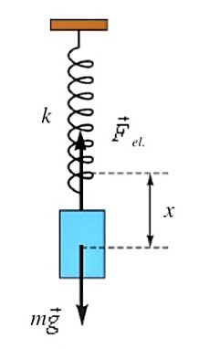
Prujinali mayatnik
Bikrligi $k$ bo‘lgan prujinaga osilgan $m$ massali yukdan iborat tizimga prujinali mayatnik deyiladi.
$ma=−kx_{0}$
$x=A\sin{(ω_{0}}t+φ_{0})$, $a=−ω_{0}^{2}x$
$−ω_{0}^{2}x+\frac{k}{m}x=0$ $⟹$ $ω_{0}=\sqrt{\frac{k}{m}}$
$T=\frac{1}{ν}=\frac{2π}{2πν}=\frac{2π}{ω_{0}}$ $⟹$ $T=\frac{2π}{ω_{0}}=\frac{2π}{\sqrt{\frac{k}{m}}}$
$T=2π\sqrt{\frac{m}{k}}$

Slide 4
$E_{k}=\frac{mθ^{2}}{2}$ $θ=Aω_{0}\cos{(ω_{0}t+}φ_{0})$
${ E}_{k}=\frac{1}{2}mA^{2}ω_{0}^{2}\cos^{2}{(ω_{0}}t+φ_{0})$
$E_{p}=\frac{kx^{2}}{2}=\frac{1}{2}kA^{2}$ $\sin^{2}{(ω_{0}}t+φ_{0})$
$E_{t}=E_{k}+E_{p}=\frac{1}{2}mA^{2}ω_{0}^{2}\cos^{2}{(ω_{0}}t+φ_{0})+\frac{1}{2}kA^{2}$ $\sin^{2}{(ω_{0}}t+φ_{0})$
$ω_{0}^{2}=\frac{k}{m}$ ekanligi hisobga olinsa,
$E_{t}=$ $\frac{1}{2}kA^{2}\left[\cos^{2}{(ω_{0}}t+φ_{0}\right)+\sin^{2}{(ω_{0}}t+φ_{0})]$
$E_{t}=\frac{1}{2}kA^{2}$

Slide 5
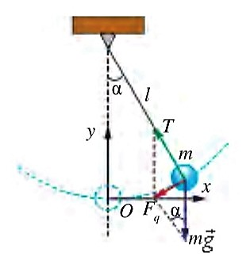
Matematik mayatnik
Cho‘zilmas va vaznsiz ipga osilgan hamda muvozanat vaziyati atrofida davriy tebranma harakat qiluvchi moddiy nuqta matematik mayatnik deyiladi.
$F_{q}=P\sin{α=mg∙\sin{α}}$
Nyutonning ikkinchi qonuniga ko‘ra
$−mg\sin{α=ma}$
$ma≈−mg∙\frac{x}{l}$ ; $a=−ω_{0}^{2}x$; $mω_{0}^{2}x=mg\frac{x}{l}$
$ω_{0}=\sqrt{\frac{g}{l}}$; $T=\frac{1}{ν}=\frac{2π}{2πν}=\frac{2π}{ω_{0}}$; $T=2π\sqrt{\frac{l}{g}}$

Slide 7
$T=2π\sqrt{\frac{l}{g}}$ Bu Gyugens tenglamasi deyiladi va uni yordamida matematik mayatnik tebranish davrini aniqlash mumkin. Bundan quyidagi qonuniyatlar kelib chiqadi:
1) matematik mayatnikning og‘ish burchagi ($α)$ kichik bo‘lganda tebranish davri uning tebranish amplitudasiga bog‘liq emas.
2) matematik mayatnikning tebranish davri unga osilgan yukning massasiga ham bog‘liq emas.
3) matematik mayatnikning tebranish davri uning uzunligidan chiqarilgan kvadrat ildizga to‘g‘ri proporsional va erkin tushish tezlanishidan chiqarilgan kvadrat ildizga teskari proporsional ekan.
$x=A\sin{(ω_{0}}t+φ_{0})$

Slide 8
5-mashq 1-masala
Matematik mayatnik 1 min 40 s ichida 50 marta tebrandi.
Mayatnikning tebranish davri va siklik chastotasini toping.

Slide 9
Berilgan: Formulasi: Yechish:
$t=1\min{40 s=100 s}$ $T=\frac{t}{N}$ $T=\frac{100s}{50}=2 s$
$N=50$
Topish kerak: $T−? ω−?$ $ω=\frac{2π}{T}$ $ω=\frac{2π}{2 s}=\frac{π}{s}$
Javob: $T=2 s; ω=\frac{π}{s}$ ;

Slide 10
Mustaqil bajarish uchun topshiriqlar
1. Mavzuni o‘qish va mavzuga oid savollarga javob yozish. (85-bet)
2. 5-mashqning 7, 9-masalalarini yechish.

