Slide 1

FIZIKA
10-sinf
Mavzu: Masalalar yechish
O‘qituvchi:
Toshkent shahar Uchtepa tumani 287-maktab fizika fani o‘qituvchisi
Xodjayeva Maxtuma Ziyatovna.

Slide 2
Absolyut noelastik to‘qnashuv
$\vec{θ}=\frac{m_{1}{\vec{θ}}_{1}+m_{2}{\vec{θ}}_{2}}{m_{1}+m_{2}}$
𝜗 ⃗=(𝑚_1 𝜗 ⃗_1+𝑚_2 𝜗 ⃗_2)/(𝑚_1+𝑚_2 )
$m_{1}{\vec{θ}}_{1}+m_{2}{\vec{θ}}_{2}=(m_{1}+m_{2})\vec{θ}$
𝑚_1 𝜗 ⃗_1+𝑚_2 𝜗 ⃗_2=(𝑚_1+𝑚_2)𝜗 ⃗

Slide 3
Absolyut elastik to‘qnashuv
$$m_{1}{\vec{θ}}_{1}+m_{2}{\vec{θ}}_{2}=m_{1}{\vec{θ}}_{1}^{′}+m_{2}θ_{2}^{′}$$
$$\frac{m_{1}θ_{1}^{2}}{2}+\frac{m_{2}θ_{2}^{2}}{2}=\frac{m_{1}θ_{1}^{′2}}{2}+\frac{m_{2}θ_{2}^{′2}}{2}$$
𝑚_1 𝜗 ⃗_1+𝑚_2 𝜗 ⃗_2=𝑚_1 𝜗 ⃗_1^′+𝑚_2 𝜗_2^′
(𝑚_1 𝜗_1^2)/2+(𝑚_2 𝜗_2^2)/2=(𝑚_1 𝜗_1^′2)/2+(𝑚_2 𝜗_2^′2)/2
$θ_{1}^{′}=\frac{2m_{2}θ_{2}+(m_{1}−m_{2})θ_{1}}{m_{1}+m_{2}}$; $θ_{2}^{′}=\frac{2m_{1}θ_{1}+(m_{2}−m_{1})θ_{2}}{m_{1}+m_{2}}$
𝜗_1^′=(2𝑚_2 𝜗_2+(𝑚_1−𝑚_2)𝜗_1)/(𝑚_1+𝑚_2 ); 𝜗_2^′=(2𝑚_1 𝜗_1+(𝑚_2−𝑚_1)𝜗_2)/(𝑚_1+𝑚_2 )

Slide 4
7-test 57-bet
Ikki yoki undan ko‘p jismlarning juda qisqa vaqt davomidagi ta’sirlashuviga nima deb aytiladi?
  Absolyut elastik
  Absolyut noelastik
  To‘qnashish
  Ko‘chish
To‘g‘ri javob: C) To‘qnashish.

Slide 5
9-test 57-bet
... to‘qnashish deb, ikkita deformatsiyalanmaydigan sharlarning to‘qnashishiga aytiladi. Gapni to‘ldiring.
    Absolyut elastik
    Absolyut noelastik
    To‘qnashish
    Ko‘chish
To‘g‘ri javob: A) Absolyut elastik.

Slide 6
Masala
Relslarga parallel ravishda 500 m/s tezlik bilan uchayotgan 100 kg massali snaryad massasi
10 t bo‘lgan tinch turgan qumli platformaga urildi va qumga kirib qoldi.
Platforma qanday (m/s) tezlik bilan harakatlanadi?

Slide 7
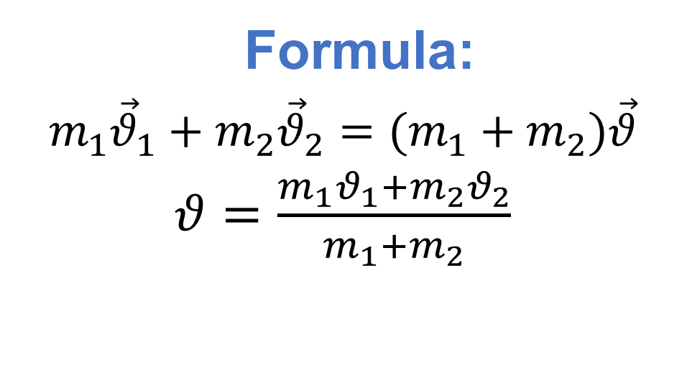
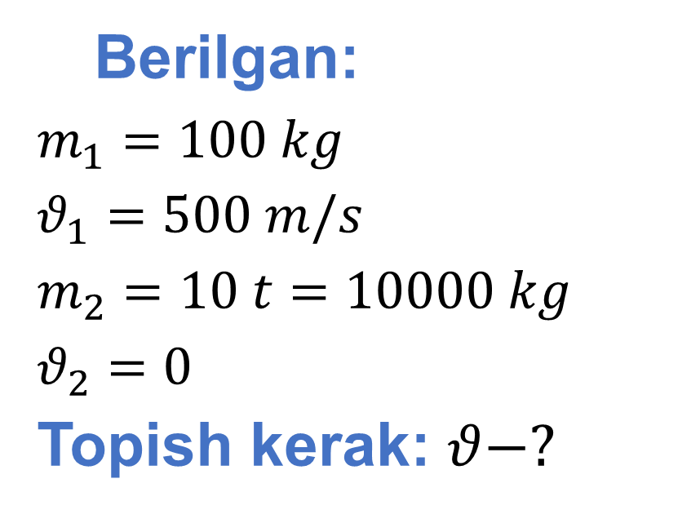
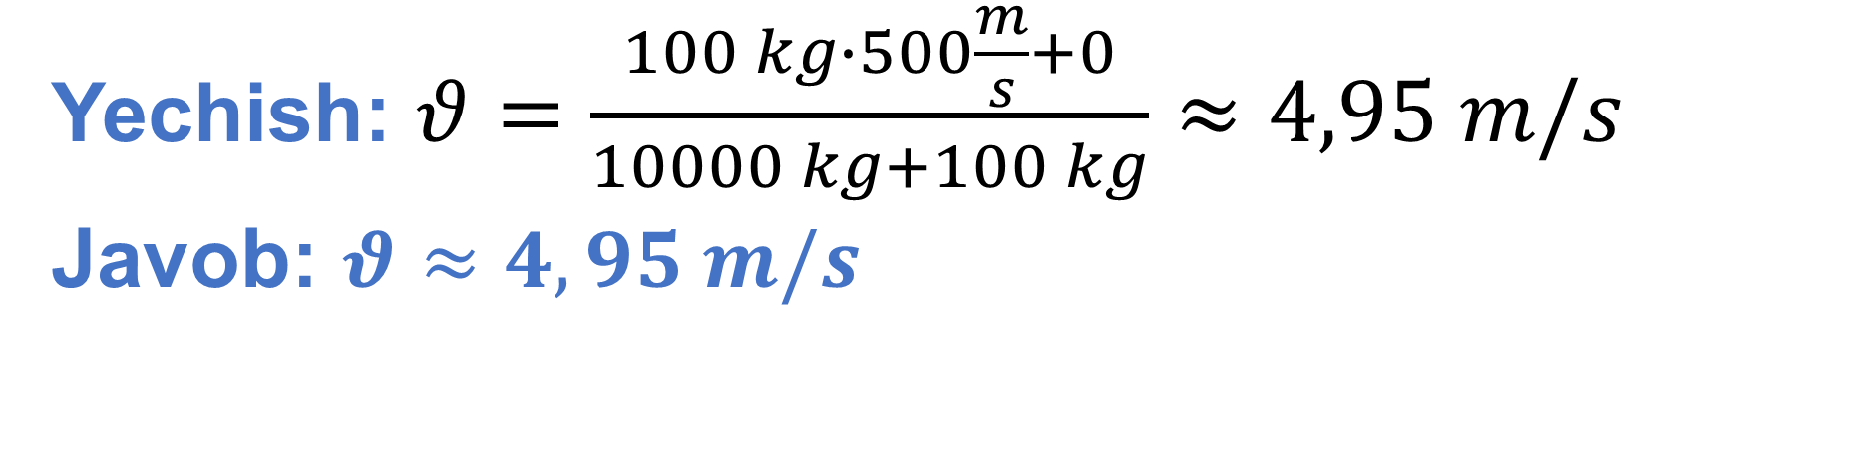
Berilgan:
$m_{1}=100 kg$
$θ_{1}=500 m/s$
$m_{2}=10 t=10000 kg$
$θ_{2}=0$
Topish kerak: $θ−?$
Formula:
$m_{1}{\vec{θ}}_{1}+m_{2}{\vec{θ}}_{2}=(m_{1}+m_{2})\vec{θ}$
$θ=\frac{m_{1}θ_{1}+m_{2}θ_{2}}{m_{1}+m_{2}}$
Yechish: $θ=\frac{100 kg∙500\frac{m}{s}+0}{10000 kg+100 kg}≈4,95 m/s$
Javob: $θ≈4,95 m/s$

Slide 8
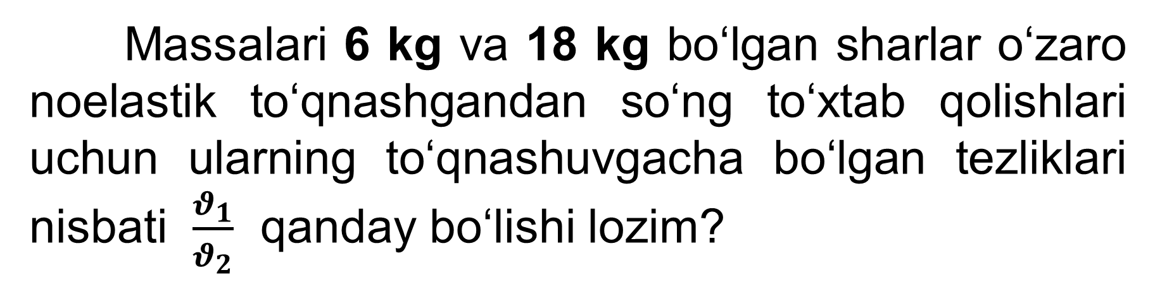
Masala
Massalari 6 kg va 18 kg bo‘lgan sharlar o‘zaro noelastik to‘qnashgandan so‘ng to‘xtab qolishlari uchun ularning to‘qnashuvgacha bo‘lgan tezliklari nisbati $\frac{θ_{1}}{θ_{2}}$ qanday bo‘lishi lozim?

Slide 9
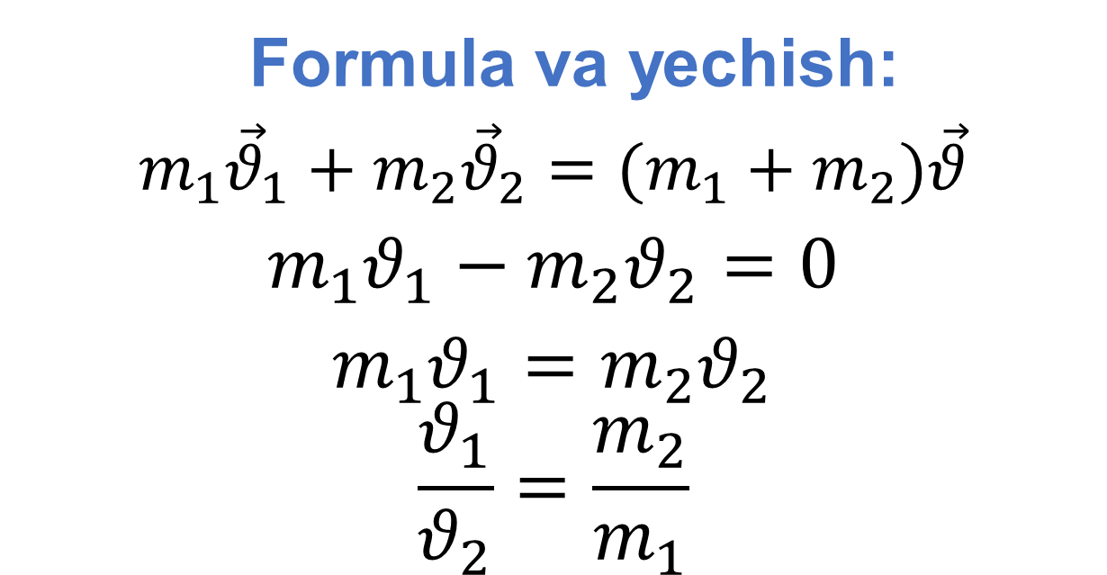
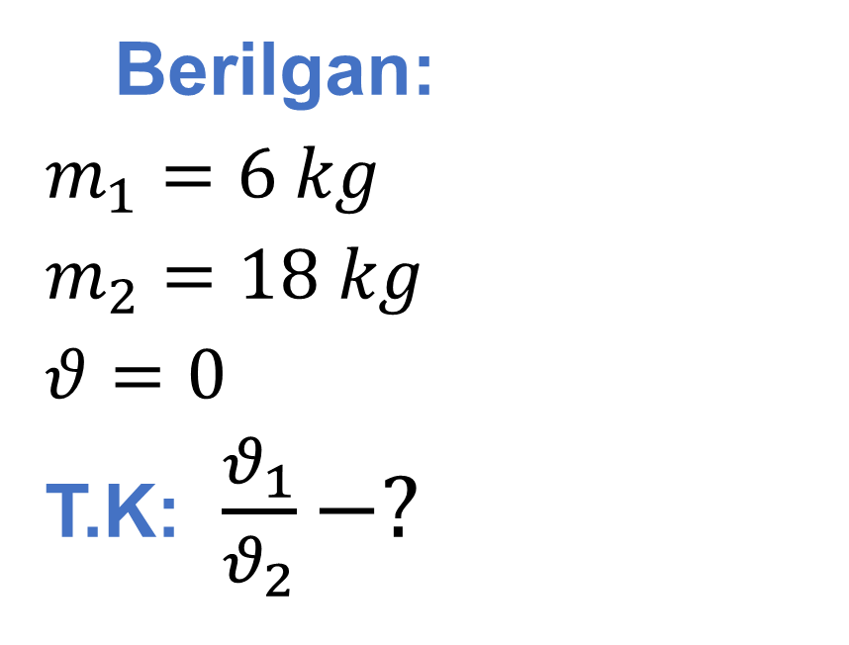
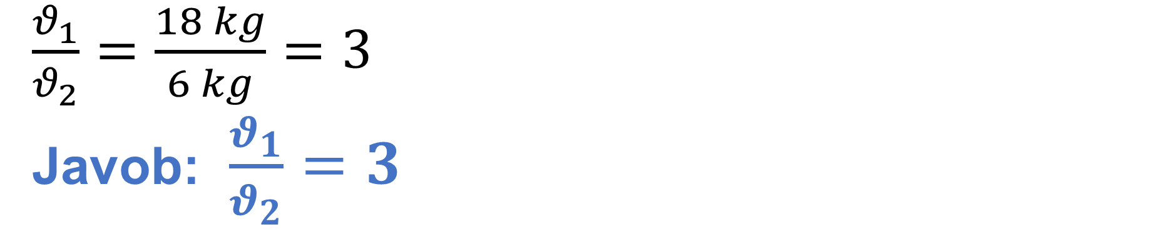
Berilgan:
$m_{1}=6 kg$
$m_{2}=18 kg$
$θ=0$
T.K: $\frac{θ_{1}}{θ_{2}}−?$
Formula va yechish:
$m_{1}{\vec{θ}}_{1}+m_{2}{\vec{θ}}_{2}=(m_{1}+m_{2})\vec{θ}$
$m_{1}θ_{1}−m_{2}θ_{2}=0$
$m_{1}θ_{1}=m_{2}θ_{2}$
$$\frac{θ_{1}}{θ_{2}}=\frac{m_{2}}{m_{1}}$$
$\frac{θ_{1}}{θ_{2}}=\frac{18 kg}{6 kg}=3$
Javob: $\frac{θ_{1}}{θ_{2}}=3$

Slide 10
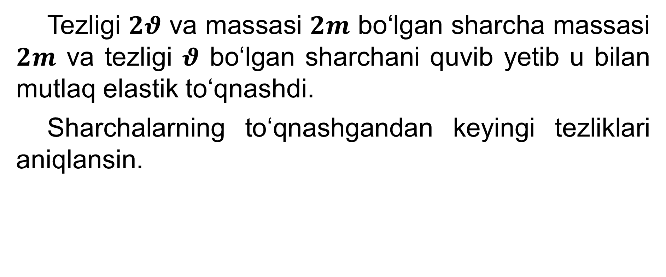
Masala
Tezligi $2θ$ va massasi $2m$ bo‘lgan sharcha massasi $2m$ va tezligi $θ$ bo‘lgan sharchani quvib yetib u bilan mutlaq elastik to‘qnashdi.
Sharchalarning to‘qnashgandan keyingi tezliklari aniqlansin.

Slide 11
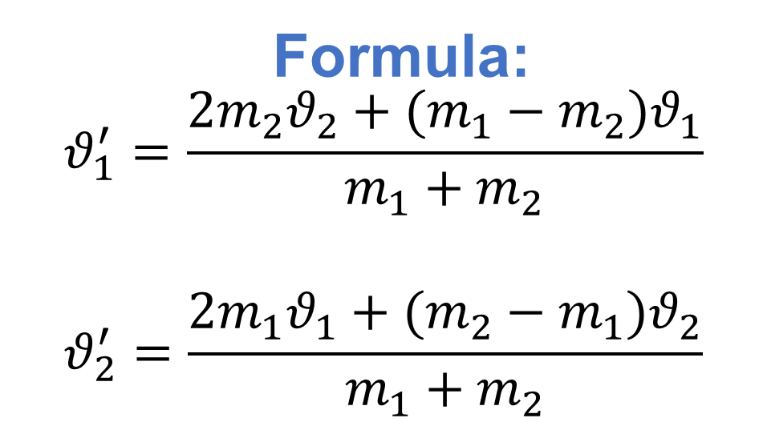
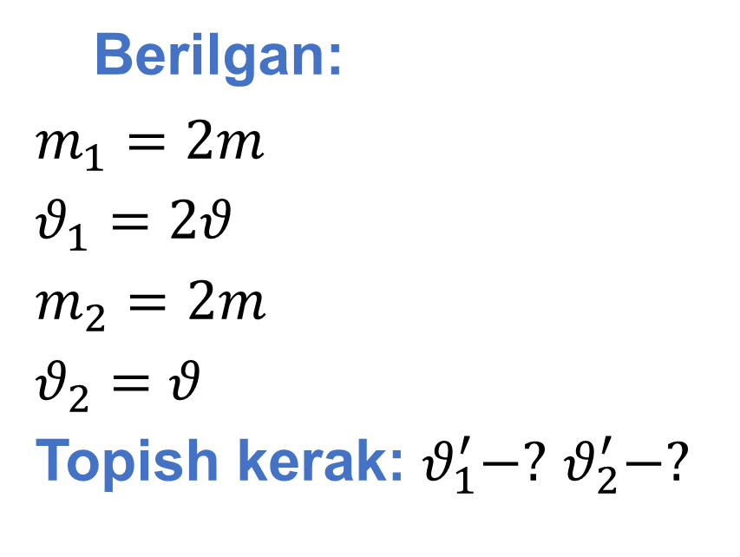
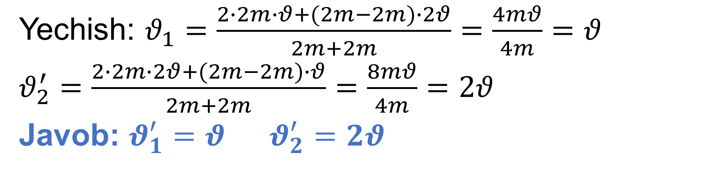
Berilgan:
$m_{1}=2m$
$θ_{1}=2θ$
$m_{2}=2m$
$θ_{2}=θ$
Topish kerak: $θ_{1}^{′}−?$ $θ_{2}^{′}−?$
Formula:
$$θ_{1}^{′}=\frac{2m_{2}θ_{2}+(m_{1}−m_{2})θ_{1}}{m_{1}+m_{2}}$$
$$θ_{2}^{′}=\frac{2m_{1}θ_{1}+(m_{2}−m_{1})θ_{2}}{m_{1}+m_{2}}$$
Yechish: $θ_{1}=\frac{2∙2m∙θ+(2m−2m)∙2θ}{2m+2m}=\frac{4mθ}{4m}=θ$
$θ_{2}^{′}=\frac{2∙2m∙2θ+(2m−2m)∙θ}{2m+2m}=\frac{8mθ}{4m}=2θ$
Javob: $θ_{1}^{′}=θ$ $θ_{2}^{′}=2θ$

Slide 12
3-mashq 8-masala
Massalari 1 kg va 2 kg bo‘lgan noelastik sharlar bir-biriga tomon, mos ravishda, 1 va 2 m/s tezlik bilan harakatlanmoqda.
To‘qnashgandan keyin sistema kinetik ener-giyasining o‘zgarishini toping.

Slide 13
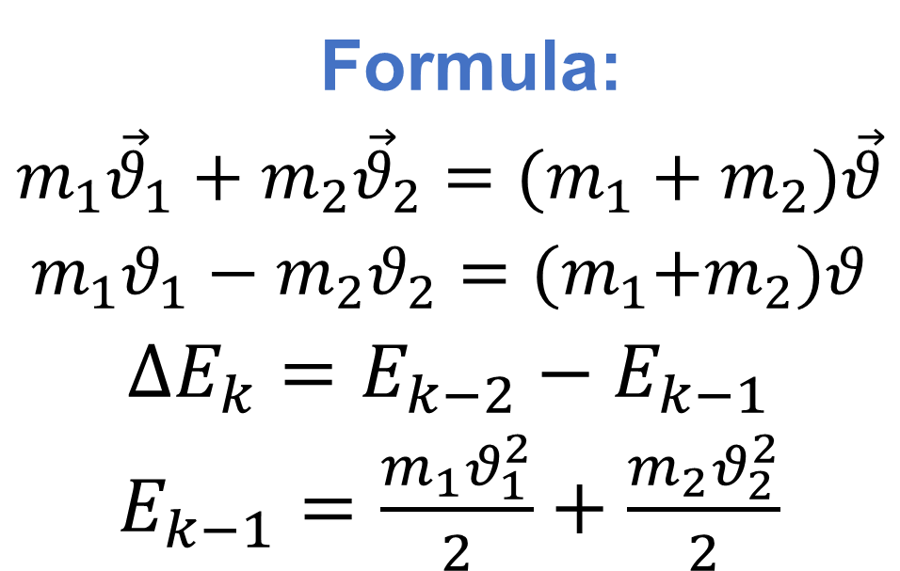
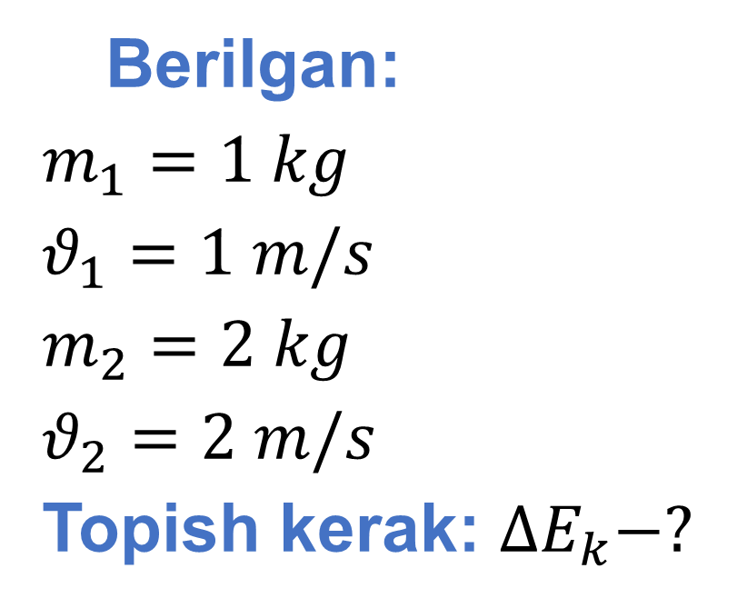
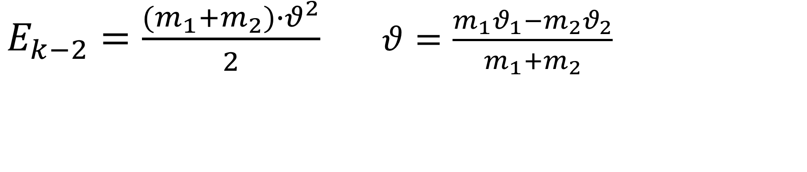
Berilgan:
$m_{1}=1 kg$
$θ_{1}=1 m/s$
$m_{2}=2 kg$
$θ_{2}=2 m/s$
Topish kerak: $∆E_{k}−?$
Formula:
$m_{1}{\vec{θ}}_{1}+m_{2}{\vec{θ}}_{2}=(m_{1}+m_{2})\vec{θ}$
$m_{1}θ_{1}−m_{2}θ_{2}={(m}_{1}+m_{2})θ$
$∆E_{k}=E_{k−2}−E_{k−1}$
$E_{k−1}=\frac{m_{1}θ_{1}^{2}}{2}+\frac{m_{2}θ_{2}^{2}}{2}$
$E_{k−2}=\frac{(m_{1}+m_{2})∙θ^{2}}{2}$ $θ=\frac{m_{1}θ_{1}−m_{2}θ_{2}}{m_{1}+m_{2}}$

Slide 14
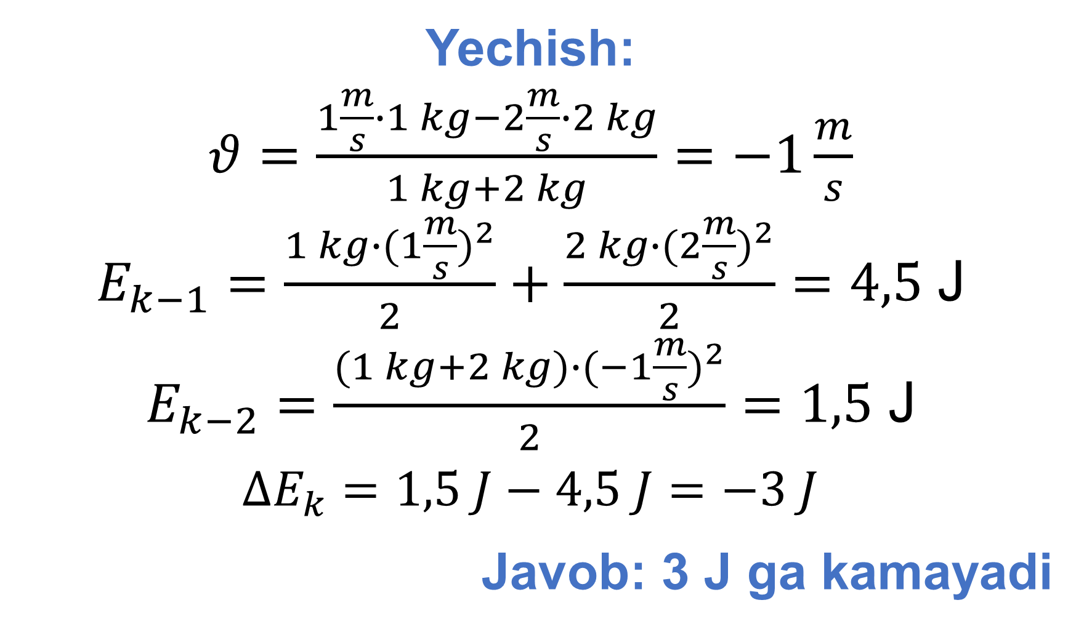
Yechish:
$θ=\frac{1\frac{m}{s}∙1 kg−2\frac{m}{s}∙2 kg}{1 kg+2 kg}=−1\frac{m}{s}$
$E_{k−1}=\frac{1 kg∙{(1\frac{m}{s})}^{2}}{2}+\frac{2 kg∙{(2\frac{m}{s})}^{2}}{2}=4,5$ J
$E_{k−2}=\frac{(1 kg+2 kg)∙{(−1\frac{m}{s})}^{2}}{2}=1,5$ J
$∆E_{k}=1,5 J−4,5 J=−3 J$
Javob: 3 J ga kamayadi

Slide 15
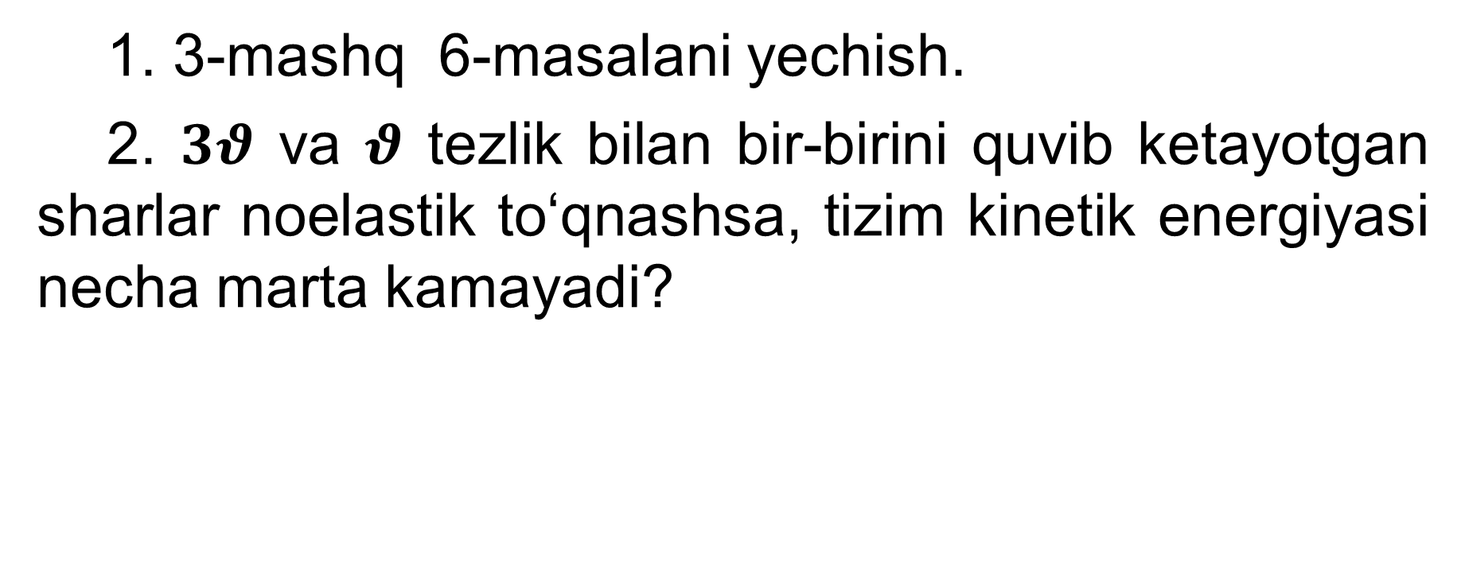
Mustaqil bajarish uchun topshiriqlar
1. 3-mashq 6-masalani yechish.
2. $3θ$ va $θ$ tezlik bilan bir-birini quvib ketayotgan sharlar noelastik to‘qnashsa, tizim kinetik energiyasi necha marta kamayadi?

