Slide 1
Fizika
10-sinf
Mavzu: Jism og‘irligining harakat turiga bog‘liqligi.
O‘qituvchi:
Toshkent shahar Uchtepa tumani 287-maktab fizika fani o‘qituvchisi
Xodjayeva Maxtuma Ziyatovna.

Slide 2
Jismning og‘irligi – Yerning tortishish kuchi tufayli jismlarning tayanchga yoki osmaga beradigan ta’sir kuchidir.
Jismning og‘irligi $\vec{P}$ harfi bilan belgilanadi.
Nyutonning 3-qonuniga ko‘ra odatda reaksiya kuchi $\vec{N}$ ga modul jihatidan teng bo‘ladi:
$\left|\vec{P}\right|=\left|\vec{N}\right|$

Slide 3
$\vec{θ}=const$ $a=0$
$\vec{F_{og‘}}+\vec{N}=0$
$F_{og‘}−N=0$
$F_{og‘}=N=mg$
$\left|\vec{P}\right|=\left|\vec{N}\right|$ dan
$\vec{P}=m\vec{g}$ yoki $P=mg$

Slide 4
$\vec{N}+\vec{F_{og‘}}=m\vec{a}$
$\vec{N}=−\vec{P}$
$$−\vec{P}+\vec{F_{og‘}}=m\vec{a}$$
$\vec{P}=\vec{F_{og‘}}−m\vec{a}$
$\vec{P}=m\vec{g}−m\vec{a}$
$$\vec{P}=m(\vec{g}−\vec{a})$$
$P=0$ holat vaznsizlik deb ataladi.

Slide 5
Liftdagi insonning og‘irligi yerdagi og‘irligiga teng holat (tekis harakat) $$\vec{g}−\vec{a}=\vec{g}$$ $\vec{a}=0$

Slide 6
Liftdagi insonning og‘irligi manfiy ya’ni qarama-qarshiga o‘zgargan holat:
$\vec{g}−\vec{a}<0$

Slide 7
Liftdagi insonning og‘irligi 0 ga teng bo‘lgan holat uchun: $\vec{g}−\vec{a} =0$

Slide 8
Liftdagi insonning og‘irligi noldan katta, lekin kamayotgan holat uchun: $0<\vec{g}−\vec{a}<\vec{g}$

Slide 9
$\vec{P}=m(\vec{g}−\vec{a})$
Lift tezlanishining yo‘nalishi og‘irlik kuchiga qarama qarshi bo‘lganidan:
$$\vec{P}=m\left(\vec{g}−(−\vec{a})\right)=m(\vec{g}+\vec{a})$$
Bu jarayonda inson oladigan yuklanish:
$n=\frac{\vec{P}}{\vec{F_{og‘}}}=\frac{m(\vec{g}+\vec{a}) }{m\vec{g}}⇒$
$n=\frac{\vec{g}+\vec{a}}{\vec{g}}=1+\frac{\vec{a}}{\vec{g}}$

Slide 10
Liftdagi insonning og‘irligi Yerdagidan biroz katta bo‘lgan holat uchun: $\vec{g}+\vec{a}>\vec{g}$

Slide 11
Liftdagi insonning og‘irligi Yerdagidan ancha katta bo‘lgan holat uchun: $\vec{g}+\vec{a}≫\vec{g}$

Slide 12
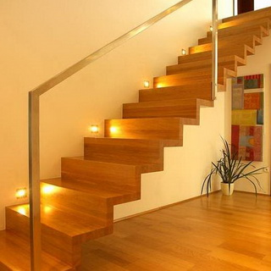
Zinadan tezlanish bilan tushilganda, og‘irligimiz $m\vec{a}$ga kamayadi, tezlanish bilan ko‘tarila boshlasak, aksincha $m\vec{a}$ ga ortadi.
Agar doimiy tezlikda tushsak yoki ko‘tarilsak og‘irligimiz o‘zgarmaydi.

Slide 13
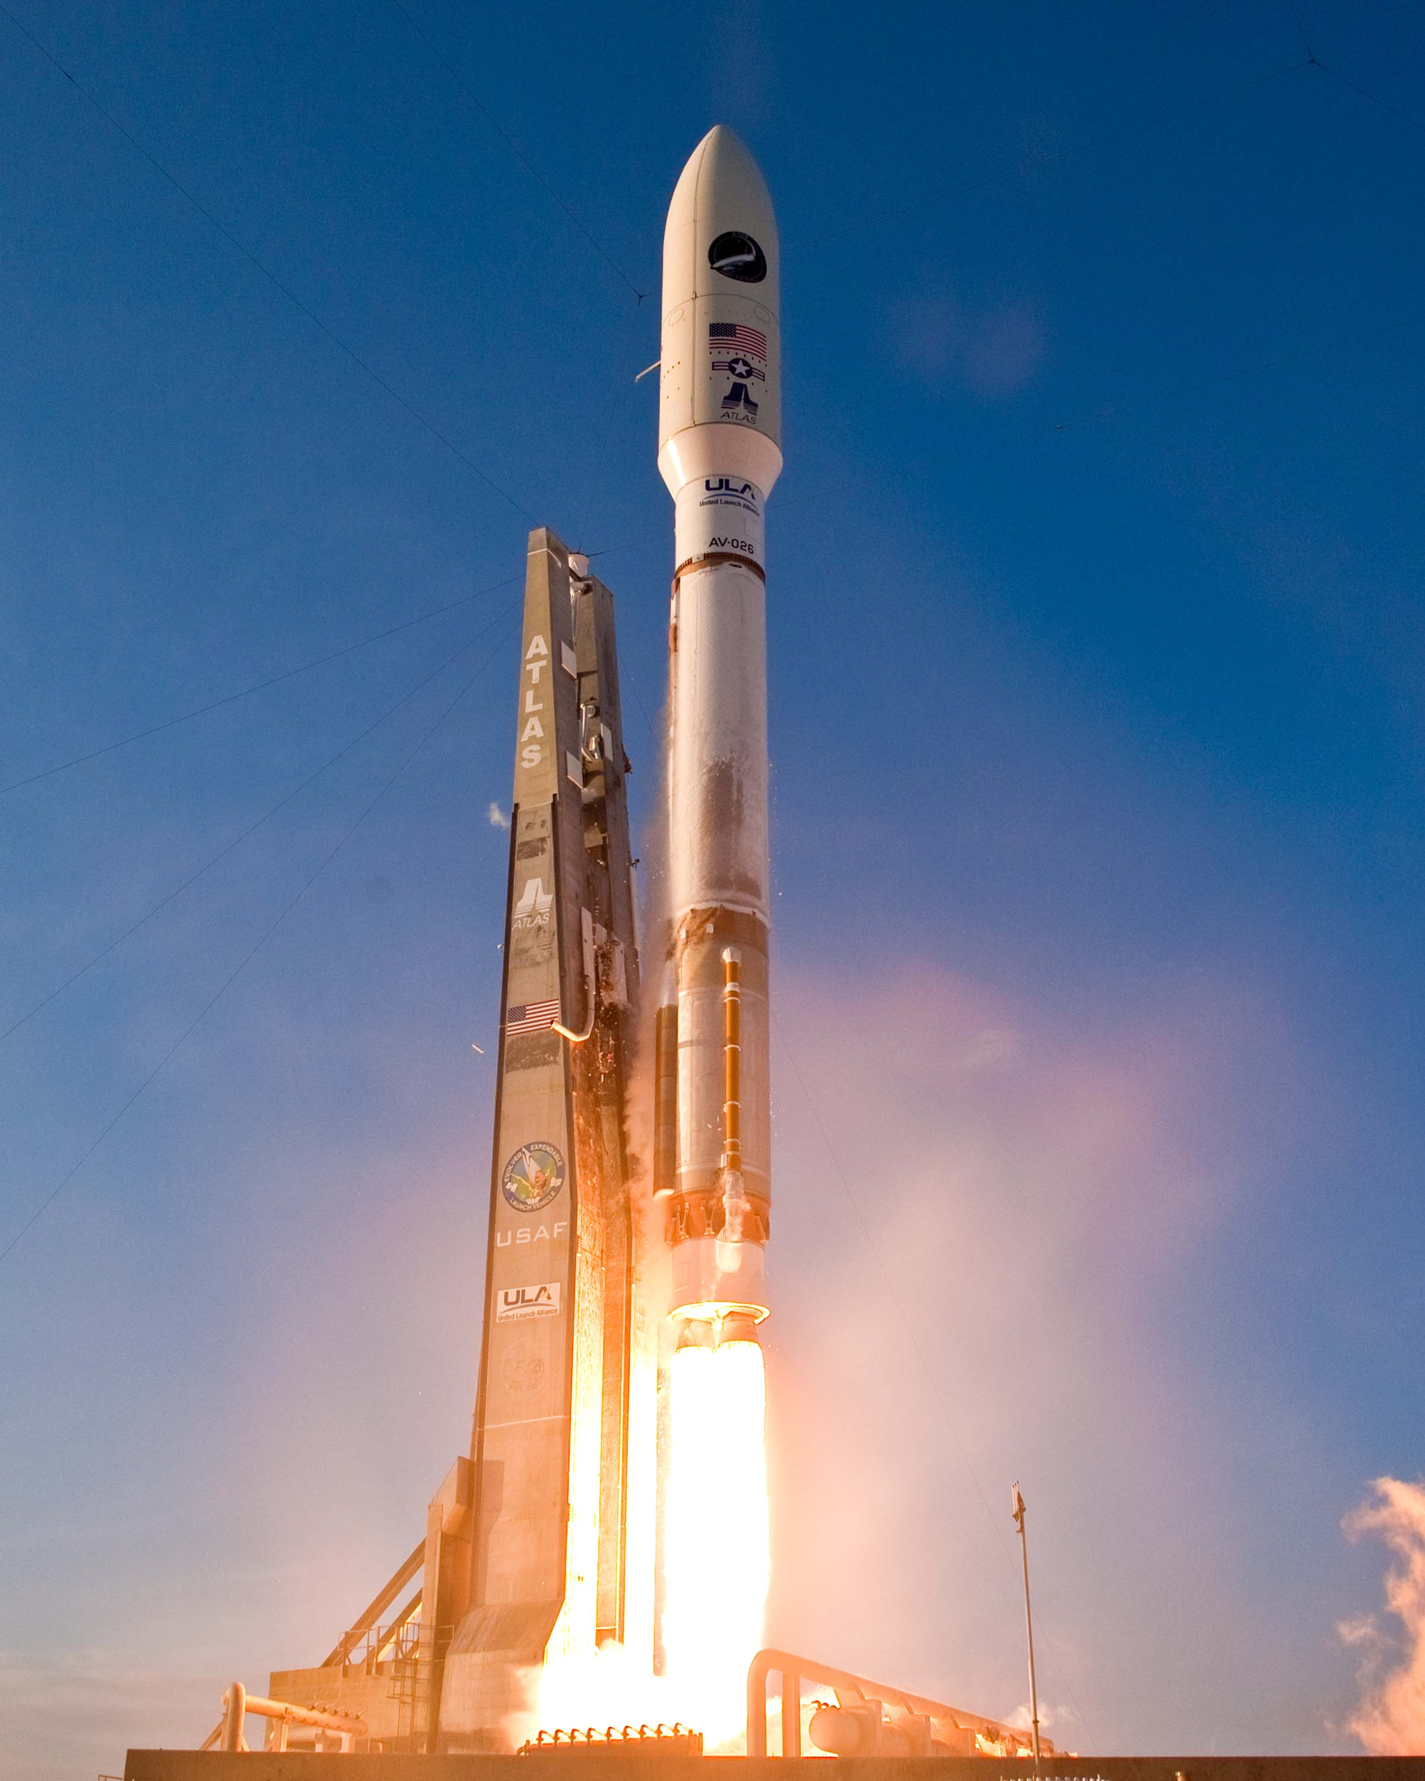

Slide 14
1-masala
10 kg massali jism vertikal pastga $5 m/s^{2}$ tezlanish bilan harakatlanishi uchun unga qanday kuch bilan ta’sir qilish kerak? $g=10\frac{m}{s^{2}}$

Slide 15
Berilgan:
$m=10 kg$
$a=5 m/s^{2}$
$g=10 m/s^{2}$
Topish kerak:
$P−?$
Formula:
$\vec{P}=m(\vec{g}−\vec{a})$
Yechish:
$P=10 kg∙\left(10\frac{m}{s^{2}}−5\frac{m}{s^{2}}\right)=$
$$kg∙\frac{m}{s^{2}}=N$$
$=50 N$
Javob: $P=50 N$

Slide 16
2-masala
60 kg massali kosmonavt raketaning vertikal ko‘tarilishida tayanchga 5400 N kuch bilan bosadi. Raketaning tezlanishini toping. $g=10\frac{m}{s^{2}}$

Slide 17
Berilgan:
$P=5400 N$
$m=60 kg$
$g=10 m/s^{2}$
Topish kerak:
$a−?$
Formula:
$P=m(g+a)$
$$P=mg+ma$$
$$ma=P−mg$$
$a=\frac{P−mg}{m}$
Yechish: $a=\frac{5400 N−60 kg∙10\frac{m}{s^{2}}}{60 kg}=80 m/s^{2}$
Javob: $a=80 m/s^{2}$

Slide 18
3-masala
Trosning chidamliligi 1600 N. Shu tross yordamida qanday massali yukni $15 m/s^{2}$ tezlanish bilan ko‘tarish mumkin? $g=10\frac{m}{s^{2}}$

Slide 19
Berilgan:
$P=1600 N$
$a=15 m/s^{2}$
$g=10 m/s^{2}$
Topish kerak:
$m−?$
Formula:
$P=m(g+a)$
$$m=\frac{P}{g+a}$$
Yechish: $m=\frac{1600 N}{15\frac{m}{s^{2}}+10\frac{m}{s^{2}}}=64 kg$
Javob: $m=64 kg$

Slide 20
Mustaqil bajarish uchun topshiriqlar
1. 40-betdagi mavzuga doir savollarga javob yozish.
2. 2 kg massali jismni yuqoriga erkin tushish tezlanishidan 2 marta katta tezlanish bilan ko‘tarish uchun qancha kuch kerak bo‘ladi?
3. Harakatdagi yuk osilgan ipning tarangligi harakatsiz yuk hosil qilgan taranglik kuchidan 3 marta katta bo‘lsa, yuk ip yordamida qanday tezlanish bilan ko‘tarilmoqda? $g=10\frac{m}{s^{2}}$

