Slide 1
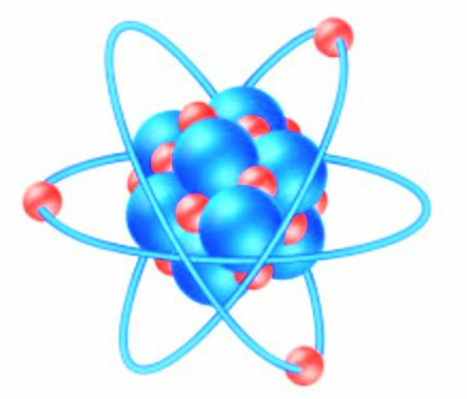
Fizika
9-sinf
Mavzu:
Masalalar yechish.
O‘qituvchi: Toshkent shahar Uchtepa tumani
287-maktab fizika fani o‘qituvchisi
Xodjayeva Maxtuma Ziyatovna.

Slide 2
Yorug‘likning qaytish va sinish qonunlari. To‘la ichki qaytish.
$α=β;$ $n_{21}=\frac{\sin{α}}{\sin{β}}$; $n=\frac{c}{θ}$; $\frac{n_{2}}{n_{1}}=\frac{θ_{1}}{θ_{2}}$
𝛼=𝛽; 𝑛_21=sin⁡𝛼/sin⁡𝛽 ; 𝑛=𝑐/𝜗; 𝑛_2/𝑛_1 =𝜗_1/𝜗_2
$\frac{n_{2}}{n_{1}}=\frac{\sin{α}}{\sin{β}}$; $\sin{α_{0}=\frac{n_{2}}{n_{1}}}; \sin{α_{0}=\frac{1}{n}}$
𝑛_2/𝑛_1 =sin⁡𝛼/sin⁡𝛽 ; sin⁡〖𝛼_0=𝑛_2/𝑛_1 〗; sin⁡〖𝛼_0=1/𝑛〗

Slide 3
Linzaning optik kuchi: $D=\frac{1}{F}$; $F=\frac{1}{D}$
Linzaning optik kuchi: 𝐷=1/𝐹; 𝐹=1/𝐷
Fokus masofasi: $F=\frac{1}{(n−1)∙(\frac{1}{R_{1}}+\frac{1}{R_{2}})}$
Fokus masofasi: 𝐹=1/((𝑛−1)∙(1/𝑅_1 +1/𝑅_2 ))
$\frac{1}{F}=\frac{1}{d}+\frac{1}{f}$; $−\frac{1}{F}=\frac{1}{d}−\frac{1}{f}$
1/𝐹=1/𝑑+1/𝑓; −1/𝐹=1/𝑑−1/𝑓

Slide 4
1-masala
Quyosh yorug‘ligi idishdagi suv yuzuga tushmoqda. Agar sinish burchagi 42⁰ bo‘lsa, tushish burchagini toping.

Slide 5
Berilgan:
$n_{21}=1,33$
$β=42⁰$
Topish kerak: $α−?$
Formula:
$n_{21}=\frac{\sin{α}}{\sin{β}}$
$\sin{α=}$ $n_{21}$∙ $\sin{β}$
Yechish: $\sin{42^{0}=}$0,6691
$\sin{α=1,33∙0,6691=0,8899}$
$α=arksin 0,8899=63⁰$
Javob: $α=63⁰$

Slide 6
2-masala
Suvning sindirish ko‘rsatkichi 1,33, shishaniki 1,5. Shishaning suvga nisbatan sindirish ko‘rsatkichini toping.

Slide 7
Berilgan:
$n_{1}=1,33$
$n_{2}=1,5$
Topish kerak: $n_{21} −?$
Formula:
$$n_{21}=\frac{n_{2}}{n_{1}}$$
Yechish: $n_{21}=\frac{1,5}{1,33}=1,13$
Javob: $n_{21}=1,13$.

Slide 8
3-masala
Spirt uchun to‘la qaytishning chegaraviy burchagi 47⁰ ga teng.
Spirtning nur sindirish ko‘rsatkichini toping.

Slide 9
Berilgan:
$α_{0}=47⁰$
Topish kerak: $n−?$
Formula:
$$\sin{α_{0}=\frac{1}{n}}$$
$$n=\frac{1}{\sin{α_{0}}}$$
Yechish: $n=\frac{1}{\sin{47⁰}}=\frac{1}{0,7314}=1,37$
Javob: $n=1,37$

Slide 10
4-masala
Fokus oralig‘I 40 cm bo‘lgan ikki tomoni qavariq linzada buyumning haqiqiy tasviri ikki marta kattalashgan bo‘lishi uchun buyumni linzadan qanday uzoqlikda o‘rnatish kerak?

Slide 11
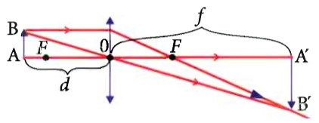
Berilgan:
$F=40 cm=0,4 m$
$K=2$
Topish kerak: $d−?$
Formula:
$\frac{1}{F}=\frac{1}{d}+\frac{1}{f}$ ; $K=\frac{f}{d}$ ; $f=Kd$
$$\frac{1}{F}=\frac{1}{d}+\frac{1}{Kd}=\frac{1}{d}\left(1+\frac{1}{K}\right)$$
$$d=F\left(1+\frac{1}{K}\right)$$

Slide 12
Yechish: $d=0,4 m∙\left(1+\frac{1}{2}\right)=0,6 m=60 cm$
Javob: $d=60 cm$

Slide 13
5- masala
Ikki tomonlama qavariq linzaning egrilik radiuslari $R_{1}=20 cm$ va $R_{2}=30 cm,$sindirish ko‘rsatkichi 1,5.
Linzaning bosh fokus oralig‘ini toping.

Slide 14
Berilgan:
${ R}_{1}=20 cm=0,2 m$
$R_{2}=30 cm=0,3 m$
$n=1,5$
Topish kerak: $F−?$
Formula:
$$F=\frac{1}{(n−1)∙(\frac{1}{R_{1}}+\frac{1}{R_{2}})}$$
Yechish: $F=\frac{1}{(1,5−1)∙(\frac{1}{0,2 m} + \frac{1}{0,3 m})}=0,24 m=24 cm$
Javob: $F=24 cm$

Slide 15
Mustaqil bajarish uchun topshiriqlar
1. Quyosh yorug‘ligi suv yuziga tushmoqda. Agar qaytish burchagi 30⁰ bo‘lsa, tushish va sinish burchagi qanday?
2. Yorug‘likning yupqa dastasi havodan qandaydir bir suyuqlikka o‘tmoqda. Agar tushish burchagi 30⁰, sinish burchagi 15⁰ bo‘lsa, suyuqlikning nur sindirish ko‘rsatkichini toping.
3. Fokus oralig‘i 40 cm bo‘lgan ikki tomoni qavariq linzada buyumning haqiqiy tasviri ikki marta kichraygan bo‘lishi uchun buyumni linzadan qanday uzoqlikda o‘rnatish kerak?

